Slide 1
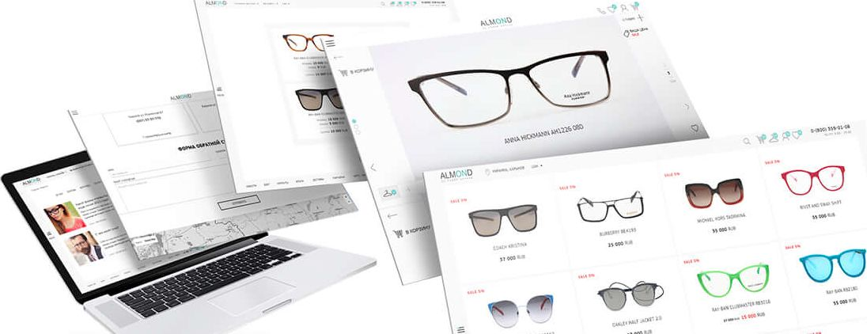

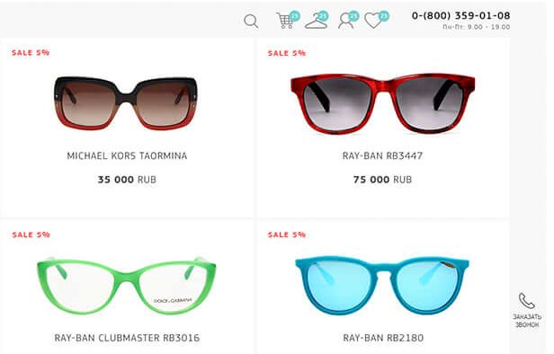
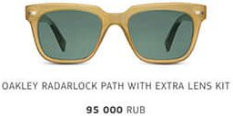
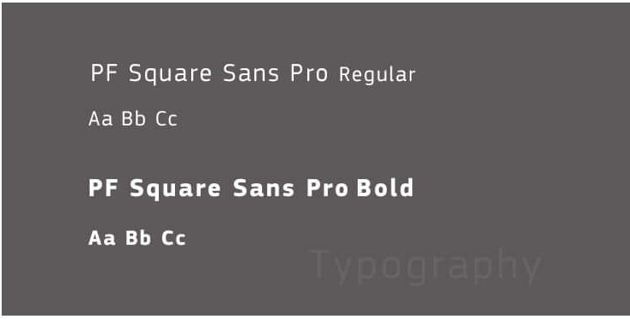

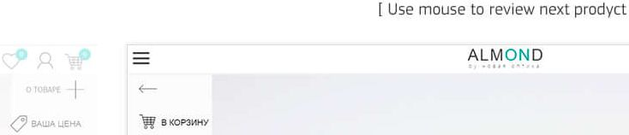
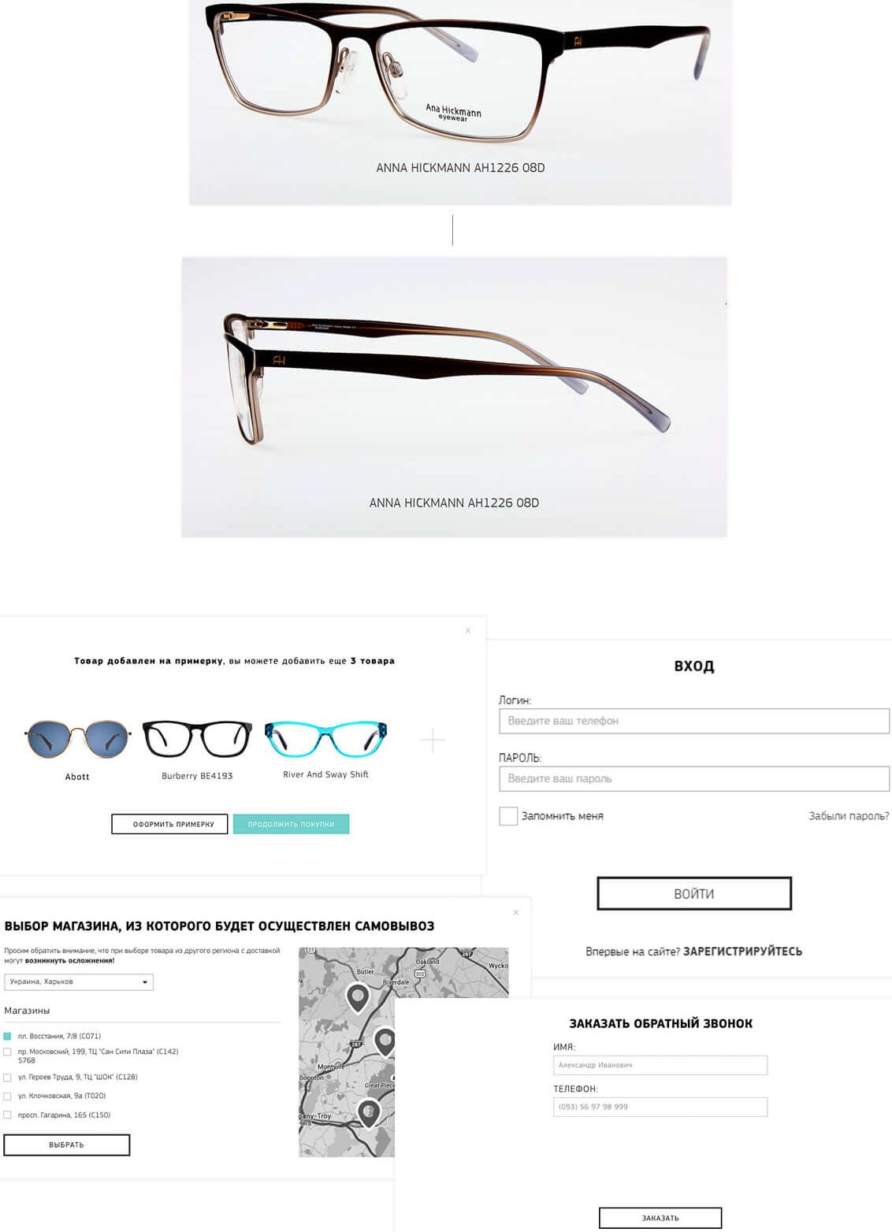

GlaSSeSShop - in
ALMOND
W9
CONTACTS POPUP COLORS MAIN PAGE
7 | C/Vj
1 | Vt
7
 | 0« OO
PRODUCT PAGE
’U ç? « W“ =
ANNA HICKMANN AH1226 08D >
V ■

