Slide 1
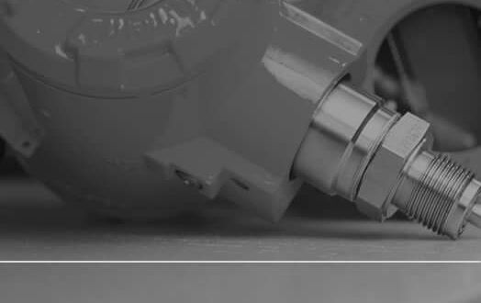

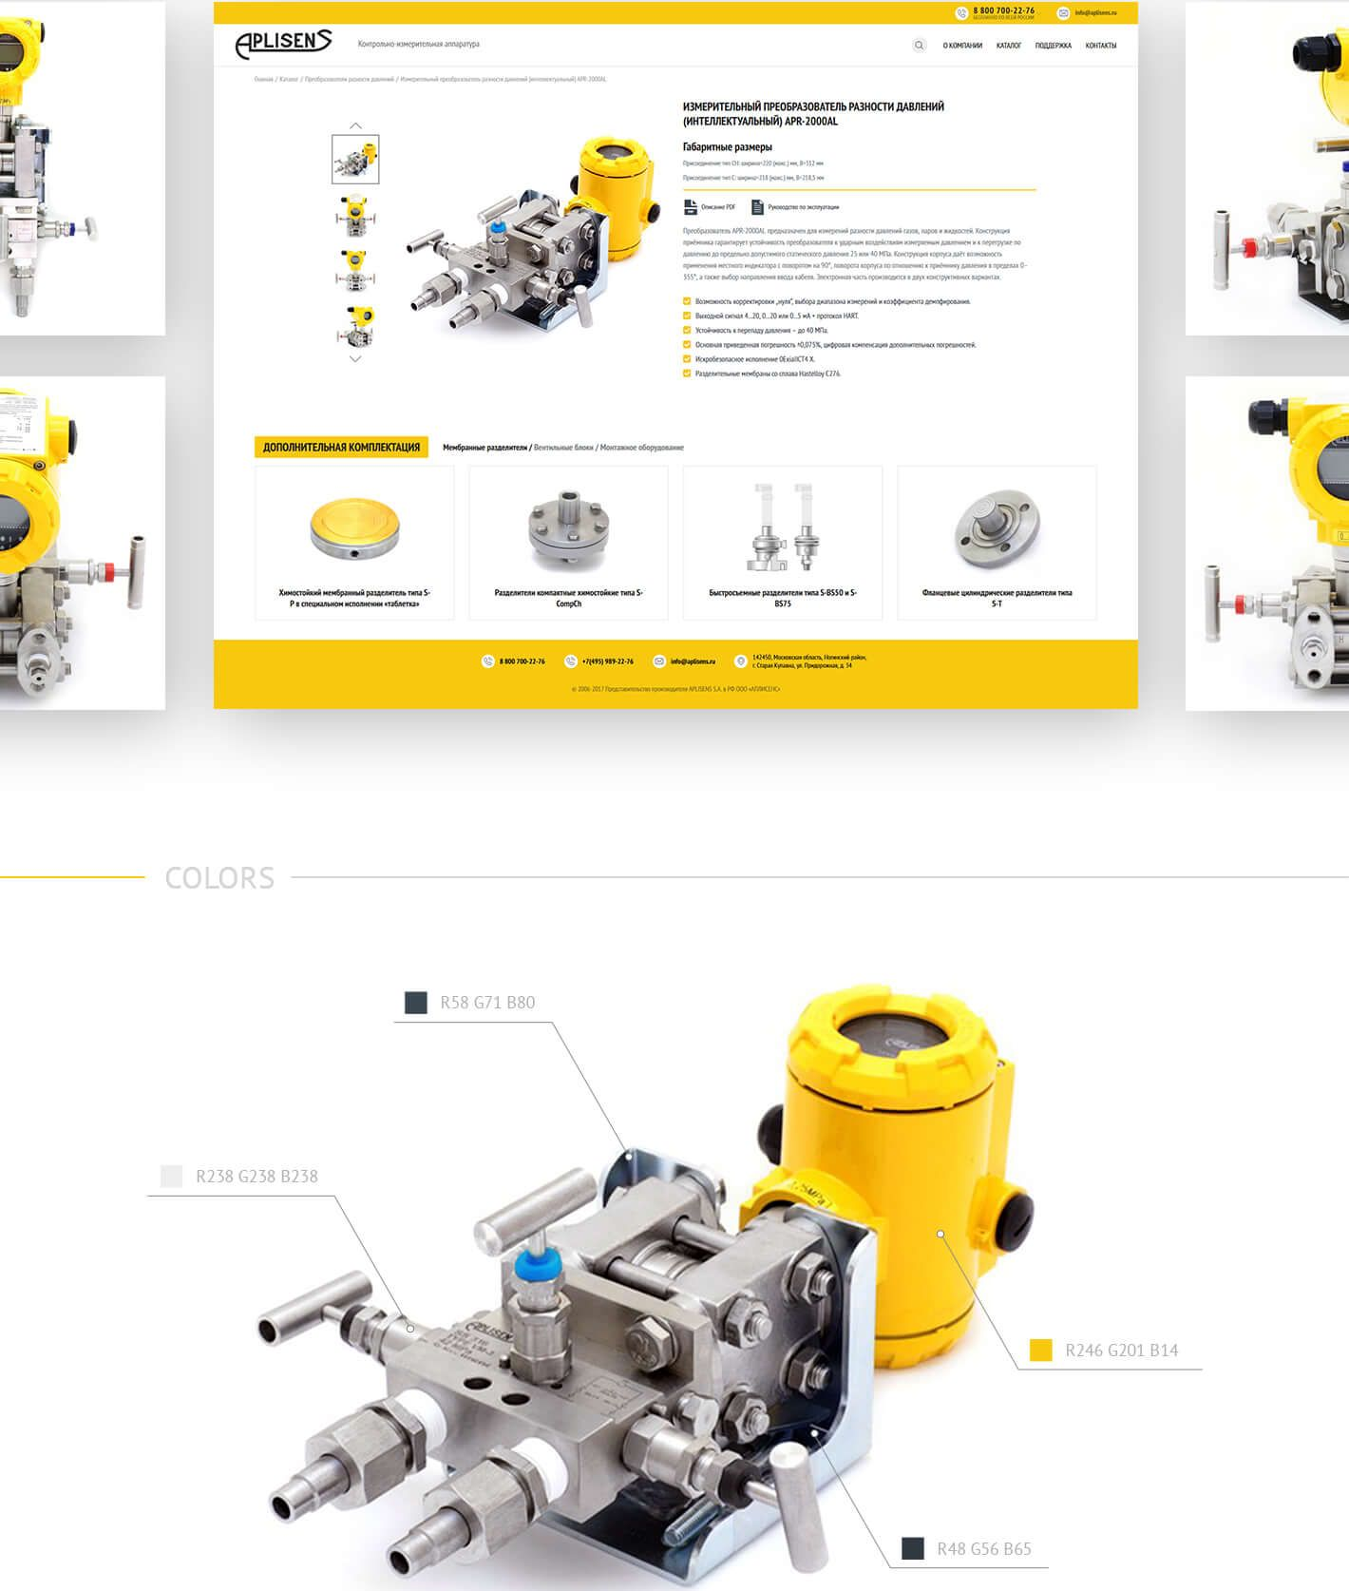
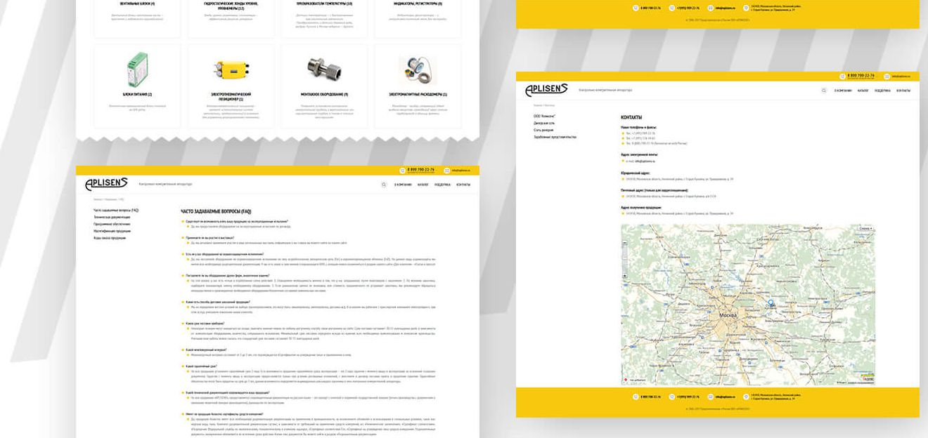

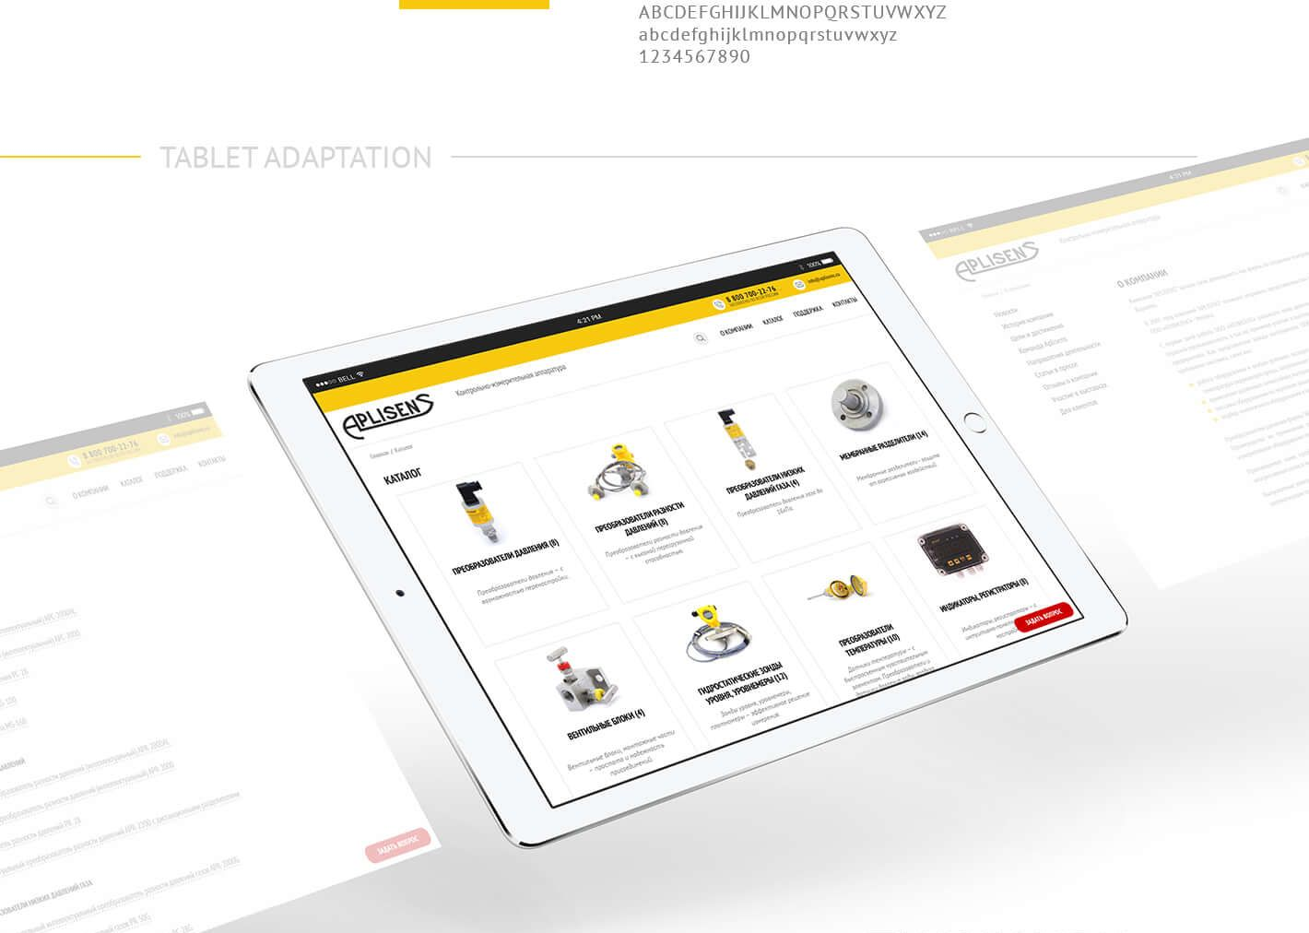
dPLISENS
11
-------- MAIN PAGE
« J
is © •
-------- FONTS
PT Sans
Regular, Italic, Medium, Bold
THANK YOU
FOR WATCHING

