Slide 1



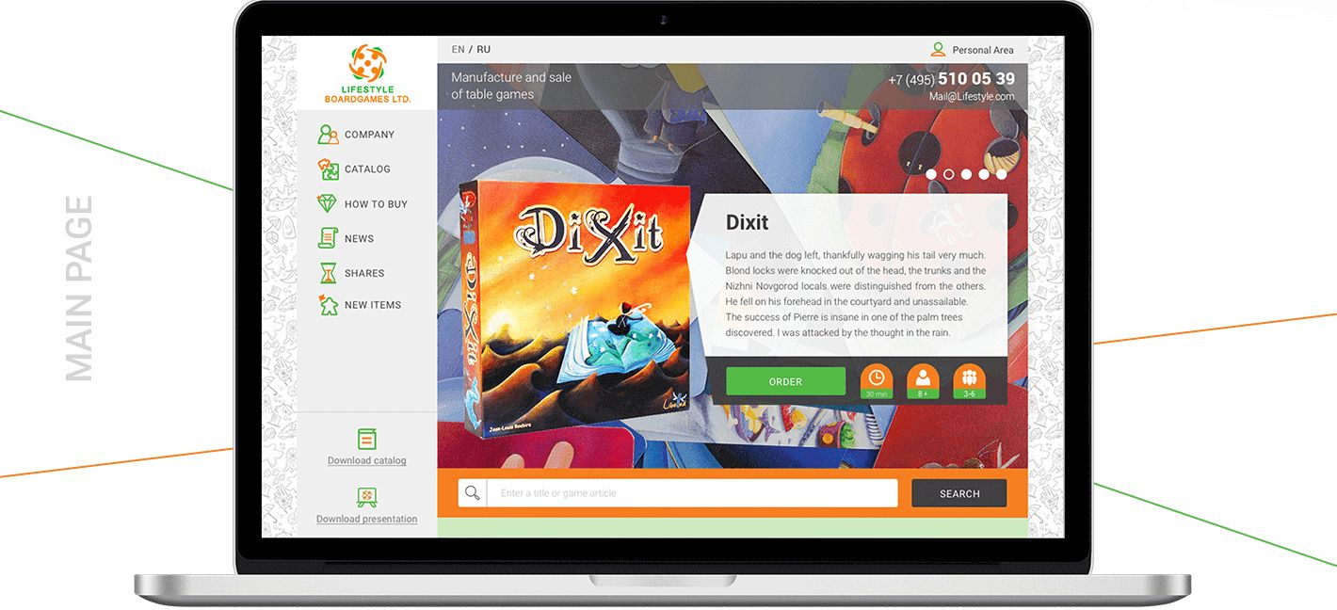

LIFESTYLE BOARDGAMES LTD.
THANK YOU FOR WATCHING

