Slide 1
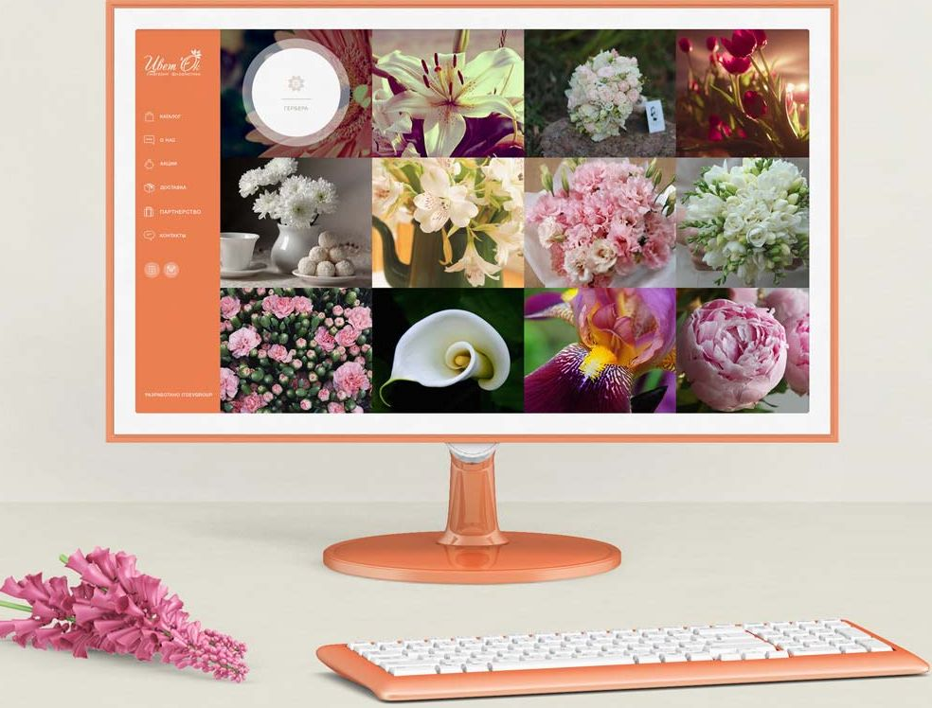
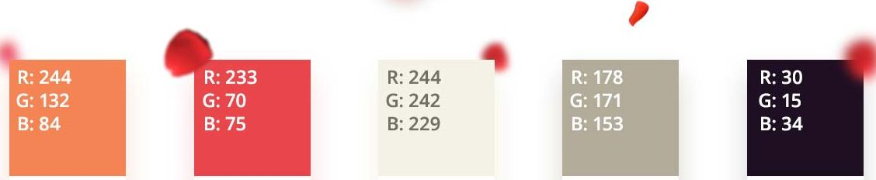
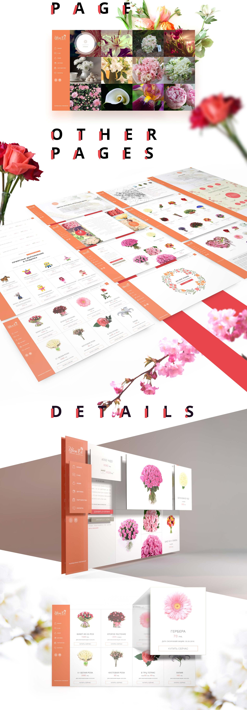
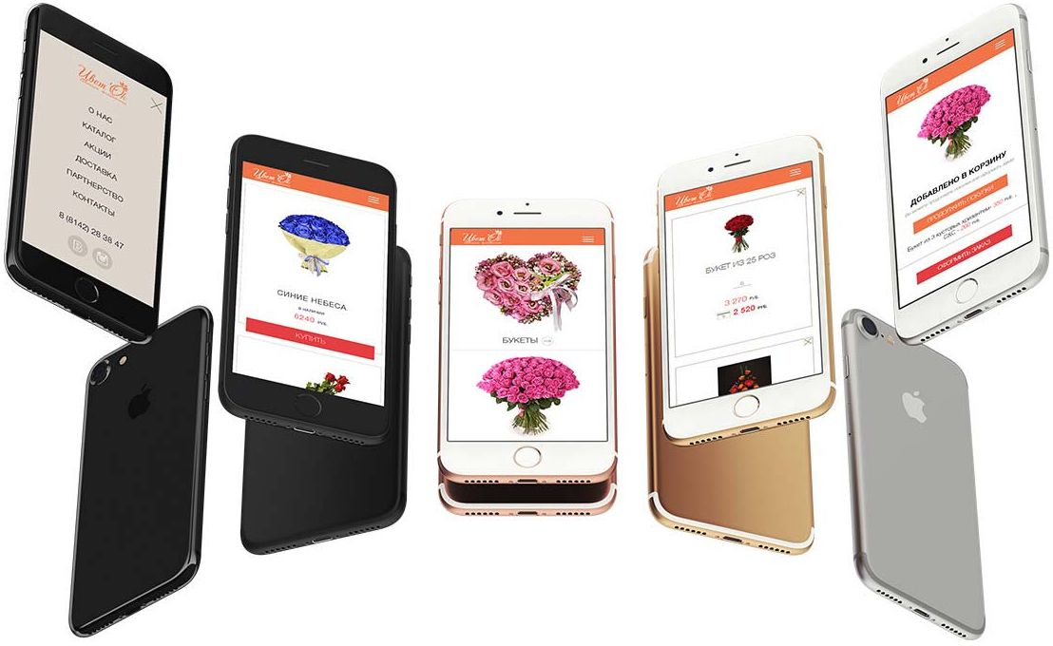
Made a website so people would smile)
UX, Design, Front-end, Back-end, Seo,
P A L‘E I T E
*
FONTS
Light
Light Ita
f\ ^{Re}9^{ular}
Mcl
HelveticaNeue Boiditt
MAIN
MOBILE
THANKS FOR WATCHING

