Slide 1
abc
GRUPPEN
This redesign was created for Swedish company ABC Gruppen where you can do an individual design of student hat you like. There you can create a unique 3D model of a student hat and complement embroidery texts, feeds and bands that match you and your program at a price that suits you.

Slide 2

CHOOSING OF MODEL TYPE

Slide 3
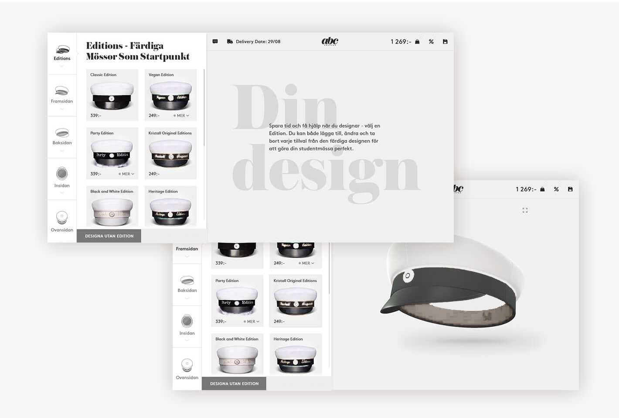
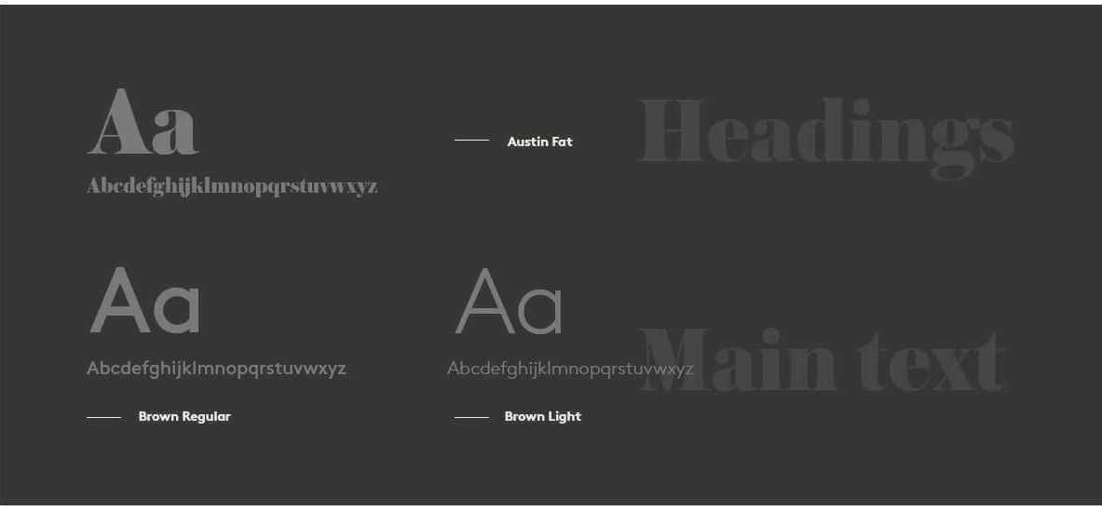
CATALOG OF HATS WITH READY DESIGN

Slide 4
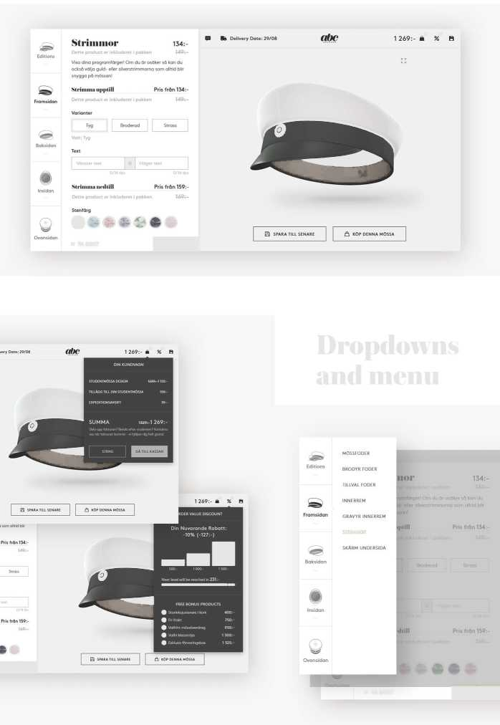
03
MODEL CONFIGURATOR

Slide 5
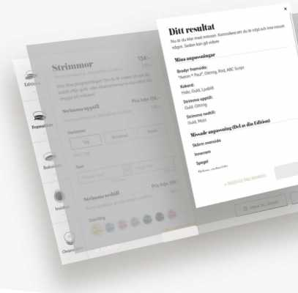
VIEWING RESULT ________________________________

Slide 6
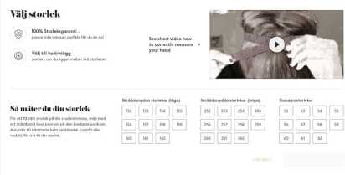
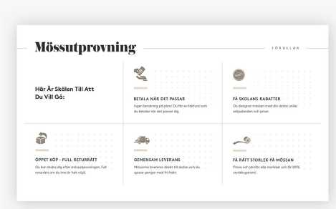
1269:- а % В
SIZE CHOOSING

Slide 7
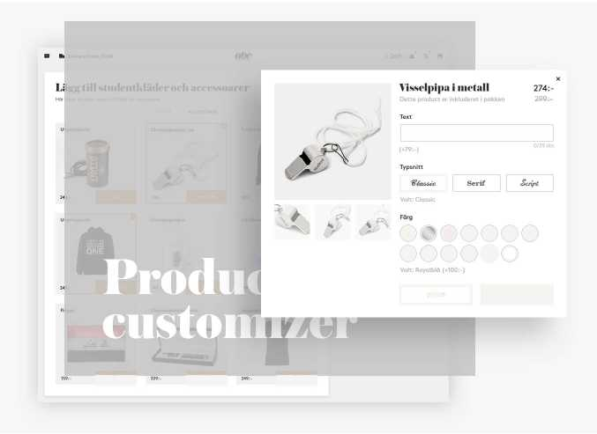
COLLECTION OF ADDITIONAL PRODUCTS

Slide 8
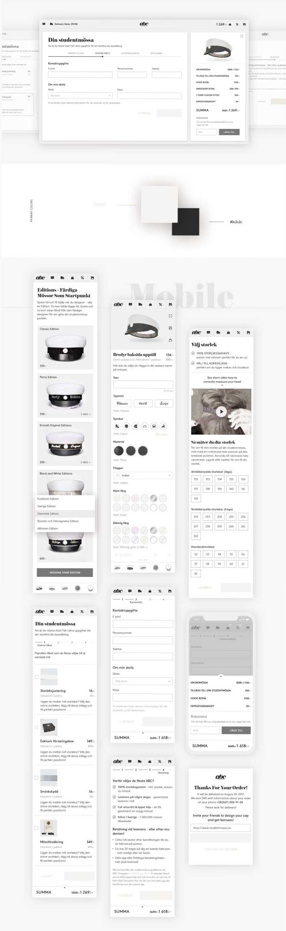
CHECKOUT STEPS

Slide 9
Thank you for watching

