Slide 1


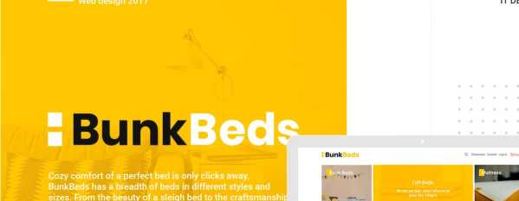

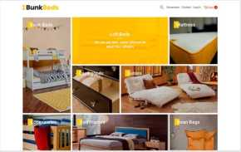





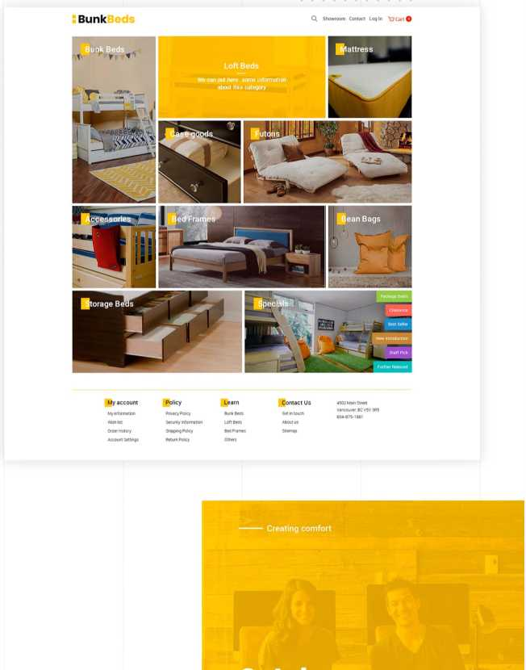
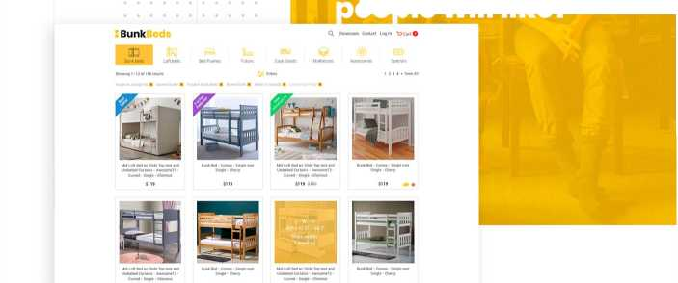




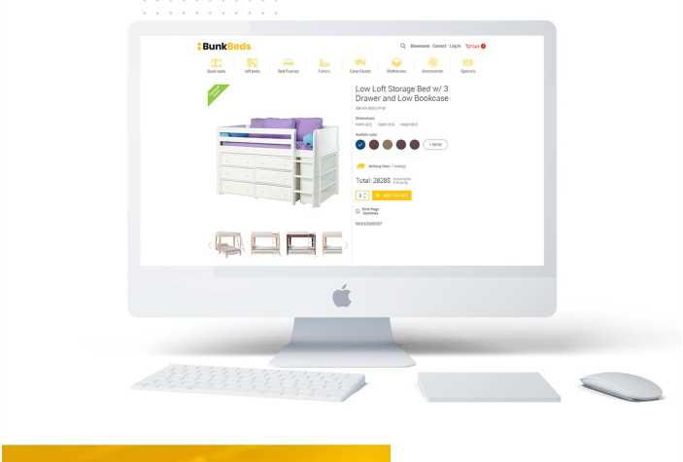
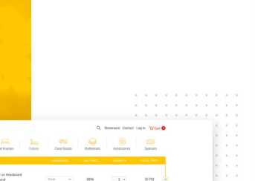
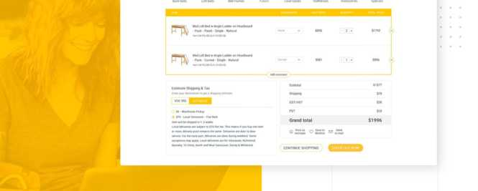

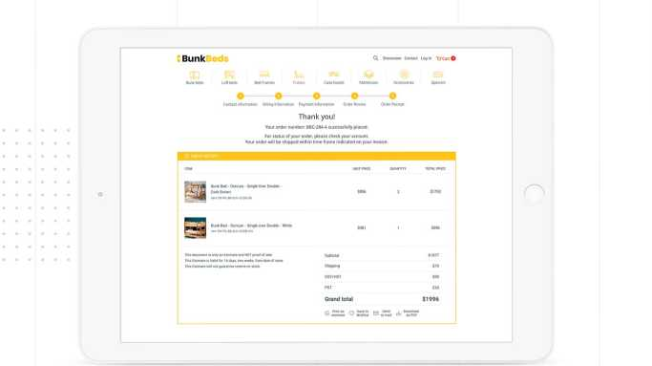

IT DEV GROUP
of a poster bed or platform bed, there is a wide range
of beds to choose from.
More interesting
Typography
Mainpage
Catalog,
people will like!
Prod ct page
------ Edit and buy
Shopping cart with all functions you need.
good
Tabletready
Thank you for watching
We did our best to create a great product

