Slide 1

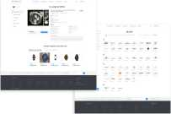

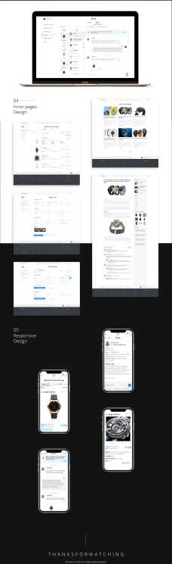
Homepage
Product page
Wireframe
& Styles
Typography
Open Sans
Responsive
Design

