Slide 1
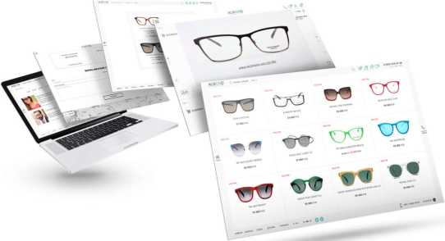
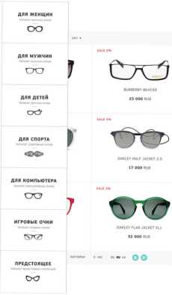
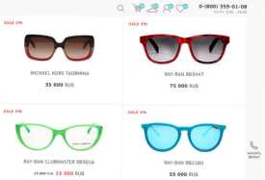


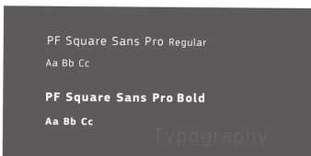
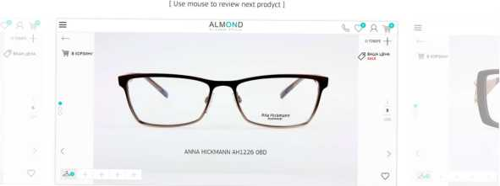


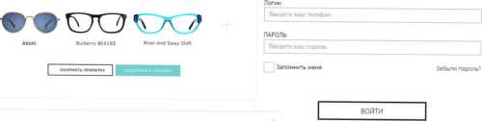
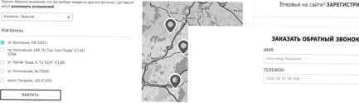
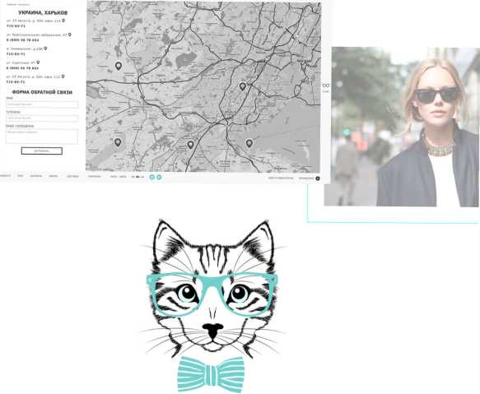
ALMOND
GlaSSeSShop - internet platform, which was created for people who are looking for decent alternative optics.
CONTACTS ^{pop up} _{r} COLORS MAIN PAGE
#272425
#60a39b
PRODUCT PAGE
ANNA HICKMANN AH1226 08D
ANNA HICKMANN AH 1226 O8D
ВЫБОР МАГАЗИНА, ИЗ КОТОРОГО БУДЕТ ОСУЩЕСТВЛЕН САМОВЫВОЗ

