Slide 1


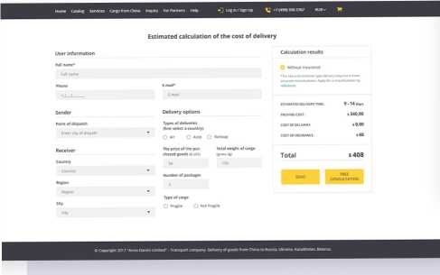


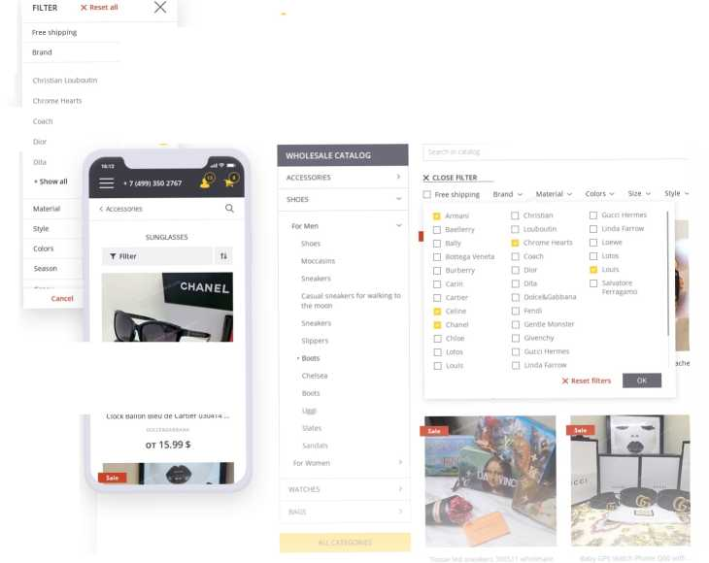







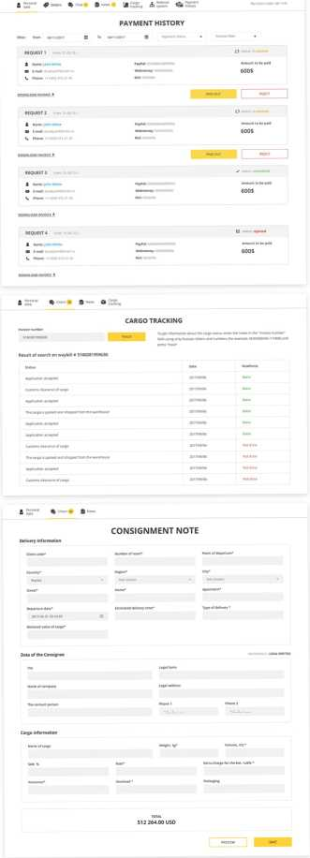

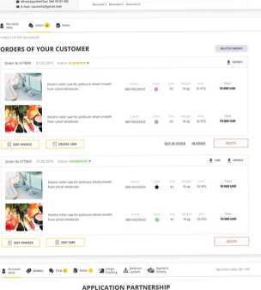


The international company Anno Danini Limited is a commodity-transport company, the main activity of which is the sale and transportation of goods. The company has been leading the market for more than 5 years. A distinctive feature high professionalism and responsibility to each client. Anno Danini Limited is a reliable partner for doing business.
Open Sans
#3B3C44 #FDD137
Calculator for estimation the cost of delivery
 | X
Home
Catalog | >
Services | >
Cargo from China
Request
For partners
Help
USD | RUB
The calculator is designed to make Anno Danini's customers easier to plan the cost of transporting goods from China. To do this, simply fill in the appropriate fields of the form with your contact information, type of delivery, type of cargo, weight and within a few seconds you will get an approximate calculation of the cost of delivery.
SHIPPING COST FROM CHINA
Wholesale and retail catalogs of products
 | The site presents goods available both for wholesale and retail, which allo ws you to attract customers, not only engaged in business, but also mods who wan goods at favorable prices and with free delivery. | t to buy
□
□ | Home Catalog Services Cargo from China Inquiry For Partners Help | •J Log in/Sign Up
□
□
WHOLESALE CATALOG
□ Free shipping
Size
Moccasins
□ Armani
□ Baellerry
□ Bally
□ Bottega Veneta
□ Burberry
□ Carin
□ Cartier
□ Celine
□ Chanel
□ Chloe
□ Christian
□ Louboutin
Q Chrome Hearts
□ Coach
□ Dior
□ Dita
□ Dolce&Gabbana
□ Fendi
□ Gentle Monster
□ Givenchy
□ Gucci Hermes
□ Linda Farrow
□ Gucci Hermes
□ Linda Farrow
Sneakers
□ Salvatore Ferragamo
Casual sneakers for walking to
Slippers
WATCHES
Product card
Uggs Classic Short Blaise wholesale
Reference: 108239223942850
$100
1-100 pcs
Excluding delivery
$50
10-50 pcs
CALCULATE DELIVERY
$20
50-100 pcs
CHOOSE CHARACTERISTICS:
IITIIIIII
Size: 35 35 57 3S 53 40
Quantity: - 25 +
Total: $56 550 'S add to cart
Product specifications Reviews Choose the size | Payment and delivery Video review
ф Manufacturer: США ф Price: up to 0.7 $ per piece ф Port: Guangzhou | (.J Price: from S 0.5 per piece and m< ф Min. order: 300 items ф Delivery time: from 15 days | ire text
В | о | и
COM«« | “О“¹“⁵ |  |  | «О
About company
About Company
Documentation
Marking of cargo
S Marking of goods from China
11,3 KB
Contracts
offer for delivery from China
Blanks
Price lists
SForm to purchase goods
48,1 KB
>вг price list Wholesale catalog
131
1
Shipments monthly
32
Requests processed monthly
1343^{ciients}
1463
Business solutions
ANNODANINI
User accounts
1ST“¹
...... ft—----
■
Thanks for watching

