Slide 1




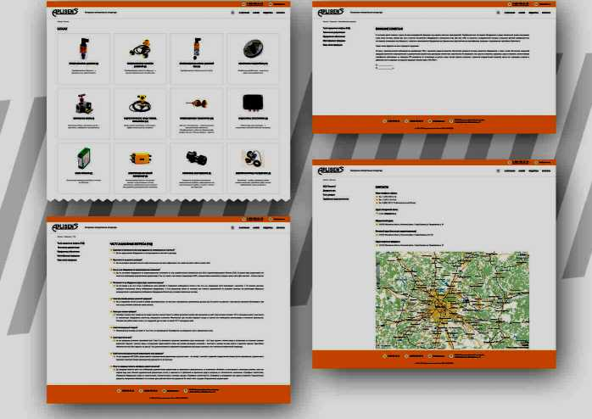
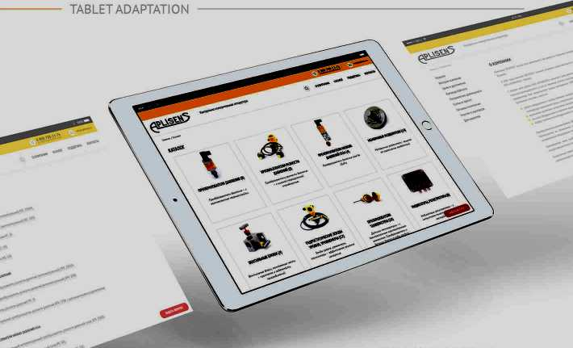
PRODUCT PAGE
COLORS
OTHER PAGES
FONTS
Aa
PT Sans
Regular, Italic, Medium, Bold
ABCDEFGHIJKLMNOPORSTUVWXYZ abcdefghijklmnopqrstuvwxyz 1234567890
THANK YOU
FOR WATCHING

