Slide 1

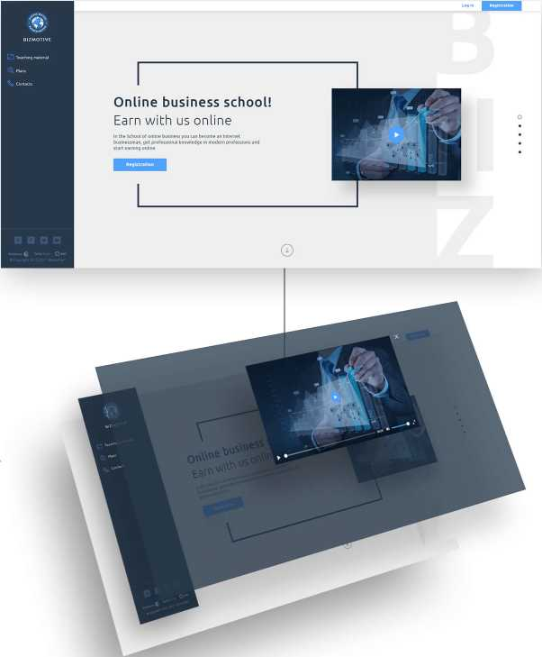
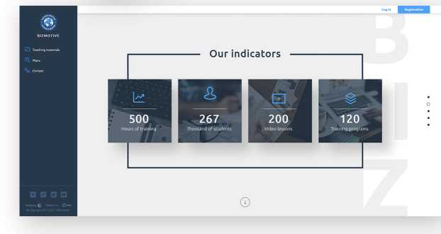
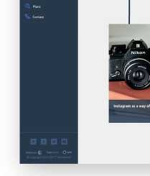

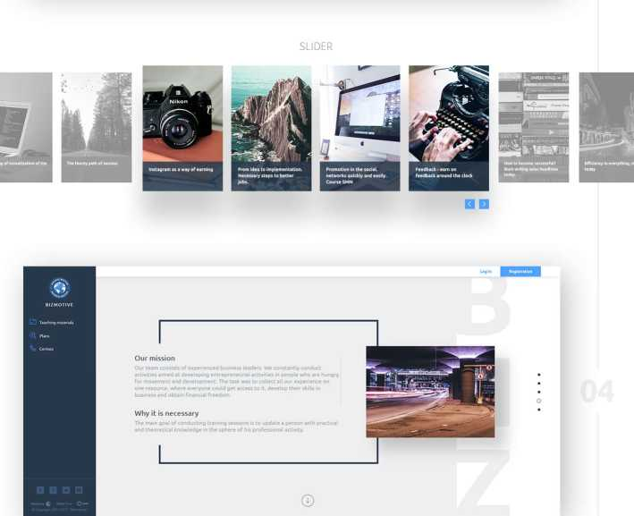
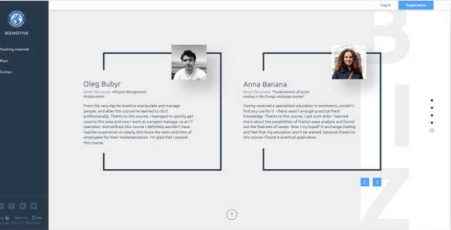
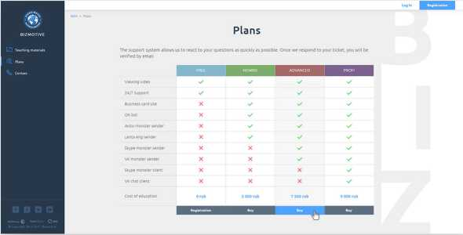
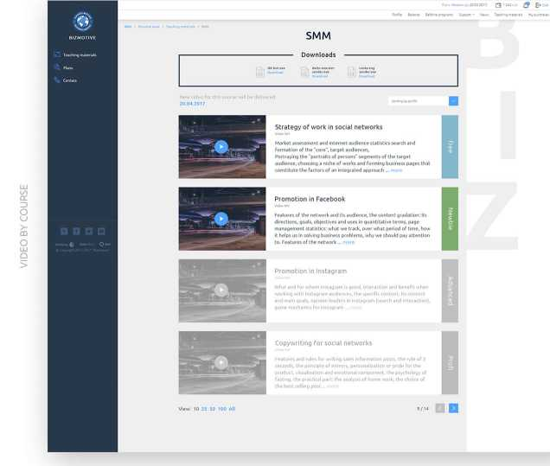
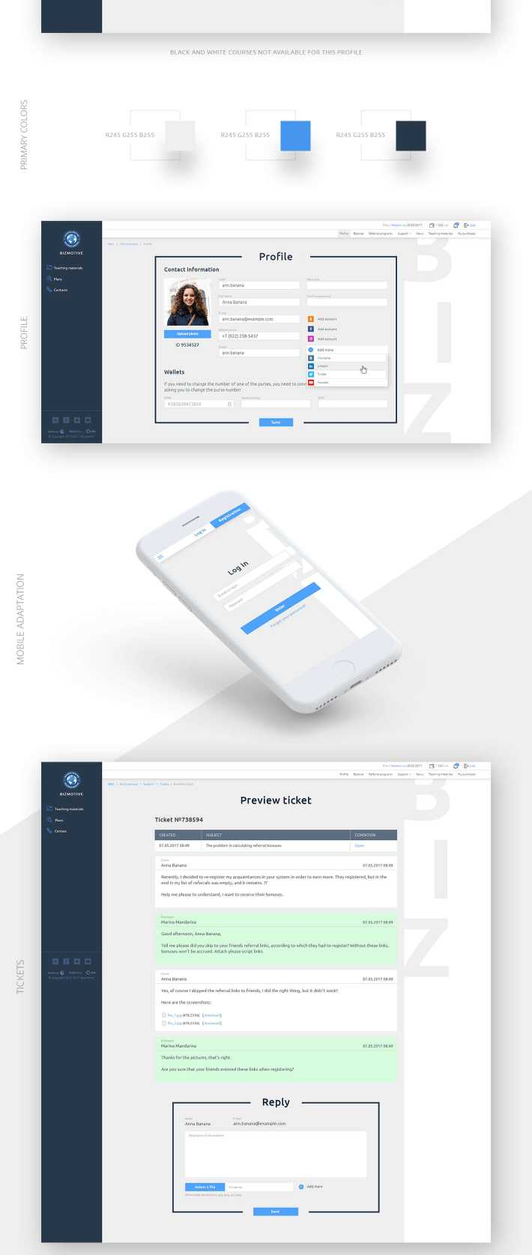
MAIN PAGE
Online business school!
COST FONTS
Our courses
Aa
Ubuntu font
ABCDEFGHIJKLMNOPQRSTUVWXYZ
Bold abcdeFghijklmnopqrstuvwxyz
1234567890
ABCDEFGHIJKLMNOPQRSTUVWXYZ
Medium abcdeFghijklmnopqrstuvwxyz
1234567890
ABCDEFGHIJKLMNOPQRSTUVWXYZ
Regular abcdeFghijklmnopqrstuvwxyz
1234567890
ABCDEFGHIJKLMNOPQRSTUVWXYZ
Light abcdeFghijklmnopqrstuvwxyz
1234567890
THANK YOU FOR WATCHING

