Slide 1
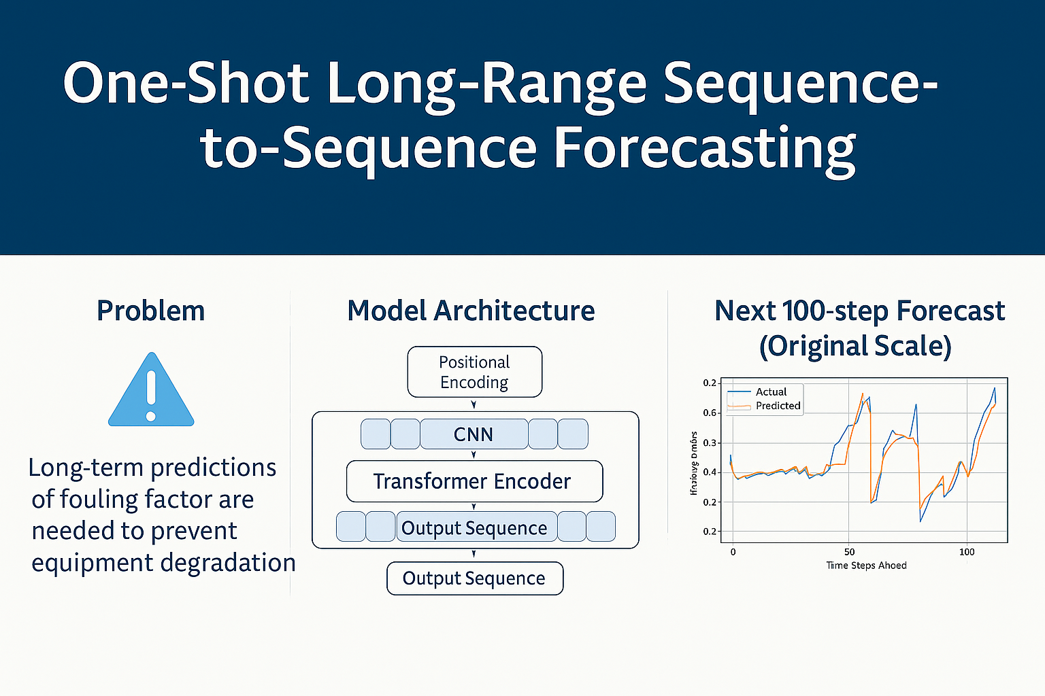
Forecasting of Fouling Factor

Slide 2
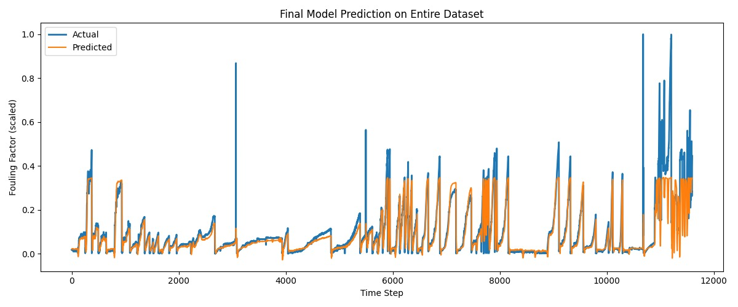
Forecasting of Fouling Factor

Slide 3
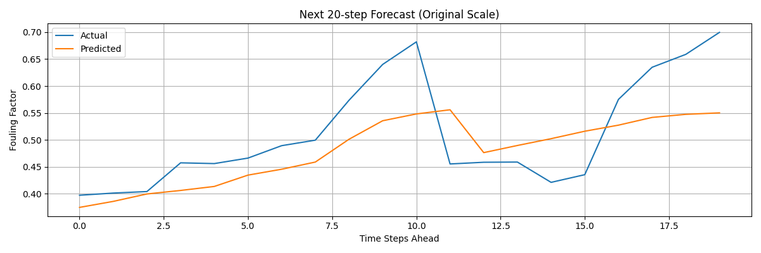
One-Shot Long-Range Forecasting of Fouling Factor
Input length = 30 Output length = 20

Slide 4
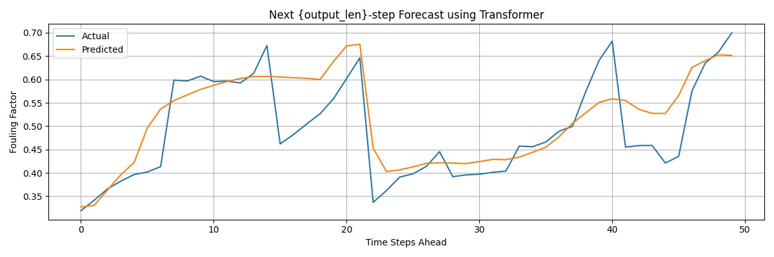
One-Shot Long-Range Forecasting of Fouling Factor
Input length = 50 Output length = 50

Slide 5
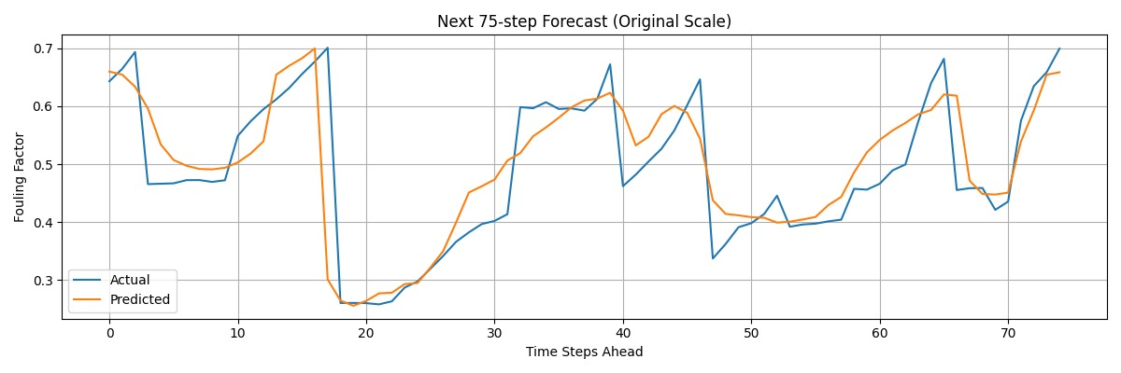
One-Shot Long-Range Forecasting of Fouling Factor
Input length = 100 Output length = 75

Slide 6
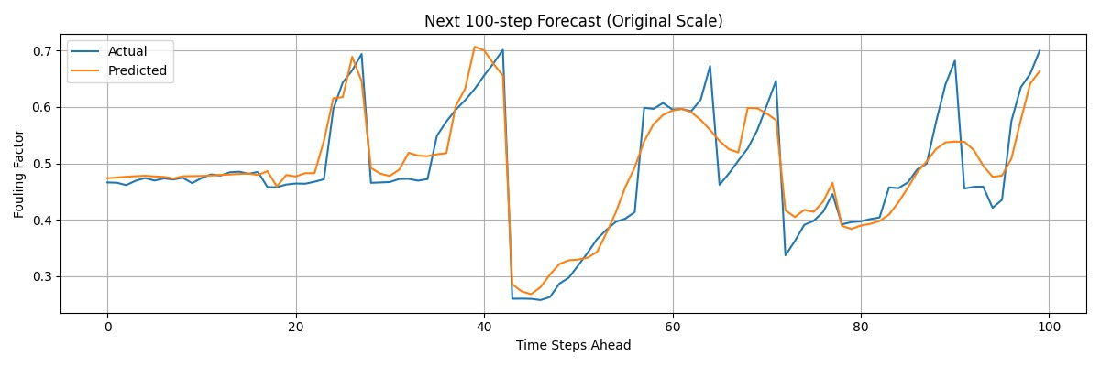
One-Shot Long-Range Forecasting of Fouling Factor
Input length = 150 Output length = 100

