Slide 1
Stacking Model
Feedforward Neural Network
Transformer Time Series
Forecasting
Prediction of
Fouling Factor

Slide 2
Metric | Stacking Model | Feedforward Neural Network For Regression | LSTM
MAE | 0.0044 | 0.0152 | 0.0212
MSE | 0.00013 | 0.0007 | 0.0018
R² | 0.9960 | 0.9784 | 0.9484
RAE | 0.0291 | 0.1237 | 0.1387

Slide 3
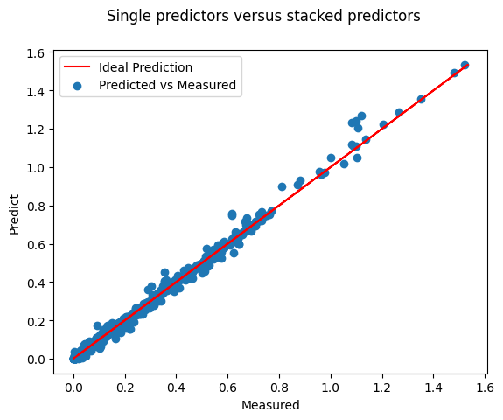
Stacking Model

Slide 4
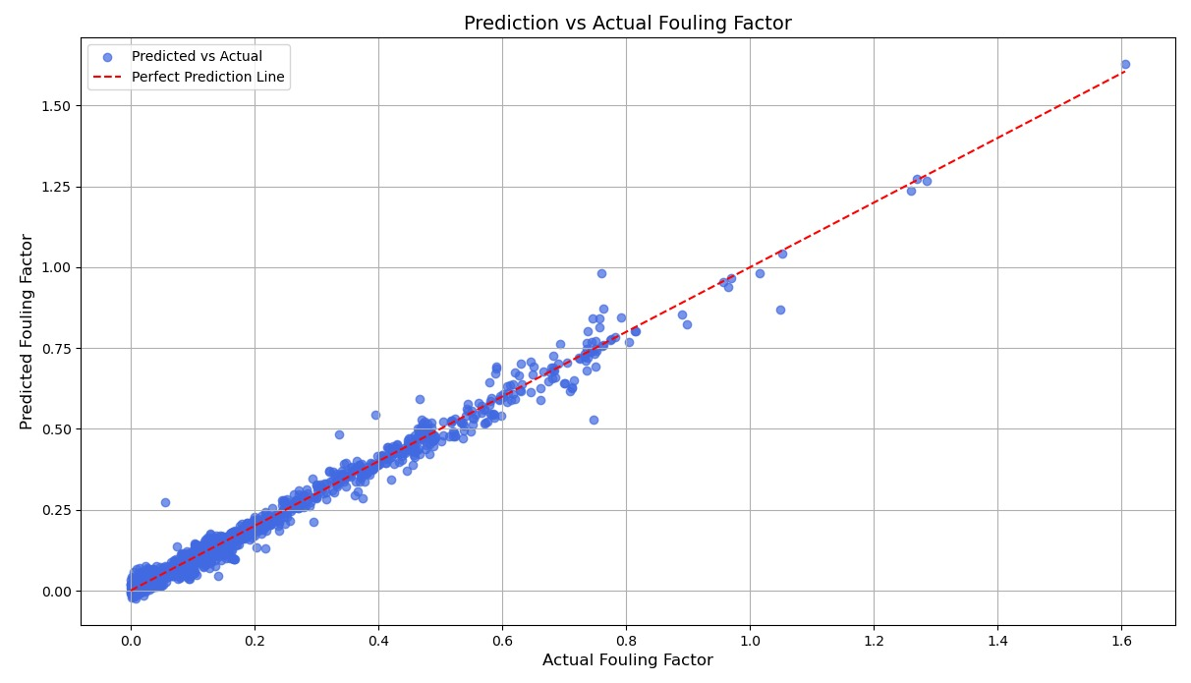
Feedforward Neural Network for Regression

Slide 5
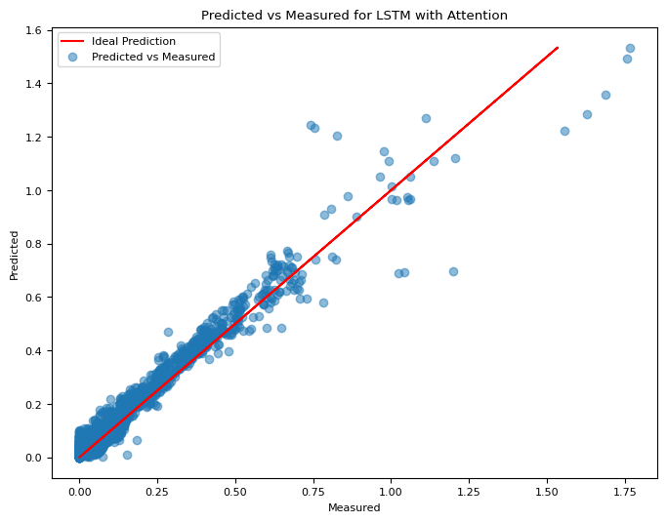

Slide 6
Transformer

Slide 7
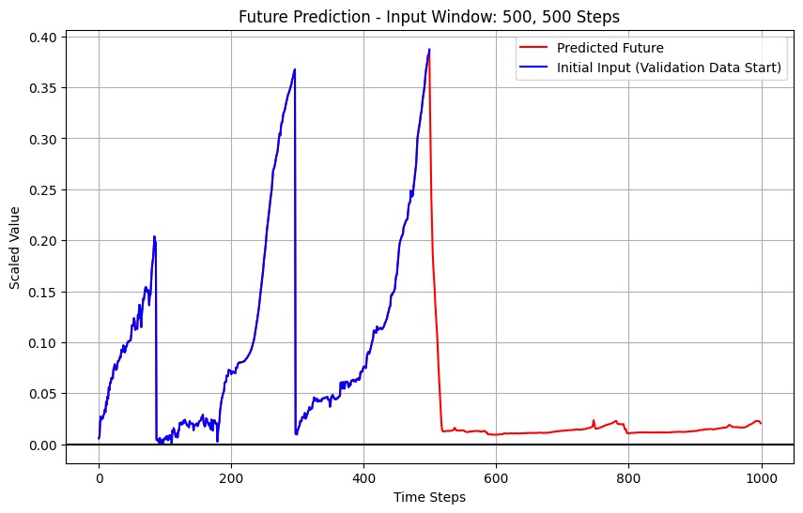
Case - 1 Training = 500 , Forecasting = 500 R² value = 0.8554

Slide 8
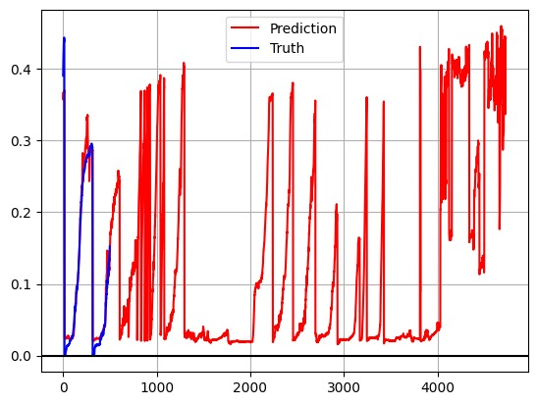
Case - 2 Training = 500 , Forecasting =4732 R² value = 0.8543

Slide 9
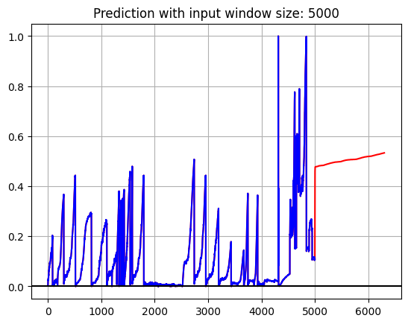
Case - 2 Training = 5000 , Forecasting = 1300

