Slide 1
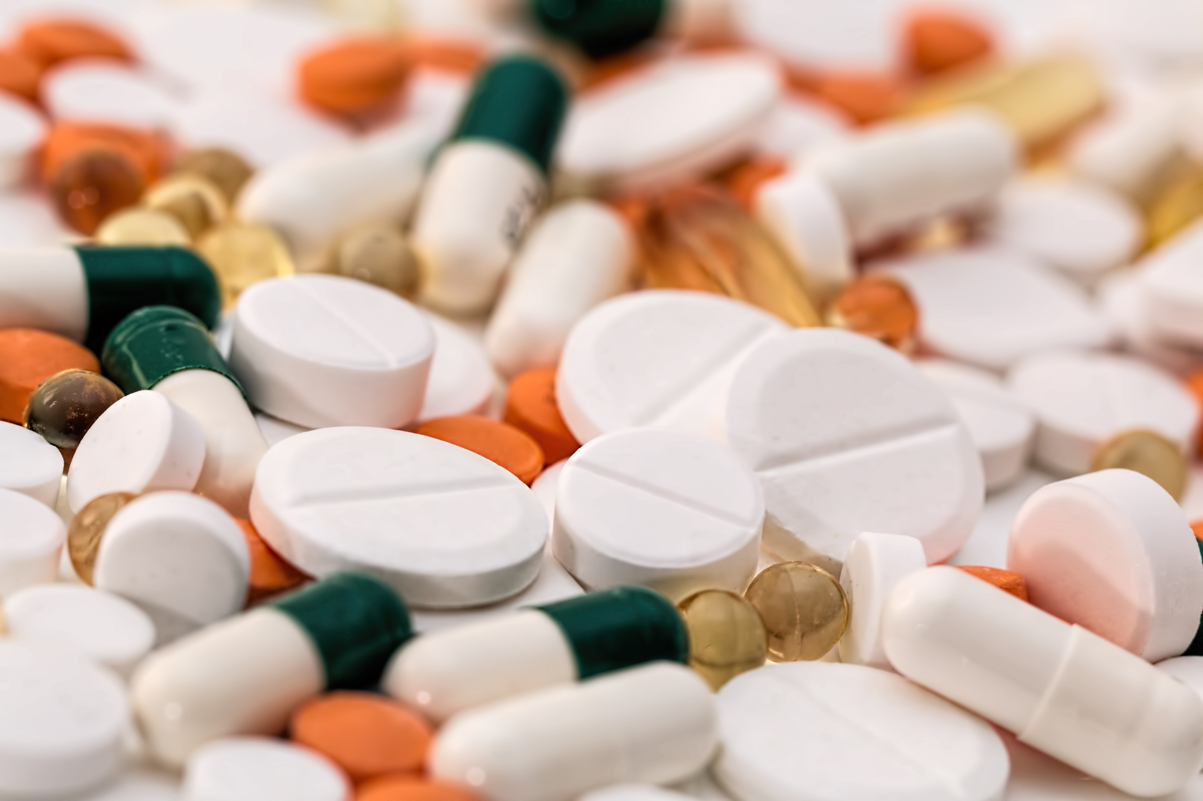
Drug Reminder Service
Darren, Kat, Jie Xin
HackMed 2018 project

Slide 2
Medicated society
Do you ever forget to take your antibiotics?
Or contraception?
Heart medication?
MOST PEOPLE DO!

Slide 3
Why is forgetting bad?
ANTIBIOTIC RESISTANCE!
Unwanted pregnancy
Increased risk of severe complications
DEATH!

Slide 4
Drug Reminder Service
Remembers for you!
Sends you a text to remind you
BONUS:
Gives you relevant food and drug interaction info

Slide 5
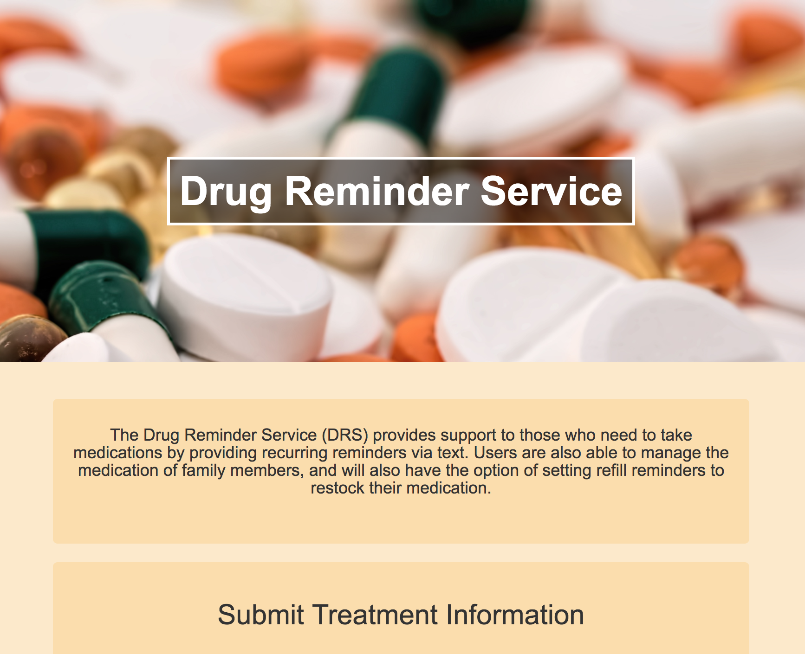
DSR

Slide 6
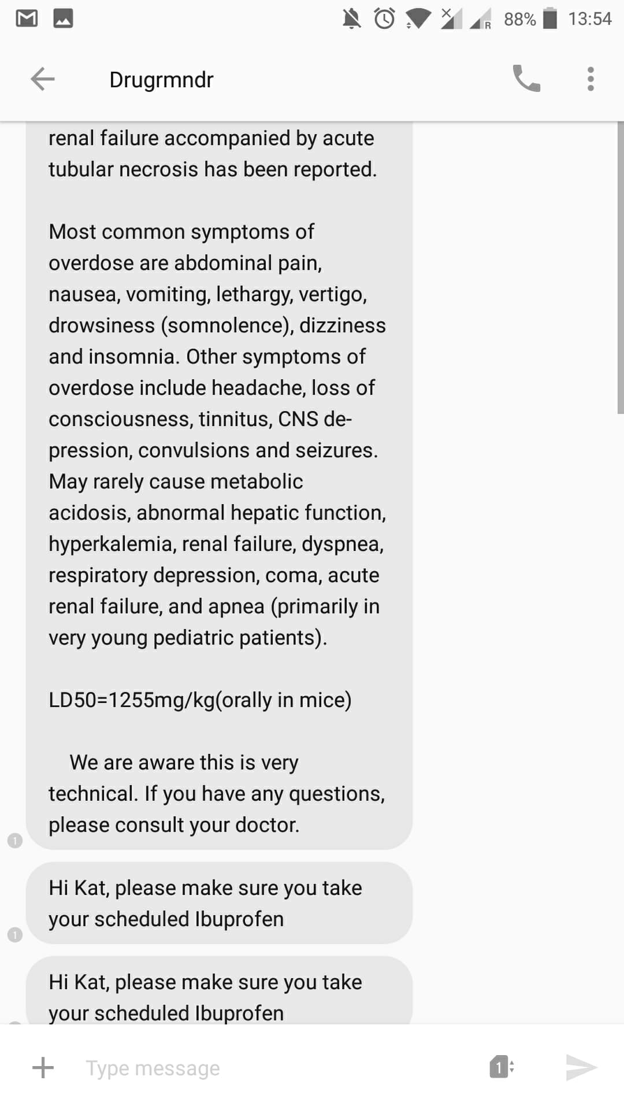
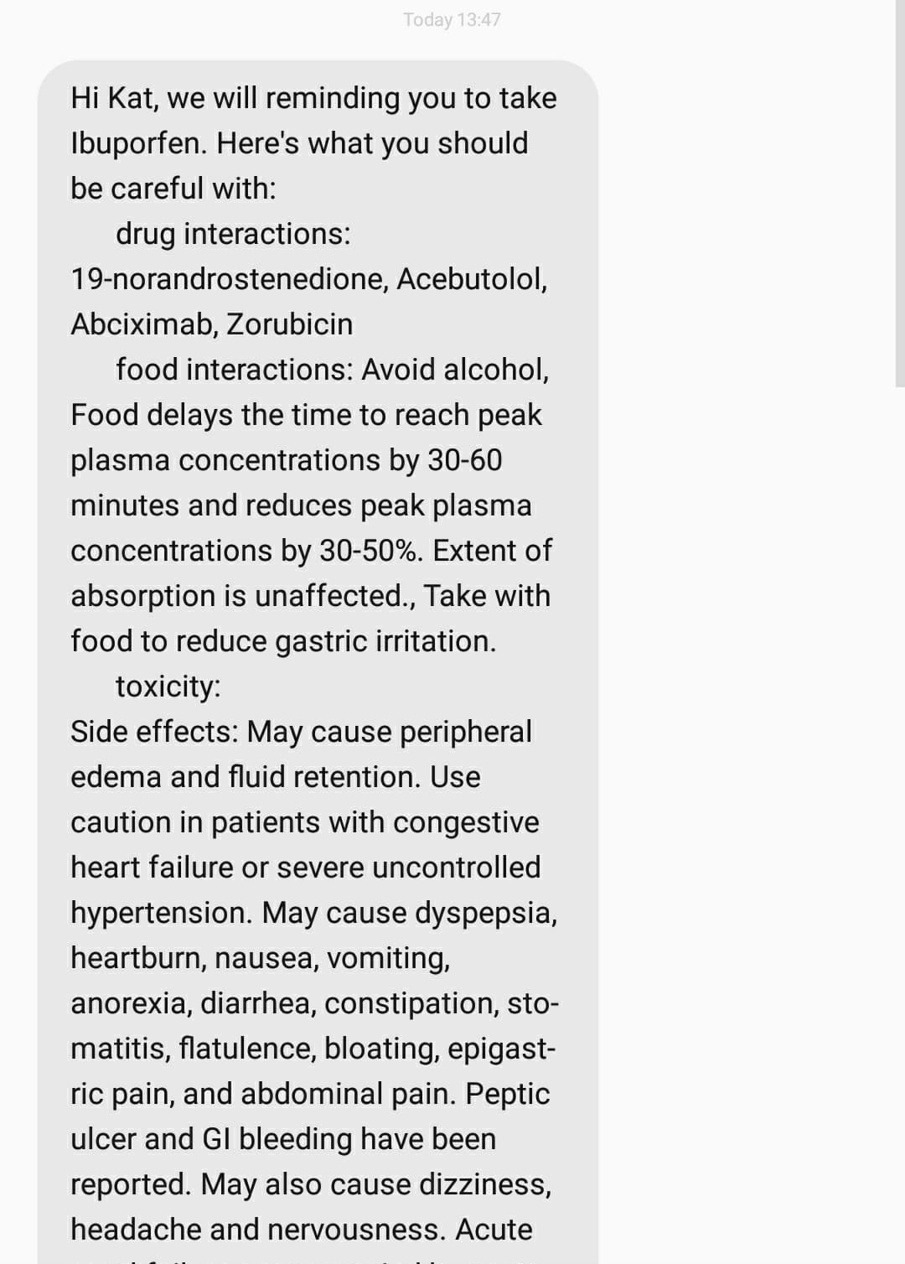
First message

Slide 7
First message
Hello
Toxicity
And
Side effects
Drug interactions
Food interactions
Talk to your doctor

Slide 8
Following messages

Slide 9
Future development
Takes in prescription information automatically rather than manual input
Wider database of drug information (manufacturer specific)
Send follow up reminders if user did not confirm
Further personalized messages

