Slide 1

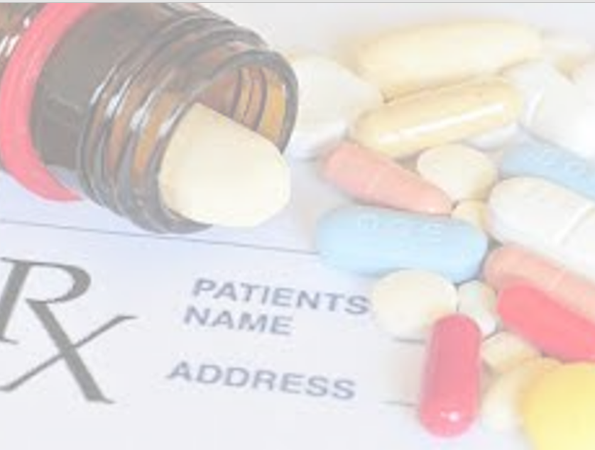
Prescribing APP
Doctor – Patient Assistance to understand drug-drug interaction
Data Engineering Course Project December 2021
Selection of the optimal drug for a patient with a complex set of diagnoses

Slide 2
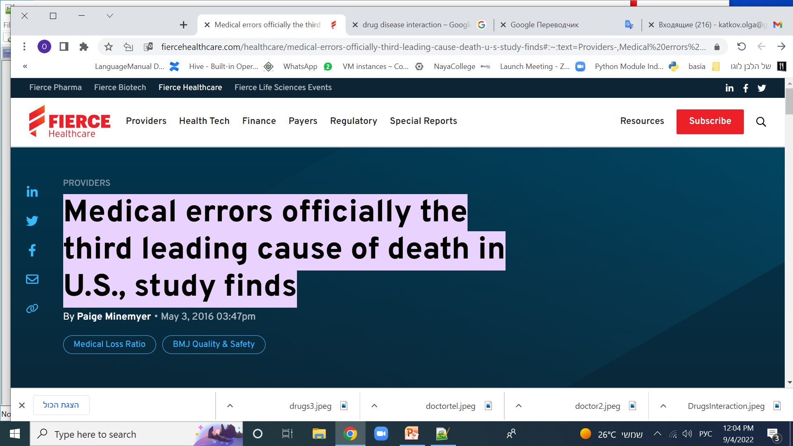
Background What Doctors really needs?
Background
What We Do
Medical errors officially the third leading cause of death in U.S.
study finds a large proportion of these deaths are due to improper selection of drugs for chronic patients and with a wide range of constantly taken drugs
They wish someone could have directed them to:
Selection of the optimal drug for a patient with a complex set of diagnoses
Building a Doctor – Patient Assistance to understand drug-drug interaction for all constant getting by the patient drug list
…
architecture
NiFi
ERD
Mongo
HDFS
Reports

Slide 3
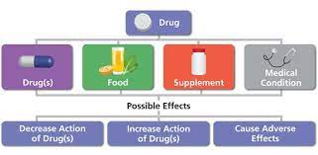
Possible full new drug checks
Background
Background
What We Do
What We Do
architecture
architecture
NiFi
NiFi
ERD
ERD
Mongo
Spark
HDFS
HDFS
Reports
Reports

Slide 4

What We Do
Background
Background
What We Do
What We Do
In this project developed automatic checking of a new drug recommended by a doctor for a patient for interaction with constantly taken drugs.
Interaction can be both positive (synergy) and negative, harming the patient. To warn the doctor about the possible negative effects of the new drug is the goal of this project.
Drug Antagonism
Drug Interaction
Drug Synergism
To do that, I used big data tools to be able to analyze information in real time.
I prepare the Pipeline that will be used for real-time analytics, created with Big Data Technologies Such as:
Kafka: Producer, Consumer
Spark: use streaming and sql functions
Mongo: db json document store
Hadoop: Hue, Hive ,MySQL DB
Software language: Python
architecture
architecture
NiFi
NiFi
ERD
ERD
Mongo
Spark
HDFS
HDFS
Reports
Reports

Slide 5
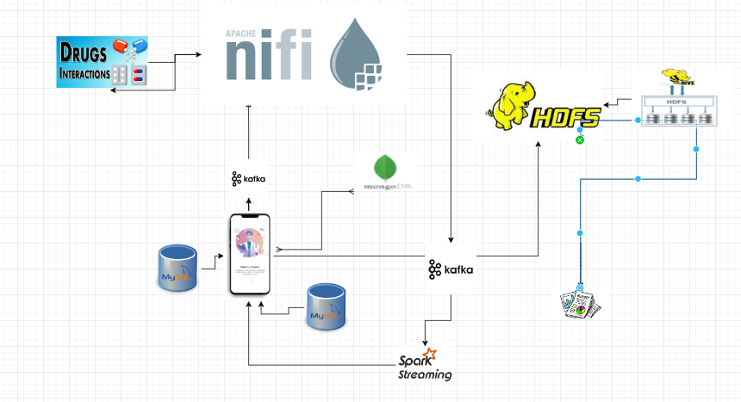
Architecture Overview:
Background
Background
Background
What We Do
What We Do
What We Do
architecture
architecture
architecture
NiFi
NiFi
ERD
ERD
Spark
Mongo
HDFS
HDFS
Reports
Reports

Slide 6
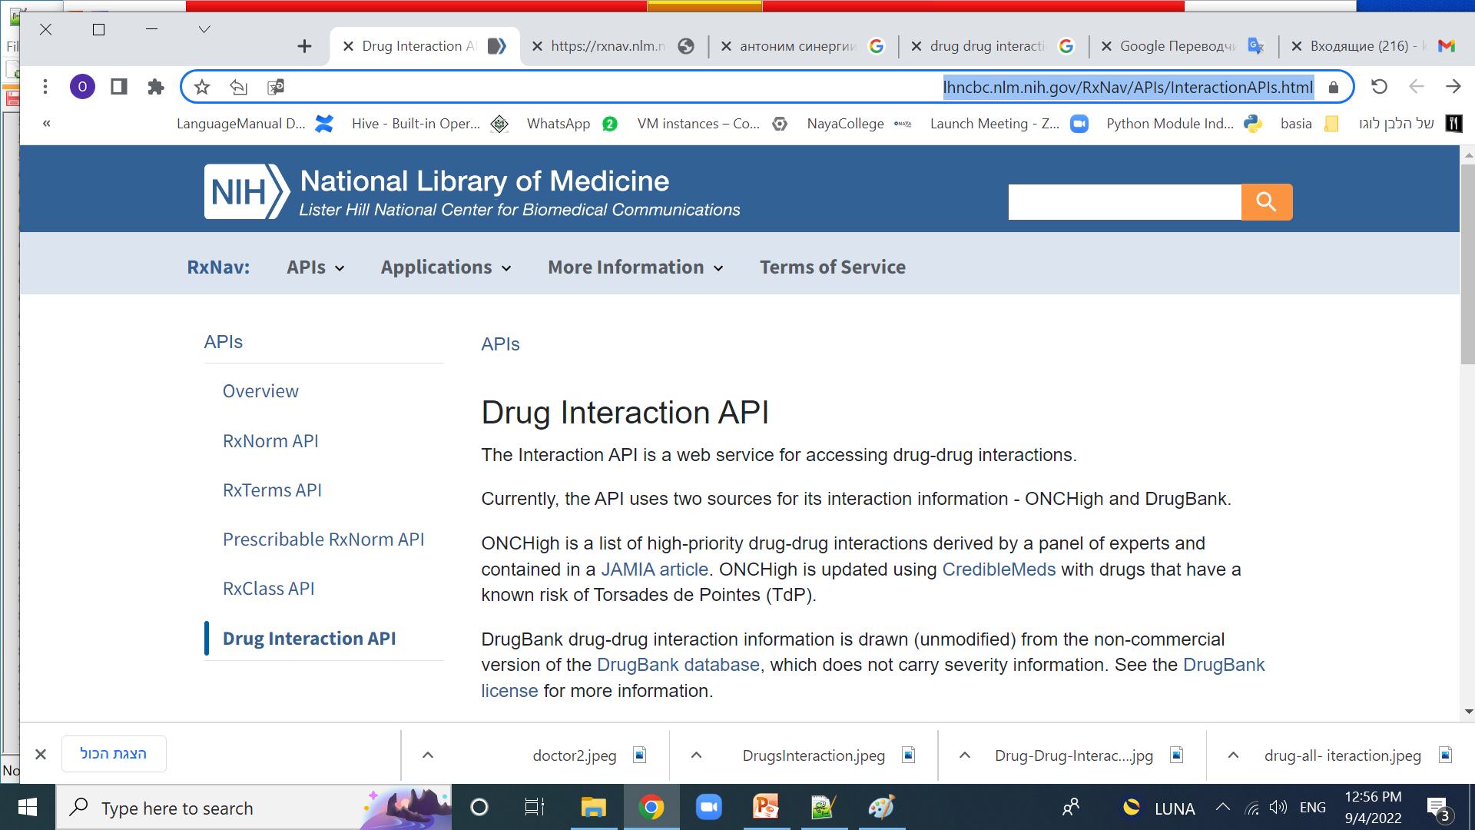
Architecture Overview:
Background
Background
Background
What We Do
What We Do
What We Do
architecture
architecture
architecture
NiFi
NiFi
ERD
ERD
Spark
Mongo
HDFS
HDFS
Reports
Reports

Slide 7
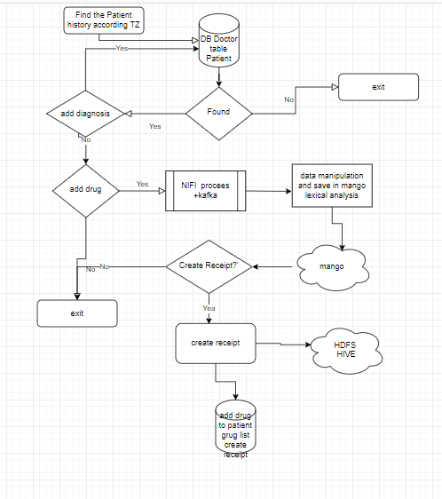
Application Logical Flow

Slide 8
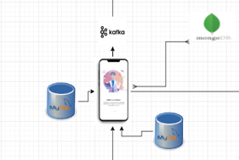
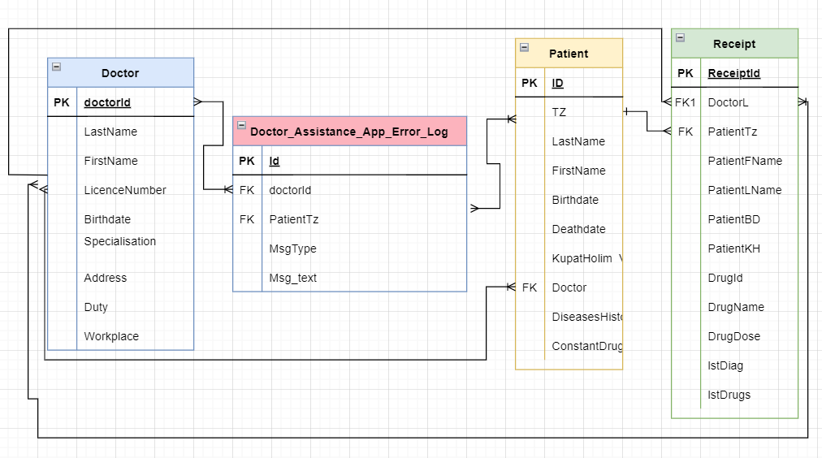
ERD of Doctor DB
Background
Background
Background
What We Do
What We Do
What We Do
architecture
architecture
architecture
NiFi
NiFi
ERD
ERD
Spark
Mongo
HDFS
HDFS
Reports
Reports

Slide 9
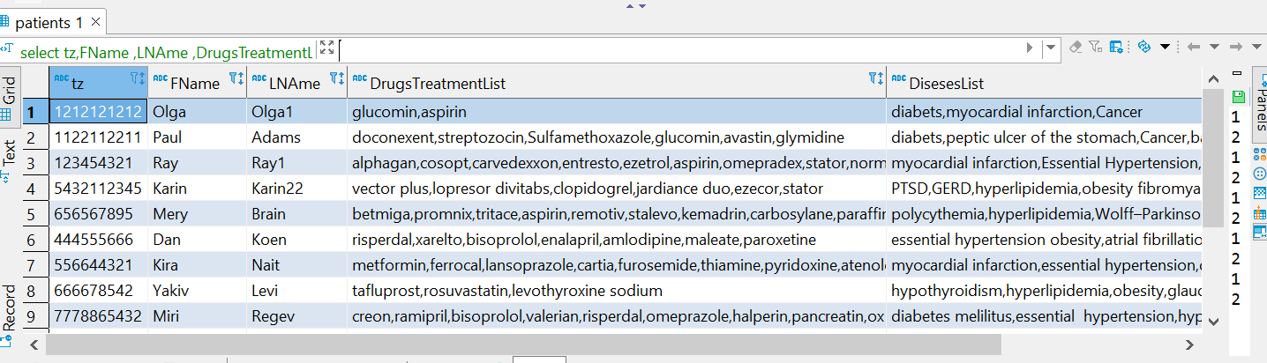
ERD of Doctor DB
Background
Background
Background
What We Do
What We Do
What We Do
architecture
architecture
architecture
NiFi
NiFi
ERD
ERD
Spark
use doctors;
select tz,FName ,LNAme ,DrugsTreatmentList ,DisesesList from patients;
Mongo
HDFS
HDFS
Reports
Reports

Slide 10
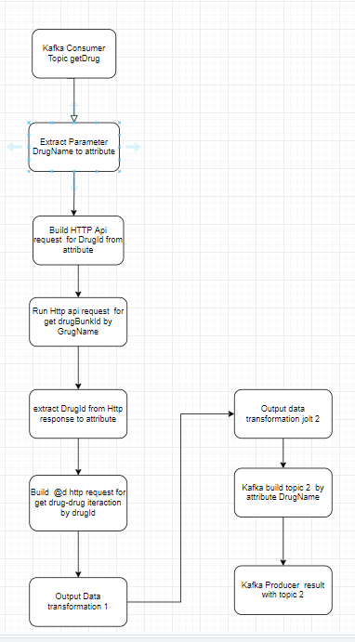
Nifi process steps and flow

Slide 11
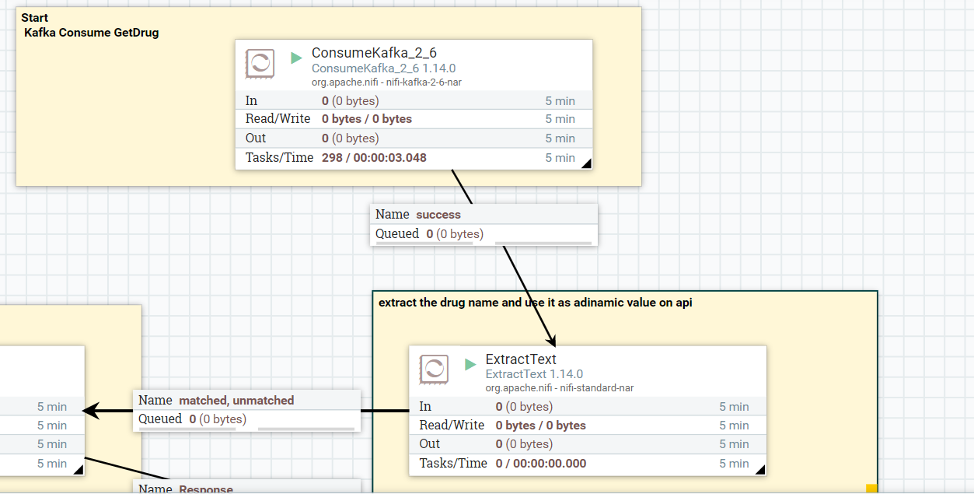
Data streaming With in nifi
Background
Background
Background
What We Do
What We Do
What We Do
architecture
architecture
architecture
NiFi
NiFi
ERD
ERD of Doctor DB
Spark
Mongo
ConsumeKafka_2_6 1.14.0:
receive getDrug requests from clients with specific drug name as parameter
ExtractText:
extract the drug name and use it as a parameter on api call, saved as nifi process attribute
HDFS
HDFS
Reports
Reports

Slide 12
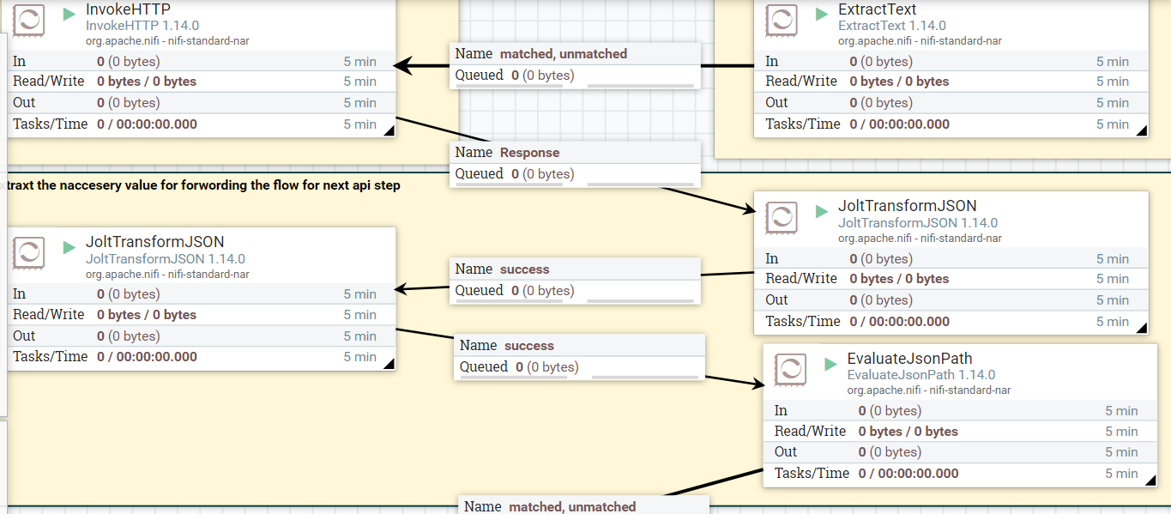
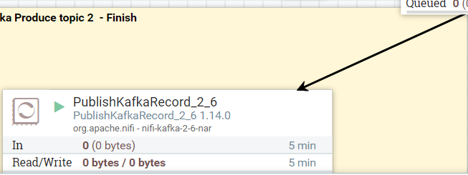
Data streaming With in nifi
Background
Background
Background
What We Do
What We Do
What We Do
architecture
architecture
architecture
NiFi
NiFi
ERD
ERD
Spark
Mongo
HDFS
HDFS
Build 1st API request and get drugId from drug name, build 2d Api request from id received
2d api call for get drug interaction, Result data transformation, kafka producer send result
Reports
Reports

Slide 13
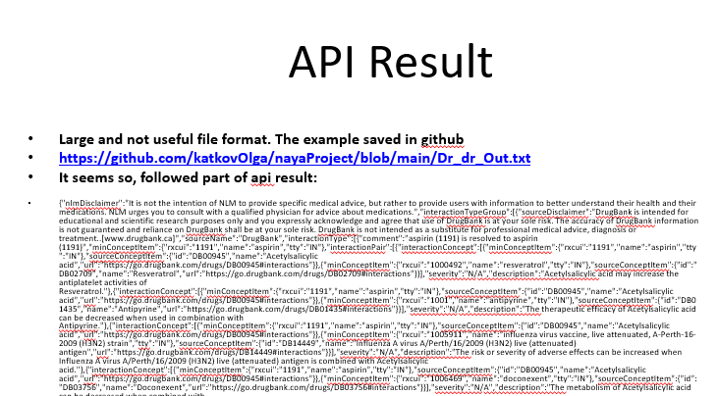
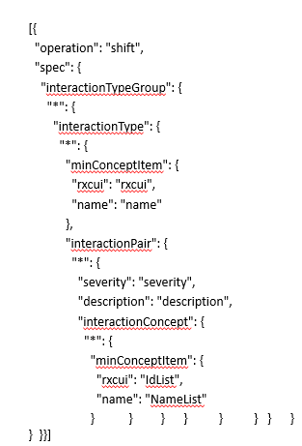
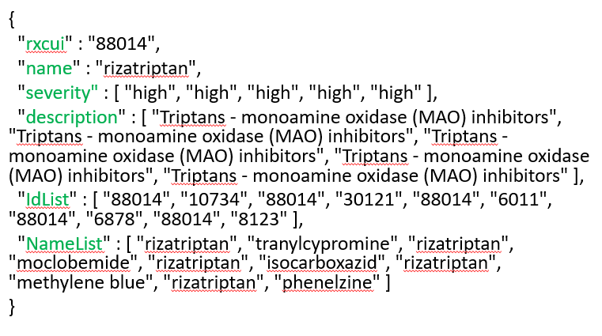
Data streaming With in nifi
Background
Background
Background
What We Do
What We Do
What We Do
architecture
architecture
architecture
NiFi
NiFi
ERD
ERD
Mongo
Spark
HDFS
HDFS
Reports
Reports

Slide 14
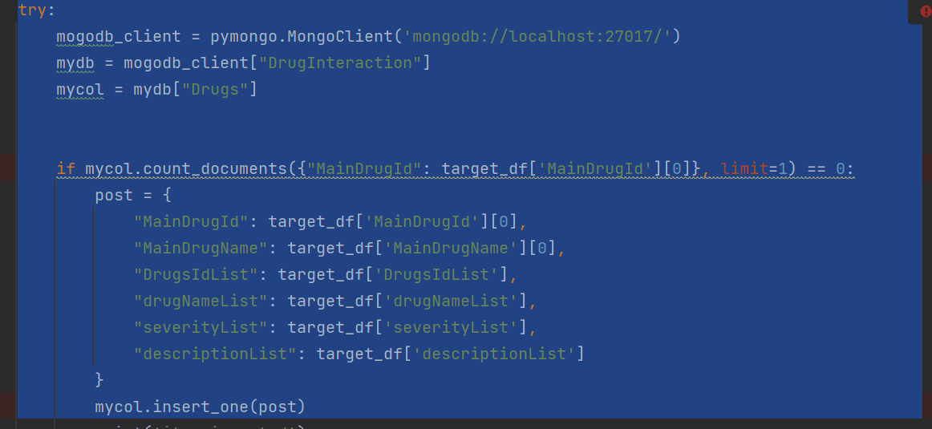
Mongo db –DrugInteraction collection -Drugs
Background
Background
Background
What We Do
What We Do
What We Do
architecture
architecture
architecture
NiFi
NiFi
ERD
ERD
Mongo
Spark
HDFS
HDFS
Reports
Reports

Slide 15
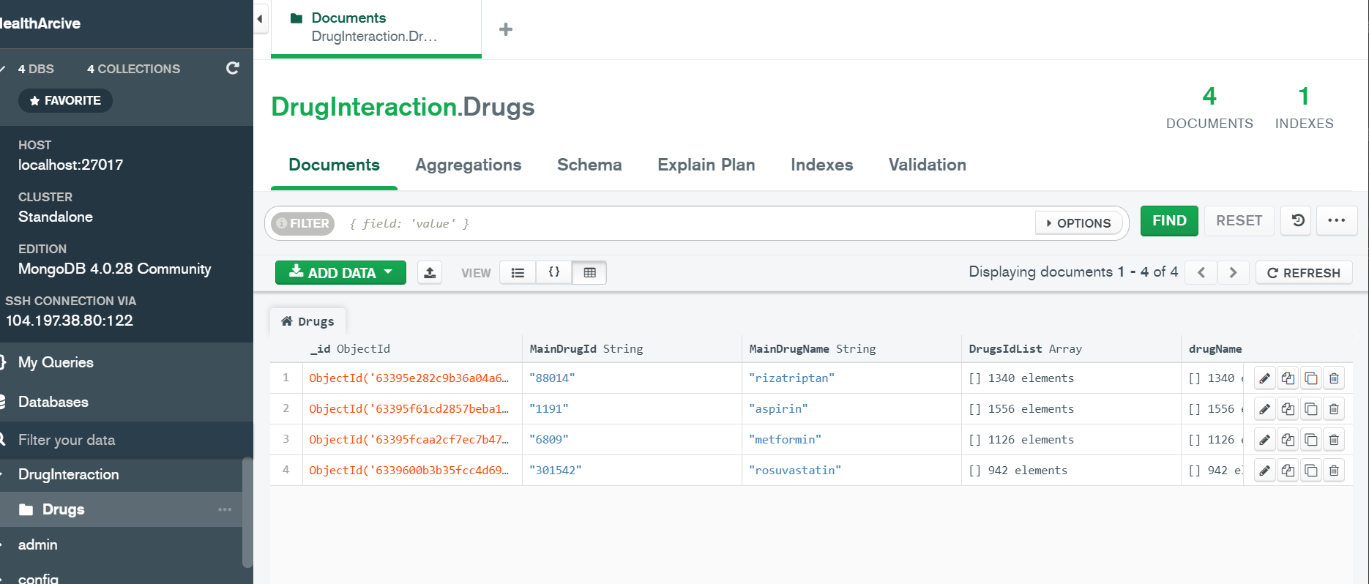
ERD of Mongo db
Background
Background
Background
What We Do
What We Do
What We Do
architecture
architecture
architecture
Mongo db –alternative further data source
NiFi
NiFi
ERD
ERD
Spark
Mongo
HDFS
HDFS
Reports
Reports

Slide 16
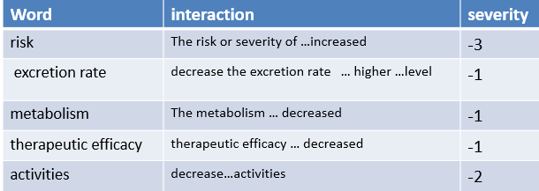
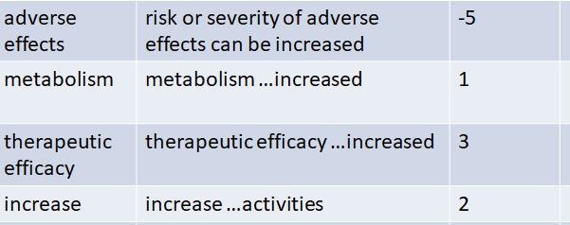
Background
Background
Background
lexical analysis & data transformation
What We Do
What We Do
What We Do
In this api we have not direct interaction & severity definition and need implement lexical analysis to understand the result.
architecture
architecture
architecture
NiFi
NiFi
ERD
ERD
Mongo
Spark
HDFS
HDFS
Reports
Reports

Slide 17
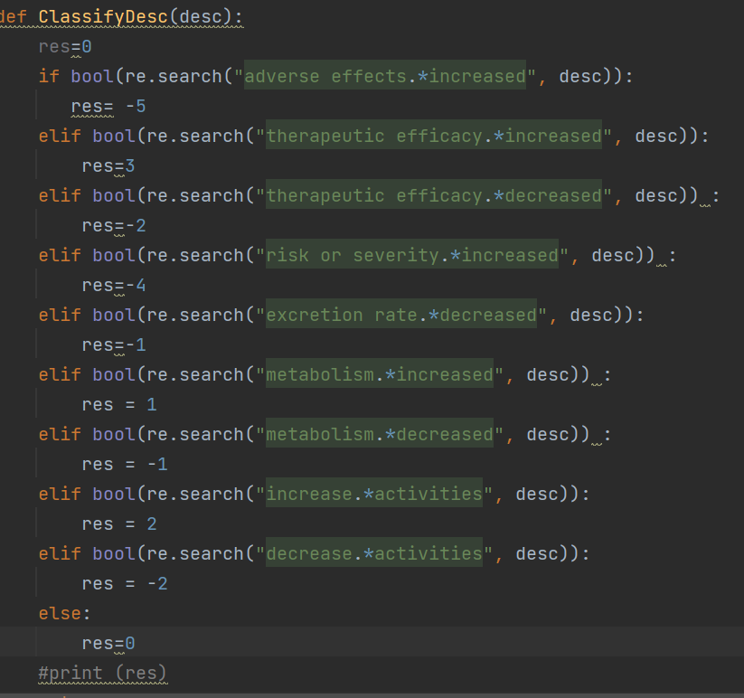
Sentimental analysis by regular expressions use
Background
Background
Background
Lexical analysis and data transformation
What We Do
What We Do
What We Do
architecture
architecture
architecture
NiFi
NiFi
ERD
ERD
Mongo
Spark
HDFS
HDFS
Reports
Reports

Slide 18
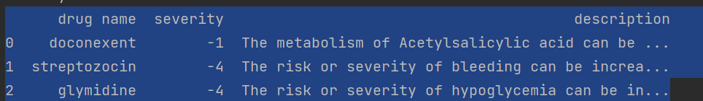
Background
Background
Background
Spark
Use streaming
What We Do
What We Do
What We Do
architecture
architecture
architecture
Result dataframe for doctor
NiFi
NiFi
ERD
ERD
Spark
Spark
HDFS
HDFS
Reports
Reports

Slide 19
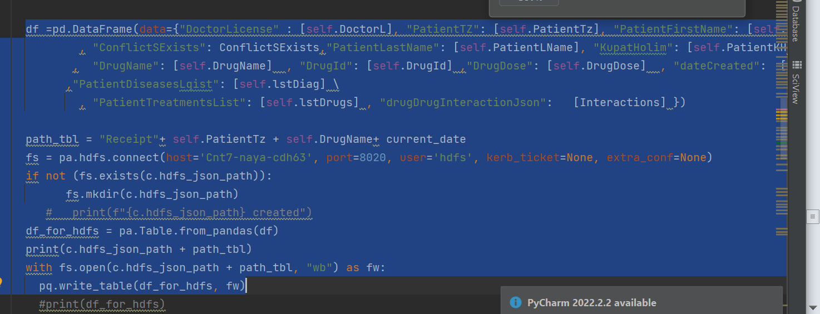
Background
Background
Background
HDFS
archive file structure
What We Do
What We Do
What We Do
architecture
architecture
architecture
Parquet format Json file
NiFi
NiFi
ERD
ERD
Spark
Mongo
HDFS
HDFS
Reports
Reports

Slide 20
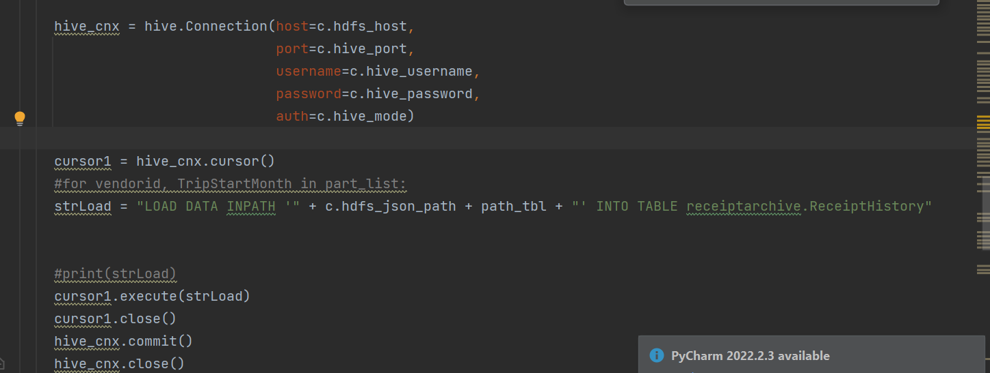
Background
Background
Background
HIVE Table
What We Do
What We Do
What We Do
architecture
architecture
architecture
Parquet format Json file
CREATE EXTERNAL TABLE IF NOT EXISTS receiptarchive.ReceiptHistory(DoctorLicense String, PatientTZ String, PatientFirstName String,ConflictSExists Boolean, PatientLastName String, KupatHolim String, PtienBirthdate String, DrugName String, DrugId String, DrugDose String, dateCreated String, PatientDiseasesLqist String, PatientTreatmentsList String,drugDrugInteractionJson String) stored as Parquet Location /user/hive/warehouse/receiptarchive.db';
NiFi
NiFi
ERD
ERD
Spark
Mongo
HDFS
HDFS
Reports
Reports

Slide 21
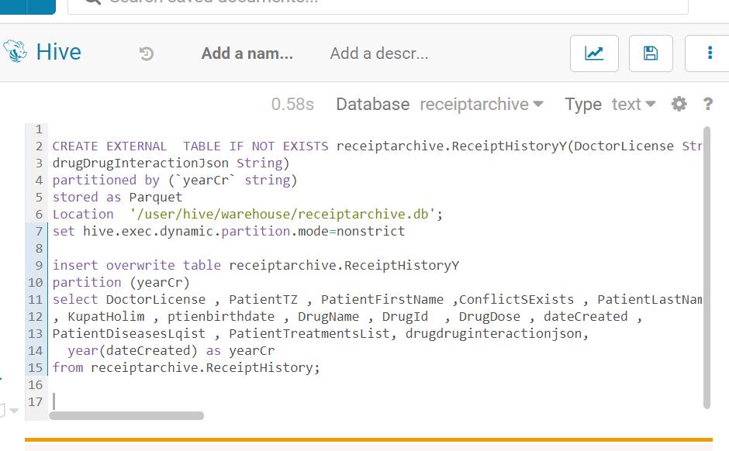
Background
Background
Background
HIVE table
Partitioned by year
For better perfomance
What We Do
What We Do
What We Do
architecture
architecture
architecture
CREATE EXTERNAL TABLE IF NOT EXISTS receiptarchive.ReceiptHistoryY(DoctorLicense String, PatientTZ String, PatientFirstName String,ConflictSExists Boolean, PatientLastName String, KupatHolim String, PatienBirthdate String, DrugName String, DrugId String, DrugDose String, dateCreated String, PatientDiseasesLqist String, PatientTreatmentsList String,
drugDrugInteractionJson String)
stored as Parquet
partitioned by (`yearCr` string)
Location '/user/hive/warehouse/receiptarchive.db';
insert overwrite table receiptarchive.ReceiptHistoryY
partition (yearCr)
select DoctorLicense , PatientTZ , PatientFirstName ,ConflictSExists , PatientLastName , KupatHolim , PatienBirthdate , DrugName , DrugId , DrugDose , dateCreated , PatientDiseasesLqist , PatientTreatmentsList,
year(dateCreated) as yearCr
from receiptarchive.ReceiptHistory;
NiFi
NiFi
ERD
ERD
Spark
Mongo
HDFS
HDFS
Reports
Reports

Slide 22
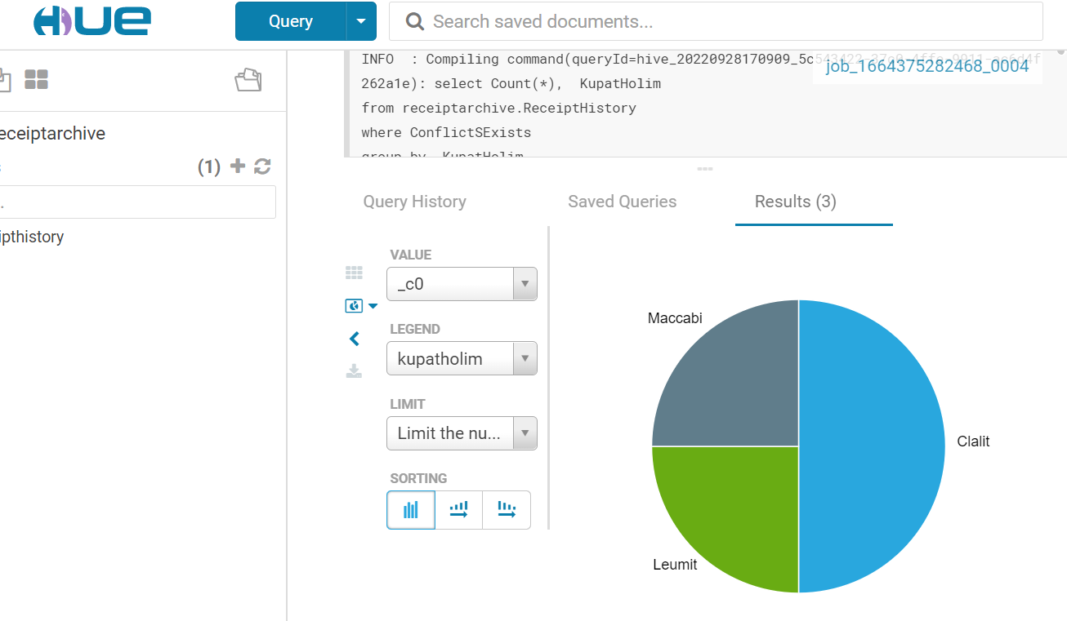
Report by Kupat Holim
Background
Background
What We Do
What We Do
architecture
architecture
NiFi
NiFi
ERD
ERD
Spark
Mongo
HDFS
HDFS
Reports
Reports

Slide 23
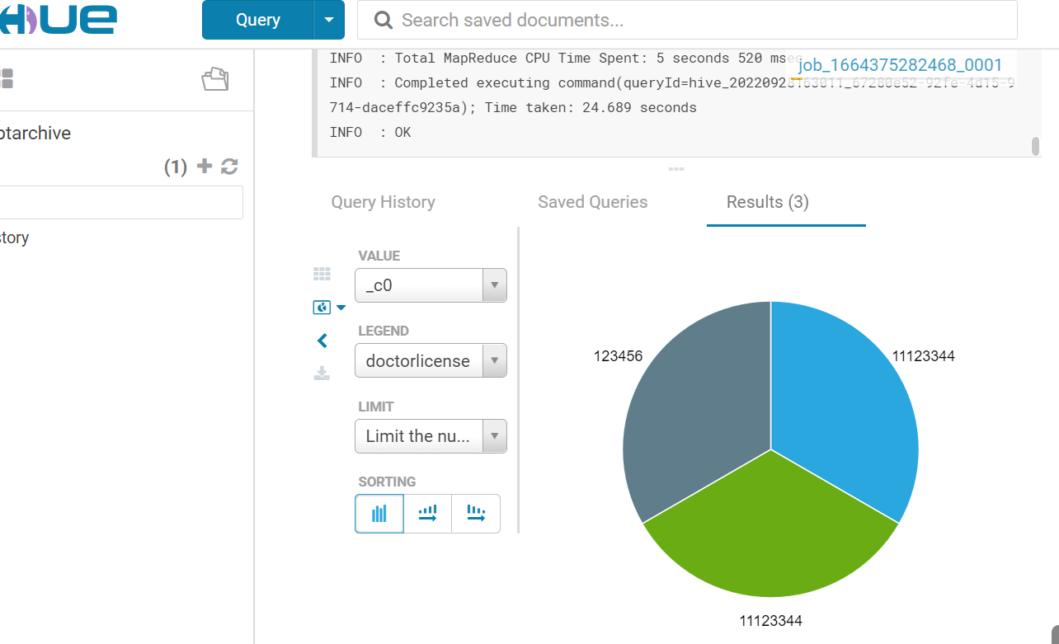
Report by Doctor License
Background
Background
What We Do
What We Do
architecture
architecture
NiFi
NiFi
ERD
ERD
Mongo
Spark
HDFS
HDFS
Reports
Reports

Slide 24
Possible reports and analysis from archive
Background
Background
What We Do
What We Do
architecture
architecture
1.Report –amount of receipts with side effects and risks, which part of receipts cause negative effects to patients
2. Which doctor gives more drugs with serious side effects and/or risks
3.Which diseases are more likely to conflict with the drugs taken for other diseases and require increased doctor's caution
4. Percent of critical side effects from new drugs
Etc and much more
NiFi
NiFi
ERD
ERD
Mםngo
Spark
HDFS
HDFS
Reports
Reports

Slide 25
Challenges
Dynamic build of topic2 and Http request to second api call
Large jolt transformation
Data understanding and lexical analysis
Nifi large pipeline

Slide 26

“Primum non nocere!”
This Latin phrase means "first, do no harm”. It is one of the principal precepts of bioethics that all students in healthcare are taught in school and is a fundamental principle throughout the world.
Thank You

