Slide 1
Selection of the optimal drug for a patient with a complex set of diagnoses
Doctor – Patient Assistance to understand drug-drug interaction

Slide 2
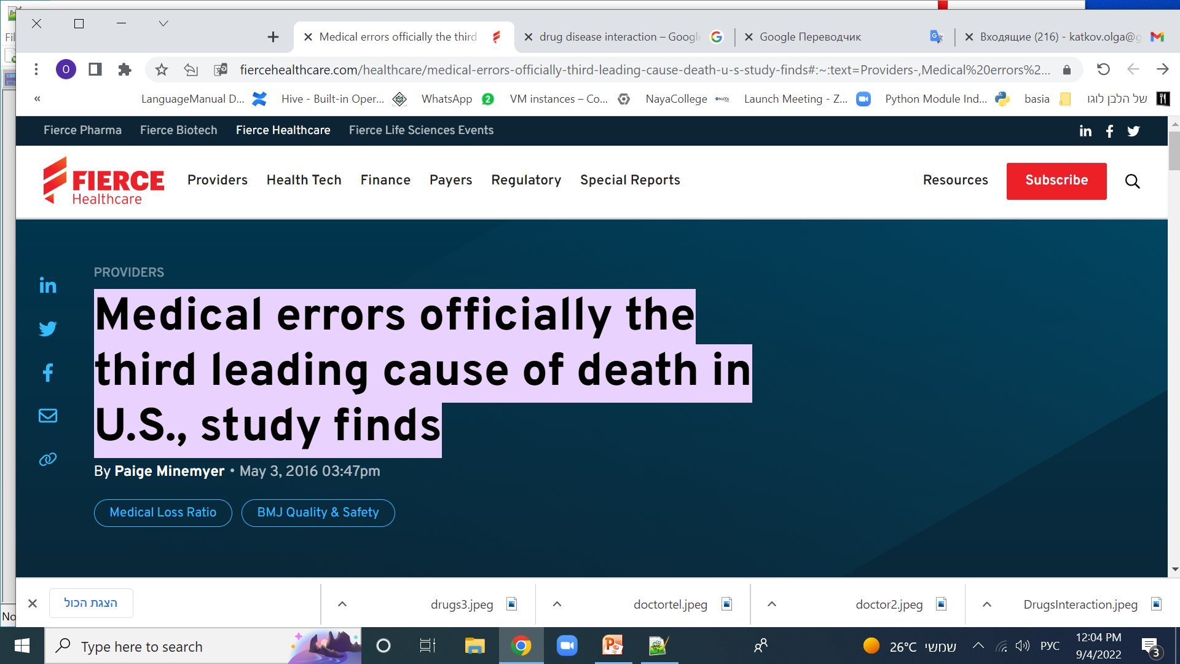
Medical errors officially the third leading cause of death in U.S., study finds
a large proportion of these deaths are due to improper selection of drugs for chronic patients and with a wide range of constantly taken drugs

Slide 3
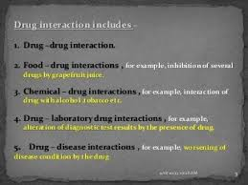
Drug Interaction Types

Slide 4
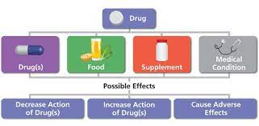
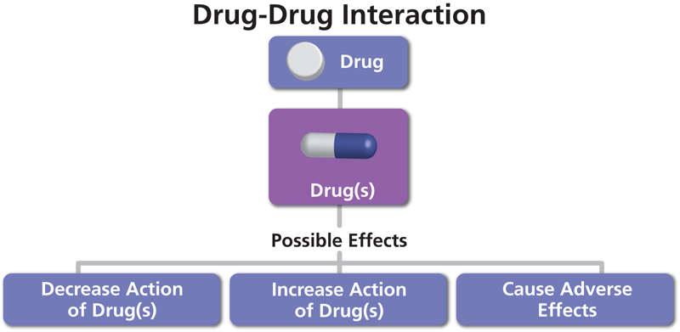
Possible full new drug checks

Slide 5

Drug- drug Interaction
In this project developed automatic checking of a new drug recommended by a doctor for a patient for interaction with constantly taken drugs. Interaction can be both positive (synergy) and negative, harming the patient. To warn the doctor about the possible negative effects of the new drug is the goal of this project.
Drug Antagonism
Drug Interaction
Drug Synergism

Slide 6
Data Sources
Source | Type | Description
Doctor DB | MySql , Relation DB | Rt doctor db ,that saved patient history, doctors information.
Diseases DB | constantly taken drugs | Loaded data from external data source
External APIs –drugs api | 4 official drug interaction apis of National Institute of Health, USA | https://lhncbc.nlm.nih.gov/RxNav/APIs/InteractionAPIs.html
All drug receipts archive | HDFS, cloud

Slide 7
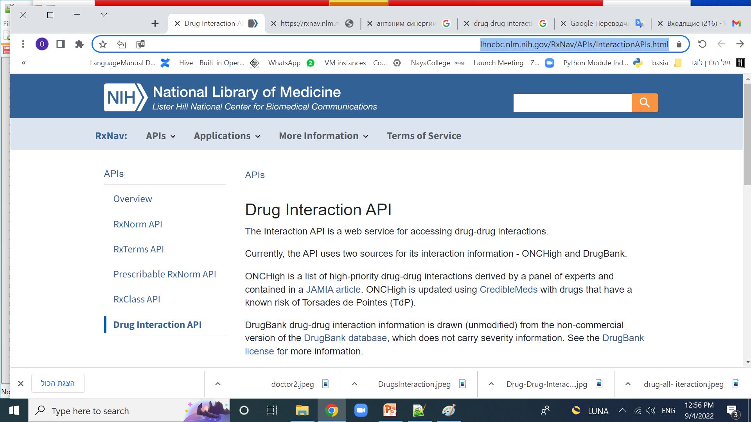

Slide 8
Toolbox for technical realization
Tool | use | description
MySql | 2 databases | 1.Loaded from external source diseases database 2. Doctor database(Kupat holim db) with his patient’s history , doctor data, recepts etc
kafka | Data stream tool , work with 2 types of topics topic1 = 'GetDrug' topic2 = 'GetInteraction' | Topic –trigger of start proccess by run kafka producer, consumer in nifi after receiving request start the check process Topic from second type in doctor application run consumer to check result , the producer will be the last step on nifi proccess
nifi | mechanism of work. Receiving and processing data. The result is sent via kafka to the doctor's application | Consumer of topic 1 receive the request. Run 1st api call to get drugId according to name. 2. Run 2d api call to get interaction according Id 3. Jolt data manipulation to simplify the data from api 4. Send result to kafka with topic 2 type
spark | Used with kafka result consumer , structured data stream, and with hdfs data reports
hdfs | Recepts data archive | Source for reports and analitics
python |  | Use parrow, pyspark , lexical analysis
NIH apis | \Source DrugBank | Api can works with different data source, in this project we use the DrugBank source

Slide 9
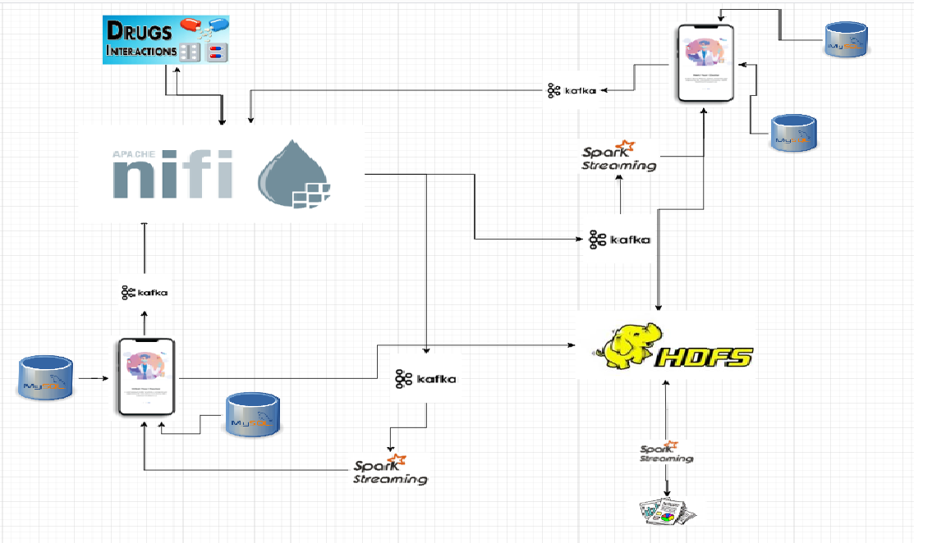
Solution architecture

Slide 10
Data streaming engine is implemented in nifi

Slide 11
API Result

Slide 12
JOLT Specification

Slide 13
Result producer data

Slide 14
Lexical analysis and data transformation

Slide 15
Result dataframe for doctor

Slide 16
HDFS archive file structure

Slide 17
Possible reports and analysis from archive

Slide 18
ERD of Doctor DB

Slide 19
Doctor Application functionallity

Slide 20
Application Classes

Slide 21


