Slide 1
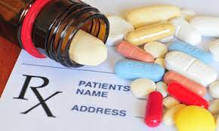
Selection of the optimal drug for a patient with a complex set of diagnoses
Doctor – Patient Assistance to understand drug-drug interaction

Slide 2
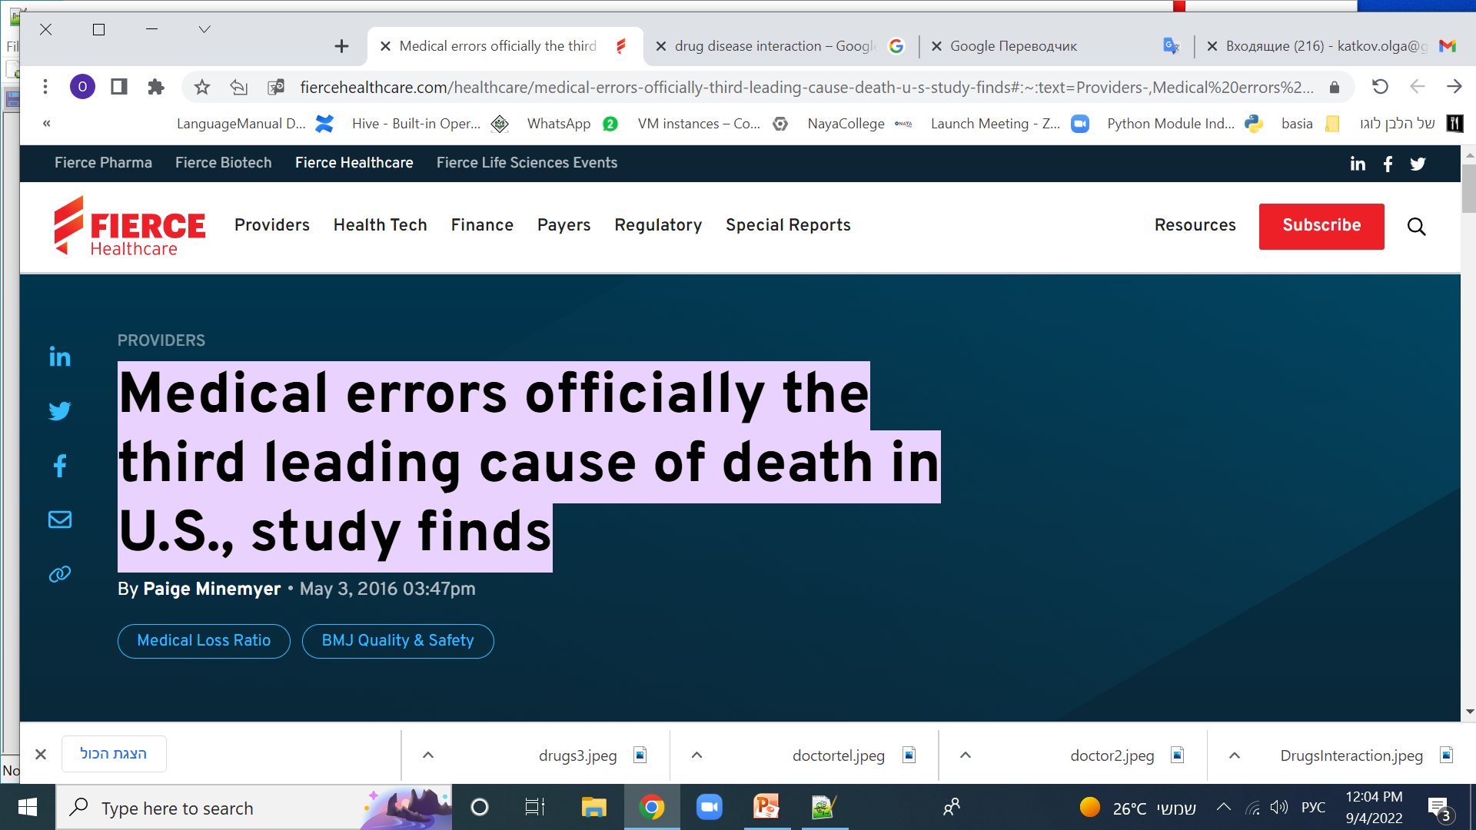
Medical errors officially the third leading cause of death in U.S., study finds
a large proportion of these deaths are due to improper selection of drugs for chronic patients and with a wide range of constantly taken drugs

Slide 3
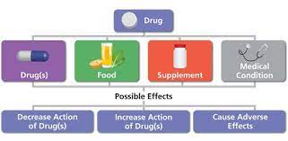
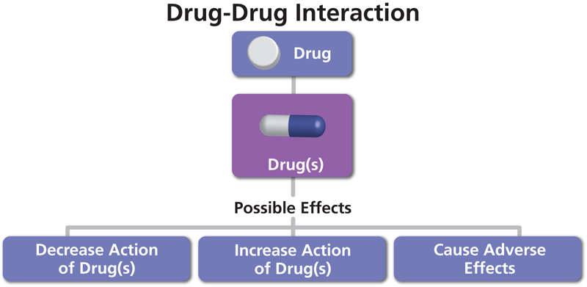
Possible full new drug checks

Slide 4
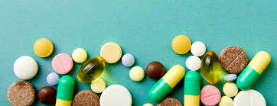
Drug- drug Interaction
In this project developed automatic checking of a new drug recommended by a doctor for a patient for interaction with constantly taken drugs. Interaction can be both positive (synergy) and negative, harming the patient. To warn the doctor about the possible negative effects of the new drug is the goal of this project.
Drug Antagonism
Drug Interaction
Drug Synergism

Slide 5
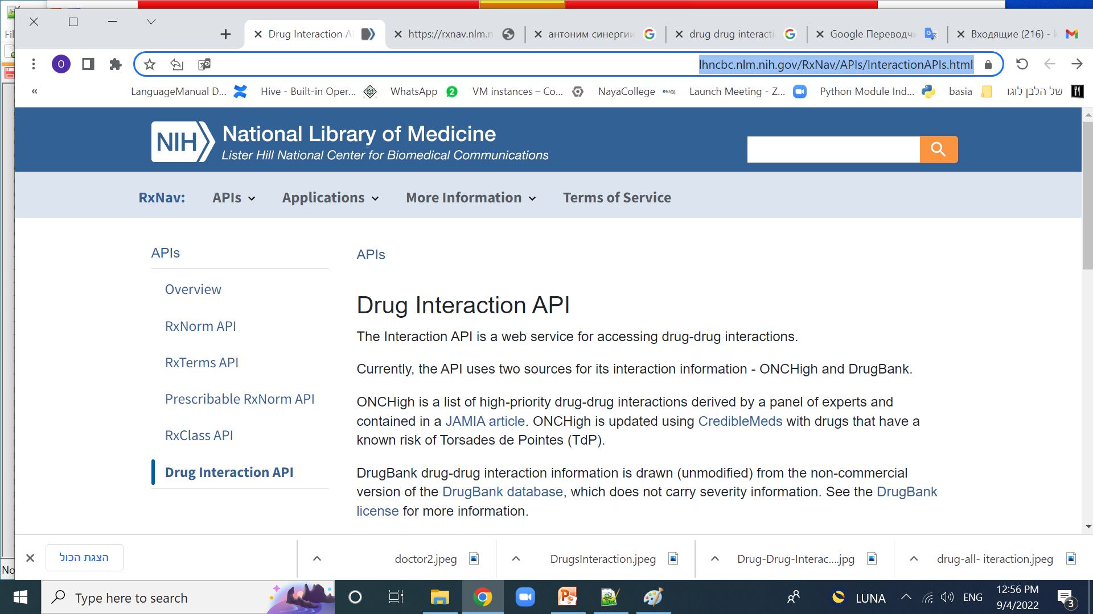
NIH supplied some drug interaction APIs

Slide 6
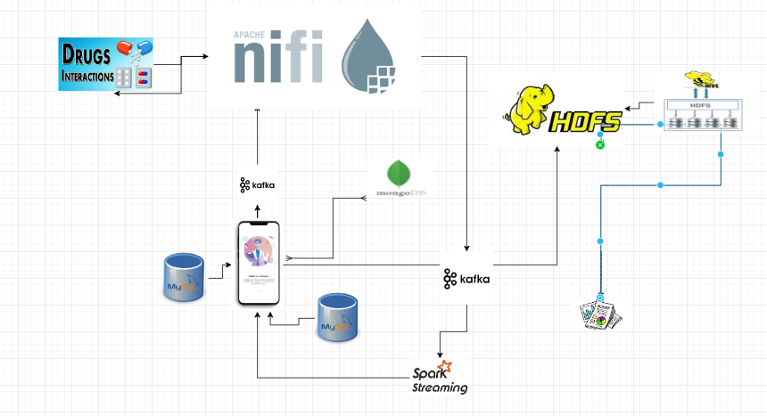
Solution architecture

Slide 7
Toolbox for technical realization
Tool | use | description
MySql | 2 databases | 1.Loaded from external source diseases database 2. Doctor database(Kupat holim db) with his patient’s history , doctor data, recepts etc
kafka | Data stream tool , work with 2 types of topics topic1 = 'GetDrug' topic2 = 'GetInteraction' | Topic –trigger of start process by run kafka producer, consumer in nifi after receiving request start the check process Topic from second type in doctor application run consumer to check result , the producer will be the last step on nifi process

Slide 8
Toolbox for technical realization -continued
Tool | use | description
nifi | mechanism of work. Receiving and processing data. The result is sent via kafka to the doctor's application | Consumer of topic 1 receive the request. Run 1st api call to get drugId according to name. 2. Run 2d api call to get interaction according Id 3. Jolt data manipulation to simplify the data from api 4. Send result to kafka with topic 2 type
spark | mechanism of work. Receiving and processing data. The result is sent via kafka to the doctor's application

Slide 9
Toolbox for technical realization -continued
tool | use | description
hdfs | Receipts data archive | Source for reports and analytics
NIH apis | Source DrugBank | Api can works with different data source, in this project we use the DrugBank source
python |  | Use parrow, pyspark , mysql, kafka, pymongo
HIVE | Sql tools for reports from hdfs archive | Used to get reports from archive
mongo | New database to save the result of data manipulation | For future use, after first period of application use possible to use ready data sets for interaction instead of run the whole process each time. Full process will be needed in future only when the drug don’t exist in mongo db.

Slide 10
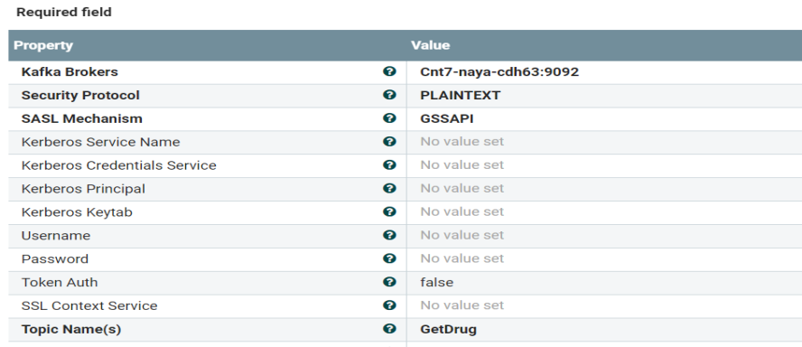
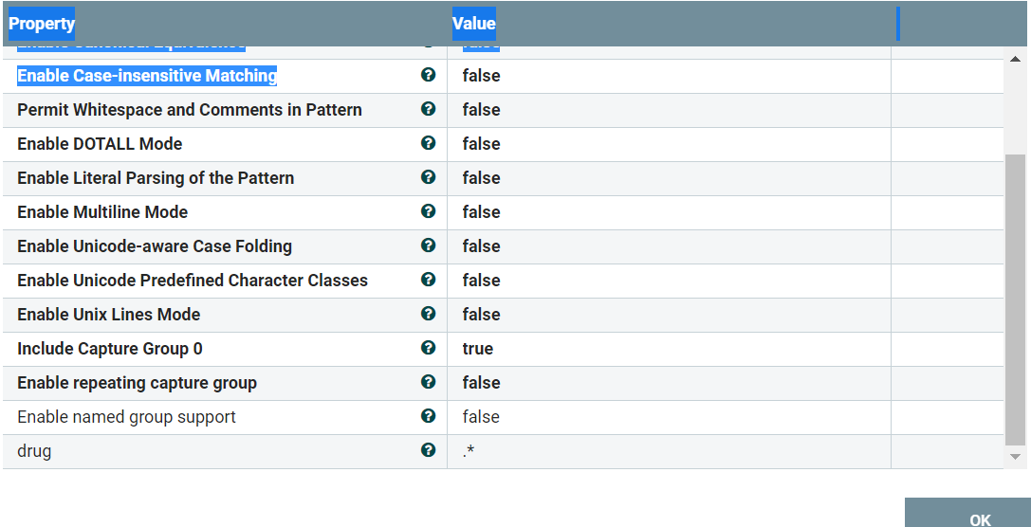
Data streaming engine is implemented in nifi(steps)
Proccessor Type | Property | Description
ConsumeKafka_2_6 1.14.0 |  | receive getDrug requests from clients with specific drug name as parameter topic=GetDrug
ExtractText 1.14.0 |  | extract the drug name and use it as a parameter on api call, saved as nifi process attribute
1.

Slide 11
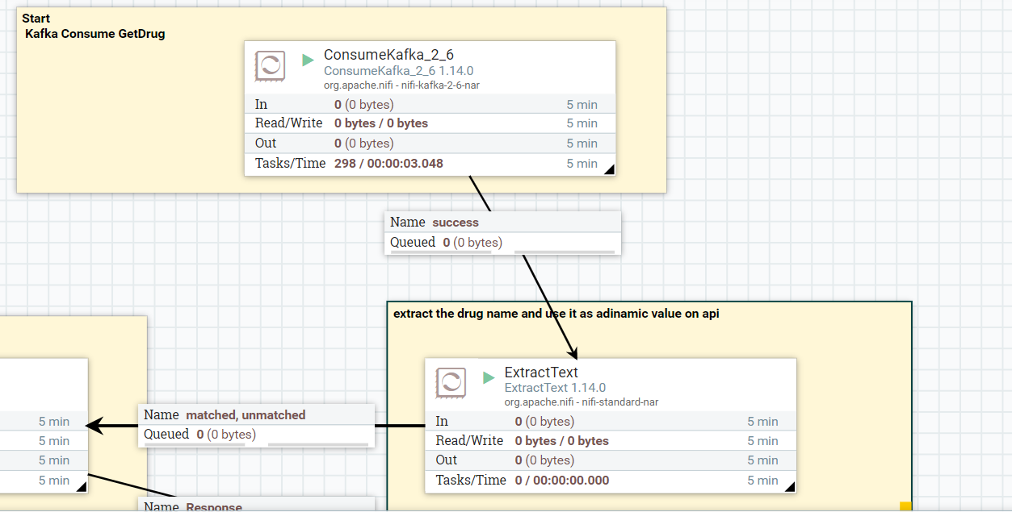
Start nifi pipeline from consumer

Slide 12
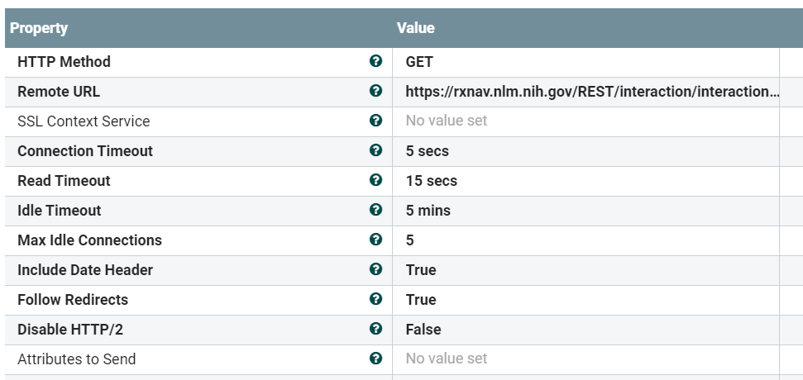
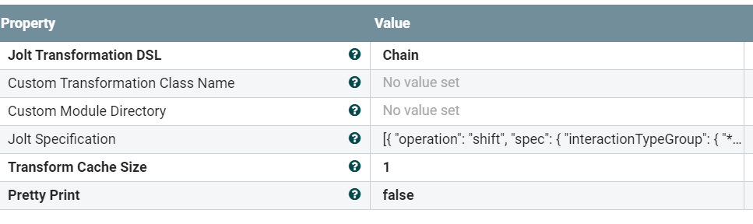
Nifi steps - continued
Proccessor Type | Property | Description
InvokeHTTP 1.14.0 |  | 2 http api calls in nifi process
JoltTransformJSON 1.14.0 |  | 3 jolt transformations

Slide 13
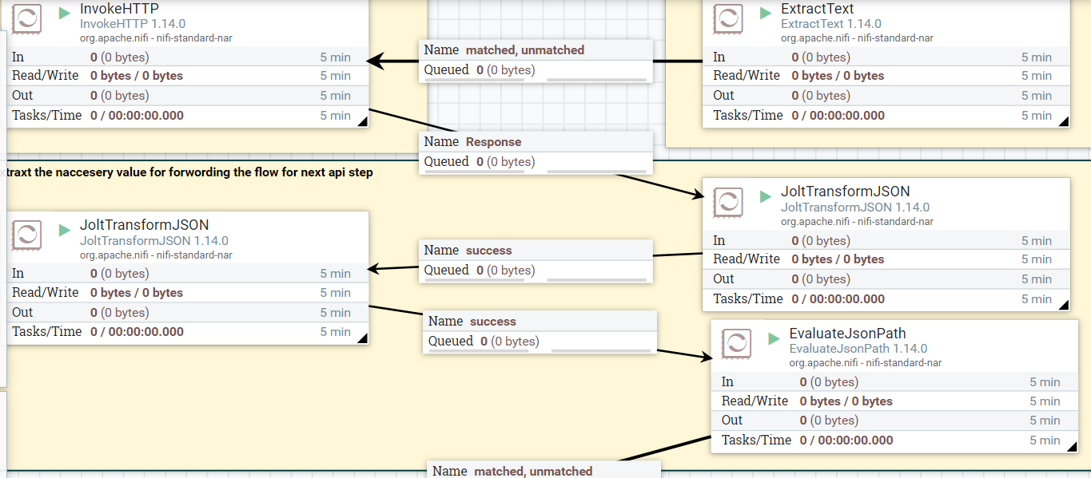
Build 1st API request and get drugId from drug name, build 2d Api request from id recieved

Slide 14
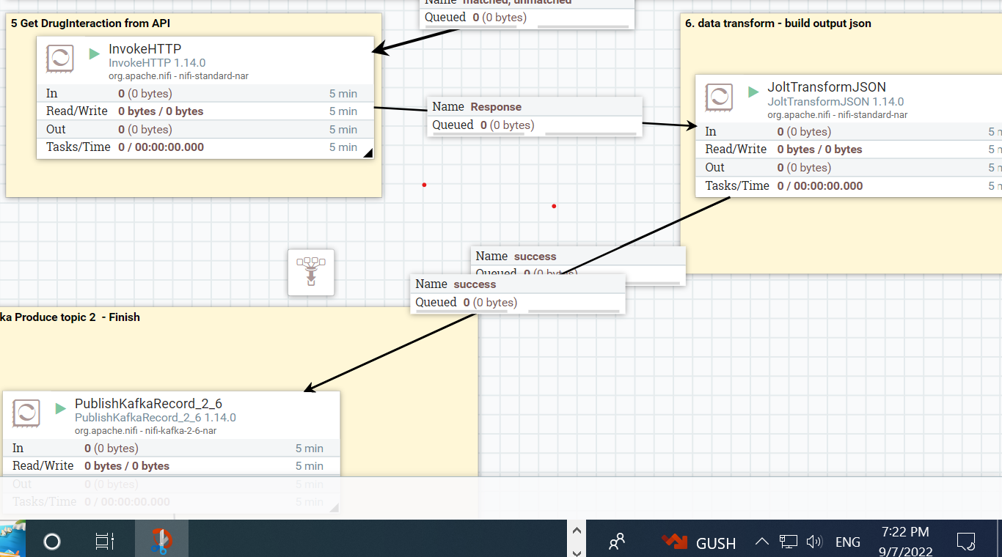
2d api call for get drug interaction, Result data transformation, kafka producer send result

Slide 15
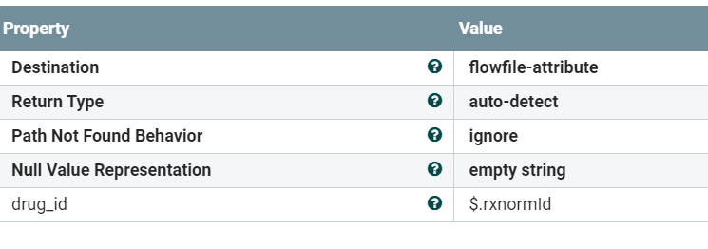
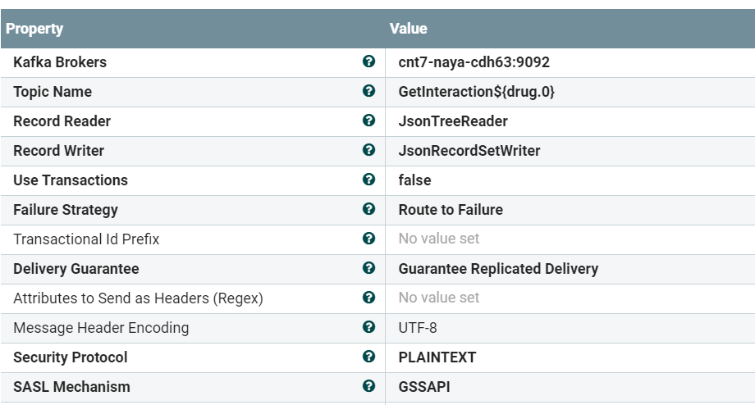
Nifi steps - continued
Proccessor Type | Property | Description
EvaluateJsonPath 1.14.0 |  | put drug_id from 1st api call to attribute drug_id
PublishKafkaRecord_2_6 1.14.0 |  | Send grug interaction result to doctor application

Slide 16
API Result
Large and not useful file format. The example saved in github
https://github.com/katkovOlga/nayaProject/blob/main/Dr_dr_Out.txt
It seems so, followed part of api result:
{"nlmDisclaimer":"It is not the intention of NLM to provide specific medical advice, but rather to provide users with information to better understand their health and their medications. NLM urges you to consult with a qualified physician for advice about medications.","interactionTypeGroup":[{"sourceDisclaimer":"DrugBank is intended for educational and scientific research purposes only and you expressly acknowledge and agree that use of DrugBank is at your sole risk. The accuracy of DrugBank information is not guaranteed and reliance on DrugBank shall be at your sole risk. DrugBank is not intended as a substitute for professional medical advice, diagnosis or treatment..[www.drugbank.ca]","sourceName":"DrugBank","interactionType":[{"comment":"aspirin (1191) is resolved to aspirin (1191)","minConceptItem":{"rxcui":"1191","name":"aspirin","tty":"IN"},"interactionPair":[{"interactionConcept":[{"minConceptItem":{"rxcui":"1191","name":"aspirin","tty":"IN"},"sourceConceptItem":{"id":"DB00945","name":"Acetylsalicylic acid","url":"https://go.drugbank.com/drugs/DB00945#interactions"}},{"minConceptItem":{"rxcui":"1000492","name":"resveratrol","tty":"IN"},"sourceConceptItem":{"id":"DB02709","name":"Resveratrol","url":"https://go.drugbank.com/drugs/DB02709#interactions"}}],"severity":"N/A","description":"Acetylsalicylic acid may increase the antiplatelet activities of Resveratrol."},{"interactionConcept":[{"minConceptItem":{"rxcui":"1191","name":"aspirin","tty":"IN"},"sourceConceptItem":{"id":"DB00945","name":"Acetylsalicylic acid","url":"https://go.drugbank.com/drugs/DB00945#interactions"}},{"minConceptItem":{"rxcui":"1001","name":"antipyrine","tty":"IN"},"sourceConceptItem":{"id":"DB01435","name":"Antipyrine","url":"https://go.drugbank.com/drugs/DB01435#interactions"}}],"severity":"N/A","description":"The therapeutic efficacy of Acetylsalicylic acid can be decreased when used in combination with Antipyrine."},{"interactionConcept":[{"minConceptItem":{"rxcui":"1191","name":"aspirin","tty":"IN"},"sourceConceptItem":{"id":"DB00945","name":"Acetylsalicylic acid","url":"https://go.drugbank.com/drugs/DB00945#interactions"}},{"minConceptItem":{"rxcui":"1005911","name":"influenza virus vaccine, live attenuated, A-Perth-16-2009 (H3N2) strain","tty":"IN"},"sourceConceptItem":{"id":"DB14449","name":"Influenza A virus A/Perth/16/2009 (H3N2) live (attenuated) antigen","url":"https://go.drugbank.com/drugs/DB14449#interactions"}}],"severity":"N/A","description":"The risk or severity of adverse effects can be increased when Influenza A virus A/Perth/16/2009 (H3N2) live (attenuated) antigen is combined with Acetylsalicylic acid."},{"interactionConcept":[{"minConceptItem":{"rxcui":"1191","name":"aspirin","tty":"IN"},"sourceConceptItem":{"id":"DB00945","name":"Acetylsalicylic acid","url":"https://go.drugbank.com/drugs/DB00945#interactions"}},{"minConceptItem":{"rxcui":"1006469","name":"doconexent","tty":"IN"},"sourceConceptItem":{"id":"DB03756","name":"Doconexent","url":"https://go.drugbank.com/drugs/DB03756#interactions"}}],"severity":"N/A","description":"The metabolism of Acetylsalicylic acid can be decreased when combined with Doconexent."},{"interactionConcept":[{"minConceptItem":{"rxcui":"1191","name":"aspirin","tty":"IN"},"sourceConceptItem":{"id":"DB00945","name":"Acetylsalicylic acid","url":"https://go.drugbank.com/drugs/DB00945#interactions"}},{"minConceptItem":{"rxcui":"1009","name":"antithrombin III","tty":"IN"},"sourceConceptItem":{"id":"DB11598","name":"Antithrombin III human","url":"https://go.drugbank.com/drugs/DB11598#interactions"}}],"severity":"N/A","description":"Acetylsalicylic acid may increase the anticoagulant activities of Antithrombin III human."},{"interactionConcept":[{"minConceptItem":{"rxcui":"1191","name":"aspirin","tty":"IN"},"sourceConceptItem":{"id":"DB00945","name":"Acetylsalicylic acid","url":"https://go.drugbank.com/drugs/DB00945#interactions"}},{"minConceptItem":{"rxcui":"10106","name":"streptokinase","tty":"IN"},"sourceConceptItem":{"id":"DB00086","name":"Streptokinase","url":"https://go.drugbank.com/drugs/DB00086#interactions"}}],"severity":"N/A","description":"Acetylsalicylic acid may increase the anticoagulant activities of Streptokinase."},{"interactionConcept":[{"minConceptItem":{"rxcui":"1191","name":"aspirin","tty":"IN"},"sourceConceptItem":{"id":"DB00945","name":"Acetylsalicylic acid","url":"https://go.drugbank.com/drugs/DB00945#interactions"}},{"minConceptItem":{"rxcui":"10109","name":"streptomycin","tty":"IN"},"sourceConceptItem":{"id":"DB01082","name":"Streptomycin","url":"https://go.drugbank.com/drugs/DB01082#interactions"}}],"severity":"N/A","description":"Acetylsalicylic acid may decrease the excretion rate of Streptomycin which could result in a higher serum level."},{"interactionConcept":[{"minConceptItem":{"rxcui":"1191","name":"aspirin","tty":"IN"},"sourceConceptItem":{"id":"DB00945","name":"Acetylsalicylic acid","url":"https://go.drugbank.com/drugs/DB00945#interactions"}},{"minConceptItem":{"rxcui":"10114","name":"streptozocin","tty":"IN"},"sourceConceptItem":{"id":"DB00428","name":"Streptozocin","url":"https://go.drugbank.com/drugs/DB00428#interactions"}}],"severity":"N/A","description":"The risk or severity of bleeding can be increased when Acetylsalicylic acid is combined with Streptozocin."},{"interactionConcept":[{"minConceptItem":{"rxcui":"1191","name":"aspirin","tty":"IN"},"sourceConceptItem":{"id":"DB00945","name":"Acetylsalicylic acid","url":"https://go.drugbank.com/drugs/DB00945#interactions"}},{"minConceptItem":{"rxcui":"10154","name":"succinylcholine","tty":"IN"},"sourceConceptItem":{"id":"DB00202","name":"Succinylcholine","url":"https://go.drugbank.com/drugs/DB00202#interactions"}}],"severity":"N/A","description":"The risk or severity of hyperkalemia can be increased when Succinylcholine is combined with Acetylsalicylic acid."},{"interactionConcept":[{"minConceptItem":{"rxcui":"1191","name":"aspirin","tty":"IN"},"sourceConceptItem":{"id":"DB00945","name":"Acetylsalicylic acid","url":"https://go.drugbank.com/drugs/DB00945#interactions"}},{"minConceptItem":{"rxcui":"10167","name":"sulbactam","tty":"IN"},"sourceConceptItem":{"id":"DB09324","name":"Sulbactam","url":"https://go.drugbank.com/drugs/DB09324#interactions"}}],"severity":"N/A","description":"Acetylsalicylic acid may decrease the excretion rate of Sulbactam which could result in a higher serum level."}

Slide 17
JOLT Specification
[{
"operation": "shift",
"spec": {
"interactionTypeGroup": {
"*": {
"interactionType": {
"*": {
"minConceptItem": {
"rxcui": "rxcui",
"name": "name"
},
"interactionPair": {
"*": {
"severity": "severity",
"description": "description",
"interactionConcept": {
"*": {
"minConceptItem": {
"rxcui": "IdList",
"name": "NameList"
} } } } } } } } } }}]

Slide 18
Result producer data
{
"rxcui" : "88014",
"name" : "rizatriptan",
"severity" : [ "high", "high", "high", "high", "high" ],
"description" : [ "Triptans - monoamine oxidase (MAO) inhibitors", "Triptans - monoamine oxidase (MAO) inhibitors", "Triptans - monoamine oxidase (MAO) inhibitors", "Triptans - monoamine oxidase (MAO) inhibitors", "Triptans - monoamine oxidase (MAO) inhibitors" ],
"IdList" : [ "88014", "10734", "88014", "30121", "88014", "6011", "88014", "6878", "88014", "8123" ],
"NameList" : [ "rizatriptan", "tranylcypromine", "rizatriptan", "moclobemide", "rizatriptan", "isocarboxazid", "rizatriptan", "methylene blue", "rizatriptan", "phenelzine" ]
}

Slide 19
Data Sources
Source | Type | Description
Doctor DB | MySql , Relation DB | Rt doctor db ,that saved patient history, doctors information.
Diseases DB | constantly taken drugs | Loaded data from external data source
External APIs –drugs api | 4 official drug interaction apis of National Institute of Health, USA | https://lhncbc.nlm.nih.gov/RxNav/APIs/InteractionAPIs.html
All drug receipts archive | HDFS, cloud
Mongo db | New db to save data in useful format after first checks for further uses without

Slide 20
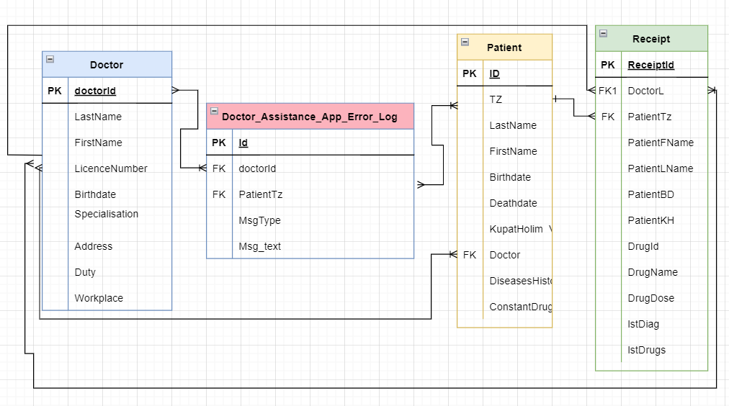
ERD of Doctor DB

Slide 21
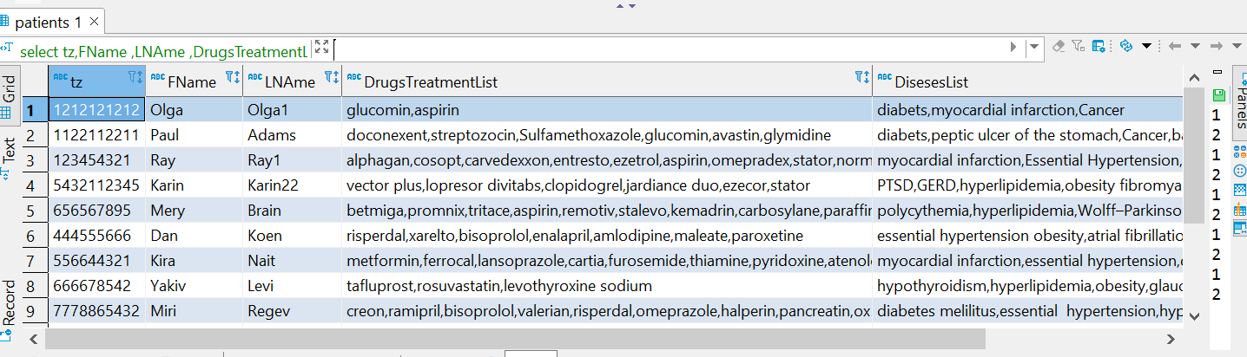
Patient table example
use doctors;
select tz,FName ,LNAme ,DrugsTreatmentList ,DisesesList from patients;

Slide 22
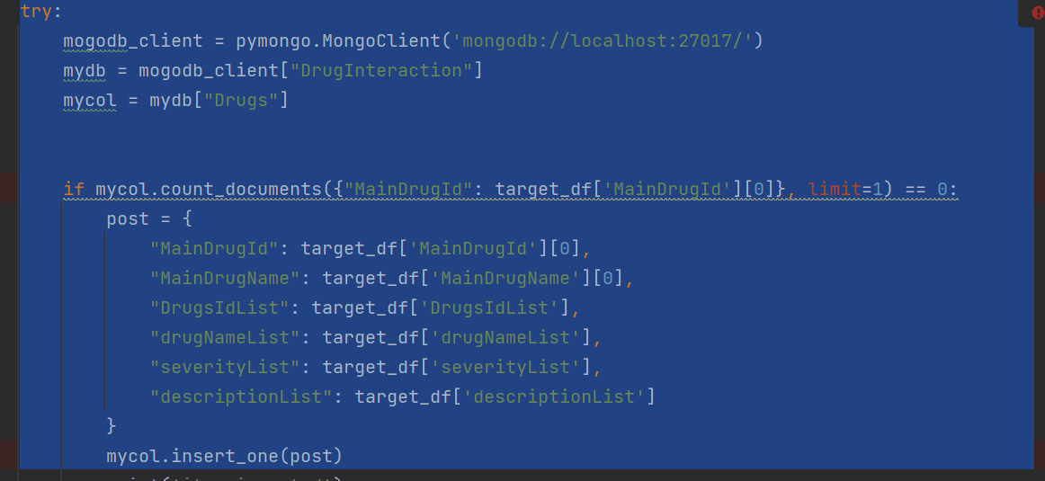
Mango db –DrugInteraction collection -Drugs

Slide 23
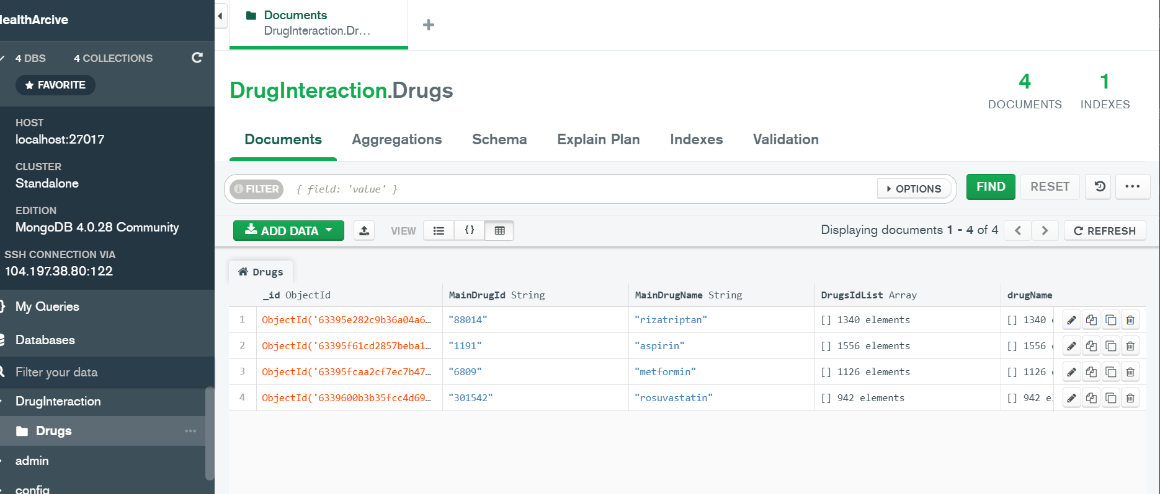
Mango db –alternative further data source

Slide 24
Lexical analysis and data transformation
In this api we have not direct interaction & severity definition and need implement lexical analysis to understand the result.
Word | interaction | severity | description
risk | The risk or severity of …increased | -3
excretion rate | decrease the excretion rate … higher …level | -1
metabolism | The metabolism … decreased | -1
therapeutic efficacy | therapeutic efficacy … decreased | -1
activities | decrease…activities | -2

Slide 25
Lexical analysis and data transformation-continued
Word |  |  | description
adverse effects | risk or severity of adverse effects can be increased | -5 | negative
metabolism | metabolism …increased | 1
therapeutic efficacy | therapeutic efficacy …increased | 3
increase | increase …activities | 2

Slide 26
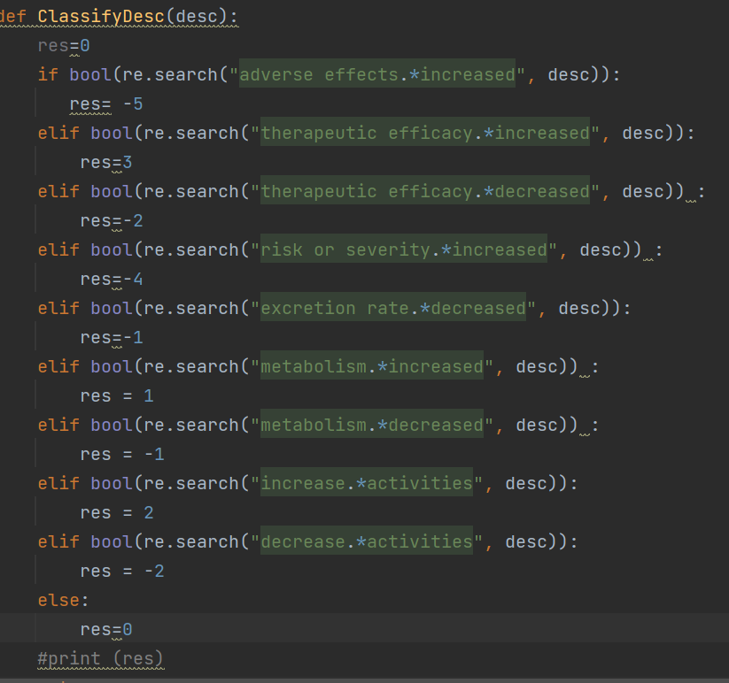
Sentimental analysis by regular expressions use

Slide 27
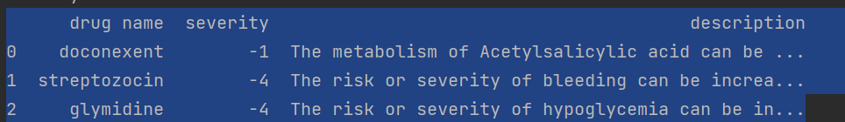
Result dataframe for doctor
Check patient constant treatment list against new drug interaction list in this case return us negative interaction with different severity.
It means, that new drug will cause to many different negative effects to specific patient. All details the doctor can get from description field, and doctor can decide to give to patient another drug with similar effect.

Slide 28
HDFS archive file structure
Parquet format Json file
CREATE EXTERNAL TABLE IF NOT EXISTS receiptarchive.ReceiptHistory(DoctorLicense String, PatientTZ String, PatientFirstName String,ConflictSExists Boolean, PatientLastName String, KupatHolim String, PtienBirthdate String, DrugName String, DrugId String, DrugDose String, dateCreated String, PatientDiseasesLqist String, PatientTreatmentsList String,
drugDrugInteractionJson String)
stored as Parquet
Location '/user/hive/warehouse/receiptarchive.db';

Slide 29
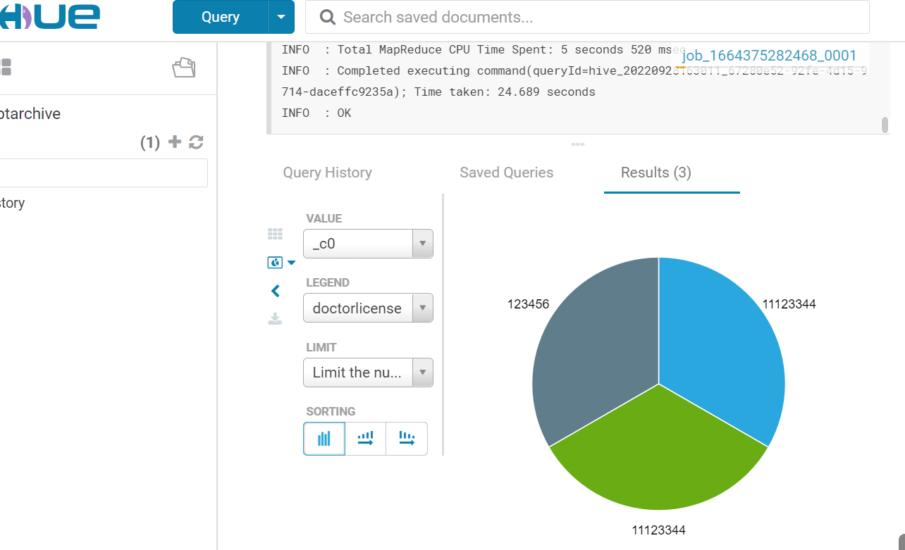
Report by Doctor License

Slide 30
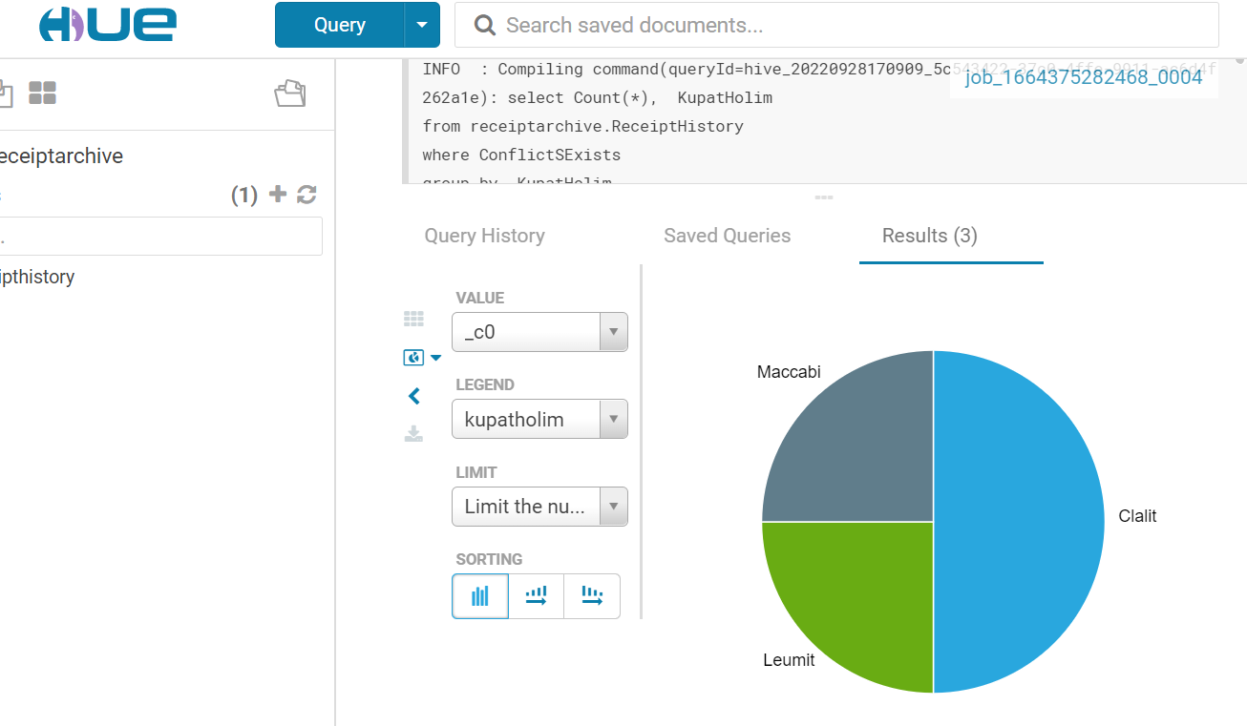
Report by Kupat Holim

Slide 31
Possible reports and analysis from archive
Report –amount of receipts with side effects and risks, which part of receipts cause negative effects to patients
Which doctor gives more drugs with serious side effects and/or risks
Which diseases are more likely to conflict with the drugs taken for other diseases and require increased doctor's caution
Etc and much more

Slide 32
Nice to have
This project theme is only drug-grug interaction check for adding new medicine for a specific patient (from patient’s health history).
Expanding the process to new drug check for patient diagnosis list interaction(drug-diseases interaction), will allow to find the optimal drug and prevent medical malpractice.

Slide 33

“Primum non nocere!”
This Latin phrase means "first, do no harm”. It is one of the principal precepts of bioethics that all students in healthcare are taught in school and is a fundamental principle throughout the world.

