Slide 1
QUIZ GAME on C language
By: KATKURI SANDEEP KUMAR-17N31A05A3. CHAITANYA-17N31A0568.
GOGINENI VENKATA ATEET-17N31A0566. ROHITH -17N31A0599
THARUN -17N31A05A1.

Slide 2
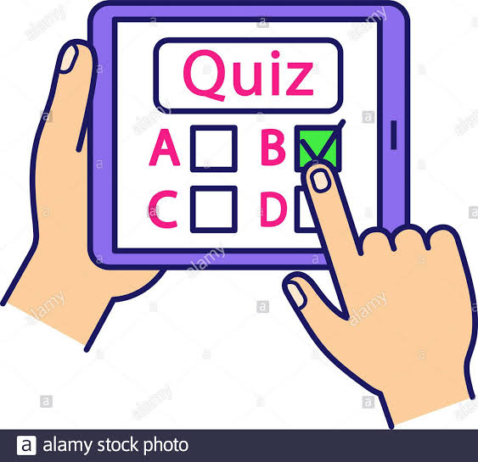

Slide 3
Introduction:
A quiz is a form of game or mind sport, in which the players (as individuals or in teams) attempt to answer questions correctly. It is a game to test your knowledge about a certain subject.
In some countries, a quiz is also a brief assessment used in education and similar fields to measure growth in knowledge, abilities, and/or skills.
Quizzes are usually scored in points and many quizzes are designed to determine a winner from a group of participants – usually the participant with the highest score.

Slide 4
History:
The first attested use of the word is from 1781[1] and means an odd person.
This sense survives today in the word quizzical. It was also used in the term quizzing glass, a common accoutrement of British Regencydandies.
It later acquired a meaning of to make fun of, or to mock. How it acquired its current meaning of a test is unknown, but that sense did not appear until 1867 and then it was in the United States.
The Oxford English Dictionary attests the use of the verb quiz to mean "to question or interrogate", with a reference from 1843

Slide 5
Purpose:
A quiz can function throughout a course as an informative feedback device allowing both the instructor and the students to see where they are excelling or need more focus.
In order to effectively create exams and quizzes, it is important to establish and understand the learning objectives that are being measured.

Slide 6
Advantages:
Quiz competitions enables students to think from different angles or simply ‘to think out of the box
It promotes a healthy debate amongst participants in order to learn from each other
Quiz competitions are used in Schools and Universities to aid in language development and in particular subject areas of study
Aiding in language development with the questions based in the language alone
Quiz competitions even help build the student’s soft skills.

Slide 7
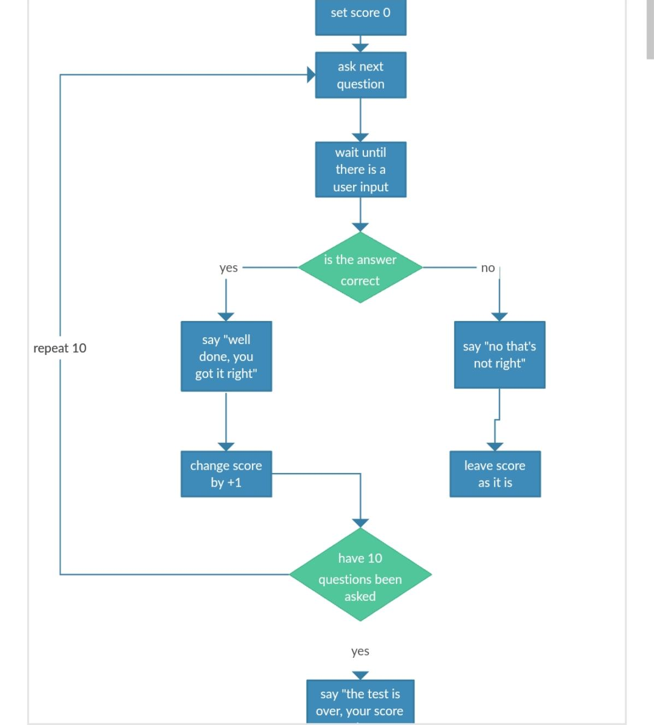
Flow chart:

Slide 8
Design algorithm:
ALGORITHM
step-1: START
step-2: ENETR THE DETAILS OF CONTEESTENTS
step-3: EDIT SCORE
step-4: HELP
step-5: RESET SCORE
step-6: SHOW RECORD
step-7: SHOW SCORE
step-8: STOP

Slide 9
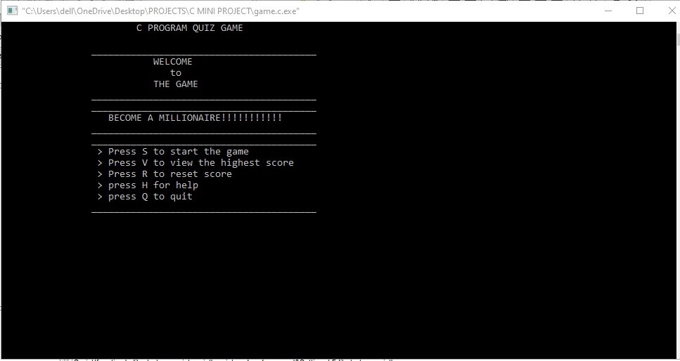
IN TERMINAL:

Slide 10
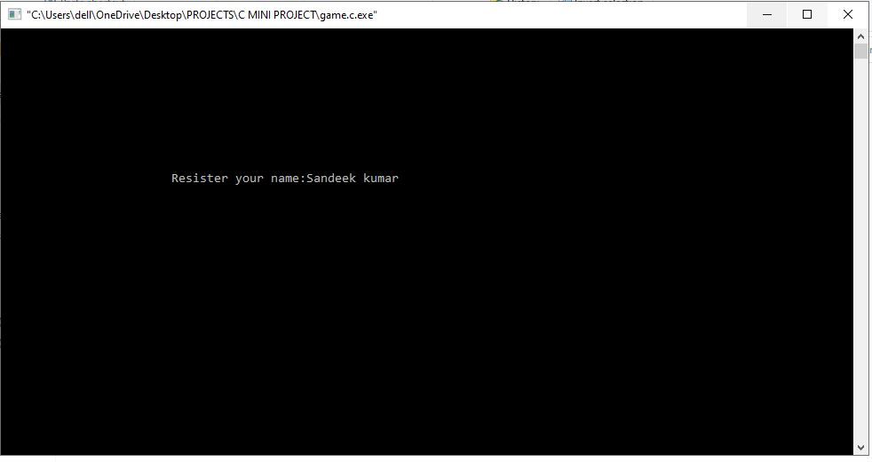
We need to enter name:

Slide 11
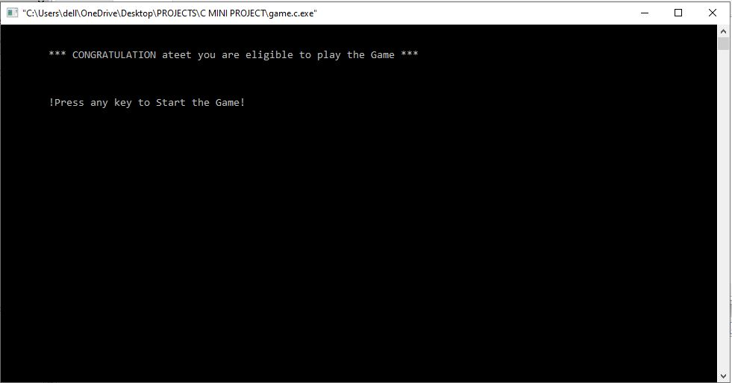
After registration in game by your name:

Slide 12
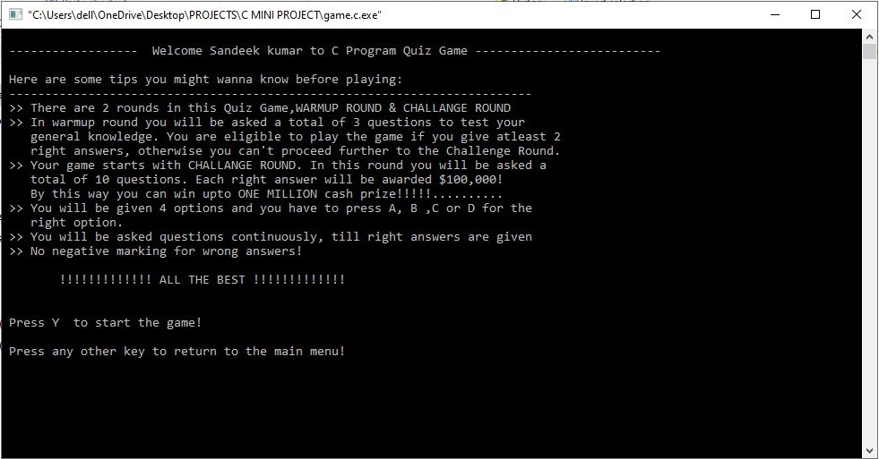
Instructions after registration to play the game:

Slide 13
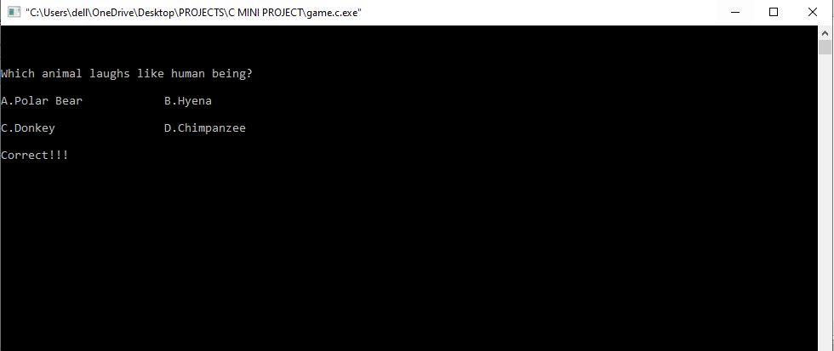
Questions:

Slide 14
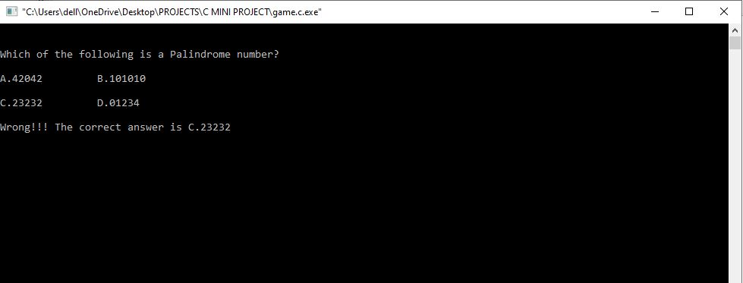
When you enter wrong answer:

Slide 15
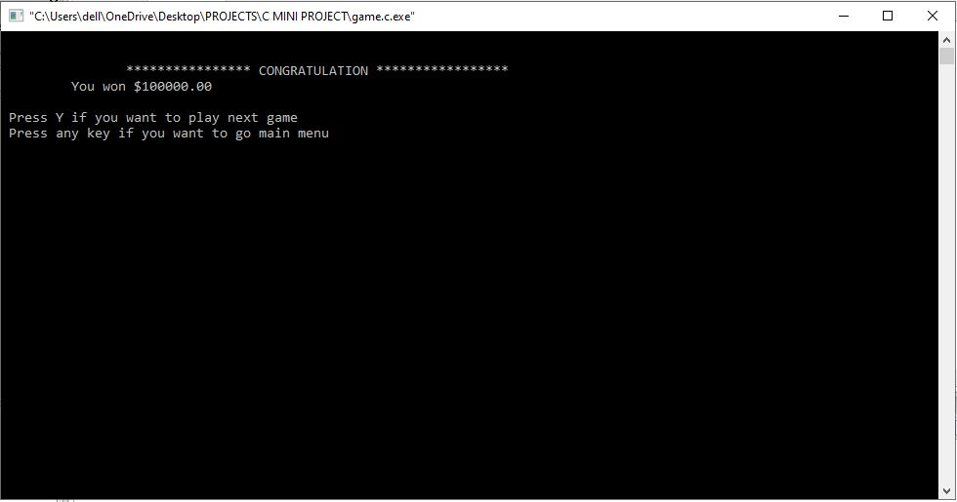
If you win the game:

Slide 16
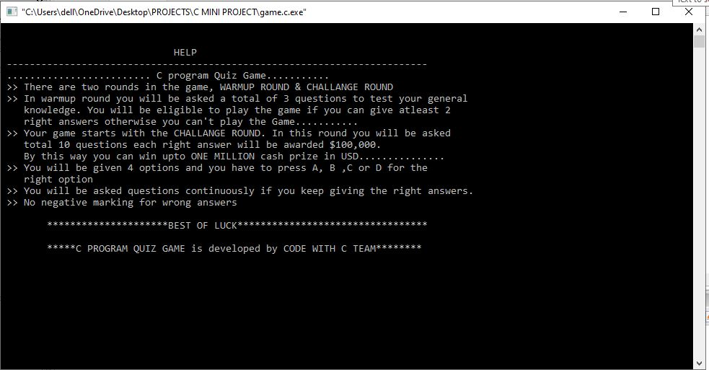
Help center:

Slide 17


