Slide 1
PICTURE DIFFERENCE RECOGNISATION
By : KOTHA MONIKA -17N31A05B6
. KATKURI SANDEEP KUMAR-17N31A05A3
GOGINENI VENKATA ATEET-17N31A0566

Slide 2
INTRODUCTION:
Using this method, we were able to easily determine if two images were identical or had differences due to slight image manipulations, compression artifacts, or purposeful tampering.
In manufacturing industries, images are commonly used for quality control purposes. In such applications, if the quality of the products is good, then their images should be all similar to the image of a good-quality product. Therefore, comparison of images is a fundamental task in image-based quality control

Slide 3
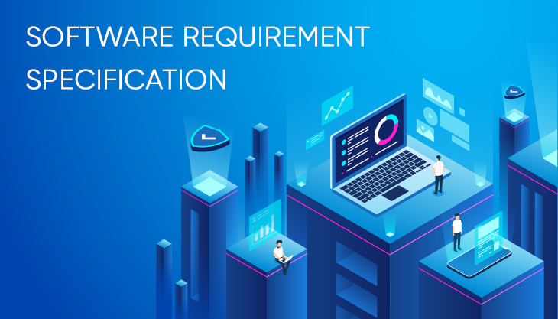

Slide 4
SOFTWARE REQUIREMENTS:
To accomplish this, we’ll first need to make sure our system has :
Python
OpenCVV
T-image-image
Imutils.

Slide 5
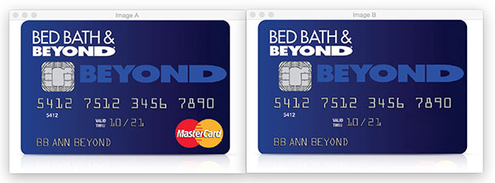
COMPUTING IMAGE DIFFERENCE:
If you take a second to study the two credit cards, you’ll notice that the MasterCard logo is present on the left image but has been Photoshopped out from the right image.
You may have noticed this difference immediately, or it may have taken you a few seconds. Either way, this demonstrates an important aspect of comparing image differences — sometimes image differences are subtle — so subtle that the naked eye struggles to immediately comprehend the difference (we’ll see an example of such an image later in this blog post).

Slide 6
So why is computing image differences so important?
One example is phishing. Attackers can manipulate images ever-so-slightly to trick unsuspecting users who don’t validate the URL into thinking they are logging into their banking website — only to later find out that it was a scam.
Comparing logos and known User Interface (UI) elements on a webpage to an existing dataset could help reduce phishing attacks (a big thanks to Chris Cleveland for passing along as an example of applying computer vision to prevent phishing)
Developing a phishing detection system is obviously much more complicated than simple image differences, but we can still apply these techniques to determine if a given image has been manipulated.

Slide 7
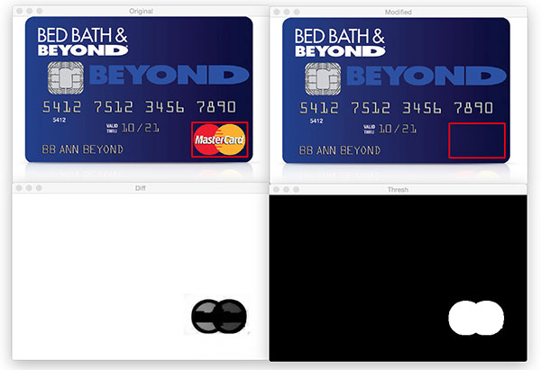
This computing cannot be done by humans:

Slide 8
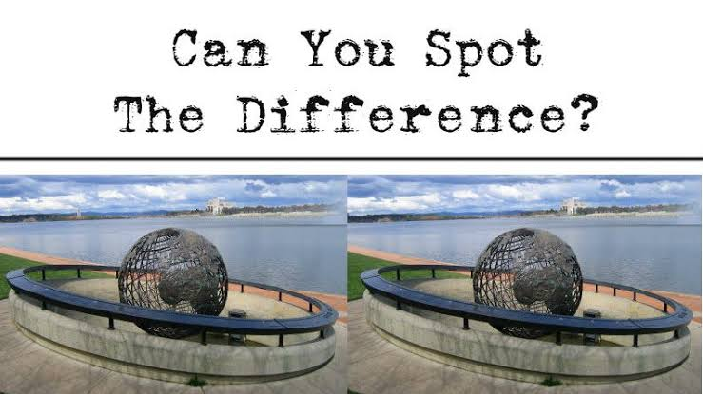
Can you????

Slide 9
Conclusion:
Hence, this paper tells us the approach to locate the image differences using OpenCV, Python, and scikit-image’s Structural Similarity Index (SSIM). Based on this image difference approach the manipulation of cards can be identified and in manufacture industry the work of identifying the good quality products can be recognised using this approach which will be beneficial .

Slide 10


