Slide 1
Pig
Chapter 11

Slide 2
Learning Objectives
  Defining and Running Pig
  Pig Latin
  User-Defined Functions
  Data Processing Operators
  Pig in Practice

Slide 3
What Is Pig – 1
  Pig is a scripting language for exploring large datasets.
  Pig is made up of two pieces:
  The language used to express data flows, called Pig Latin.
  The execution environment to run Pig Latin programs.
  There are currently two environments:
  Local execution in a single JVM
  Distributed execution on a Hadoop cluster.

Slide 4
What Is Pig – 2
  Pig can process terabytes of data simply by issuing a half-dozen lines of Pig Latin from the console.
  Pig is very supportive of a programmer writing a query.
  Pig is designed to be extensible.
  Pig is designed to process large portions of a large dataset.
  The execution environment to run Pig Latin programs.

Slide 5
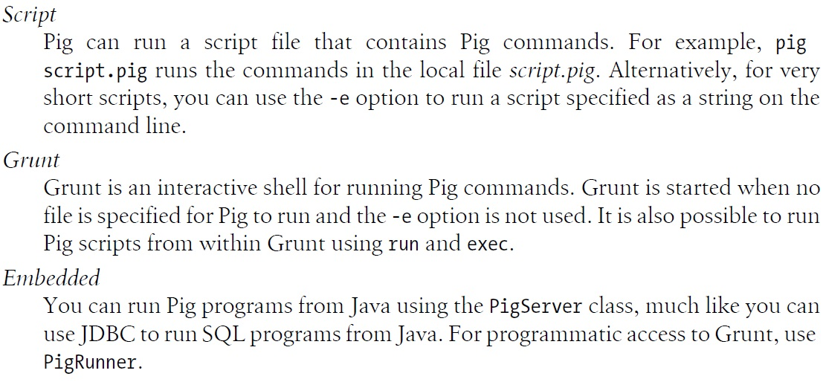
Run Pig

Slide 6
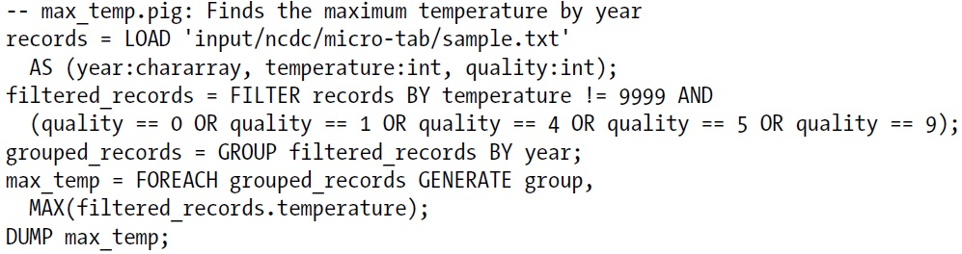
A Pig Example – p. 371

Slide 7
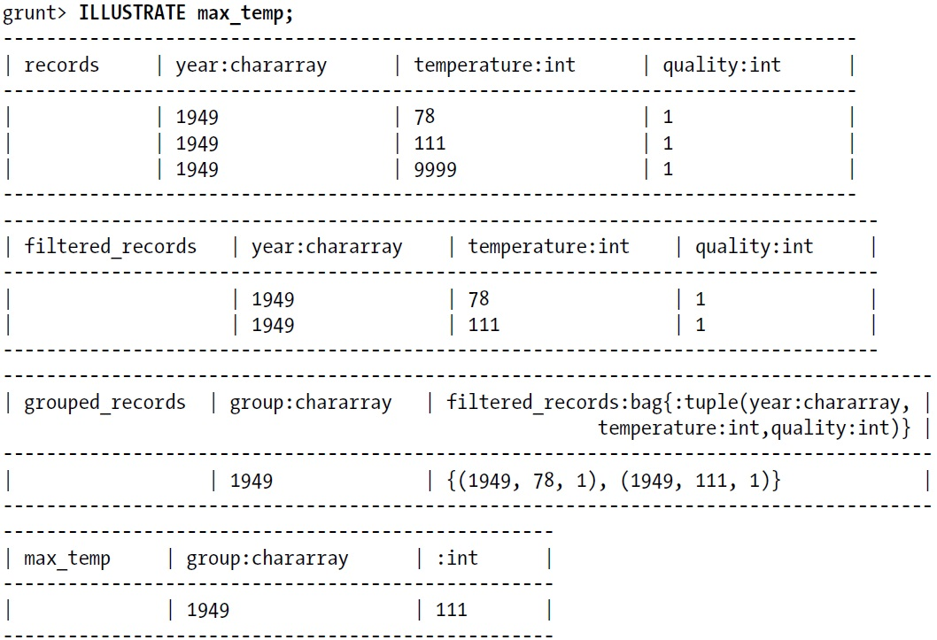
Illustrate

Slide 8
Pig/Pig Latin vs. Relational/SQL
  Difference between Pig Latin and SQL:
  Pig Latin is a data flow programming language, whereas SQL is a declarative programming language.
  RDBMSs store data in tables, with tightly predefined schemas; Pig is more relaxed about the data that it processes: you can define a schema at runtime.
  Pig’s support for complex, nested data structures differentiates it from SQL, which operates on flatter data structures.
  RDBMSs have several features to support online, low-latency queries, such as transactions and indexes, that are absent in Pig.

Slide 9
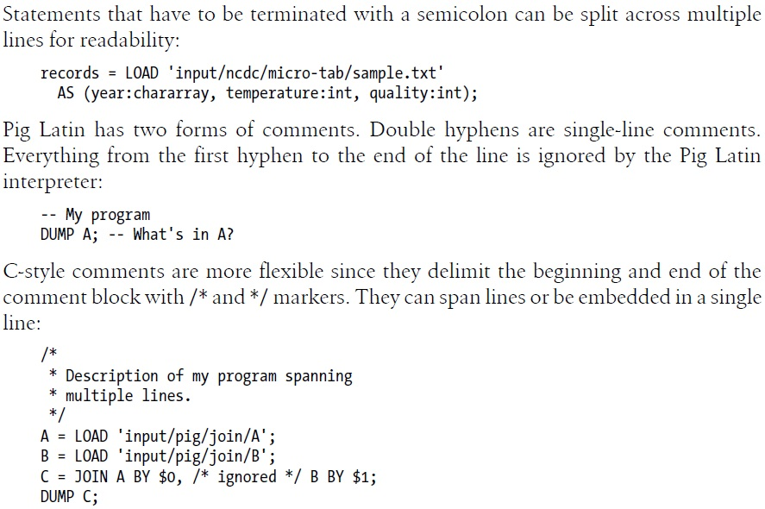
Pig Latin – Structure

Slide 10
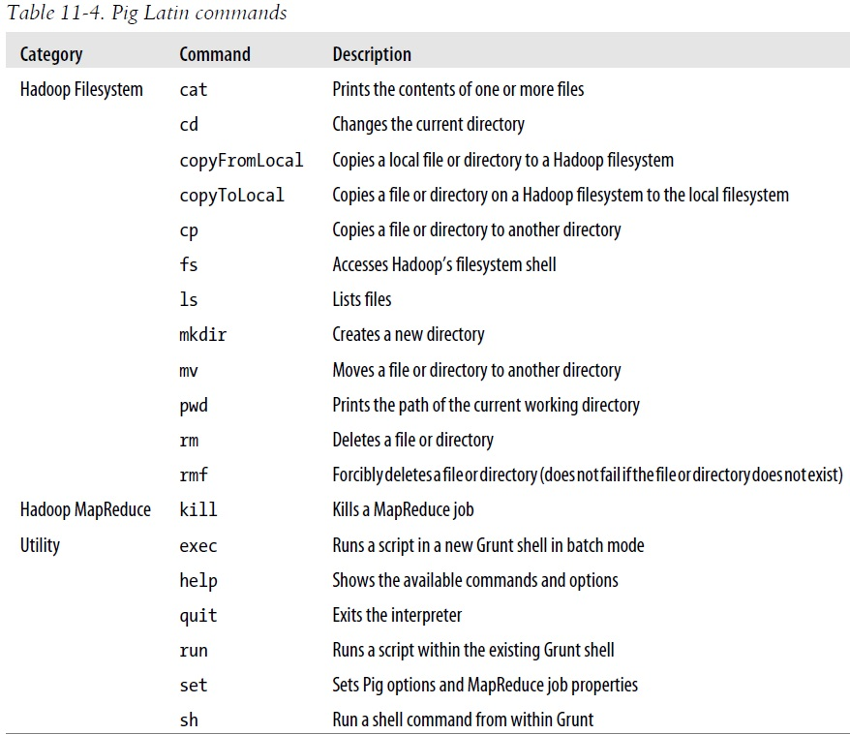
Pig Latin Commands

Slide 11
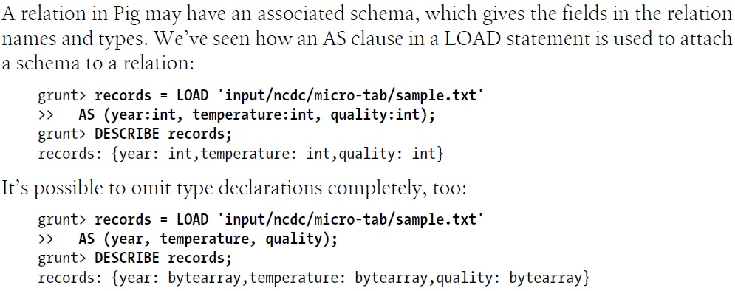
Pig Latin Schemas – 1

Slide 12
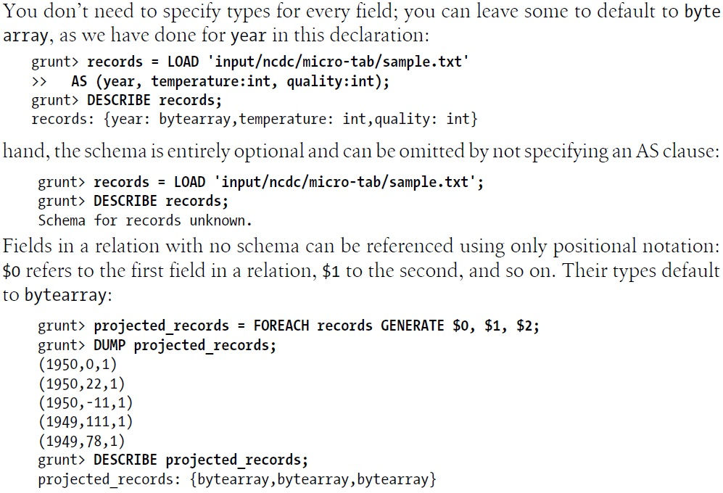
Pig Latin Schemas – 2

Slide 13
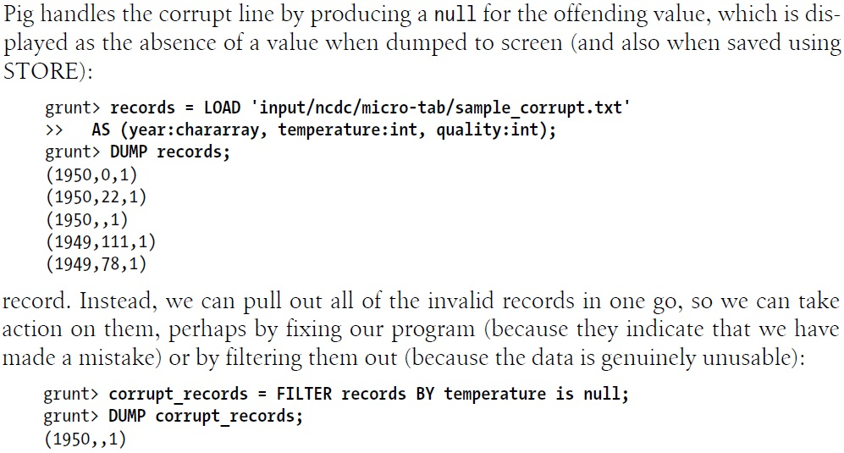
Validation and Nulls – 1

Slide 14
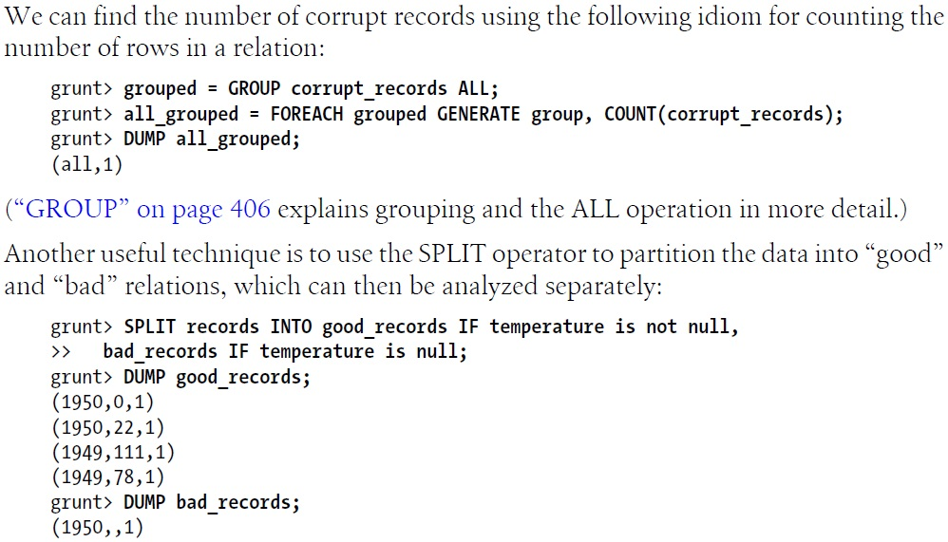
Validation and Nulls – 2

Slide 15
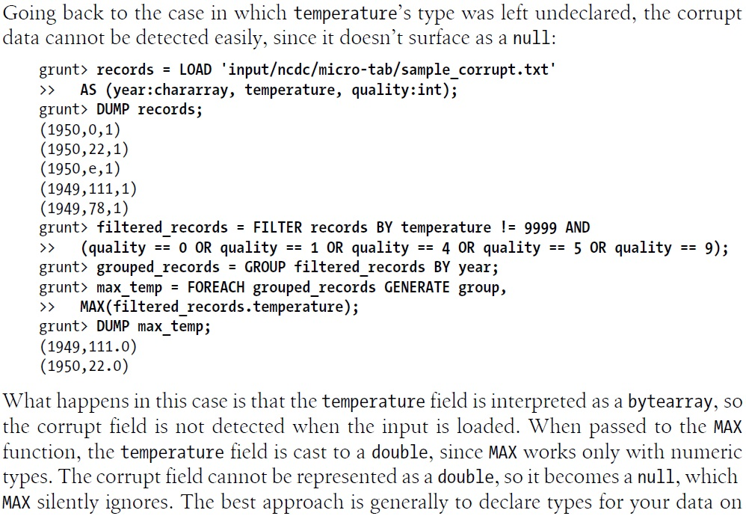
Validation and Nulls – 3

Slide 16
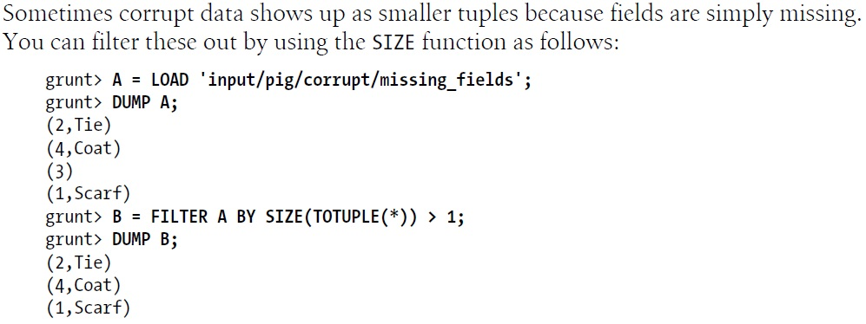
Validation and Nulls – 4

Slide 17
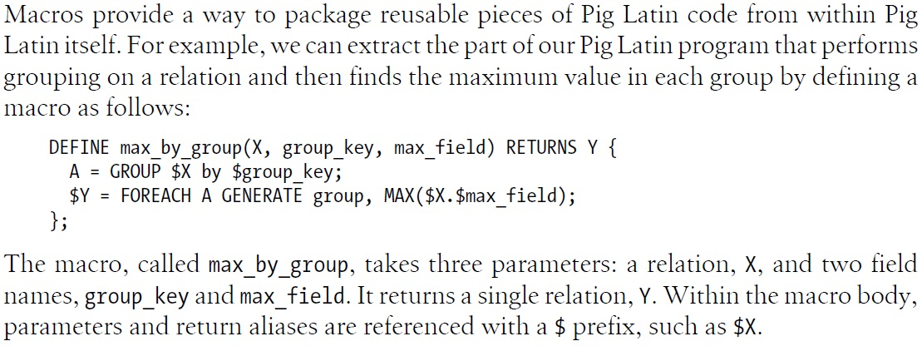
Macros – 1

Slide 18
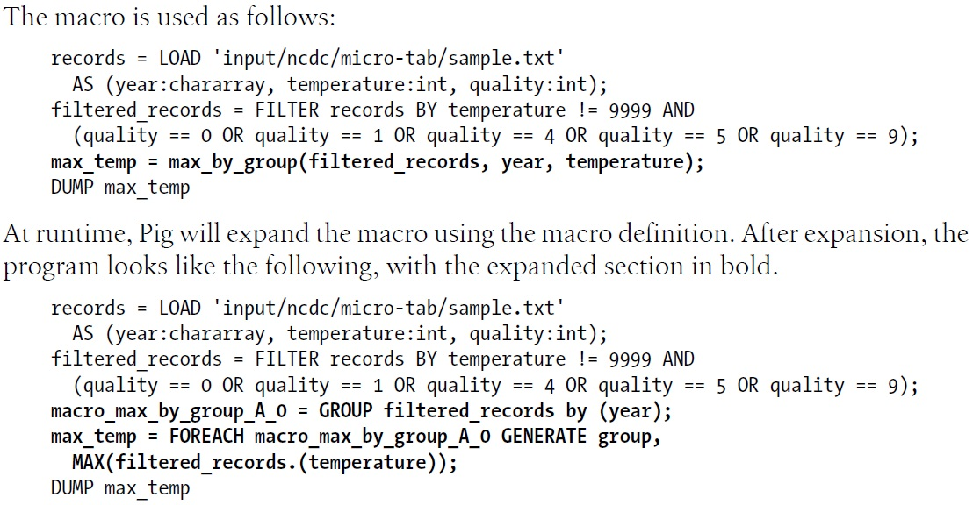
Macros – 2

Slide 19
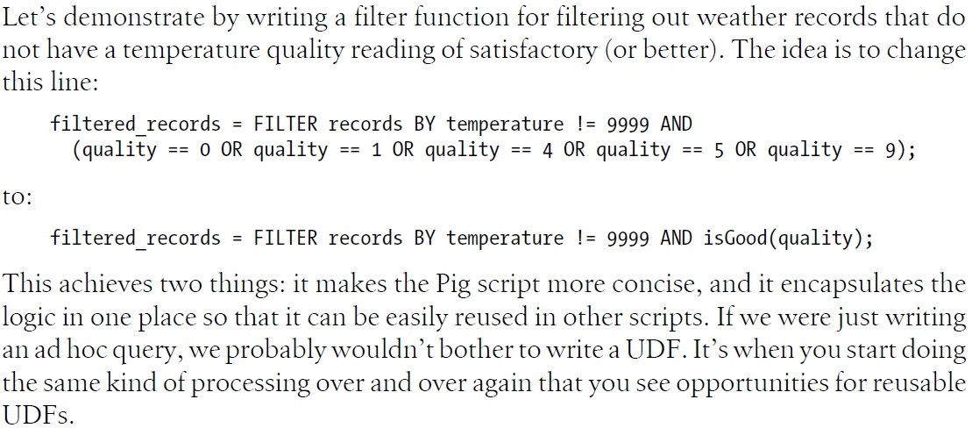
A User-Defined Filter – 1

Slide 20
A User-Defined Filter – 2
  P. 392: Example 11-1

Slide 21
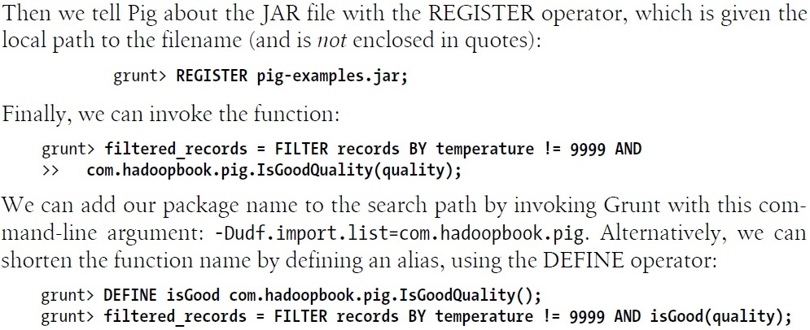
A User-Defined Filter – 3

Slide 22
Three User-Defined Functions
  P. 394: An Eval UDF
  P. 396: A Load UDF
  P. 400: Filtering Data

Slide 23
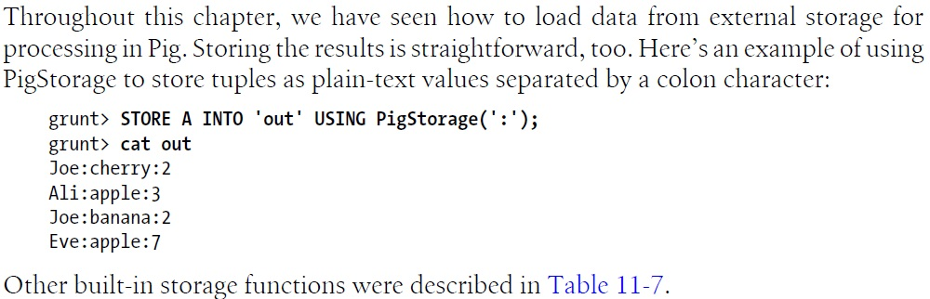
Loading and Storing Data

Slide 24
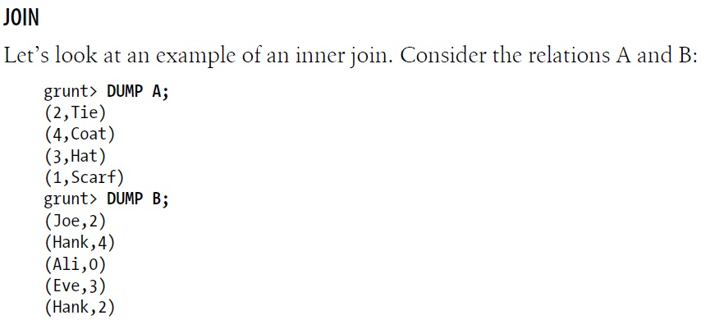
JOIN – 1

Slide 25
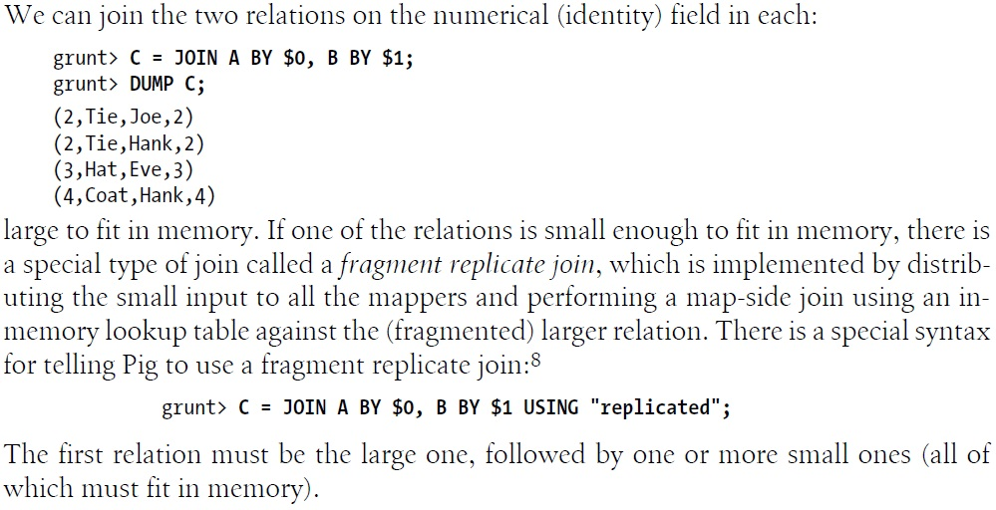
JOIN – 2

Slide 26
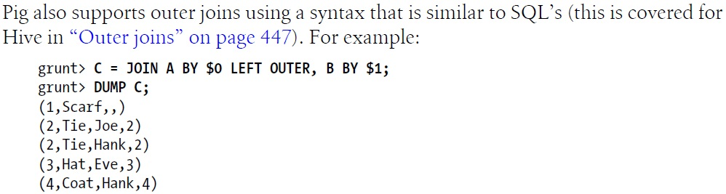
JOIN – 3

Slide 27
More Features
  P. 404: More Examples
  P. 405: Cross
  P. 406: Group
  P. 407: Sorting Data
  P. 408: Combining and Splitting data

Slide 28
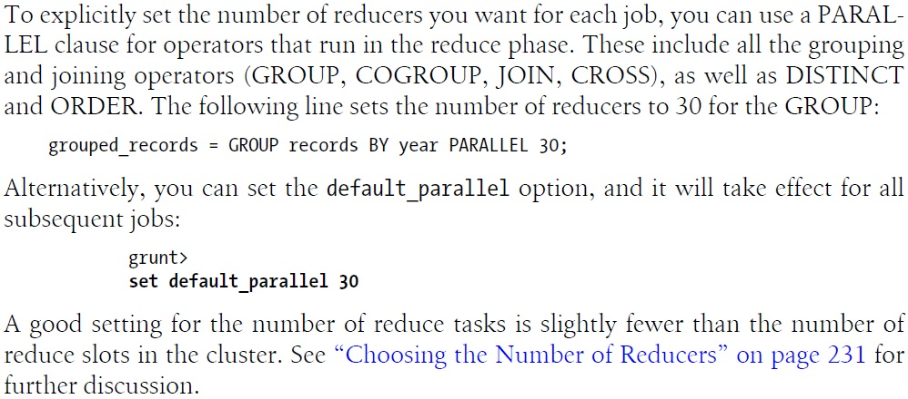
Parallelism

Slide 29
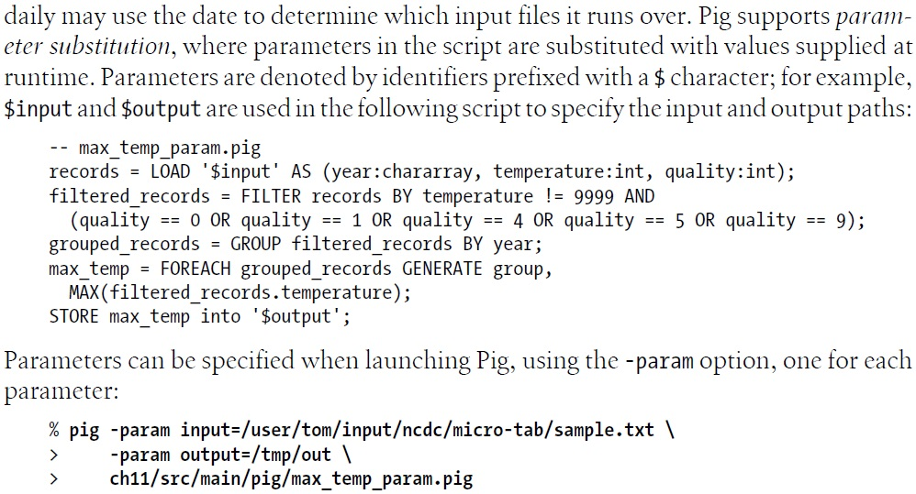
Parameter Substitution

