Slide 1
Hive
Chapter 12

Slide 2
Learning Objectives
  Defining and Running Hive
  Hive vs. Traditional Databases
  HiveQL
  Tables
  Querying Data
  User-Defined Functions

Slide 3
What Is Hive
  Hive is a framework for data warehousing on top of Hadoop.
  Hive grew from a need to manage and learn from the huge volumes of data that Facebook was producing every day.
  Hive allows analysts with strong SQL skills to run queries on the huge volumes of data.
  Today, Hive is a successful Apache project used by many organizations as a general-purpose, scalable data processing platform.

Slide 4
The Hive Shell
  The shell is the primary way that we will interact with Hive, by issuing commands in HiveQL.
  HiveQL is Hive’s query language, a dialect of SQL.
  Like SQL, HiveQL is generally case-insensitive (except for string comparisons).
  When starting Hive for the first time, we can check that it is working by listing its tables:
    hive> SHOW TABLES;
    OK
    Time taken: 10.425 seconds

Slide 5
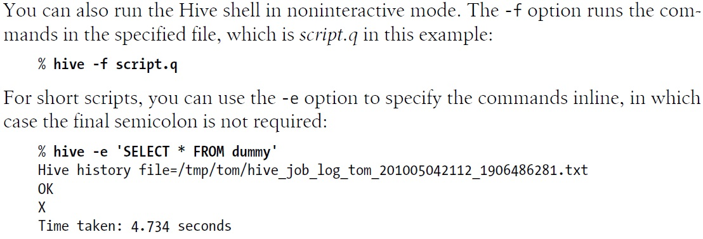
Hive –f and –e Options

Slide 6
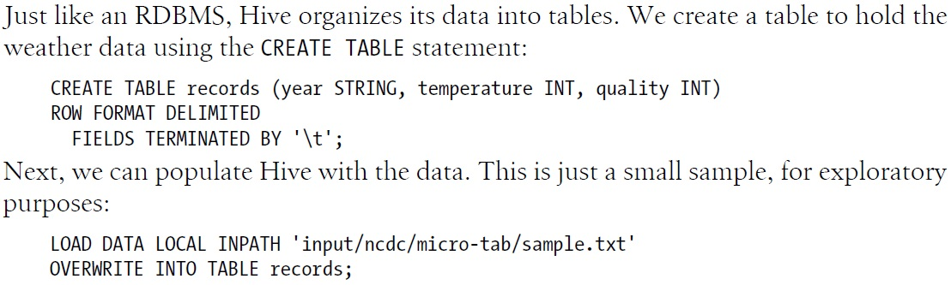
A Hive Example – 1

Slide 7
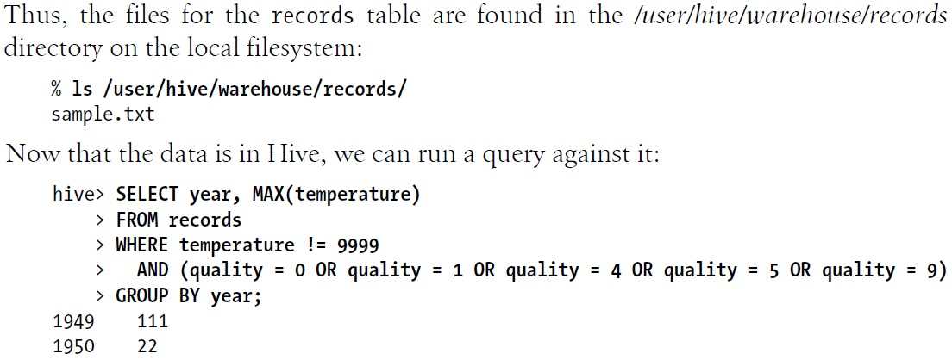
A Hive Example – 2

Slide 8
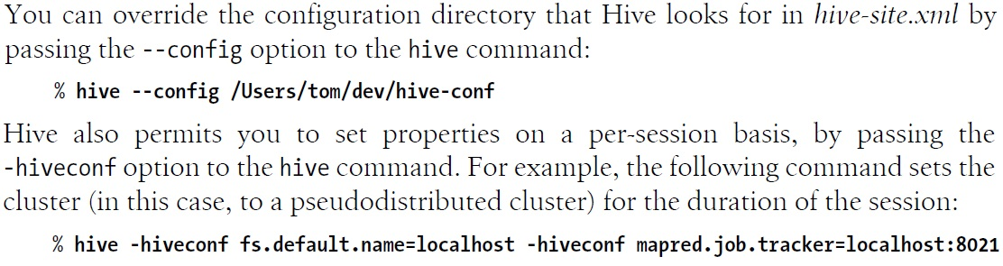
Configuring Hive – 1

Slide 9
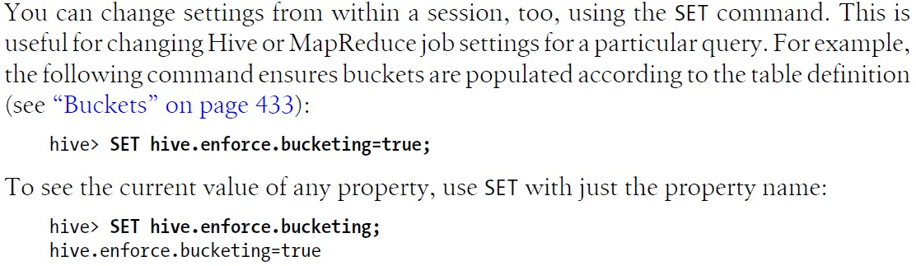
Configuring Hive – 2

Slide 10
Schema on Read vs. Schema on Write
  Schema on read – doesn’t verify the data when it is loaded, but rather when a query is issued.
  Makes for a very fast initial load, since the data does not have to be read, parsed, and serialized to disk in the database’s internal format.
  Schema on write – data is checked against the schema when it is written into the database.
  Makes query time performance faster because the database can index columns and perform compression on the data.
  Takes longer to load data into the database.

Slide 11
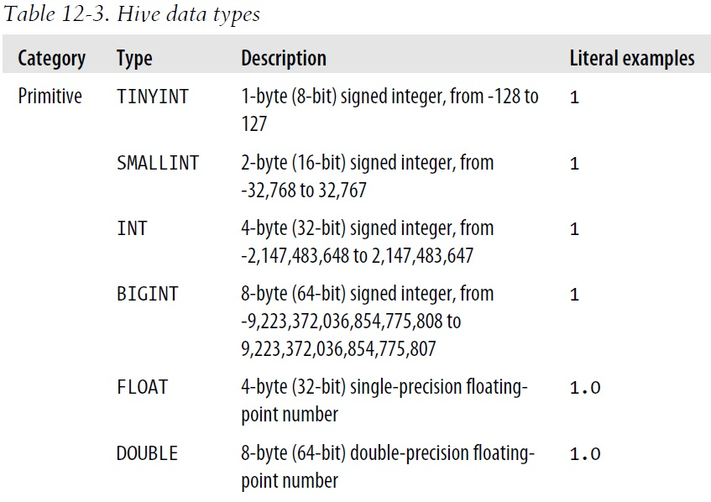
Hive Data Types – 1

Slide 12
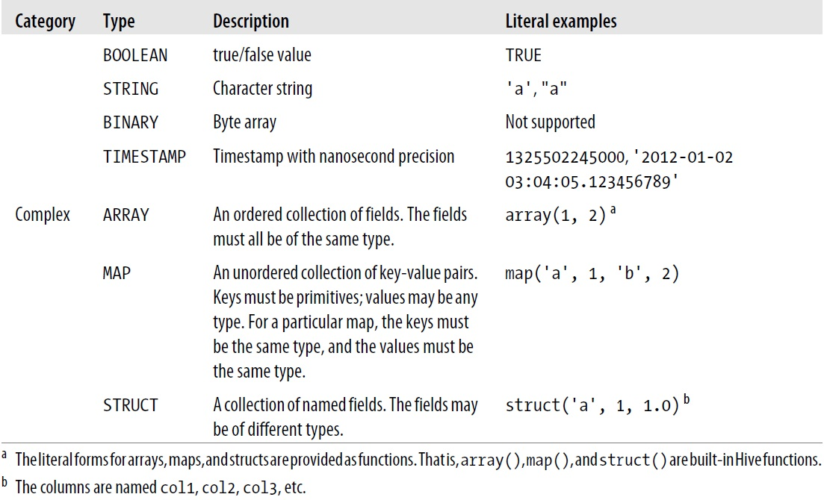
Hive Data Types – 2

Slide 13
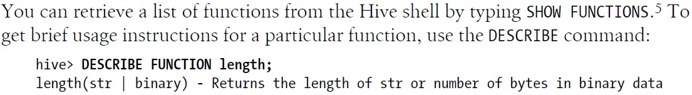
Functions
  Hive comes with a large number of built-in functions.
  Mathematical and statistical functions
  String functions
  Date functions
  Conditional functions
  Aggregate functions
  Functions for working with XML.

Slide 14
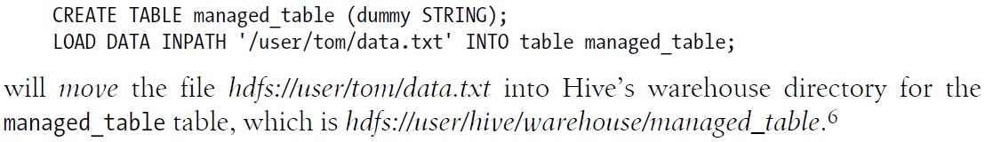
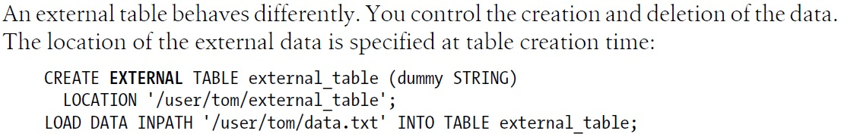
Managed Table vs. External Table
  Managed table is in Hive’s warehouse directory, whereas external table is at an existing location outside the warehouse directory.

Slide 15
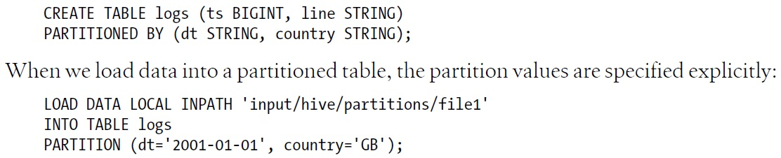
Partitions – 1
  Hive organizes tables into partitions, a way of dividing a table into parts based on the value of a partition column, such as a date.
  A table may be partitioned in multiple dimensions.
  Tables or partitions may be subdivided further into buckets to give extra structure to the data for more efficient queries.
  Partitions are defined at table creation time using the PARTITIONED BY clause.

Slide 16
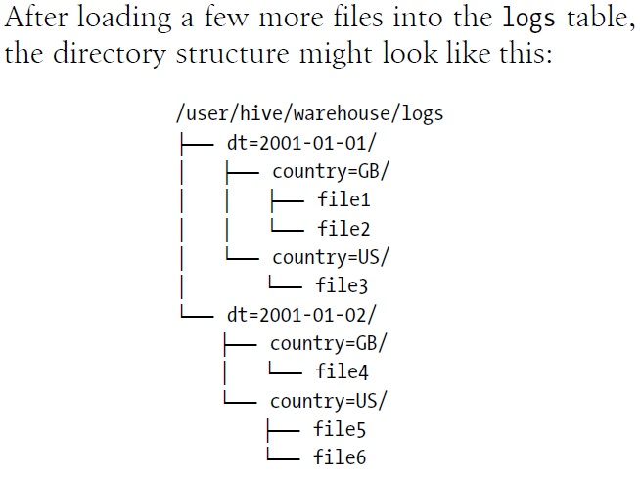
Partitions – 2

Slide 17
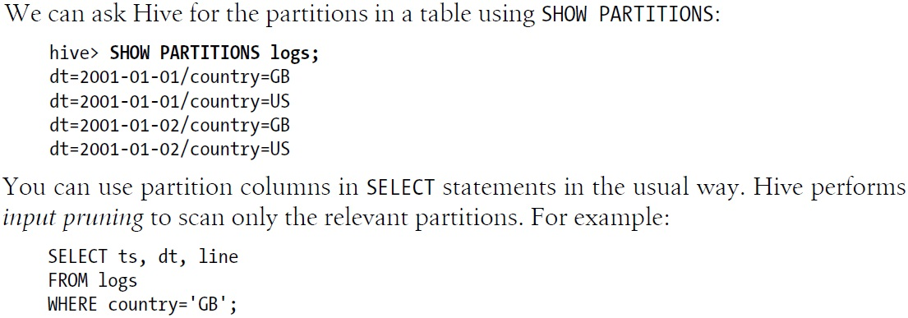
Partitions – 3

Slide 18
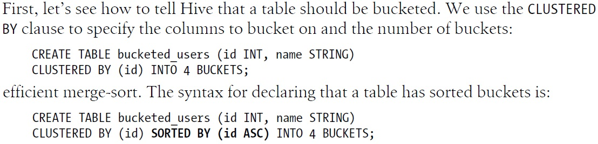
Bucket – 1

Slide 19
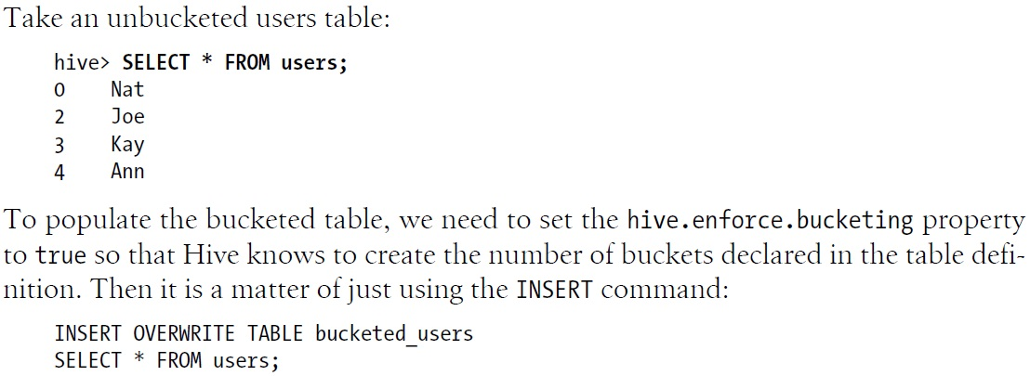
Bucket – 2

Slide 20
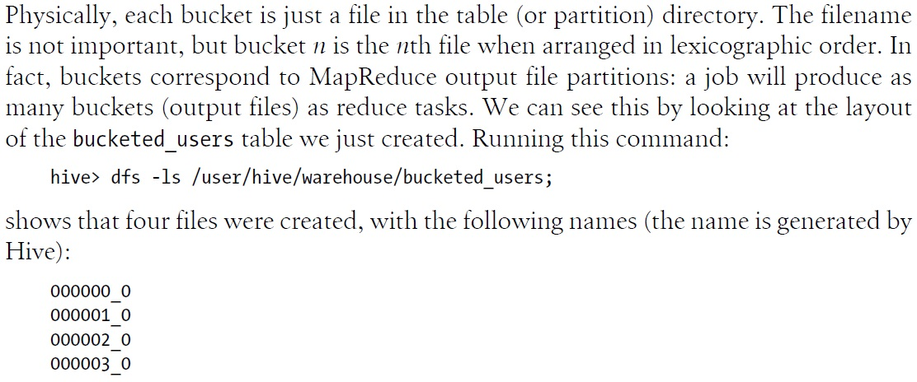
Bucket – 3

Slide 21
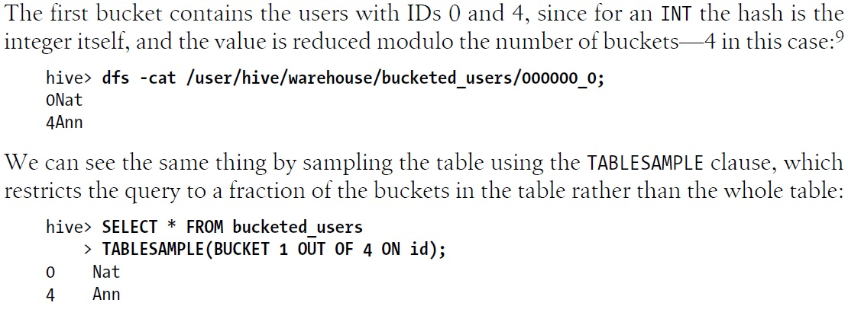
Bucket – 4

Slide 22
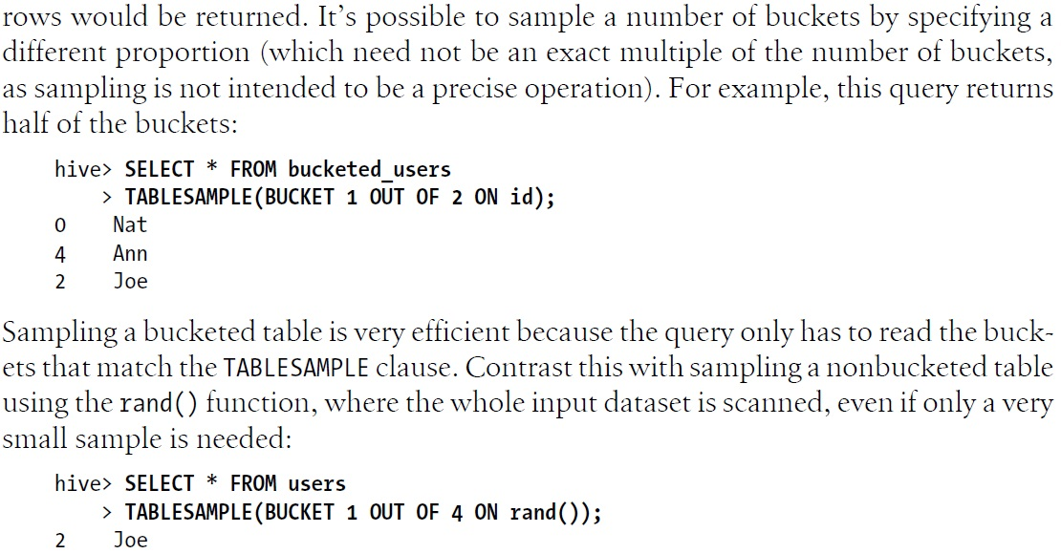
Bucket – 5

Slide 23
Storage Formats – 1
  There are two dimensions that govern table storage in Hive: the row format and the file format.
  The row format dictates how rows, and the fields in a particular row, are stored.
  In Hive parlance, the row format is defined by a SerDe, a portmanteau word for a Serializer-Deserializer.
  When you create a table with no ROW FORMAT or STORED AS clauses, the default format is delimited text with one row per line.

Slide 24
Storage Formats – 2
  When acting as a deserializer, which is the case when querying a table, a SerDe will deserialize a row of data from the bytes in the file to objects used internally by Hive to operate on that row of data.
  When used as a serializer, which is the case when performing an INSERT or CTAS (see “Importing Data” on page 441), the table’s SerDe will serialize Hive’s internal representation of a row of data into the bytes that are written to the table.

Slide 25
Sequence Files
  Hadoop’s sequence file format (see “SequenceFile” on page 130) is a general-purpose binary format for sequences of records (key-value pairs).
  Sequence files in Hive can be declared using STORED AS SEQUENCEFILE in the CREATE TABLE statement.
  Sequence files support for splittable compression.
  Sequence files are row-oriented, that is, the fields in each row are stored together as the contents of a single sequence-file record.

Slide 26
Avro Files and RCFile
  Avro datafiles are like sequence files (splittable, compressible, row-oriented), except they have support for schema evolution and bindings in multiple languages (see “Avro” on page 110).
  Hive provides another binary storage format called RCFile, short for Record Columnar File.
  RCFiles are similar to sequence files, except that they store data in a column-oriented fashion.
  RCFile breaks up the table into row splits, then within each split stores the values for each row in the first column, followed by the values for each row in the second column, and so on.

Slide 27
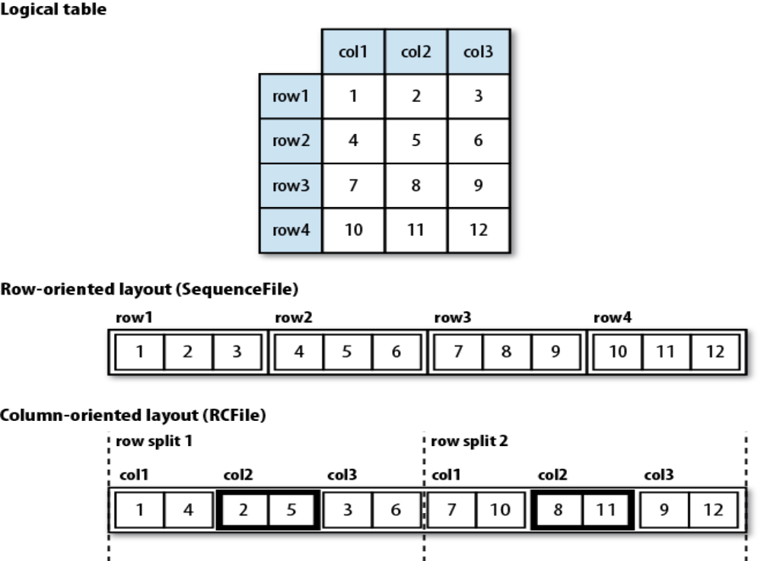
Row-Oriented vs. Column-Oriented Storage

Slide 28
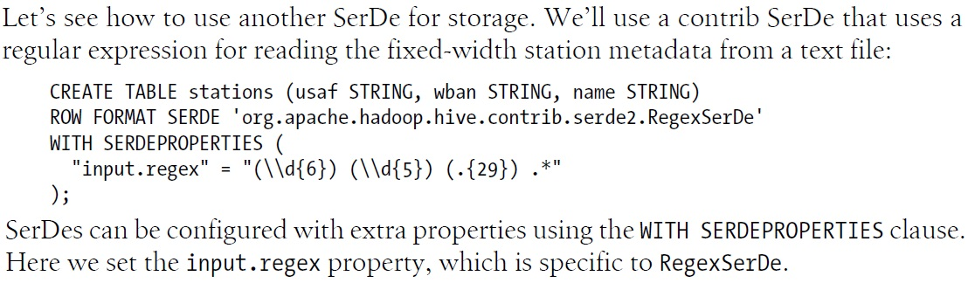
RegexSerDe – 1

Slide 29
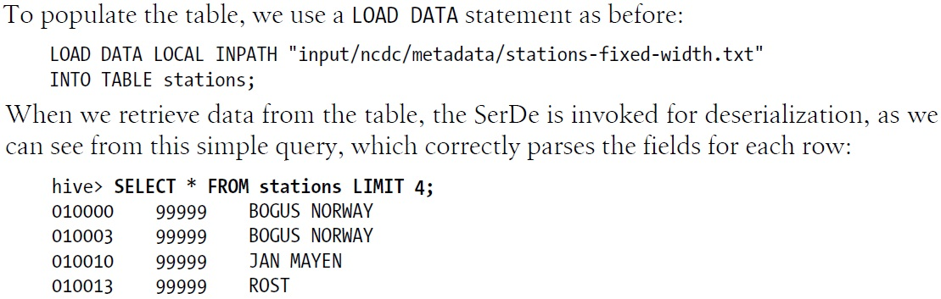
RegexSerDe – 2

Slide 30
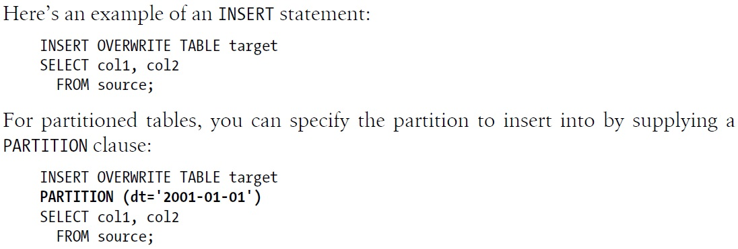
Insert – 1

Slide 31
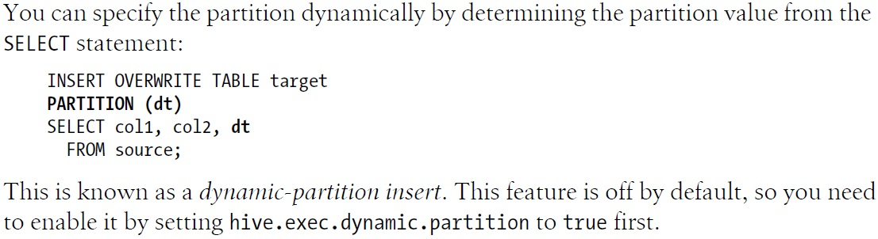
Insert – 2

Slide 32
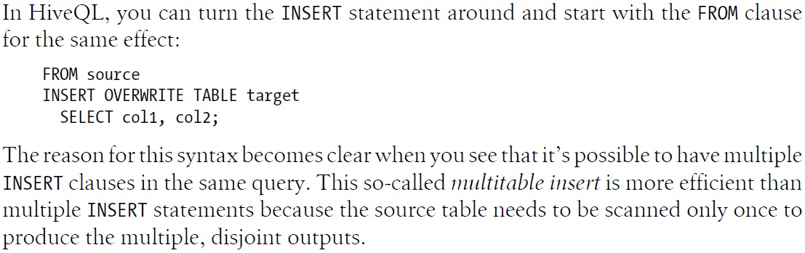
Insert Statement Turn-Around

Slide 33
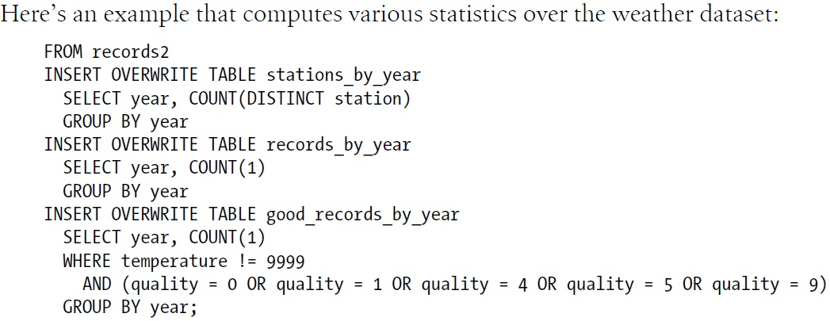
Multitable Insert

Slide 34
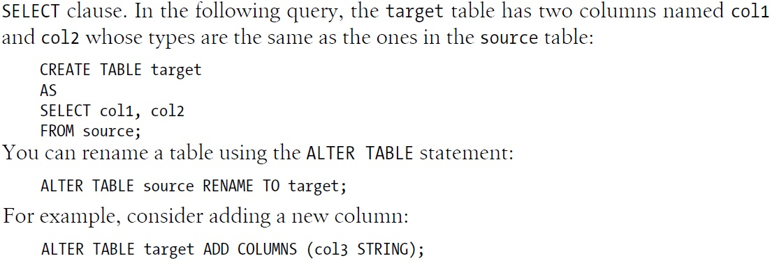
Create and Alter

Slide 35
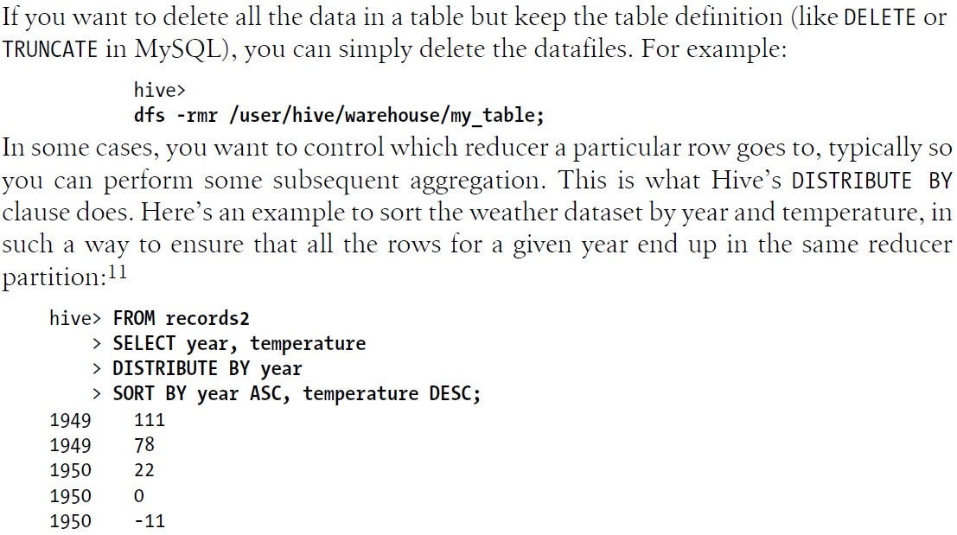
Drop and Select

Slide 36
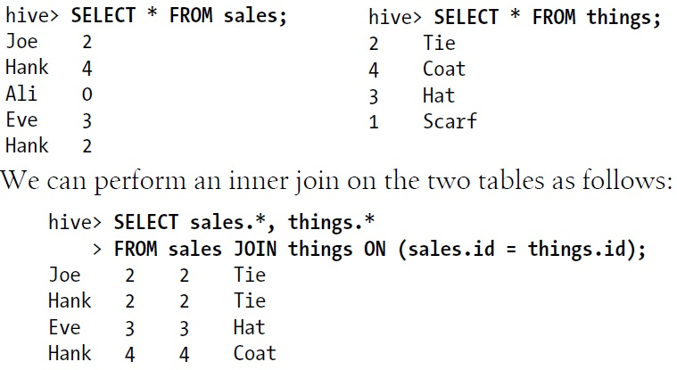
Inner Join

Slide 37
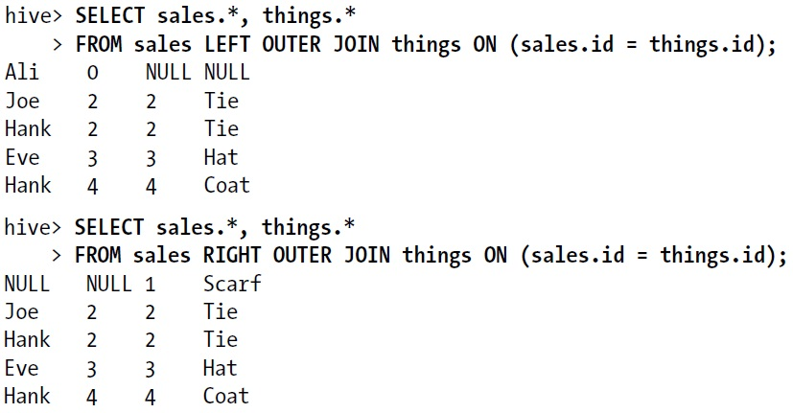
Outer Join – 1

Slide 38
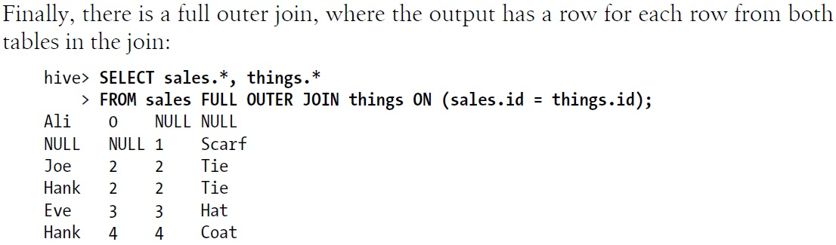
Outer Join – 2

Slide 39
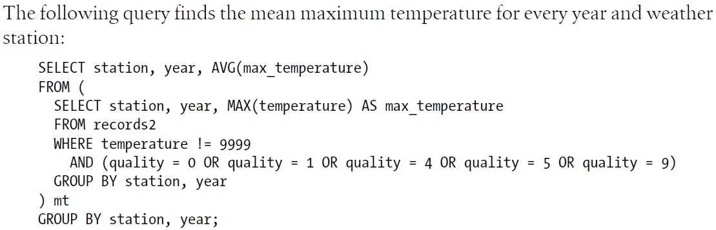
Subqueries

Slide 40
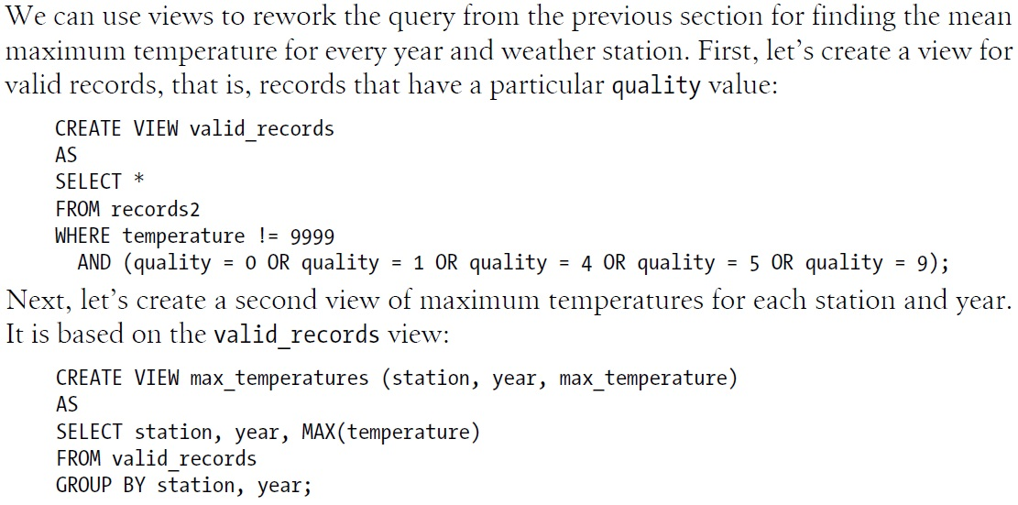
Views – 1

Slide 41
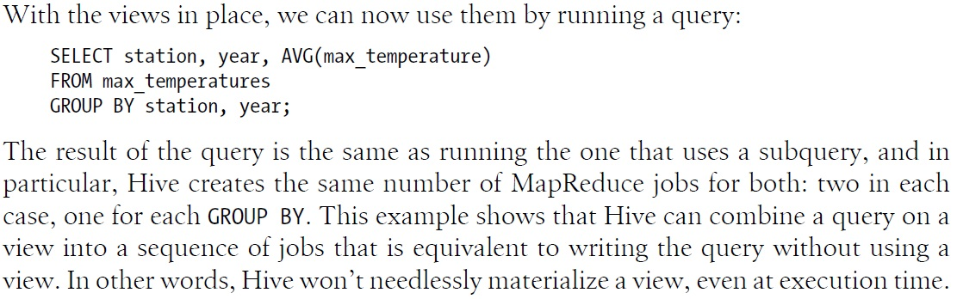
Views – 2

Slide 42
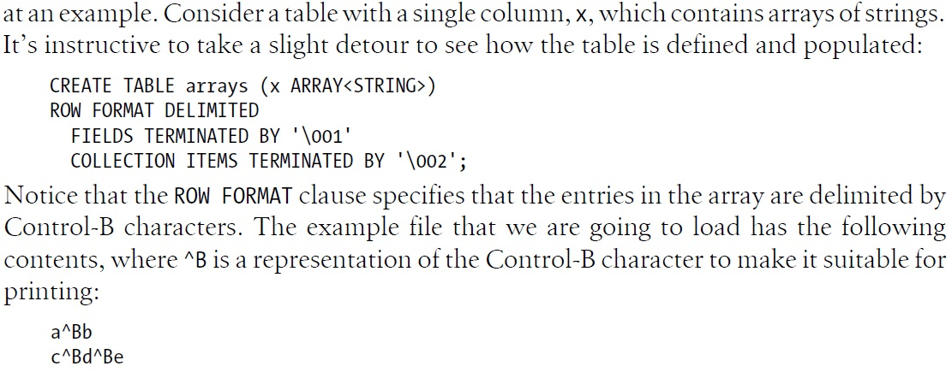
User-Defined Functions – 1

Slide 43
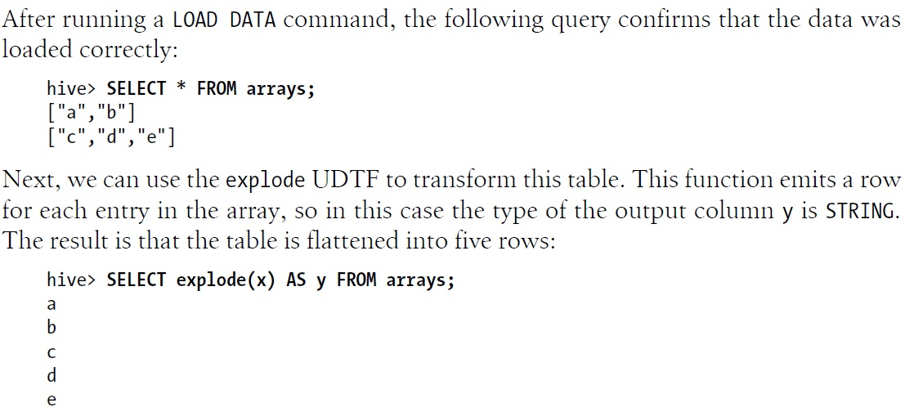
User-Defined Functions – 2

Slide 44
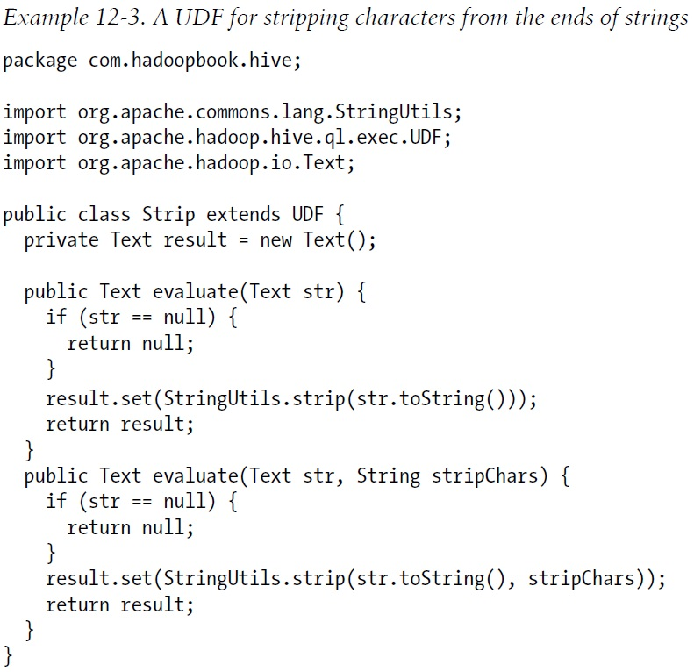
User-Defined Functions – 3

Slide 45
User-Defined Functions – 4
  Two User-Defined Aggregate Functions: P. 454 and P. 457

