Slide 1
HBase, ZooKeeper, and Sqoop
Chapters 13, 14 & 15

Slide 2
Learning Objectives
  Introduce HBase
  Introduce ZooKeeper
  Introduce Sqoop

Slide 3
What Is HBase
  HBase is a distributed column-oriented database built on top of HDFS.
  HBase is used for real-time read/write random access to very large datasets.
  HBase is not relational and does not support SQL.
  Hbase can do what an RDBMS cannot: host very large, sparsely populated tables on clusters.

Slide 4
Column Family
  Row columns are grouped into column families and all column family members have a common prefix.
  The columns temperature:air and temperature:dew_point are both members of the temperature column family.
  Whereas station:identifier belongs to the station family.
  The column family prefix must be composed of printable characters. The qualifying tail and the column family qualifier can be made of any arbitrary bytes.

Slide 5
Regions
  Tables are automatically partitioned horizontally by HBase into regions.
  Each region comprises a subset of a table’s rows.
  A region is denoted by the table it belongs to, its first row, inclusive, and last row, exclusive.
  Initially, a table comprises a single region, but as the size of the region grows, after it crosses a configurable size threshold, it splits at a row boundary into two new regions of approximately equal size.
  Until this first split happens, all loading will be against the single server hosting the original region.

Slide 6
Hbase Configuration
  HBase includes an HBase master node and a cluster of one or more regionserver slaves.
  The HBase master is responsible for bootstrapping a virgin install, for assigning regions to registered regionservers, and for recovering regionserver failures.
  The regionservers carry zero or more regions and field client read/write requests.
  The regionservers also manage region splits, informing the HBase master about the new daughter regions.

Slide 7
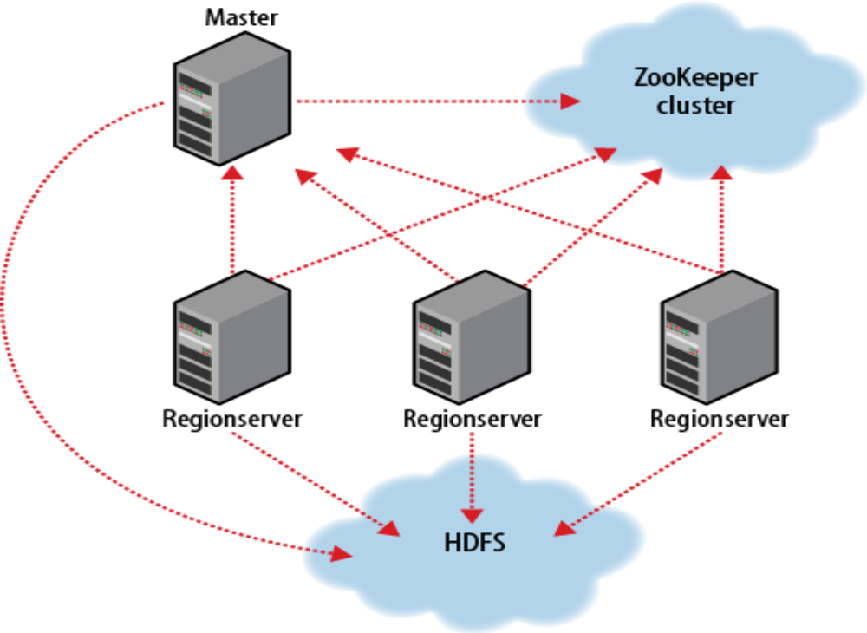
Hbase Cluster Members

Slide 8
Hbase Needs ZooKeeper
  HBase depends on ZooKeeper (Chapter 14), and by default it manages a ZooKeeper instance as the authority on cluster state.
  HBase hosts vitals such as the location of the root catalog table and the address of the current cluster master.
  Assignment of regions is mediated via ZooKeeper in case participating servers crash mid-assignment.
  Hosting the assignment transaction state in ZooKeeper makes it so recovery can pick up on the assignment where the crashed server left off.

Slide 9
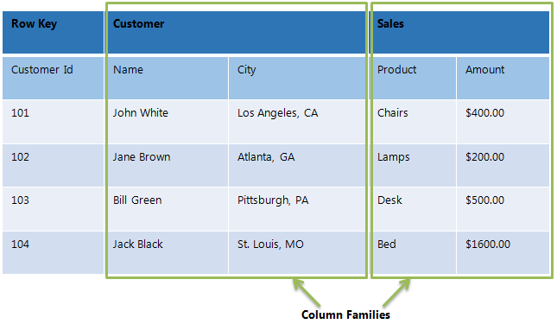
Hbase Example – 1

Slide 10
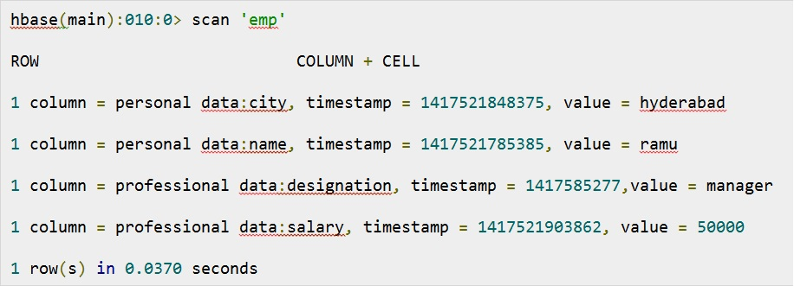
Hbase Example – 2

Slide 11
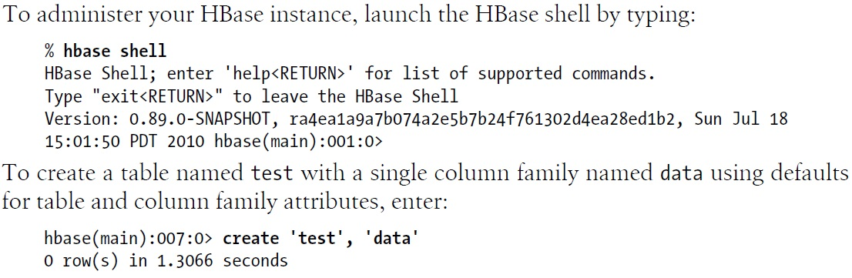
Launch Hbase

Slide 12
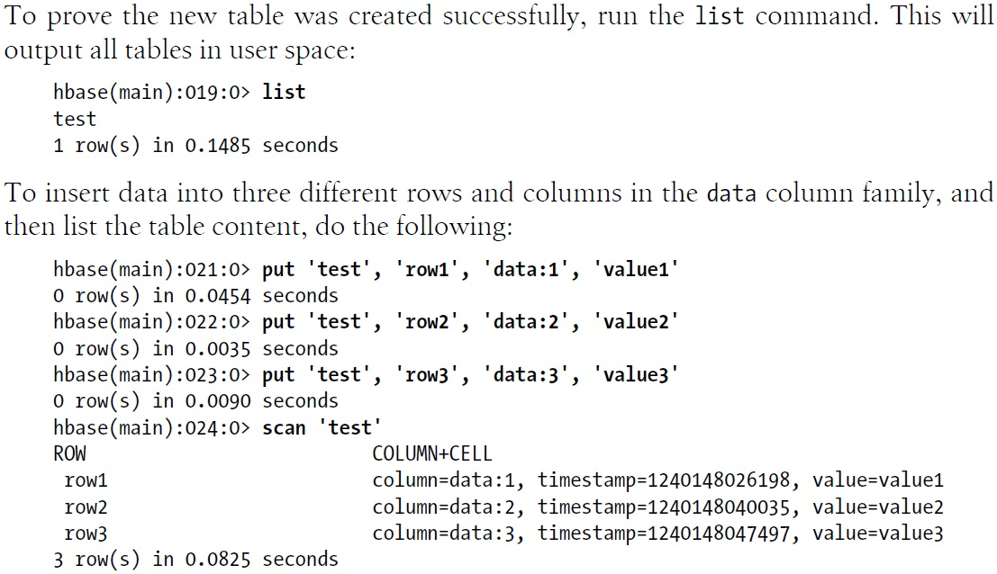
Insert and List Data

Slide 13
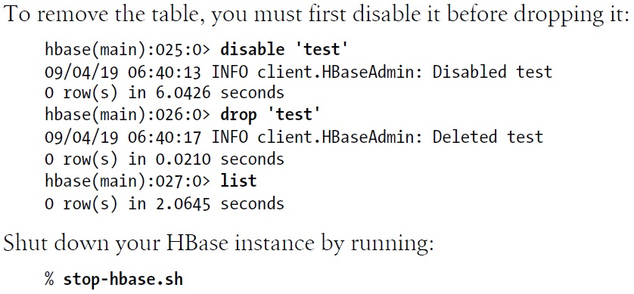
More Hbase Commands

Slide 14
What Is ZooKeeper
  ZooKeeper is a centralized service for maintaining configuration information, naming, providing distributed synchronization, and providing group services.
  ZooKeeper provides users a set of tools to build distributed applications that can safely handle partial failures.
  ZooKeeper has a rich set of building blocks that can be used to build a large class of coordination data structures and protocols. Examples include: distributed queues, distributed locks, and leader election among a group of peers.

Slide 15
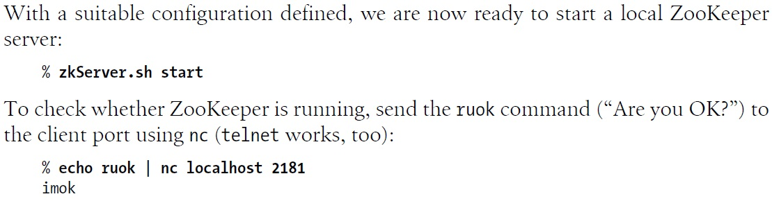
Start ZooKeeper

Slide 16
Znodes – 1
  One way of understanding ZooKeeper is to think of it as providing a high-availability filesystem.
  It doesn’t have files and directories, but a unified concept of a node, called a znode.
  Znode acts both as a container of data (like a file) and a container of other znodes (like a directory).

Slide 17
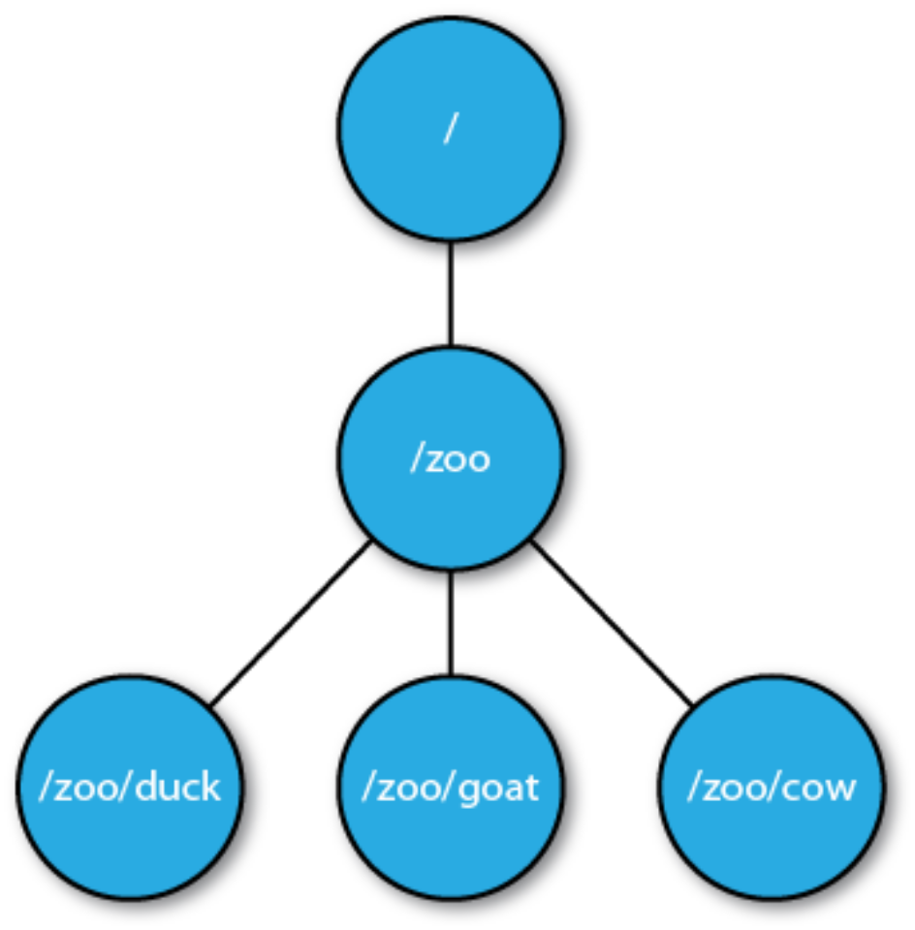
Znodes – 2

Slide 18
ZooKeeper Application Examples
  Create a ZooKeeper group – p. 493
  Join a ZooKeeper group – p. 495
  List members in a group – p. 496
  Delete a ZooKeeper group – p. 498

Slide 19
What Is Sqoop
  Sqoop is an open source tool that allows users to extract data from a structured data store into Hadoop for further processing.
  It’s even possible to use Sqoop to move data from a database into HBase.
  When the final results of an analytic pipeline are available, Sqoop can export these results back to the data store for consumption by other clients.

Slide 20
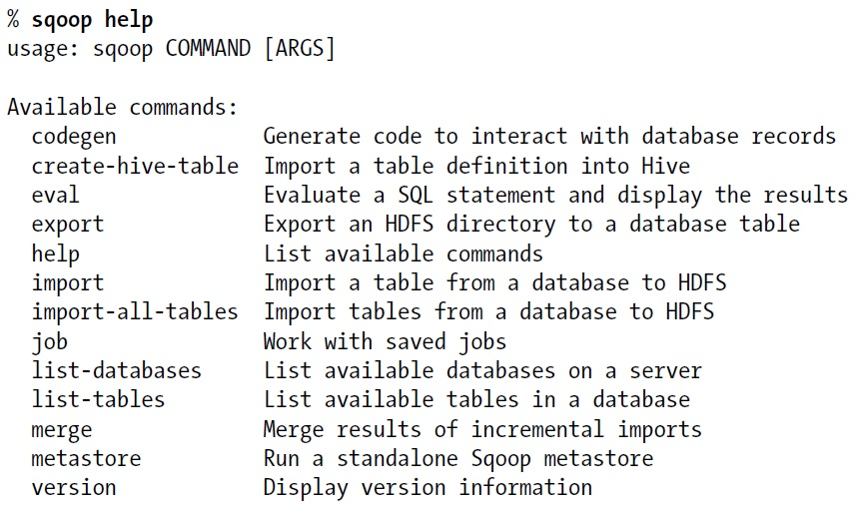
Sqoop Commands

Slide 21
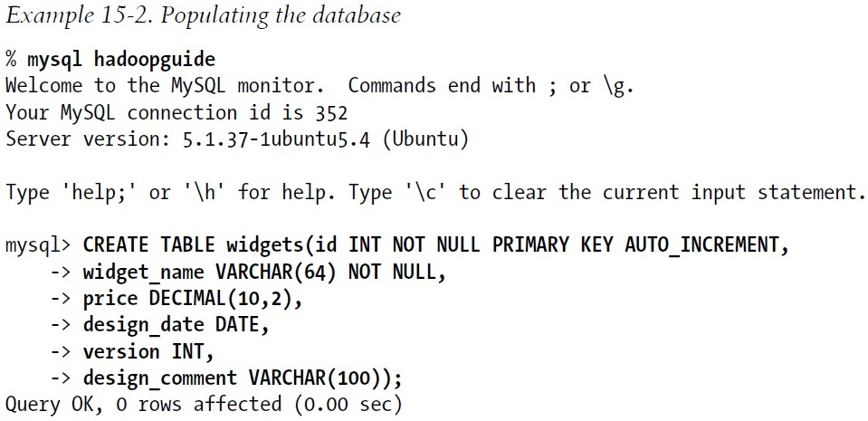
A Sqoop Example – 1

Slide 22
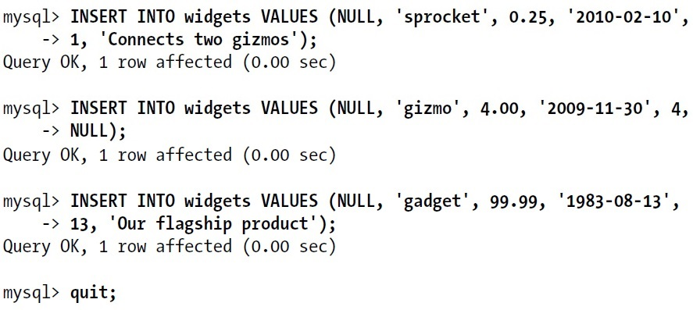
A Sqoop Example – 2

Slide 23
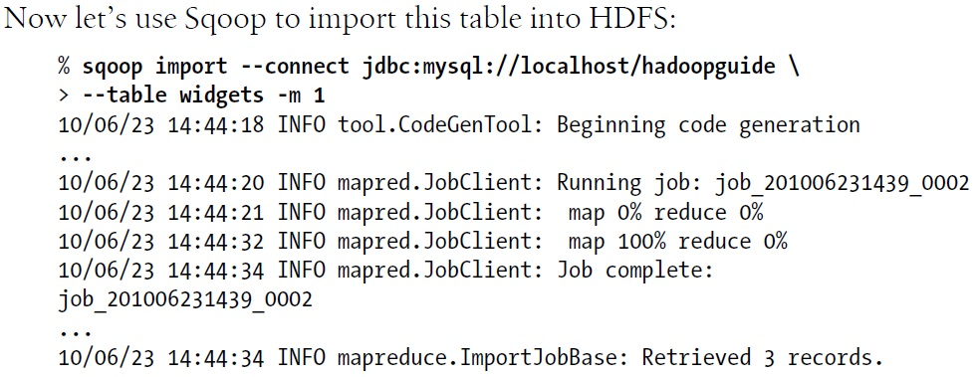
A Sqoop Example – 3

Slide 24
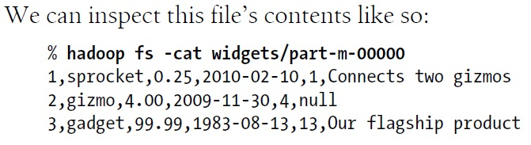
A Sqoop Example – 4

