Slide 1
Introduction to Apache Spark

Slide 2
What is Spark?
Fast and Expressive Cluster Computing
Engine Compatible with Apache Hadoop
Up to 10× faster on disk,
100× in memory
2-5× less code
Efficient
Usable
General execution graphs
In-memory storage
Rich APIs in Java, Scala, Python, R
Interactive shell
Notes:
Generalize the map/reduce framework

Slide 3
What is Spark?
May be 100 times faster than Map Reduce for
  Iterative algorithms
  Interactive data mining
Used with Hadoop / HDFS (Spark can run on Hadoop 1.0, Hadoop 2.0, Apache Mesos, or a standalone Spark cluster)
Released under BSD License
A driver program that controls the execution of parallel operations across a cluster
Open Source
A low latency cluster computing system
For very large data sets
Notes:
Generalize the map/reduce framework
The BSD license (Berkeley Source Distribution) is part of the low restriction FOSS (Free and Open Source Software) family of licenses

Slide 4
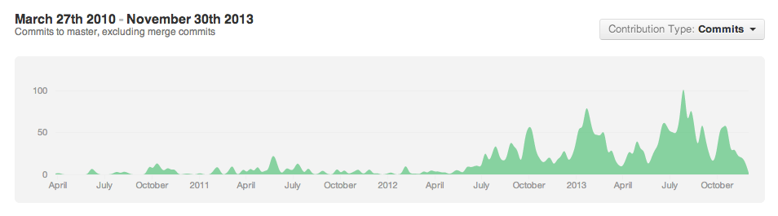



























The Spark Community
Notes:
One of the most exciting things you’ll find
Growing all the time
NASCAR slide
Including several sponsors of this event are just starting to get involved…
If your logo is not up here, forgive us – it’s hard to keep up!

Slide 5
The Spark Community
Notes:
One of the most exciting things you’ll find
Growing all the time
NASCAR slide
Including several sponsors of this event are just starting to get involved…
If your logo is not up here, forgive us – it’s hard to keep up!

Slide 6
Spark Programming Model
PySpark
Resilient Distributed Datasets (RDDs)

Slide 7
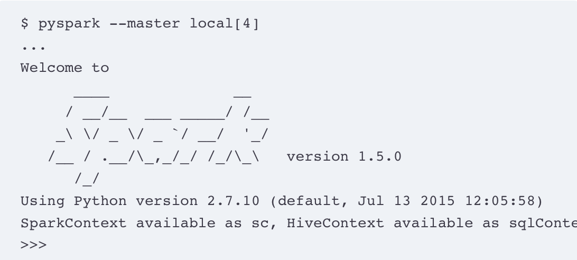
PySpark
PySpark is Spark’s Python API. PySpark allows Spark applications to be created from an interactive shell or from Python programs.
Interactive Shell:

Slide 8
PySpark
Self-Contained Applications
Self-contained applications must first create a SparkContext object before using any Spark methods.
To execute self-contained applications, they must be submitted to the spark-submit script.
Notes:
A self-contained application consists of a single, installable bundle that contains your application and a copy of the JRE needed to run the application.

Slide 9
Key Concept: RDD’s
Write programs in terms of operations on distributed datasets
Resilient Distributed Datasets
Collections of objects spread across a cluster, stored in RAM or on Disk
Built through parallel transformations
Automatically rebuilt on failure
Operations
Transformations
(e.g. map, filter, groupBy)
Actions
(e.g. count, collect, save)
Notes:
RDD ➔ Colloquially referred to as RDDs
(e.g. caching in RAM)
Lazy operations to build RDDs from other RDDs
Return a result or write it to storage

Slide 10
Resilient Distributed Datasets
RDDs can be constructed in multiple ways:
  by parallelizing existing Python collections,
  by referencing files in an external storage system such as HDFS
  by applying transformations to existing RDDs.

Slide 11
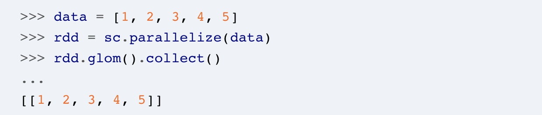
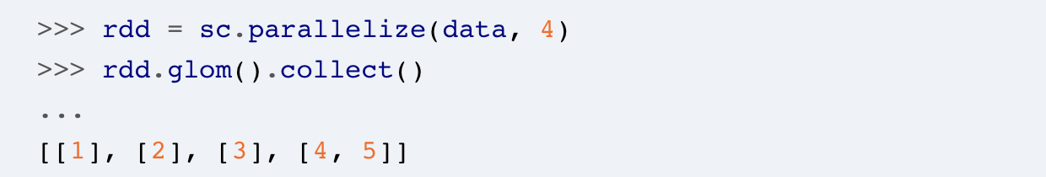
Creating RDDs from Collections
RDDs can be created from a Python collection by calling the SparkContext.parallelize() method
To specify the number of partitions an RDD should be created with, a second argument can be passed to the parallelize() method.
Notes:
glom() transforms each partition into a tuple (immutable list) of elements.

Slide 12
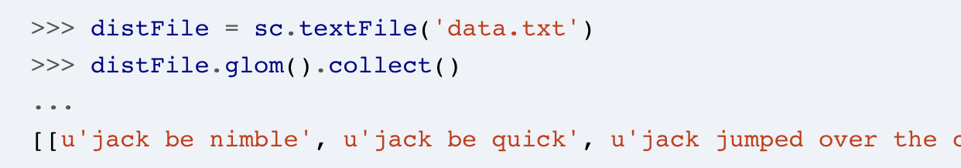
Creating RDDs from External Sources
Spark can read files residing on the local filesystem, any storage source supported by Hadoop, Amazon S3, and so on.
Spark supports text files, SequenceFiles, any other Hadoop InputFormat, directories, compressed files, and wildcards;

Slide 13
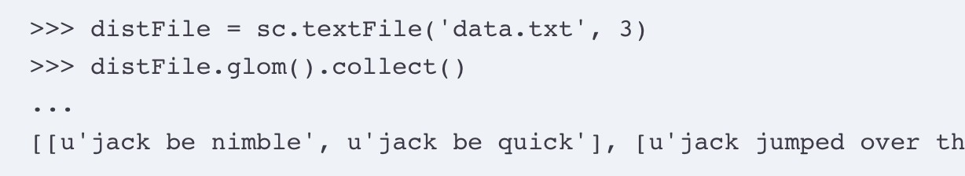
Creating RDDs from External Sources
the textFile() method takes a second parameter that specifies the number of partitions to create:

Slide 14
RDD Operations
RDDs support two types of operations: transformations and actions.
  Transformations create new datasets from existing ones;
  Actions run a computation on the dataset and return results to the driver program;
  Transformations are lazy: Transformations are computed when an action requires a result to be returned to the driver program.

Slide 15
RDD Workflow
Create an RDD from a data source.
Apply transformations to an RDD.
Apply actions to an RDD.

Slide 16
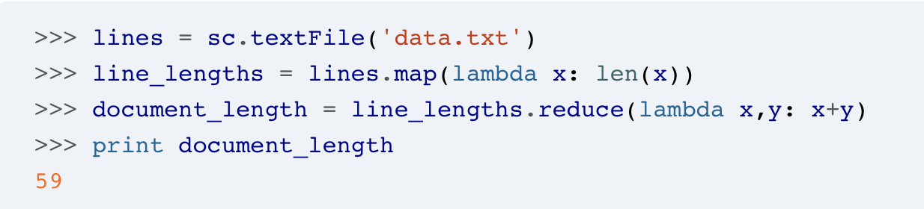
Example: Calculate the number of characters in a file:
Transformation: map() function to calculate the number of characters in each line. The variable line_lengths is not immediately computed due to the laziness of transformations.
Action: reduce () method. Spark divides the computations into tasks to run on separate machines.
Notes:
A lambda function is a small anonymous function. A lambda function can take any number of arguments, but can only have one expression.

Slide 17
Python Lambda Functions
Lambda functions are anonymous functions (i.e., they do not have a name) that are created at runtime.
Used wherever function objects are required and are syntactically restricted to a single expression.
Defined by the keyword lambda, followed by a comma-separated list of arguments. A colon separates the function declaration from the function expression.
The function expression is a single expression that produces a result for the provided arguments.

Slide 18
Examples of Lambda Functions:
a lambda function that returns the sum of its two arguments:
a lambda function has one argument and returns the length of the argument.

Slide 19
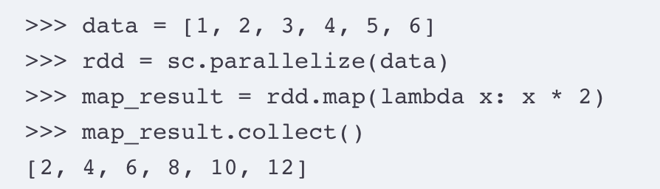
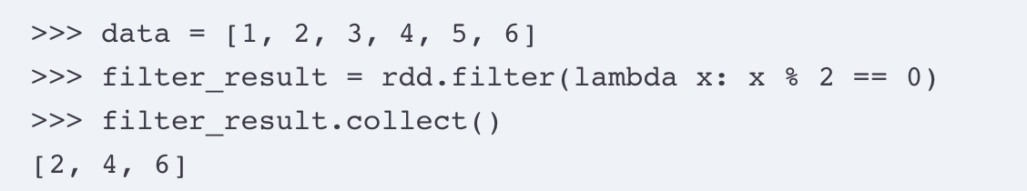
Basic Transformations
Map: The map(func) function returns a new RDD by applying a function, func, to each element of the source.
Filter: The filter(func) function returns a new RDD containing only the elements of the source that the supplied function returns as true.

Slide 20
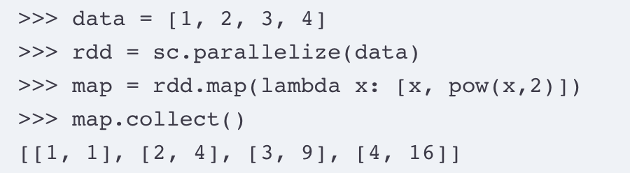
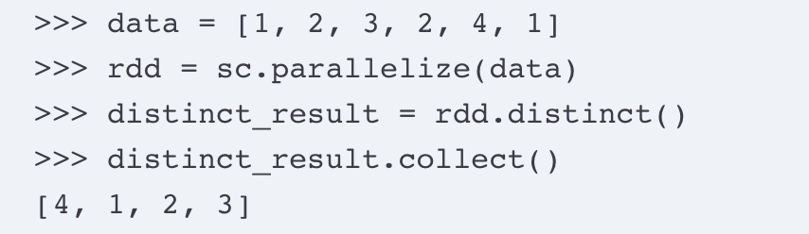
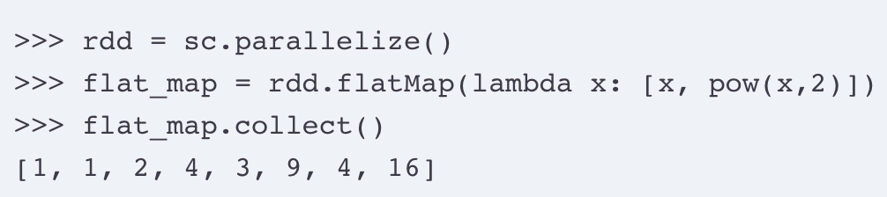
Basic Transformations
FlatMap: The flatMap(func) function is similar to the map() function, except it returns a flattened version of the results.
Distinct: The distinct() method returns a new RDD containing only the distinct;

Slide 21
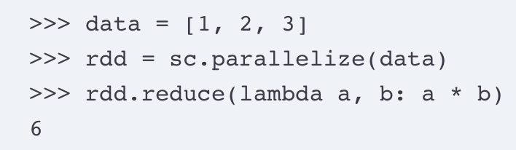
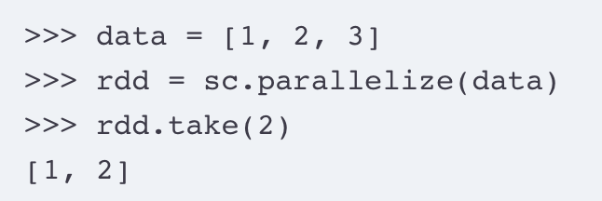
Basic Actions
Reduce: The reduce() method aggregates elements in an RDD using a function, which takes two arguments and returns one.
Take: The take(n) method returns an array with the first n elements of the RDD.

Slide 22
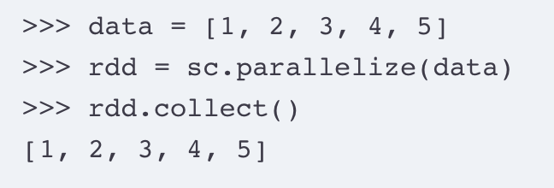
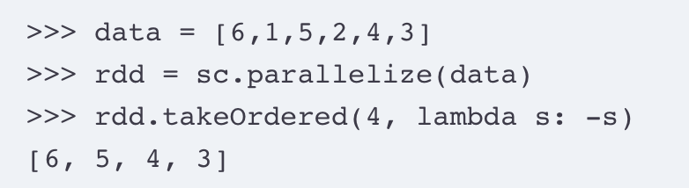

Basic Actions
Collect: The collect() method returns all of the elements of the RDD as an array.
The take() and collect()methods can be used to inspect the top n elements of a large RDD.
TakeOrdered: The takeOrdered(n, key=func) method returns the first n elements of the RDD, in their natural order, or as specified by the function func.

Slide 23
More RDD Operators
map
filter
groupBy
sort
union
join
leftOuterJoin
rightOuterJoin
reduce
count
fold
reduceByKey
groupByKey
cogroup
cross
zip
sample
take
first
partitionBy
mapWith
pipe
save ...

Slide 24
Working with Key-Value Pairs
Spark’s “distributed reduce” transformations operate on RDDs of key-value pairs
Python: pair = (a, b)
pair[0] # => a
pair[1] # => b
Scala: val pair = (a, b)
pair._1 // => a
pair._2 // => b
Java: Tuple2 pair = new Tuple2(a, b);
pair._1 // => a
pair._2 // => b

Slide 25
Some Key-Value Operations
pets = sc.parallelize(
[(“cat”, 1), (“dog”, 1), (“cat”, 2)])
pets.reduceByKey(lambda x, y: x + y)
# => {(cat, 3), (dog, 1)}
pets.groupByKey() # => {(cat, [1, 2]), (dog, [1])}
pets.sortByKey() # => {(cat, 1), (cat, 2), (dog, 1)}
reduceByKey also automatically implements combiners on the map side

Slide 26
More Examples
Word Count Example
Text Search Example
Max Temperature Example

Slide 27
Example: Word Count
lines = sc.textFile(“data.txt”)
counts = lines.flatMap(lambda line: line.split( ))
.map(lambda word => (word, 1))
.reduceByKey(lambda x, y: x + y)
“to”
“be”
“or”
(to, 1)
(be, 1)
(or, 1)
(be, 2)
(not, 1)
“to be or”
“not”
“to”
“be”
(not, 1)
(to, 1)
(be, 1)
(or, 1)
(to, 2)
“not to be”

