Slide 1
The Hadoop Distributed Filesystem
Chapter 3

Slide 2
Learning Objectives
  HDFS Concepts
  Command-Line Interface
  Java Interface
  Data Flow
  Distcp and Hadoop Archives

Slide 3
Design Criteria of HDFS
Very large files
Lots of small files
Petabyte-scale data
Growing of filesystem metadata
Streaming data access
Random data access
Write-once, read-many-times
High throughput
Multiple writers, arbitrary file update
Low latency
Commodity hardware
Node failure handling

Slide 4
HDFS Blocks
  Block: the minimum unit of data to read/write/replicate
  Large block size: 64MB by default, 128MB in practice
  Small metadata volumes, low seek time
  A small file does not occupy a full block
  HDFS runs on top of underlying filesystem
  Filesystem check (fsck)
% hadoop fsck –files -blocks

Slide 5
Namenode – The Master
Task | Information Stored
Manage filesystem namespace (i.e., filesystem tree & metadata) | Namespace image, edit log (stored persistently)
Keeping track of all the blocks | Block locations (stored just in memory)
  Single point of failure
  Backup the persistent metadata files
  Run a secondary namenode (standby)

Slide 6
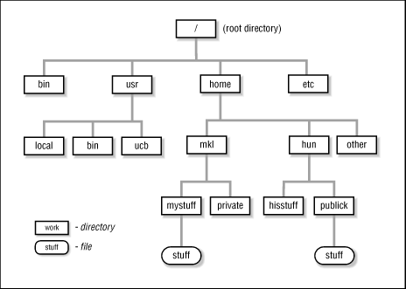
Filesystem Tree Example

Slide 7
Datanodes - Workers
  Datanodes are the workhorse of the filesystem.
  Store and retrieve blocks when they are told to.
  Report the lists of storing blocks to the namenode periodically.

Slide 8
HDFS High Availability
  HDFS high availability
  Use a pair of namenodes in an active-standby configuration.
  The standby has both the latest edit log entries and an up-to-date block mapping in memory.
  Failover controller manages the transition from the active namenode to the standby.
  Failover may also be initiated manually by an administrator.

Slide 9
HDFS Configuration
  Pseudo-distributed configuration
  fs.default.name = hdfs://localhost/
  dfs.replication = 1
  hdfs://localhost/ is used to set a default filesystem for Hadoop.
  Set dfs.replication = 1 so that HDFS doesn’t replicate filesystem blocks by the default factor of 3.

Slide 10
Basic Filesystem Operations – 1
  Copying a file from the local filesystem to HDFS
  Copying the file back to the local filesystem
% hadoop fs –copyFromLocal input/docs/quangle.txt hdfs://localhost/user/tom/quangle.txt
% hadoop fs –copyToLocal hdfs://localhost/user/tom/quangle.txt
quangle.copy.txt

Slide 11
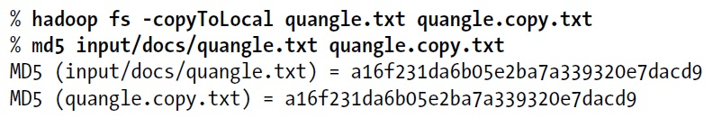
Basic Filesystem Operations – 2
  Check if two files are the same using MD5 message digest
  Creating a directory
% hadoop fs –mkdir books
% hadoop fs -ls .
Found 2 items
drwxr-xr-x - tom supergroup 0 2009-04-02 22:41 /user/tom/books
-rw-r--r-- 1 tom supergroup 118 2009-04-02 22:29 /user/tom/quangle.txt

Slide 12
Hadoop Filesystems – 1
Filesystem | URI scheme | Java implementation (all under org.apache.hadoop)
Local | file | fs.LocalFileSystem
HDFS | hdfs | hdfs.DistributedFileSystem
HFTP | hftp | hdfs.HftpFileSystem
HSFTP | hsftp | hdfs.HsftpFileSystem
HAR | har | fs.HarFileSystem
KFS (Cloud-Store) | kfs | fs.kfs.KosmosFileSystem
FTP | ftp | fs.ftp.FTPFileSystem
S3 (native) | s3n | fs.s3native.NativeS3FileSystem
S3 (block-based) | s3 | fs.s3.S3FileSystem

Slide 13
Hadoop Filesystems – 2
  Listing the files in the root directory of the local filesystem.
% hadoop fs –ls file:///
  HDFS is just one implementation of Hadoop filesystem.
  You can run MapReduce programs on any of these filesystems, but HDFS is better to process large volumes of data.

Slide 14
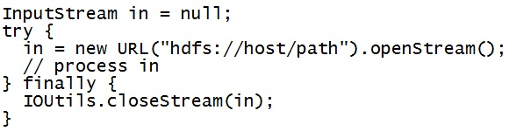
Open a Data Stream
  Using java.net.URL object to open a tream to read the data from

Slide 15
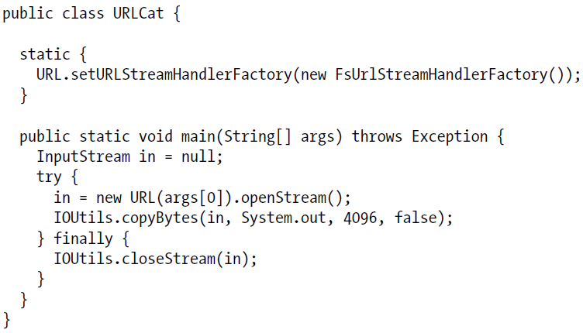
Read Data
  Displaying a file like UNIX cat command
This method can only be called
just once per JVM

Slide 16
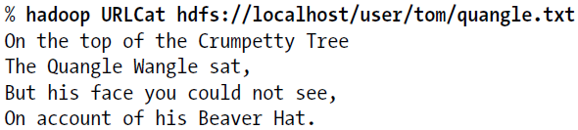
A Sample Run
  Output of A Sample Run

Slide 17
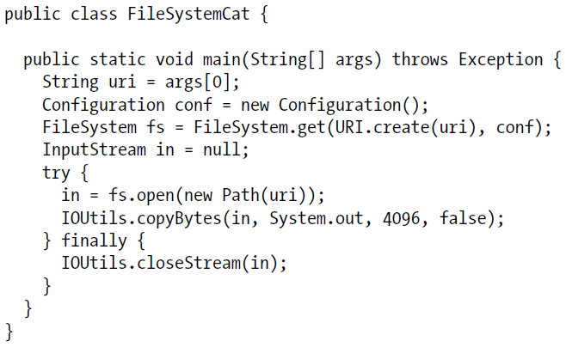
Reading Data Using the FileSystem

Slide 18
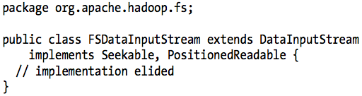
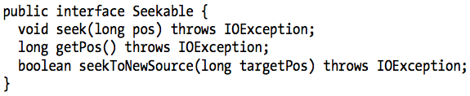
FSDataInputStream
  A specialization of java.io.DataInputStream

Slide 19
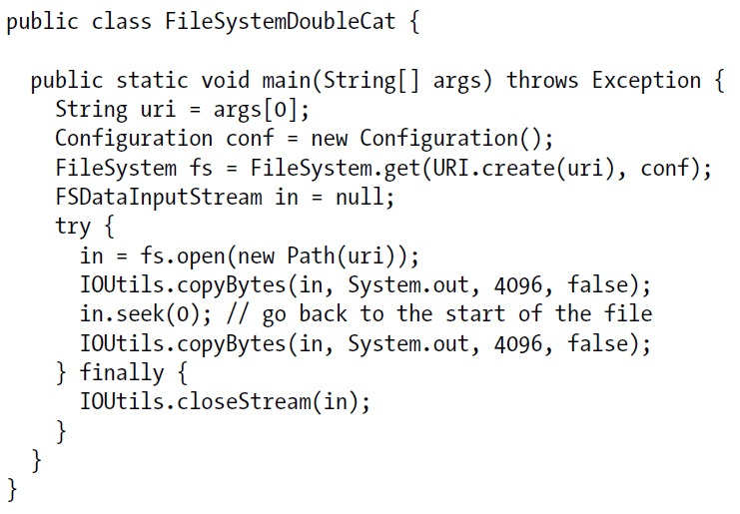
Seek – p.58
  Display files on standard output twice by using seek

Slide 20

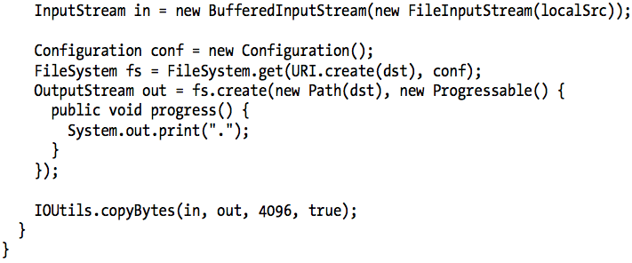
Writing Data
  Copy a local file to a Hadoop filesystem

Slide 21
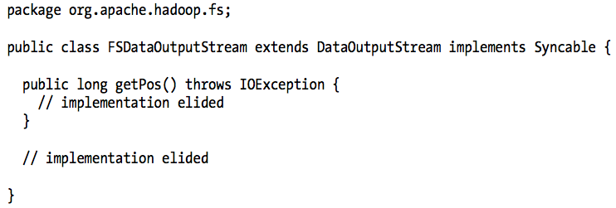
FSDataOutputStream
  The create() method on FileSystem returns an FSDataOutputStream

Slide 22
Show File Status Test – p.62
  Example 3-5: ShowFileStatusTest

Slide 23
Directories
  Creating a directory
  Often, you don’t need to explicitly create a directory.
  Writing a file will automatically creates any parent directories.

Slide 24
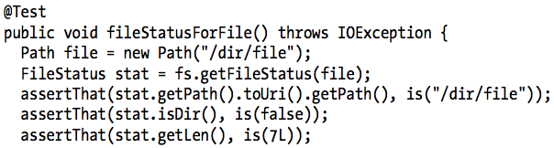
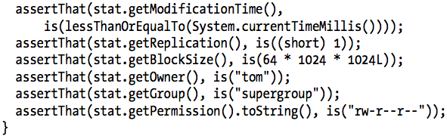
File Metadata: FileStatus

Slide 25
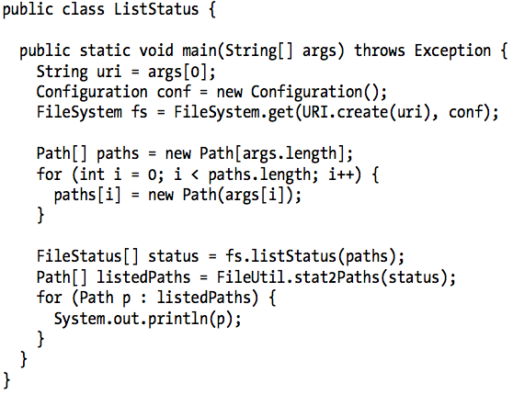
Listing Files

Slide 26
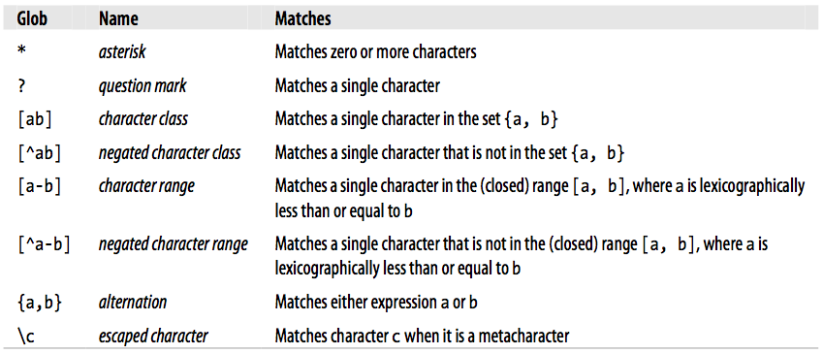
File Patterns
  Globbing: to use wildcard characters to match multiple files.
  Glob characters and their meanings

Slide 27
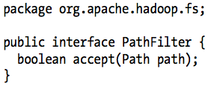
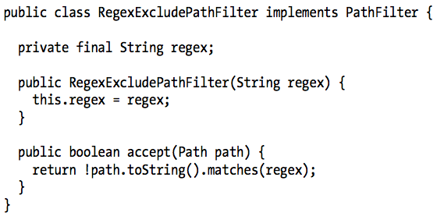
PathFilter
  Allows programmatic control over matching
  PathFilter for excluding paths that match a regex

Slide 28
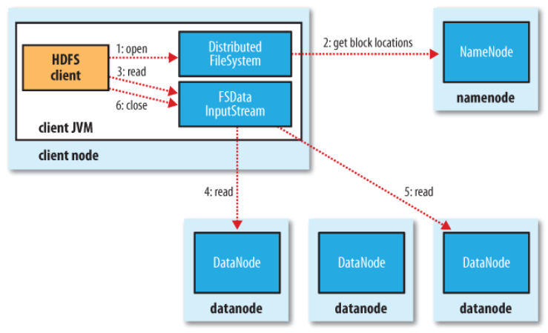
A Client Reading Data From HDFS
(according to
network topology)
(first block)
(next block)

Slide 29
Error Handling – 1
Key point
Client contacts datanodes directly to retrieve data.
  Error handling
  Error in client-datanode communication
  Try next closest datanode for the block
  Remember failed datanode for later blocks
  Block checksum error
  Report to the namenode

Slide 30
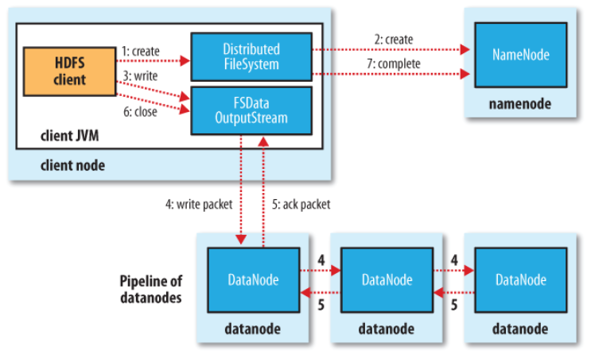
A Client Writing Data To HDFS
(file exist &
permission check)
enqueue packet
to data queue
dequeue the packet
from ack queue
chose by
replica placement strategy
move the packet
to ack queue

Slide 31
Error Handling – 2
  Datanode error while data is being written:
  Client
  Adds any packets in the ack queue to data queue.
  Removes the failed datanode from the pipeline.
  Writes the remainder of the data.
  Namenode
  Arranges under-replicated blocks for further replicas.
  Failed datanode
  Deletes the partial block when the node recovers later on.

Slide 32
Coherency Model
  A coherency model for a filesystem describes the data visibility of reads and writes for a file.
Key point
The current block being written that is not guaranteed to be visible (even if the stream is flushed).
  HDFS provides sync() method
  Forcing all buffers to be synchronized to the datanodes.
  Applications should call sync() at suitable points.

Slide 33
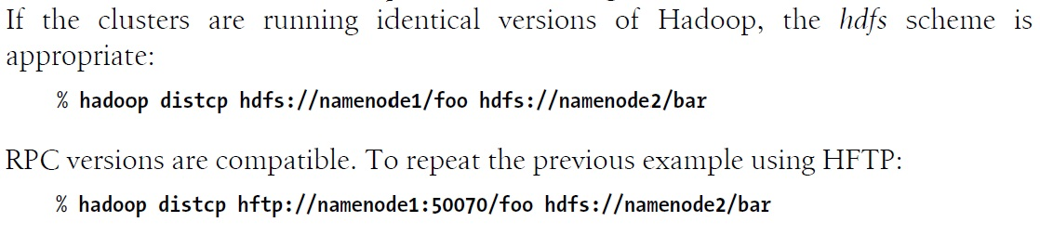
Distcp – Parallel Coping
  Hadoop comes with distcp for copying large amounts of data to and from Hadoop filesystems in parallel.

Slide 34
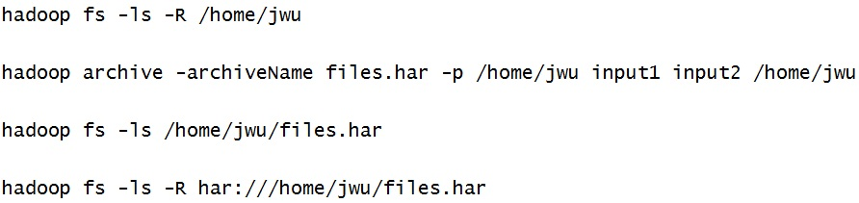
Hadoop Archives – New Commands
  Hadoop Archives, or HAR files, are a file archiving facility that packs files into HDFS blocks more efficiently.
  It reduces namenode memory usage while still allowing transparent access to files.

Slide 35
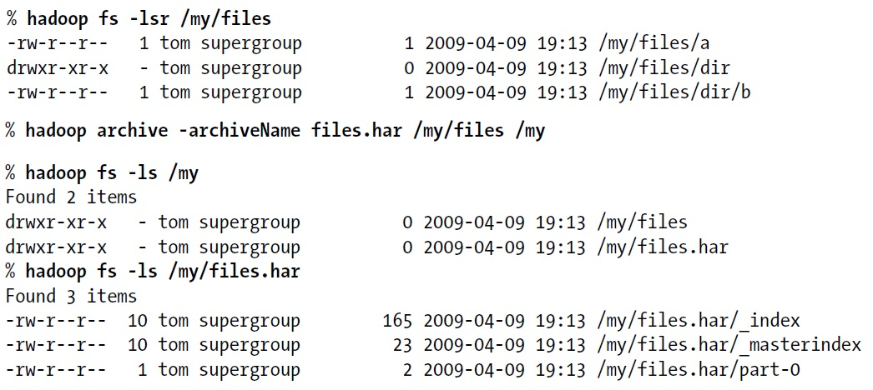
Hadoop Archives – Old Commands

