Slide 1
Hadoop I/O
Chapter 4

Slide 2
Learning Objectives
  Data Integrity
  Compression
  Serialization
  File-based Data Structures

Slide 3
Data Integrity – 1
  The chance of data corruption is high because of the large volumes of data handled by Hadoop.
  Checksum
  Usual way of detecting corrupted data.
  Technique for only error detection (cannot fix the corrupted data).
  CRC-32 (cyclic redundancy check) - compute a 32-bit integer checksum for input of any size.

Slide 4
Data Integrity – 2
  HDFS transparently checksums all data written to it and by default verifies checksums when reading data.
  Compute checksums for every 512 bytes by default.
  Datanodes are responsible for verifying the data they receive before storing the data and its checksum.
  Client receives a ChecksumException, if it detects an error.
  When clients read data from datanodes, they verify checksums as well, comparing them with the ones stored at the datanode.

Slide 5
Data Integrity – 3
  Checksum verification log
  Each datanode keeps a persistent log to know the last time each of its blocks was verified.
  When a client successfully verifies a block, it tells the datanode who sends the block.
  Then, the datanode updates its log.
  DataBlockScanner
  Background thread that periodically verifies all the blocks stored on the datanode.
  Guard against corruption due to “bit rot” in the physical storage media.

Slide 6
Data Integrity – 4
  Healing corrupted blocks
  If a client detects an error when reading a block, it reports the bad block and the datanode to the namenode.
  Namenode marks the block replica as corrupt.
  Namenode schedules a copy of the block to be replicated on another datanode.
  The corrupt replica is deleted.

Slide 7
Data Integrity – 5
  Disabling verification of checksum
  Pass false to the setVerifyCheckSum() method on FileSystem.
  -ignoreCrc option with the -get or the equivalent -copyToLocal command.
  This feature is useful if you have a corrupt file that you want to inspect and decide what to do.

Slide 8
Data Integrity – 6
  LocalFileSystem
  Performs client-side checksumming;
  When you write a file called filename, the FS client transparently creates a hidden file, .filename.crc, in the same directory containing the checksums for each chunk of the file.
  ChecksumFileSystem
  LocalFileSystem uses ChecksumFileSystem to do its work.
  Make it easy to add checksumming to other (nonchecksummed) filesystems.

Slide 9
Compression
  Two major benefits of file compression
  Reduce the space needed to store files;
  Speed up data transfer across the network.
  When dealing with large volumes of data, both of these savings can be significant.
  So it pays to carefully consider how to use compression in Hadoop.

Slide 10
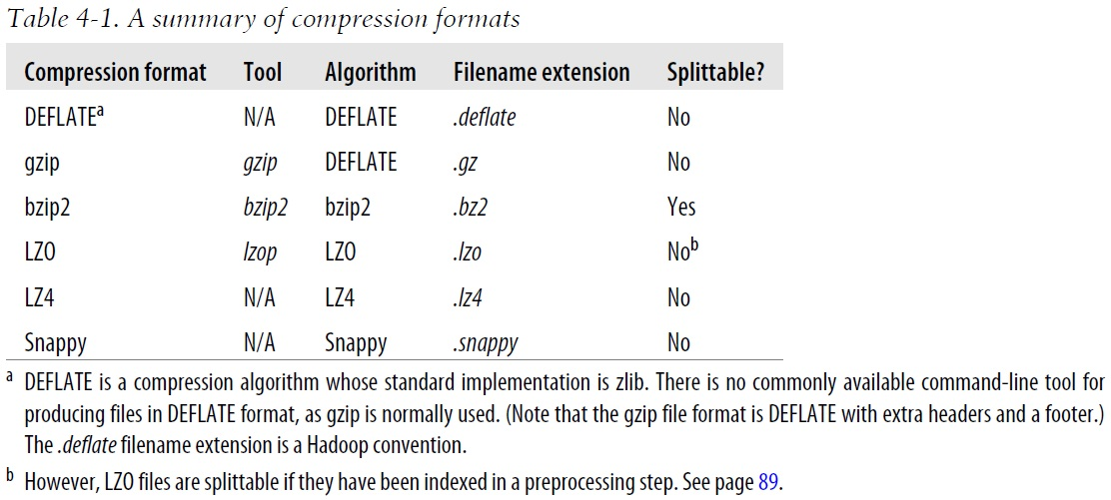
Hadoop Compression Codecs

Slide 11
“Splittable” Column
  “Splittable” column
  Indicates whether the compression format supports splitting;
  Whether you can seek to any point in the stream and start reading from some point further on.
  Splittable compression formats are especially suitable for MapReduce.

Slide 12
Input Splits
  It is important whether the compression format supports splitting.
  Example of not-splitable compression problem:
  A gzip-compressed file is 1 GB;
  Creating a split for each block won’t work since it is impossible to start reading at an arbitrary point in the gzip stream;
  Therefore impossible for a map task to read its split independently of the others.

Slide 13
CompressionCodec
  CompressionCodec
  createOutputStream(OutputStream out): create a CompressionOutputStream to which you write your uncompressed data to have it written in compressed form to the underlying stream.
  createInputStream(InputStream in): obtain a CompressionInputStream, which allows you to read uncompressed data from the underlying stream.

Slide 14
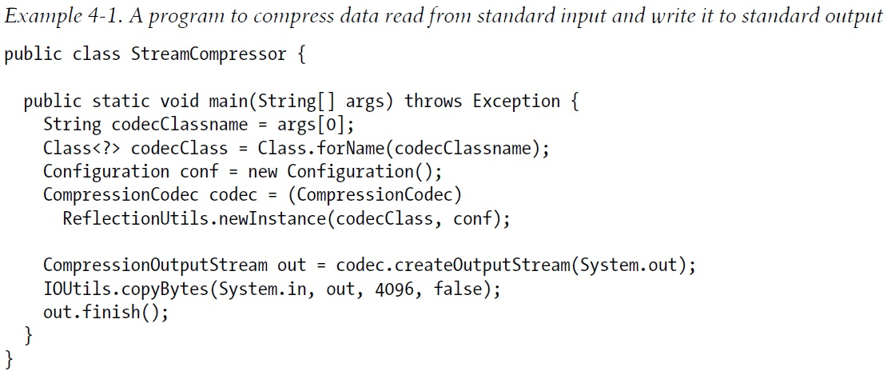
Example
% echo "Text" | hadoop StreamCompressor org.apache.hadoop.io.compress.GzipCodec \
| gunzip -
Text

Slide 15
Serialization
  Process of turning structured objects into a byte stream for transmission over a network or for writing to persistent storage.
  Deserialization is the reverse process of serialization.
  Serialization appears in two quite distinct areas of distributed data processes: for interprocess communication and for persistent storage.

Slide 16
Remote Procedure Calls (RPCs) Serialization
  In Hadoop, interprocess communication between nodes is implemented using RPCs. Requirements for RPCs:
  Compact – to make efficient use of storage space;
  Fast – the overhead in reading and writing of data is minimal;
  Extensible – we can transparently read data written in an older format;
  Interoperable – we can read or write persistent data using different language.

Slide 17
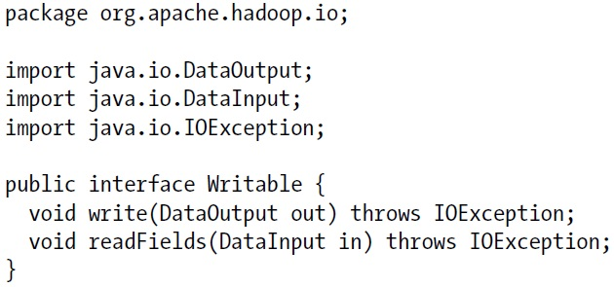
Writable Interface
public static byte[] serialize(Writable writable) throws IOException {
ByteArrayOutputStream out = new ByteArrayOutputStream();
DataOutputStream dataOut = new DataOutputStream(out);
writable.write(dataOut);
dataOut.close();
return out.toByteArray();
}

Slide 18
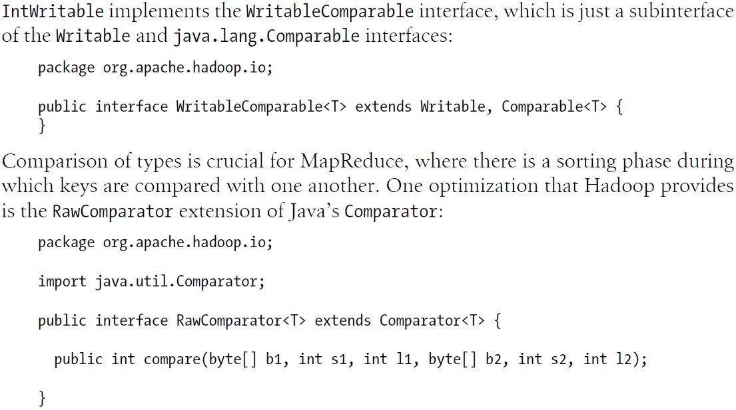
WritableComparable and Comparator – 1

Slide 19
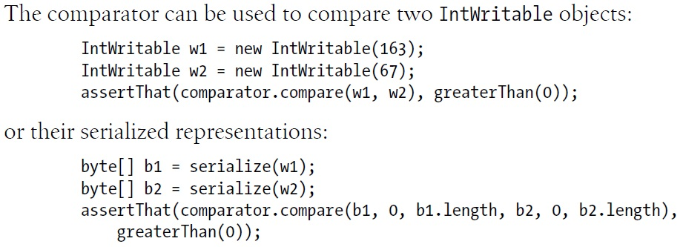
WritableComparable and Comparator – 2

Slide 20
Writable Wrappers for Java Primitives
  There are Writable wrappers for all the Java primitive types except char (which can be stored in an IntWritable).
  get() for retrieving and set() for storing the wrapped value.
Java Primitive | Writable Implementation | Serialized Size (bytes)
boolean | BooleanWritable | 1
byte | ByteWritable | 1
int | IntWritable | 4
 | VIntWritable | 1~5
float | FloatWritable | 4
long | LongWritable | 8
 | VLongWritable | 1~9
double | DoubleWritable | 8

Slide 21
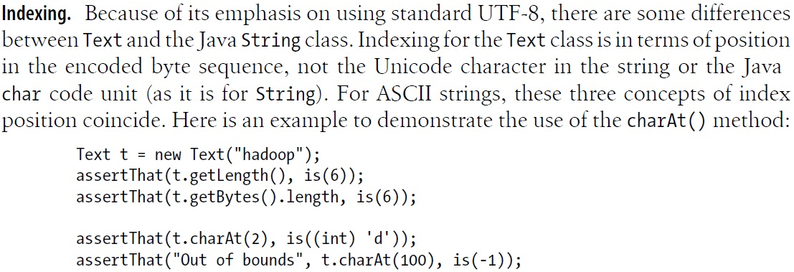
Text – 1
  Text is a Writable for UTF-8 sequences; can be seen as the Writable equivalent of java.lang.String.
  Text is a replacement for the org.apache.hadoop.io.UTF8 class (deprecated).

Slide 22
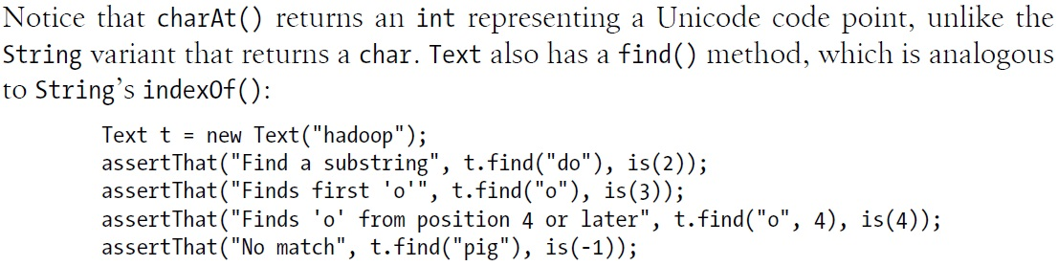
Text – 2

Slide 23
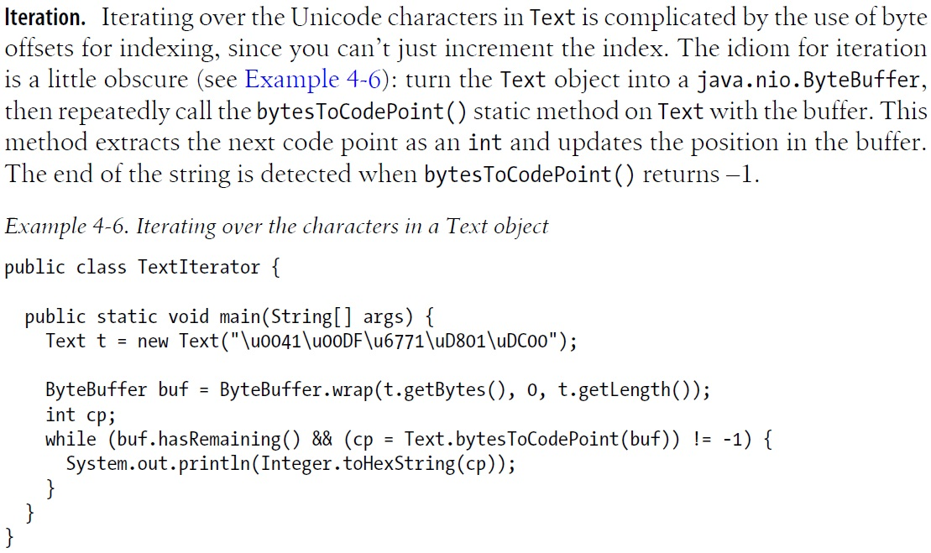
Iteration

Slide 24
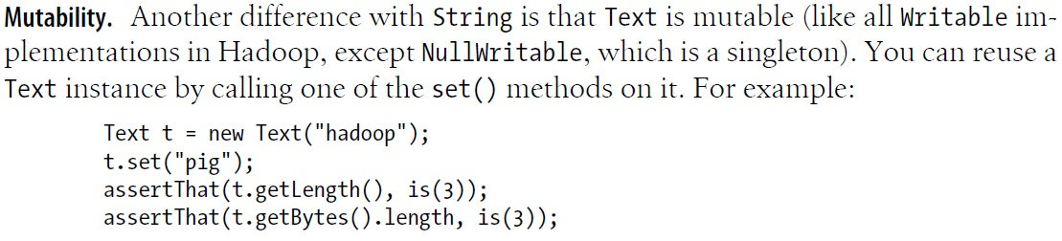
Mutability

Slide 25
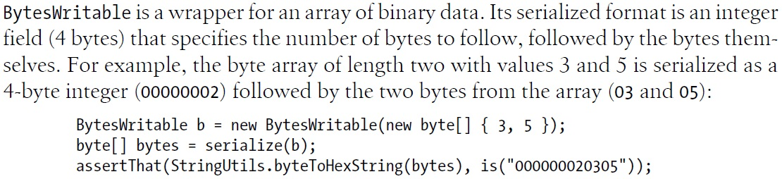
BytesWritable – 1

Slide 26
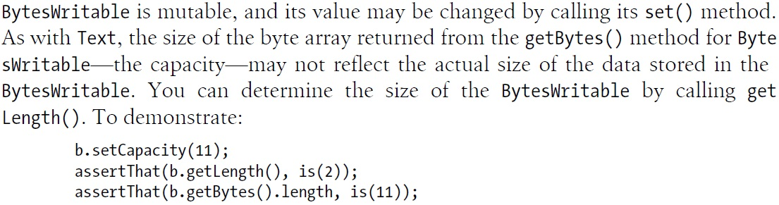
BytesWritable – 2

Slide 27
SequenceFile
  Hadoop’s SequenceFile class provides a persistent data structure for binary key-value pairs.
  It is used as a logfile format.
  As containers for smaller files.
  Usage example
  Key: timestamp represented by a LongWritable.
  Value: Writable represents the quantity being logged.

Slide 28
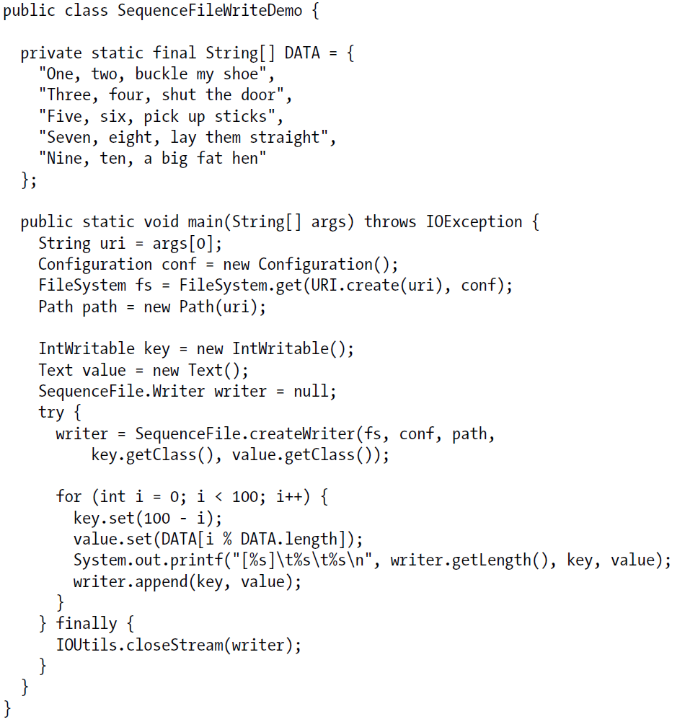
Writing a SequenceFile – p.131

Slide 29
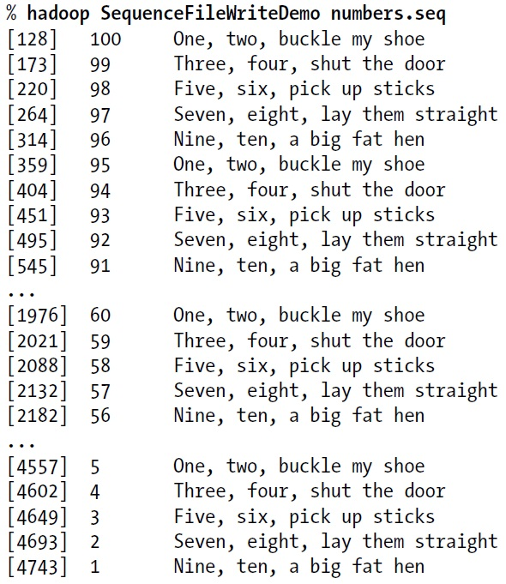
Writing a SequenceFile – Results

Slide 30
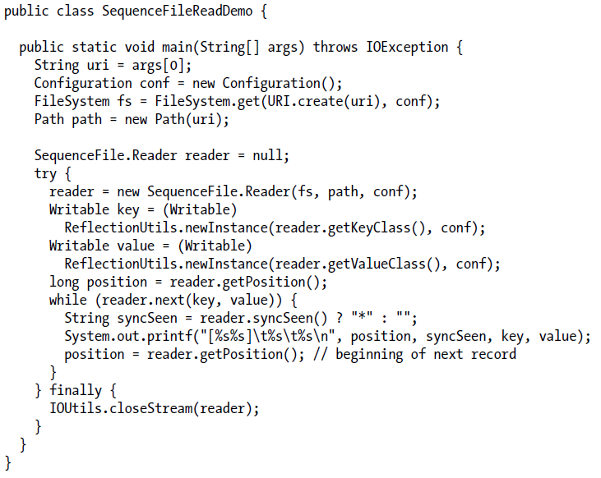
Reading a SequenceFile – p.133

Slide 31
Sync Point
  A sync point is a point in the stream that can be used to resynchronize with a record boundary if the reader is “lost”—for example, after seeking to an arbitrary position in the stream.
  Sync points are recorded by SequenceFile.Writer, which inserts a special entry to mark the sync point every few records as a sequence file is being written.
  Sync points always align with record boundaries.

Slide 32
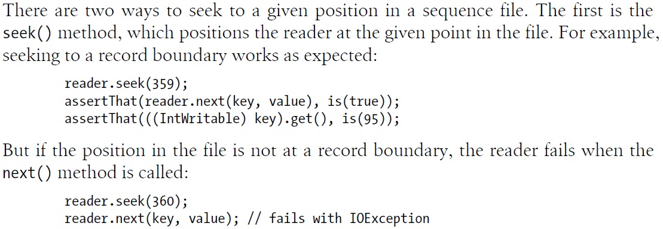
Seek

Slide 33
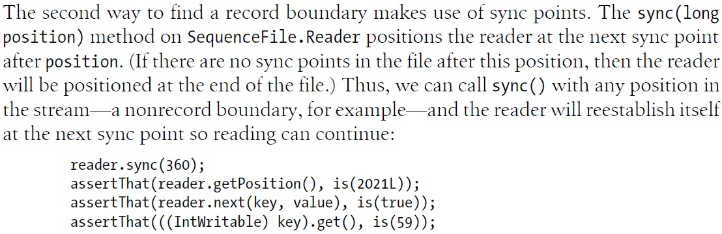
Sync

Slide 34
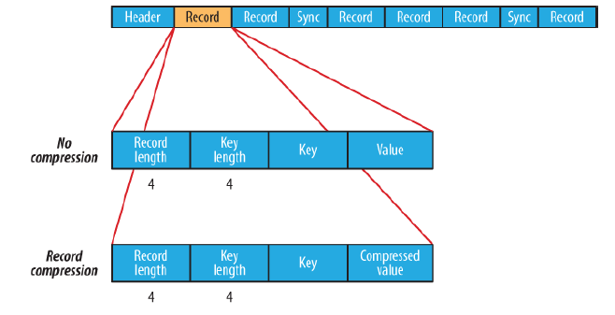
SequenceFile Format – 1
  Header contains the version number, the names of the key and value classes, compression details, user-defined metadata, and the sync marker.

Slide 35
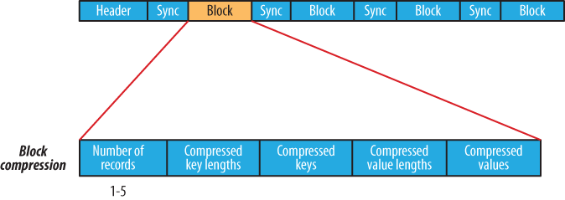
SequenceFile Format – 2
  Block compression compresses multiple records at once; it is therefore more compact.

Slide 36
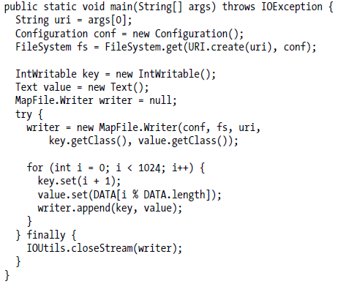

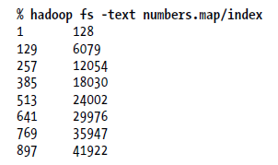
MapFile – p.137
  A MapFile is a sorted SequenceFile with an index to permit lookups by key.
  Keys must be instances of WritableComparable and values must be Writable.

