Slide 1
Developing a MapReduce Application
Chapter 5

Slide 2
Learning Objectives
  The Configuration File
  Development Environment Setup
  Write a Unit Test
  Run a Job

Slide 3
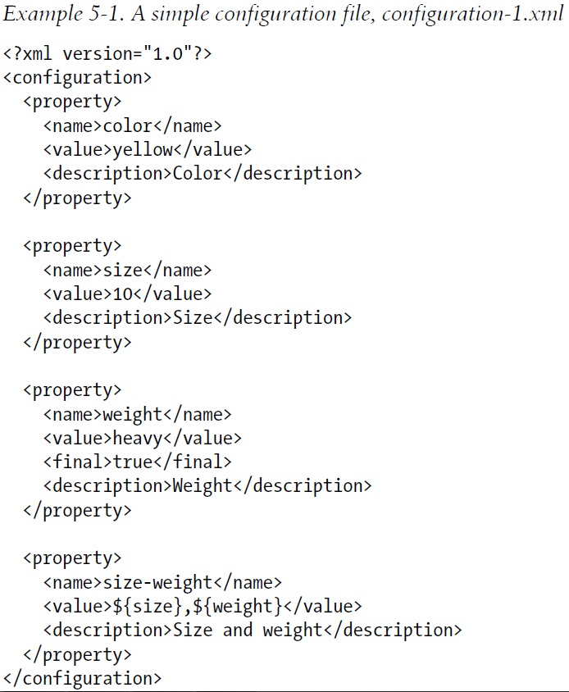
Hadoop Configuration File – 1

Slide 4
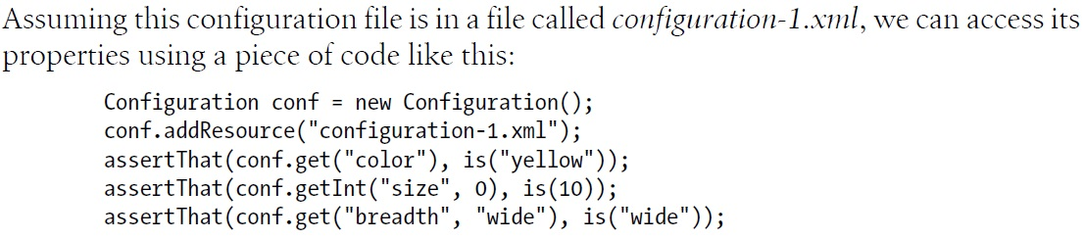
Hadoop Configuration File – 2

Slide 5
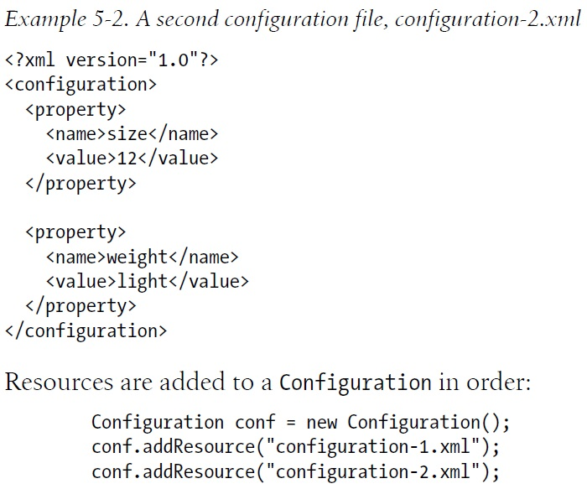
Hadoop Configuration File – 3

Slide 6
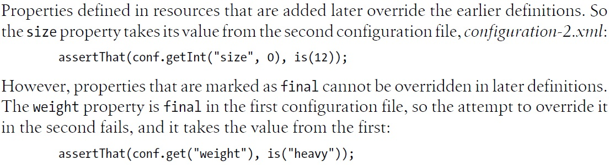
Hadoop Configuration File – 4

Slide 7
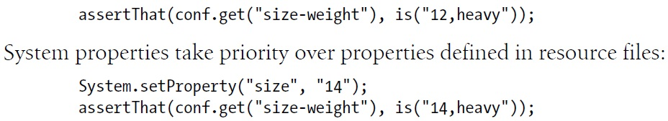
Variable Expansion
  Properties can be defined in terms of other properties, or system properties.

Slide 8
Configuring the Development Environment
  Assume the conf directory contains three configuration files: hadoop-local.xml, hadoop-localhost.xml, and hadoop-cluster.xml.
 | Local | Pseudo-distributed | Distributed
fs.default.name | file:/// | hdfs://localhost/ | hdfs://namenode/
mapred.job.tracker | local | localhost:8021 | jobtracker:8021
  To specify which configuration file you are using

Slide 9
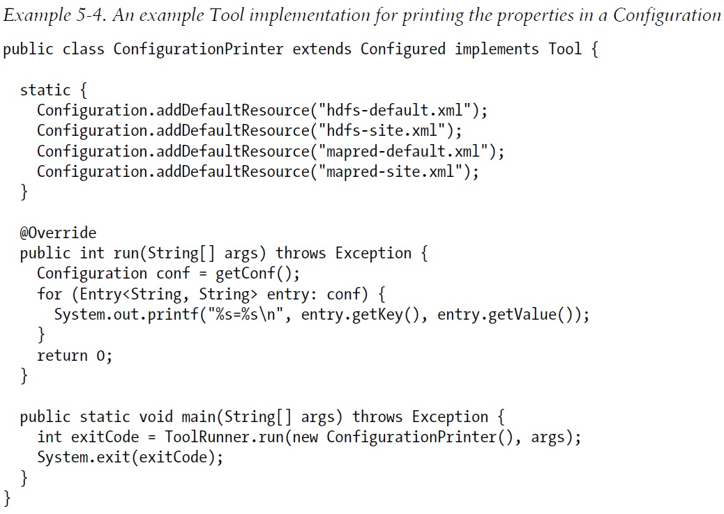
A Tool Implementation

Slide 10
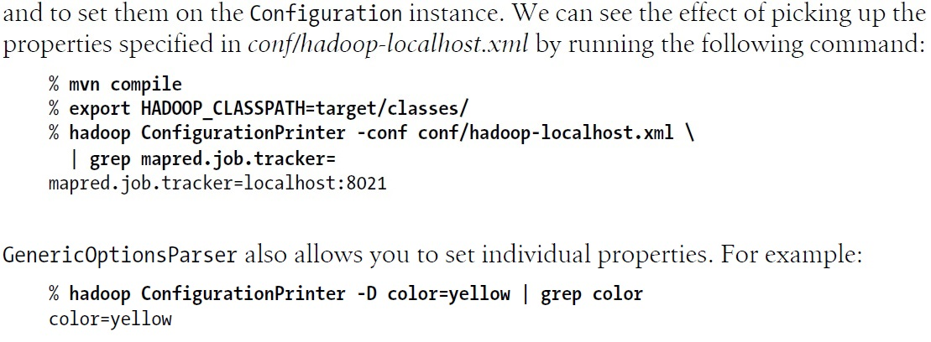
Show the Properties

Slide 11
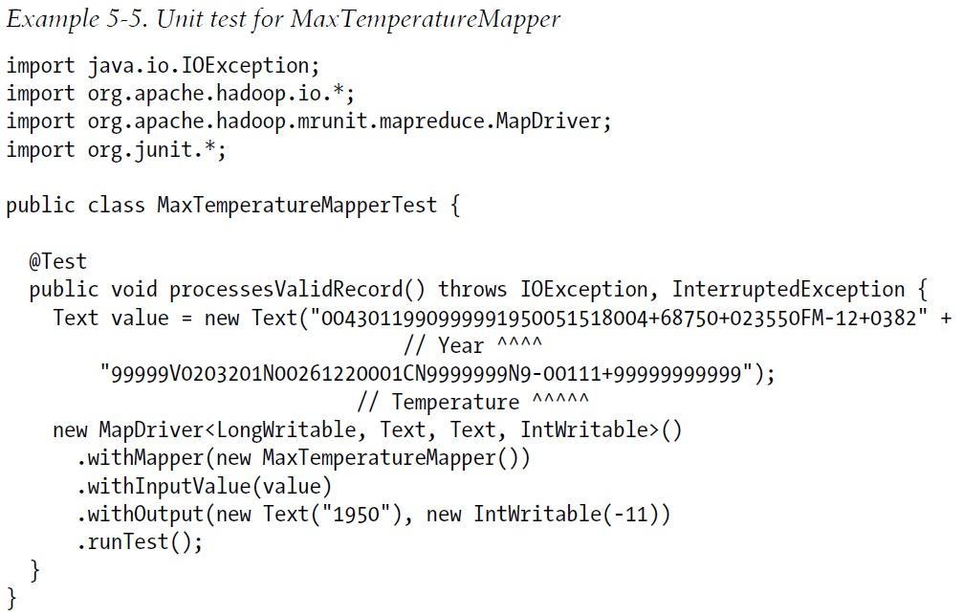
Test For Mapper

Slide 12
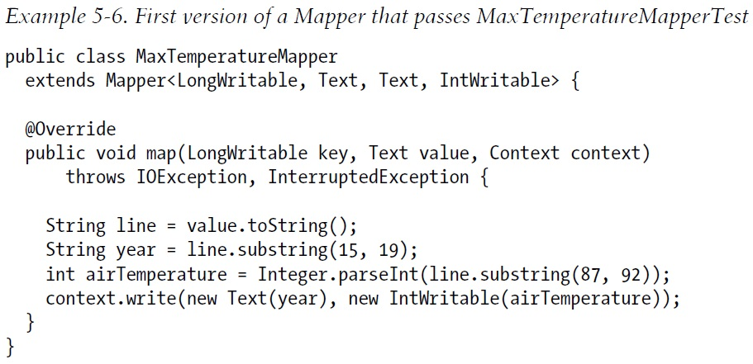
The First Version of a Mapper

Slide 13
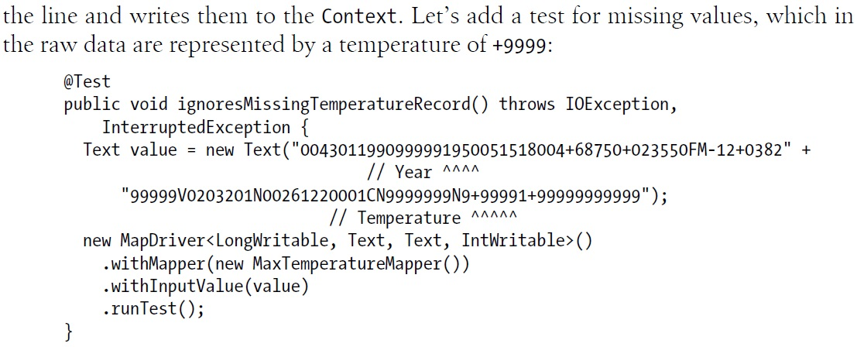
Test Missing Value

Slide 14
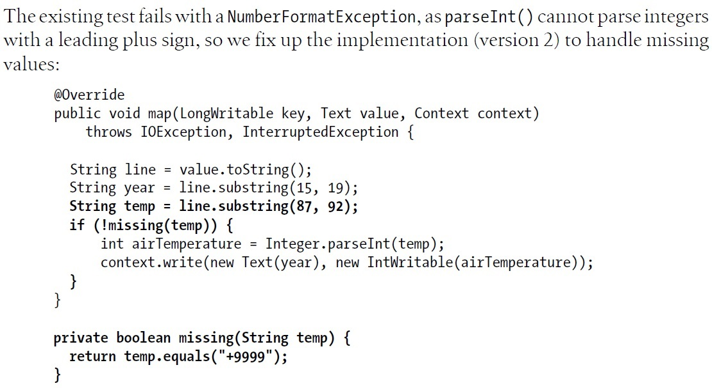
A Fix to Handling Missing Value

Slide 15
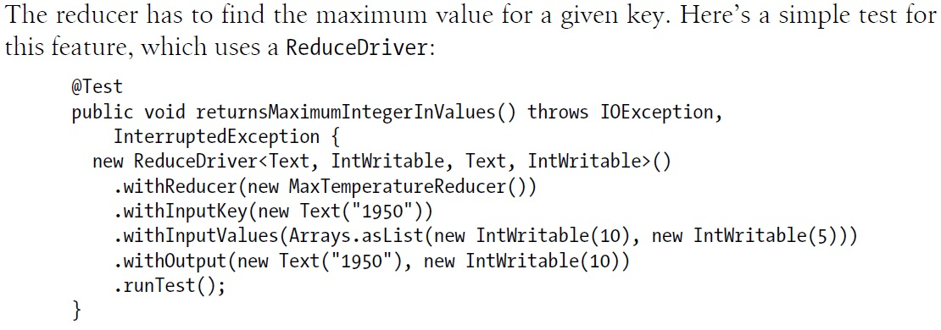
Test For Reducer

Slide 16
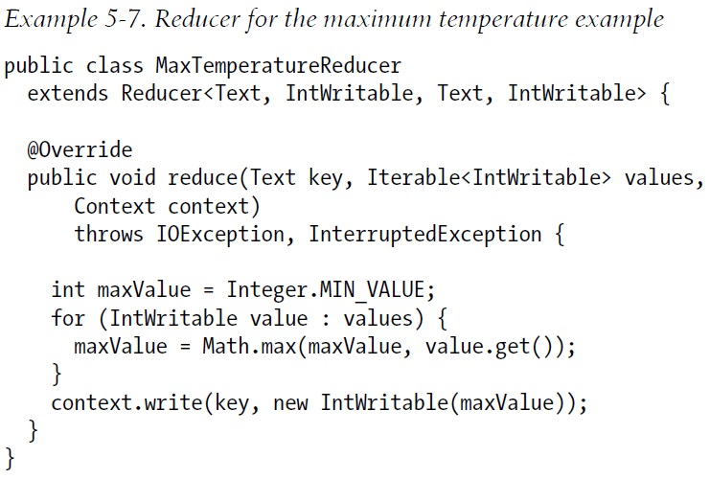
Reducer Passes the Test

Slide 17
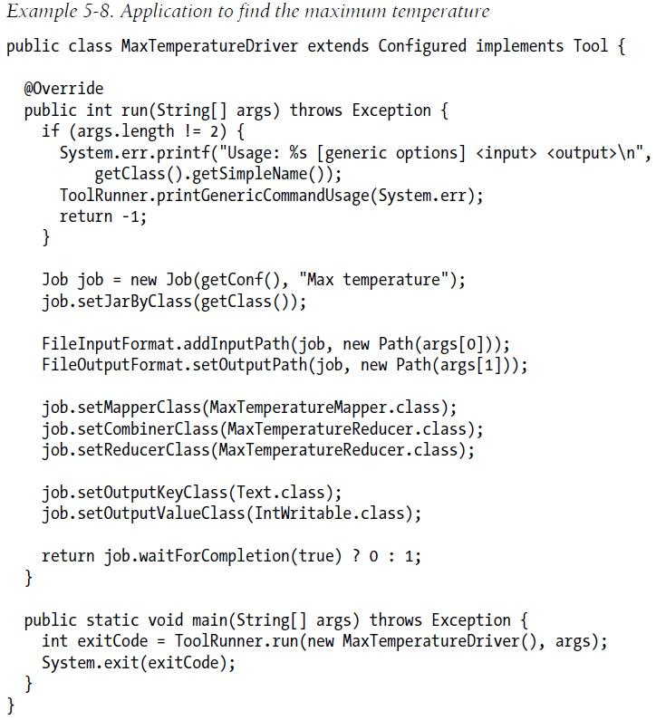
A Driver to Run MapReduce – p.157

Slide 18
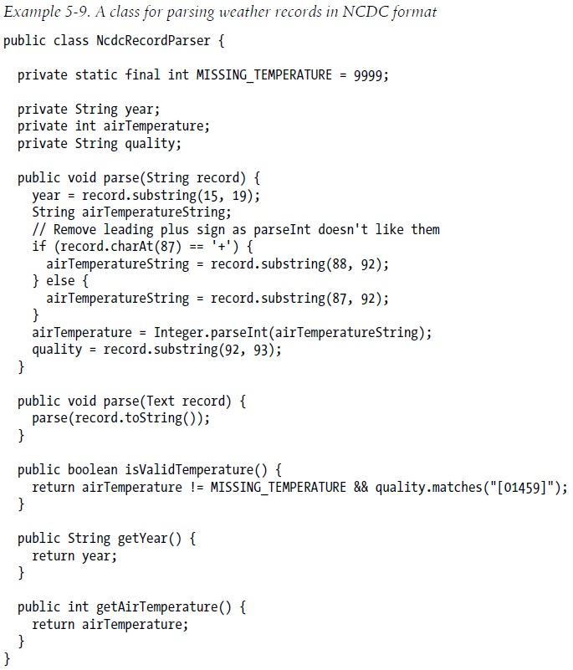
Fixing the Mapper – 1

Slide 19
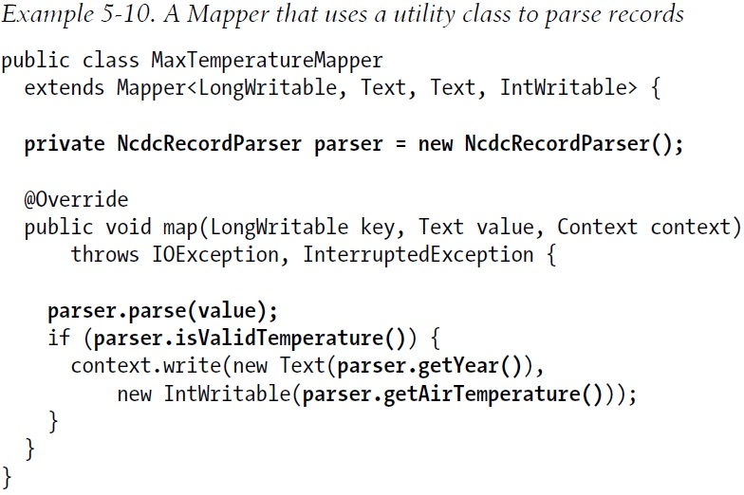
Fixing the Mapper – 2

Slide 20
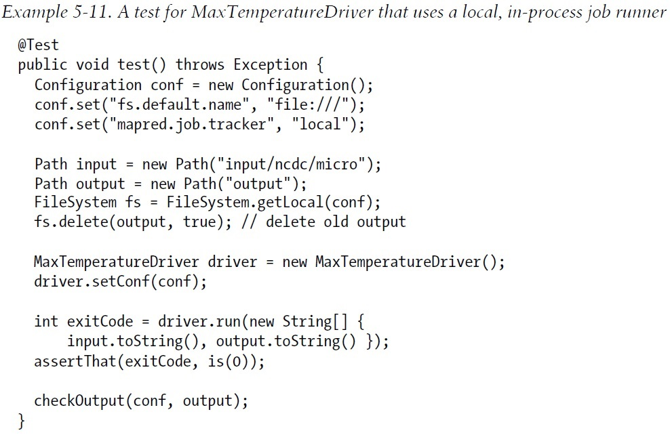
Testing the Driver

Slide 21
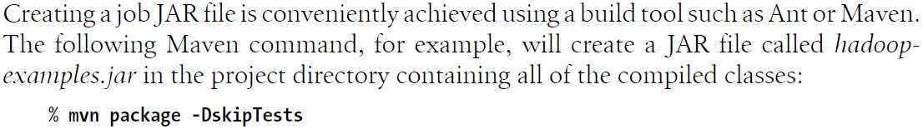
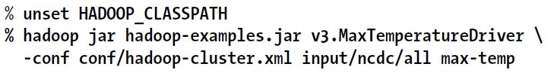
Packaging and Launching a Job
  Packaging – package a job’s classes into a JAR file.
  This class will also use Eclipse to create a JAR file
  Launching – run the driver, specifying the driver class, input and output folders.

Slide 22
View Job Information
  Hadoop comes with a web UI for viewing job information.
  It is useful for finding job’s progress, statistics, and logs.
  The UI is at http://jobtracker-host:50030
  It has a jobtracker/home page and a job page.

Slide 23
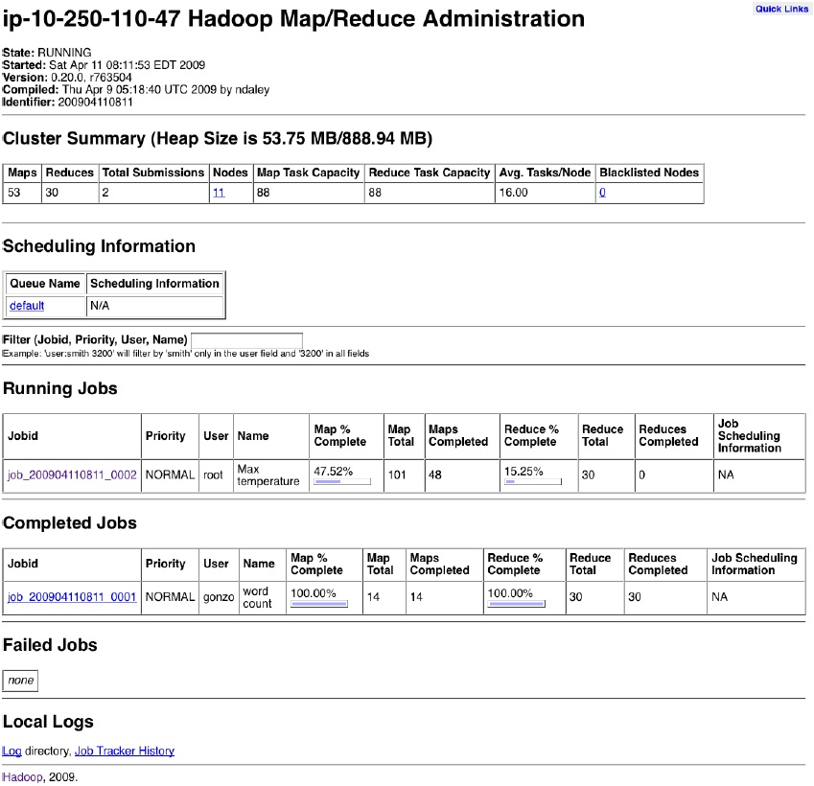
The JobTracker/Home Page

Slide 24
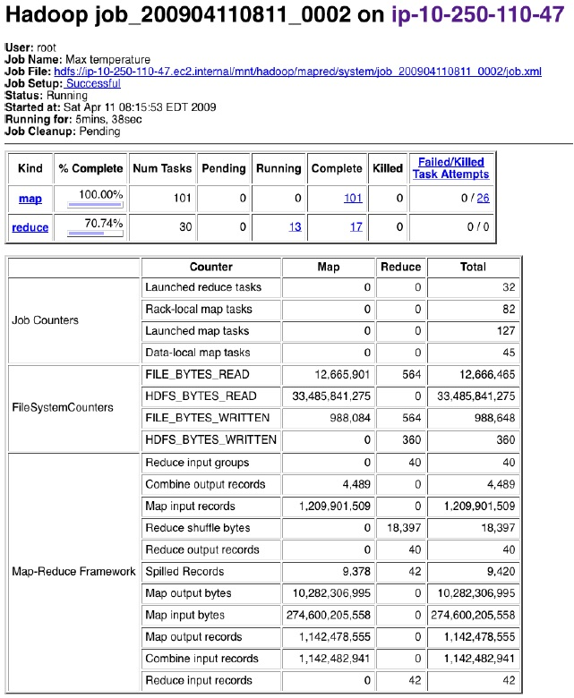
The Job Page

Slide 25
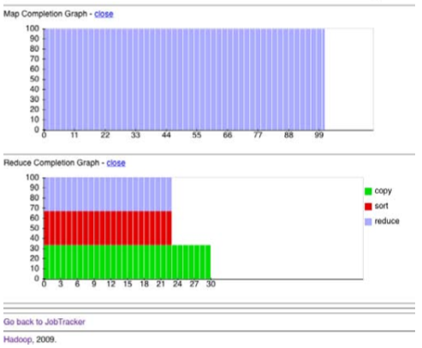
Completion Graph

Slide 26
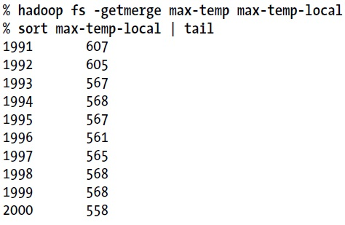
Retrieve Results
  The –getmerge option gets all the files in the directory and merges them into a single file on the local filesystem.
  The –cat option prints the output files to the console.

Slide 27
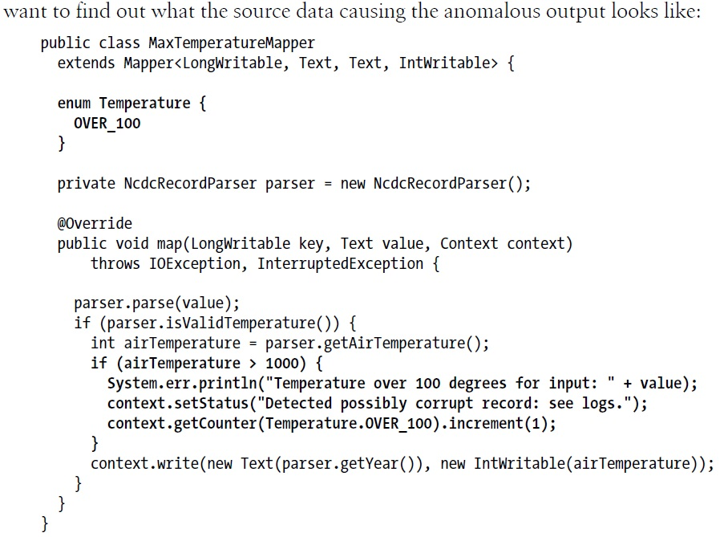
Debugging a Job – p.171

Slide 28
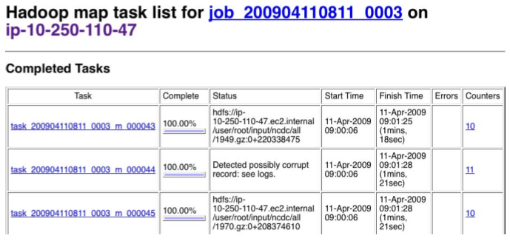
Debugging a Job – 2

Slide 29
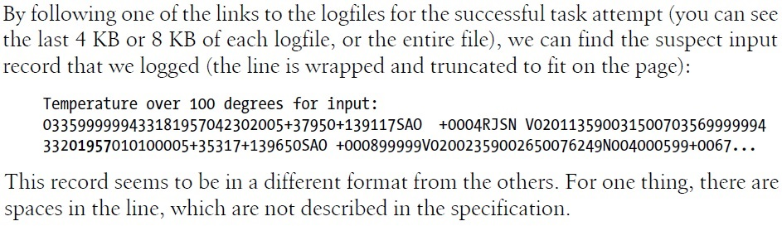
Debugging a Job – 3 (p.174)

Slide 30
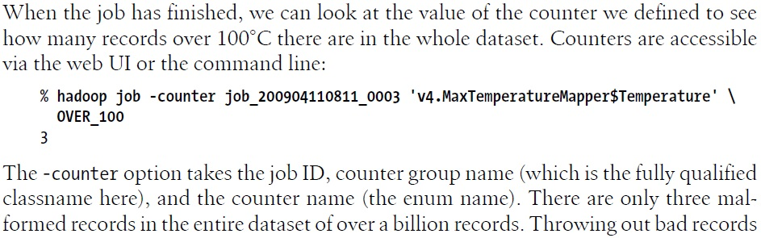
Debugging a Job – 4

Slide 31
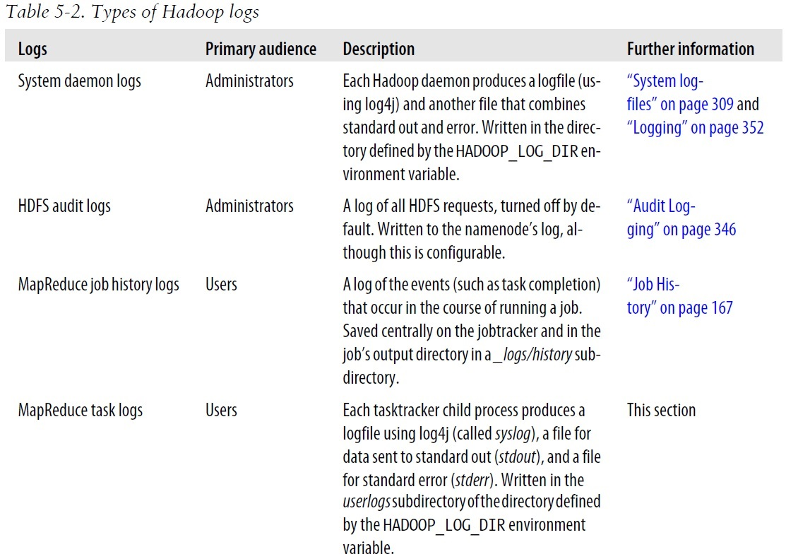
Hadoop Logs

