Slide 1
How MapReduce Works
Chapter 6

Slide 2
Learning Objectives
  MapReduce Job Anatomy
  Failures
  Job Scheduling
  Shuffle and Sort
  Task Execution

Slide 3
Entities in Classic MapReduce (MapReduce 1)
  Client – submits the MapReduce job.
  Jobtracker – coordinates the job run; a Java application whose main class is JobTracker.
  Tasktrackers – run the tasks that the job has been split into.
  Distributed file system (HDFS) – is used for sharing job files between the other entities.

Slide 4
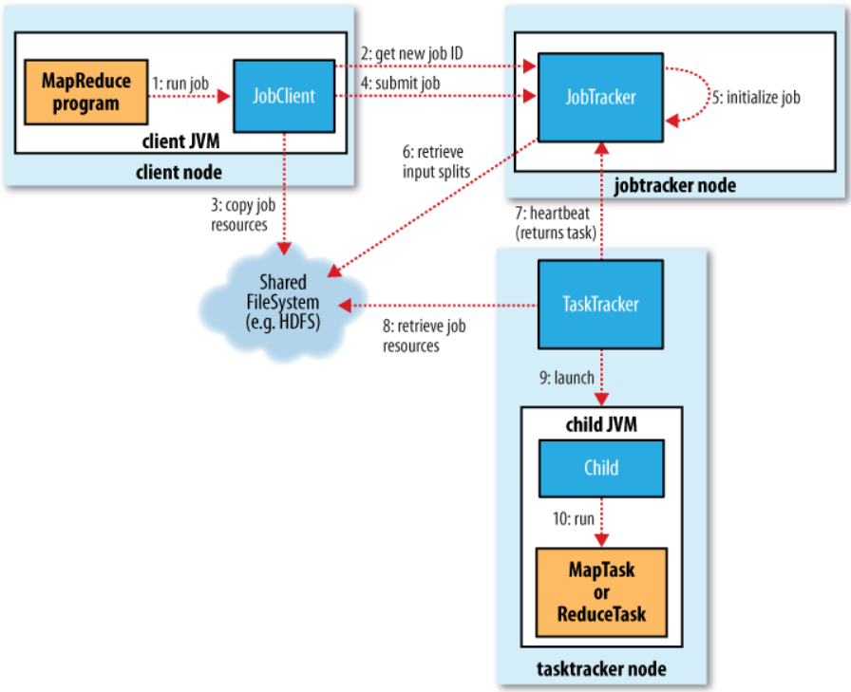
Classic MapReduce Framework

Slide 5
Job Submission
  Job submission – the submit() method on Job creates an internal JobSummitter instance and calls submitJobInternal() on it, and does the following:
  Ask the jobtracker for a new job ID;
  Check the output specification of the job;
  Computer the input splits for the job;
  Copy the resources needed to run the job;
  Tell the jobtracker that the job is ready for execution.

Slide 6
Job Initialization
  Job initialization – the JobTracker puts a job into an internal queue where the job scheduler will pick it up and initialize it. It involves:
  Creating an object to represent the job being run;
  Bookkeeping information to keep track of the status and progress of its tasks.

Slide 7
Job Assignment
  Job assignment – the JobTracker assign a task to a TaskTracker when it is ready to run a new task. The JobTracker will
  Choose a job to select the task from;
  Set a fixed number of slots for map tasks and for reduce tasks independently.

Slide 8
Task Execution
  Task execution – the TaskTracker runs the task. The TaskTracker will:
  Localize the job JAR by copying it from the shared filesystem to the tasktracker’s filesystem;
  Create a local working directory for the task and “un-jars” the contents of the JAR into this directory;
  Create an instance of TaskRunner to run the task.

Slide 9
Progress and Status Updates
  Progress and status updates – MapReduce jobs are long-running batch jobs, taking anything from minutes to hours to run. So, it is important for the user to get feedback.
  A job and each of its tasks have a status;
  This includes the state of the job or task (e.g., running, successfully completed, failed) and task counters.

Slide 10
Job Completion
  Job completion – when the JobTracker is notified that the last task for a job is complete, it changes the status for the job to “successful.” It will:
  Print a message to tell the user;
  Return from the waitForCompletion() method;
  Job statistics and counters are printed to the console.

Slide 11
YARN (MapReduce 2) – 1
  MapReduce 1 hits scalability bottlenecks for a very large cluster of 4,000 nodes or more.
  YARN is the next generation of MapReduce, short for Yet Another Resource Negotiator.
  YARN splits the responsibilities of the JobTracker into separate entities for scalability.
  The JobTracker takes care of both job scheduling and task progress monitoring.

Slide 12
YARN (MapReduce 2) – 2
  YARN uses two independent daemons to separate these two roles:
  A resource manager to manage the use of resources across the cluster, and
  An application master to manage the lifecycle of applications running on the cluster.
  YARN is more general than MapReduce;
  In fact MapReduce is just one type of YARN application.

Slide 13
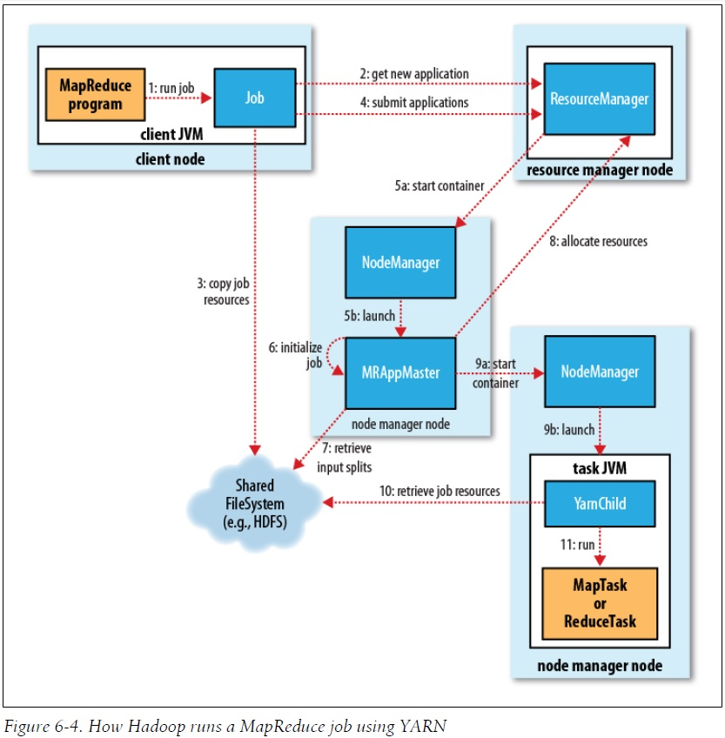
YARN Framework

Slide 14
Failures
  There are three failure modes:
  Task failure – when user code in the map or reduce task throws a runtime exception.
  TaskTracker failure – when a TaskTracker fails by crashing or running very slowly and stopping (or very infrequently) sending heartbeats to the JobTracker.
  JobTracker failure – when the JobTracker fails by crashing; all running jobs fail.

Slide 15
Task Failure – 1
  Child task failing
  Child JVM reports the error back to its parent TaskTracker
  Sudden exit of the child JVM
  The TaskTracker notices that the process has exited and marks the attempt as failed.
  Hanging tasks
  The TaskTracker notices that it hasn’t received a progress update for a while and mark the task as failed.
  The child JVM process will be automatically killed after this period (timeout period of 10 minutes)

Slide 16
Task Failure – 2
  Tasktracker
  Notifying the jobtracker of the failure using heartbeat.
  Jobtracker
  Reschedule the task on a different TaskTracker.
  A task failing four or more times will not be retried.

Slide 17
TaskTracker Failure
  Jobtracker
  Notices a tasktracker that has stopped sending heartbeats;
  Removes it from tasktracker pool to schedule tasks on;
  Arranges for map tasks that were run and completed successfully on that tasktracker to be rerun.
  Blacklist
  A tasktracker is blacklisted if its task failure rate is significantly higher than the average’s on the cluster.
  Blacklisted tasktrackers can be restarted to remove them from the blacklist.

Slide 18
Jobtracker Failure
  Currently, Hadoop has no mechanism for dealing with failure of the jobtracker.
  Jobtracker failure has a low chance of occurring.
  Future work
  Running multiple jobtrackers, only one of which is the primary jobtracker at any time.
  Choosing the primary jobtracker using ZooKeeper as a coordination mechanism.

Slide 19
Failures in YARN
  Failures in YARN:
  Task failure – is similar to the classic case.
  Application master failure – give several attempts to succeed; marked as failed if they fail once.
  Node manager failure – resource manager removes node manager from its pool of available nodes.
  Resource manager failure – a new resource manager instance is brought up and it recovers from the saved state.

Slide 20
Job Scheduling
  FIFO scheduler (default) – run in order of submission; later on, can set a job’s priority, but does not support preemption.
  Fair scheduler – each user gets their own pool, where jobs are placed in; a user who submits more jobs will not get any more cluster resources; support preemption.
  Capacity scheduler – a cluster is made up of a number of queues, which may be hierarchical; each queue has an allocated capacity; within each queue, jobs are scheduled using FIFO.

Slide 21
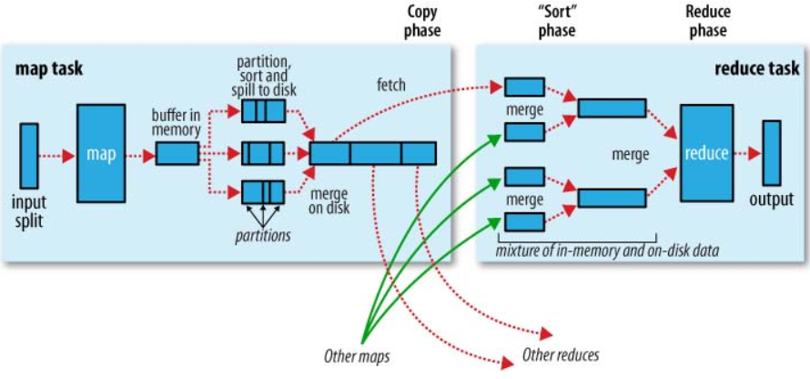
Shuffle and Sort
  Shuffle is the process that the system performs the sort and transfers the map outputs to the reducers as inputs.

Slide 22
The Map Side
  Buffering write and spill to disk
  Circular memory buffer of 100MB by default;
  A background thread spills the contents to disk when the contents of the buffer reaches a certain threshold (default: 0.80 = 80%).
  Before writing to disk, the background thread partitions the data corresponding to the reducers.
  The thread performs an in-memory sort by key, within each partition.

Slide 23
The Reduce Side
  Copy phase
  Map tasks may finish at different times.
  Reduce task starts copying their outputs as soon as each completes.
  The map outputs also written using memory buffer and spill to disk if it reaches a threshold size.
  Sort phase (merge phase)
  Map outputs are merged in rounds.

Slide 24
Configuration Tuning
  The general principle is to give the shuffle as much memory as possible.
  For map, the best performance can be obtained by avoiding multiple spills to disk; one is optimal.
  For reduce, the best performance is obtained when the intermediate data can reside entirely in memory.
  Hadoop uses a buffer size of 4 KB by default, which is low, so you should increase this across the cluster.

Slide 25
Speculative Execution
  Job execution time is sensitive to slow-running tasks.
  Only one straggling task can make the whole job take significantly longer.
  Speculative task – another, equivalent, backup task.
  Launched only after all the tasks have been launched.
  When a task completes successfully, any duplicate tasks that are running are killed.

Slide 26
Task JVM Reuse
  To reduce the overhead of starting a new JVM for each task. Effective case:
  Jobs have a large number of very short-lived tasks (these are usually map tasks).
  Jobs have lengthy initialization.
  If tasktrackers run more than one task at a time, this is always done in separate JVMs.

Slide 27
Skipping Bad Records
  In mapper or reducer code – ignore bad records; throw an exception.
  Using Hadoop’s skipping mode – when you can’t handle them because there is a bug in a third party library. Skipping process:
  Task fails
  Task fails
  Skipping mode is enabled
  Task fails but failed record is stored by the tasktracker;
  Skipping mode is still enabled
  Task succeeds by skipping the bad record that failed in the previous attempt.
  Skipping mode can detect only one bad record per task attempt.
  This mechanism is appropriate only for detecting occasional bad records.

