Slide 1
MapReduce
Types and Formats
Chapter 7

Slide 2
Learning Objectives
  MapReduce Types
  Input Formats
  Output Formats

Slide 3

General Form of MapReduce
  General form:
≠
Map: (K1, V1) → list(K2, V2)
Reduce: (K2, list(V2)) → list(K3, V3)
=
  Combine function:

Slide 4
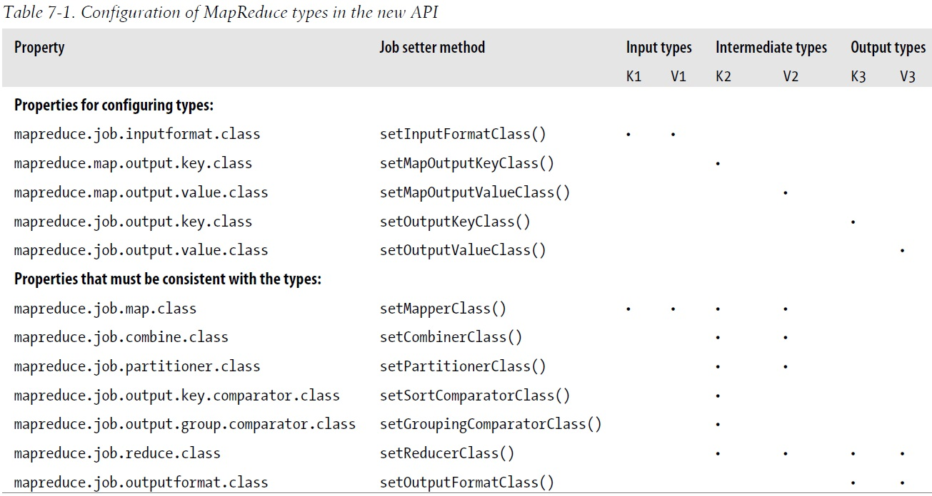
Configuration of MapReduce Types – 1

Slide 5
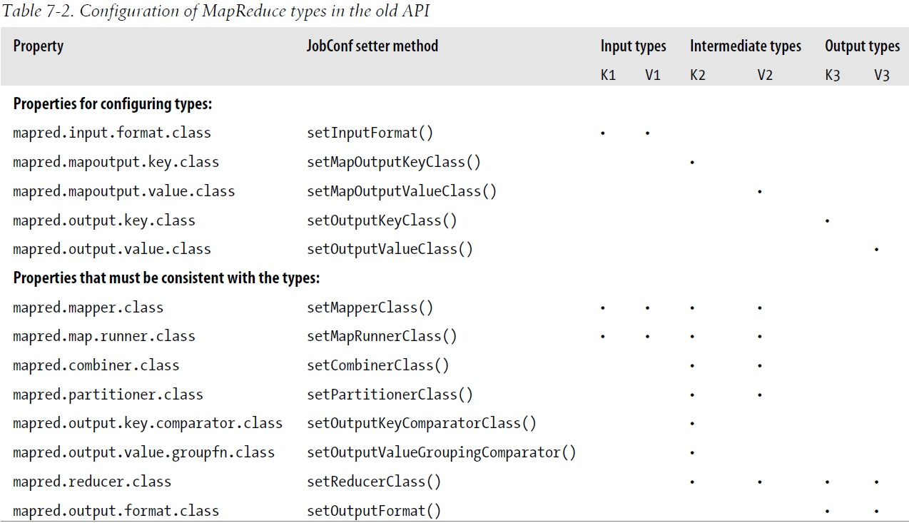
Configuration of MapReduce Types – 2

Slide 6
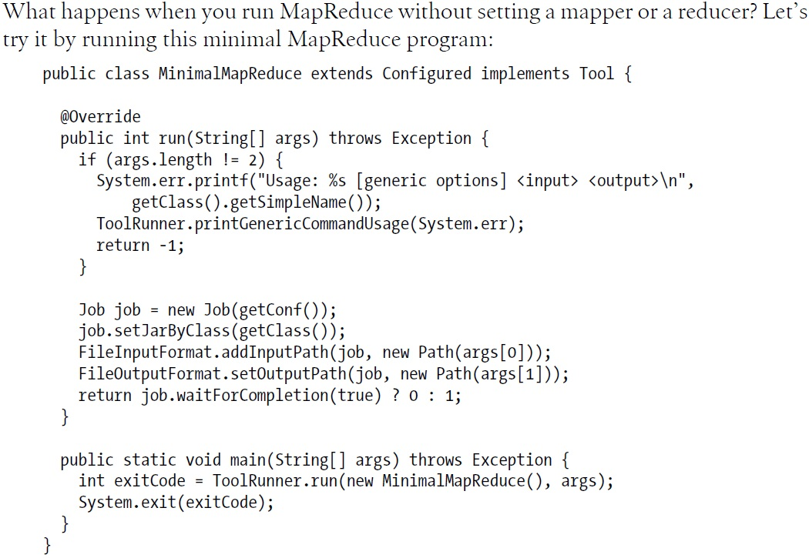
Without Setting a Mapper or a Reducer – 1

Slide 7
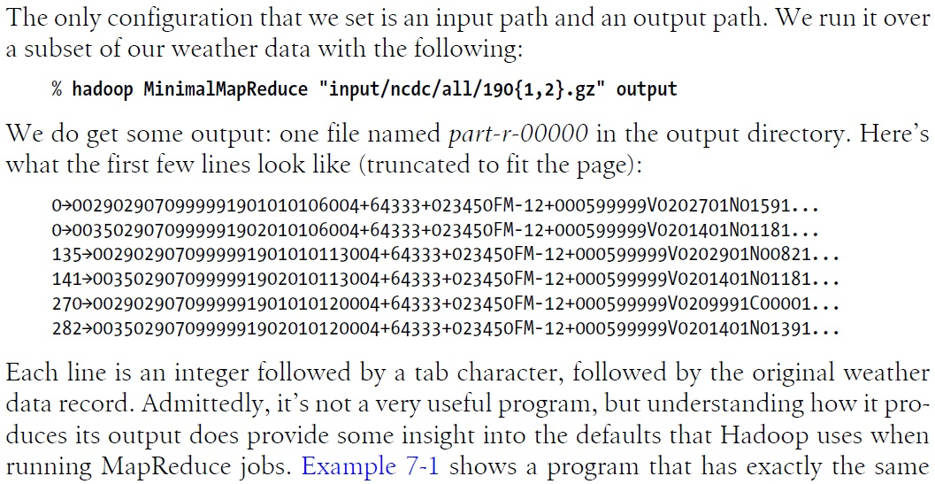
Without Setting a Mapper or a Reducer – 2

Slide 8
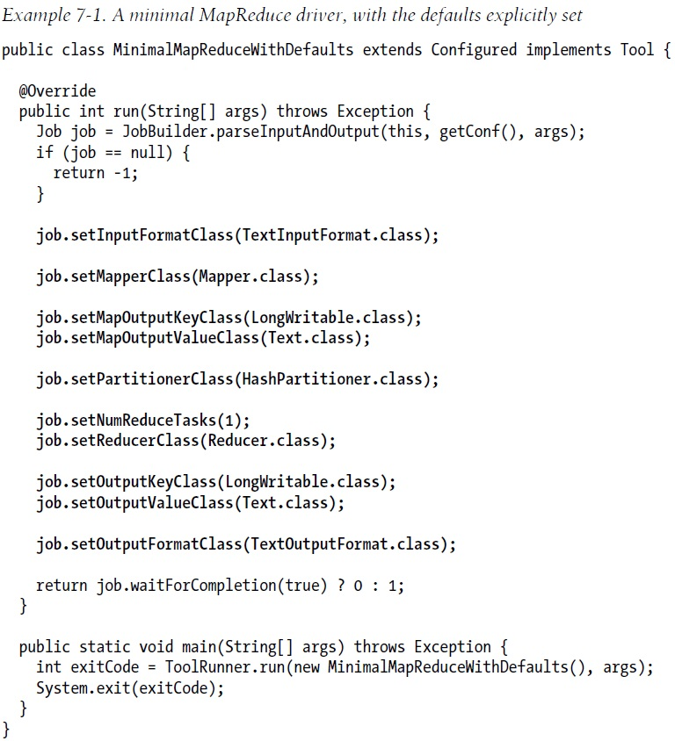
MapReduce Default Settings

Slide 9
Choosing the Number of Reducers
  The single reducer default is no good and needs to be set to a larger number.
  The optimal number of reducers is related to the total number of available reducer slots, which can be calculated as:
  Total nodes * tasktracker.reduce.tasks.maximum (default 2)
  To have slightly fewer reducers than total slots.
  Tolerate a few failures without extending job execution time.

Slide 10
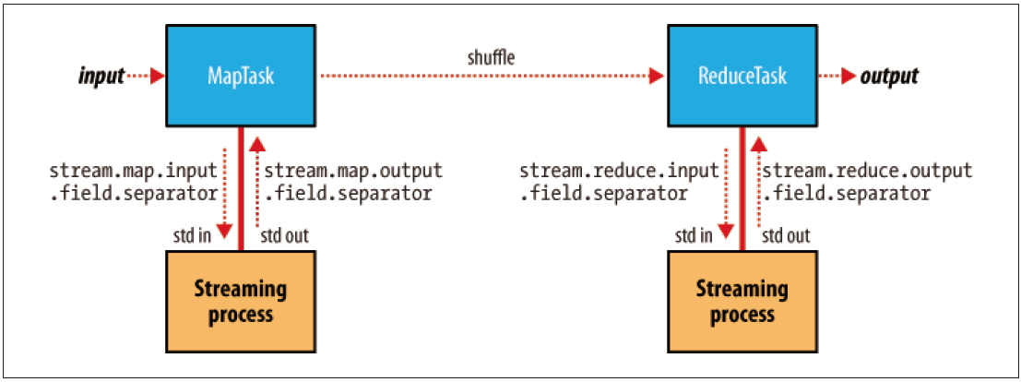
Keys and values in Streaming
A streaming application can control the separator.
  Default separator: tab character;
  Separators may be configured independently for maps and reduces;
  A key can be made up of the first n fields:
  Ex) Output was a,b,c (and separator is a comma), n=2
      Key: a,b Value:c

Slide 11
Input Splits
  InputSplit
  A chunk of the input processed by a single map;
  Each split is divided into records;
  The map processes each record—a key-value pair;
  Process the largest split first to minimize the job runtime;
  The client sends the calculated splits to the JobTracker.

Slide 12
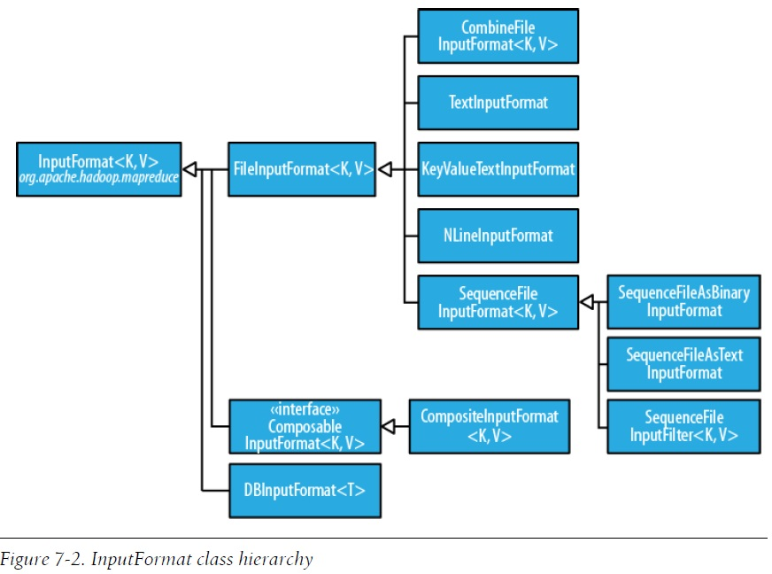
InputFormat Class Hierarchy

Slide 13

Input Paths
  FileInputFormat offers 4 static methods for setting a Job’s input paths:
  addInputPath() and addInputPaths()
  Add a path or paths to the list of inputs
  Can call these methods repeatedly
  Two setInputPaths()
  Set entire list of paths in one time (Replacing any paths that were set in previous calls)
  A path may represent
  A file or a directory (consider all files in the directory as input)
  A collection of files and directories by using a glob

Slide 14
FileInputFormat
  FileInputFormat uses a default filter that excludes hidden files.
  FileInputFormat splits only large files that larger than an HDFS block.
  The split size is normally the size of an HDFS block.
  The minimum split size is usually 1 byte.
  The maximum split size defaults to the maximum value of Java long type.

Slide 15
Small Files and CombineFileInputFormat
  Hadoop works better with a small number of large files than a large number of small files.
  FileInputFormat generates splits that each split is all or part of a single file
  Use CombineFileInputFormat to pack many files into splits.
  Designed to work well with small files
  Take node and rack locality when packing blocks into split
  Worth when already have a large number of small files in HDFS
  Avoiding the many small files is a good idea.
  Reduce the number of seeks
  Merge small files into larger files by using a SequenceFile

Slide 16
Preventing Splitting
  Some application don’t want files to be split.
  Want to process entire data by a single mapper
  Two ways of ensuring an existing file is not split:
  Set the minimum split size larger than the largest file size
  Override the isSplitable() method to return false

Slide 17
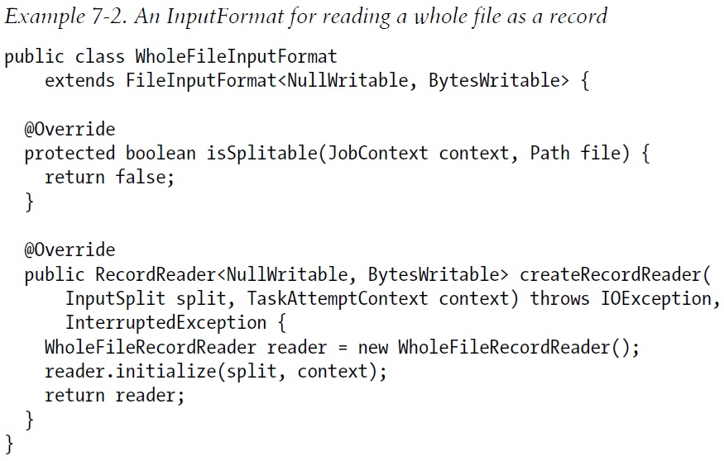
Processing a Whole File As a Record – p.242

Slide 18


TextInputFormat – 1
  TextInputFormat is the default InputFormat
  Key: The byte offset of the beginning of the line (LongWritable) ; Not line number
  Value: The contents of the line excluding any line terminators (Text)

Slide 19
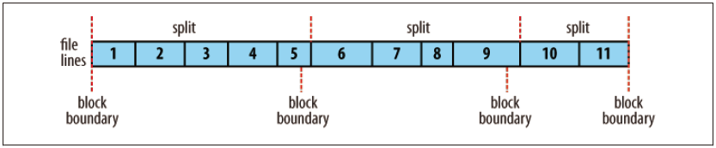
TextInputFormat – 2
  The offset within the file of each line is known by each split independently of the other splits;
  Each split knows the size of the preceding splits;
  Add previous split size onto the offsets within the split to produce a global file offset.

Slide 20
NLineInputFormat
  TextInputFormat, KeyValueTextInputFormat – each mapper receives a variable number of lines of input.
  NLineInputFormat – receive a fixed number of lines of input.
  N: The number of lines of input.
  Control N in Mapred.line.input.format.linespermap property
  With N set to one, each mapper receives exactly one line of input.

Slide 21
Binary Input
  SequenceFileInputFormat
  Hadoop’s sequence file format stores sequences of binary key-value pairs
  Data is splittable (Data has sync points)
  Use SequenceFileInputFormat
  SequenceFileAsTextInputFormat
  Convert the sequence file’s keys and values to Text objects
  Use toString() method
  SequenceFileAsBinaryInputFormat
  Retrieve the sequence file’s keys and values as opaque binary objects

Slide 22
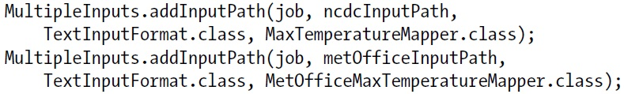
Multiple Inputs
  Use MultipleInput when have data sources that provide the same type of data but in different formats, for example:
  One might be tab-separated plain text, the other a binary sequence file;
  Need to be parsed differently;
  Use different mappers;
  The map outputs have the same types;
  Reducers are not aware of the different mappers.

Slide 23
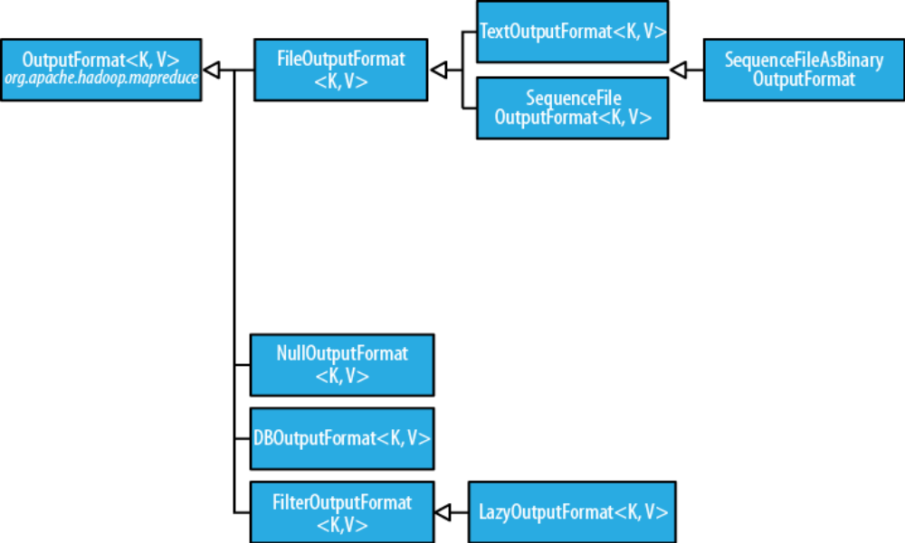
Output Formats
Figure 7-4. The OutputFormat class hierarchy

Slide 24
Text Output
TextOutputFormat (default)
  Write records as lines of text
  Keys and Values may be of any type
  It calls toString() method
  Each key-value pair is separated by a tab character
  Set the separator in mapred.textoutputformat.separator property

Slide 25
Binary Output
  SequenceFileOutputFormat
  Write sequence files for its output.
  Compact, readily compressed (Useful for a further MapReduce job).
  SequenceFileAsBinaryOutputFormat
  Write keys and values in raw binary format into a SequenceFile container.
  MapFileOutputFormat
  Write MapFiles as output.
  The keys in MapFile must be added in order.

Slide 26
MultipleOutputs – 1
MultipleOutputs
  Output file names are derived from the output keys and values, or from an arbitrary string.
  Allows each reducer (or mapper in a map-only job) to create more than a single file.
  Filenames are of the form name-m-nnnnn for map outputs and name-r-nnnnn for reduce outputs.
  Name is arbitrary and set by the program, and nnnnn is an integer designating the part number, starting from zero.

Slide 27
MultipleOutputs – 2
  P. 255 Example 7-5

