Slide 1
MapReduce Features
Chapter 8

Slide 2
Learning Objectives
  Counters
  Sorting
  Joins
  Side Data Distribution

Slide 3
Counters
  Counters are a useful channel for gathering statistics about the job:
  for quality control;
  for application-level statistics;
  for problem diagnosis (# of invalid records);
  Easier to use and to retrieve than log output.

Slide 4
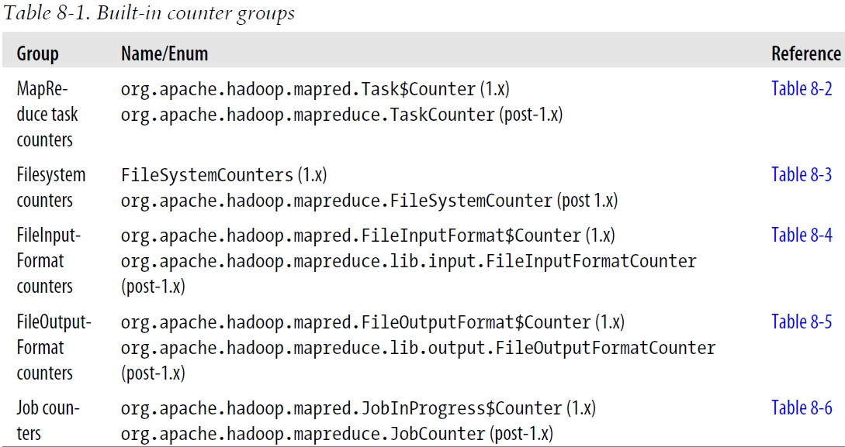
Built-In Counters
  Built-in counters for every job
  Report various metrics for Map-Reduce jobs.
  Counters for the number of bytes and records processed.

Slide 5
Task and Job Counters
  Task counters gather information about tasks over the course of their execution.
  MAP_INPUT_RECORDS counter counts the input records read by each map task;
  Then aggregates over all map tasks in a job.
  Job counters are maintained by the jobtracker (or application master in YARN).
  Measure job-level statistics,
  TOTAL_LAUNCHED_MAPS counts the number of map tasks that were launched (including tasks that failed).

Slide 6
User-Defined Java Counters – 1
  MapReduce allows user code to define a set of counters, which are then incremented as desired in the mapper or reducer.
  Counters are defined by a Java enum, which serves to group related counters.
  The name of the enum is the group name.
  The enum’s fields are the counter names.

Slide 7
User-Defined Java Counters – 2
  P. 264: Example 8-1

Slide 8
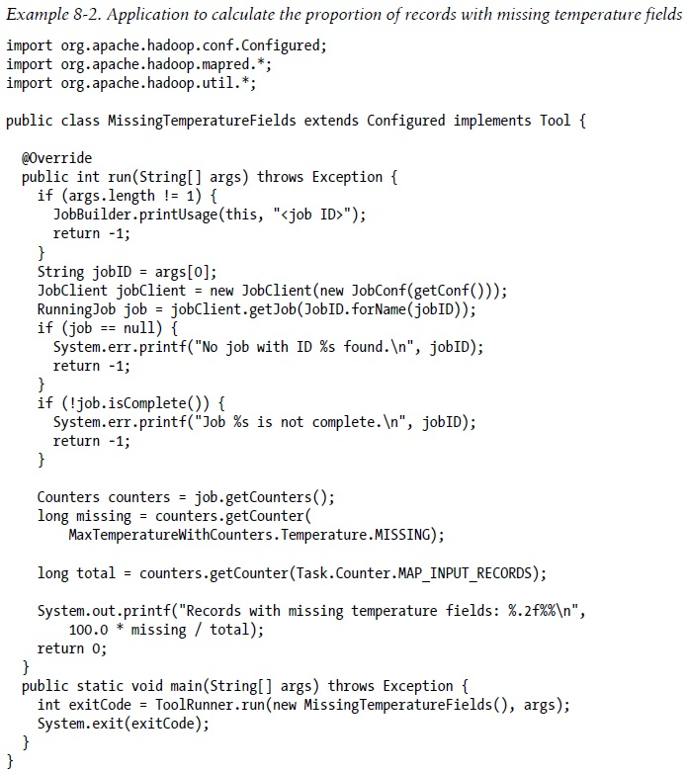
Retrieving Counters – P. 267

Slide 9
Sorting
  The ability to sort data is at the heart of MapReduce.
  Even if your application isn’t concerned with sorting per se, it may be able to use the sorting stage that MapReduce provides to organize its data.
  P. 269: Example 8-3.

Slide 10
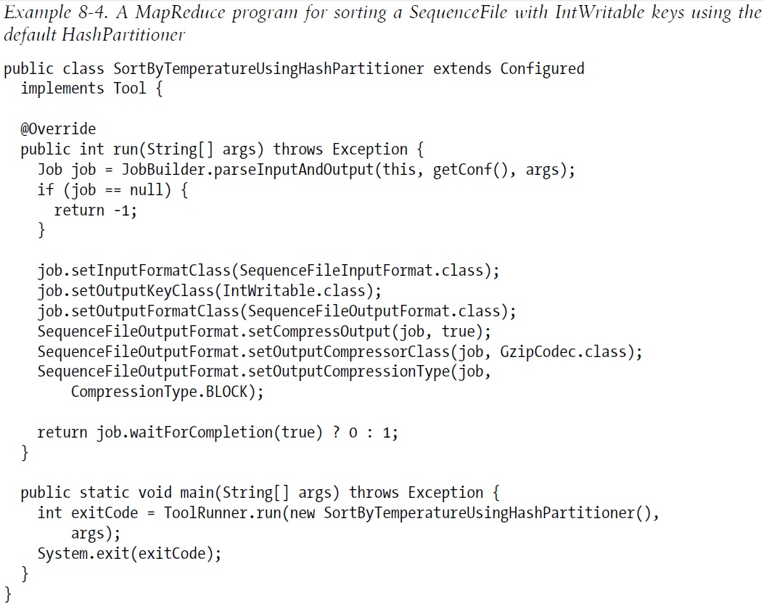
Sorting a Sequence File with IntWritable – P. 270

Slide 11
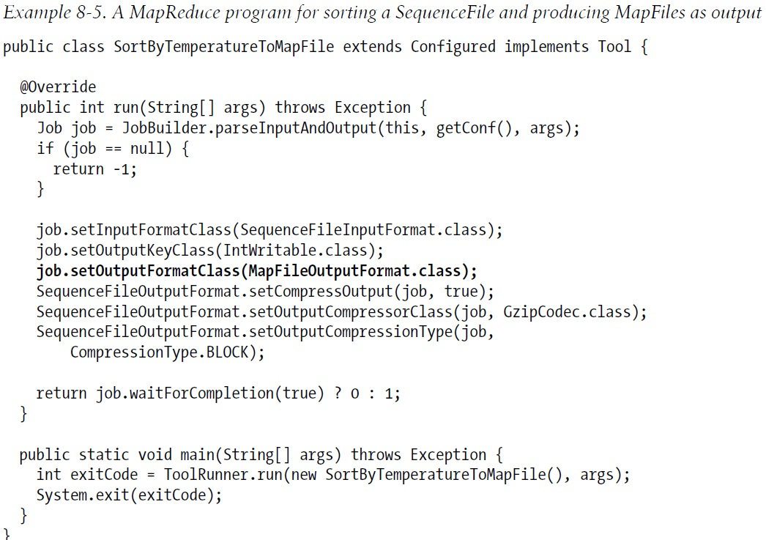
Produce MapFiles as Output – 271

Slide 12
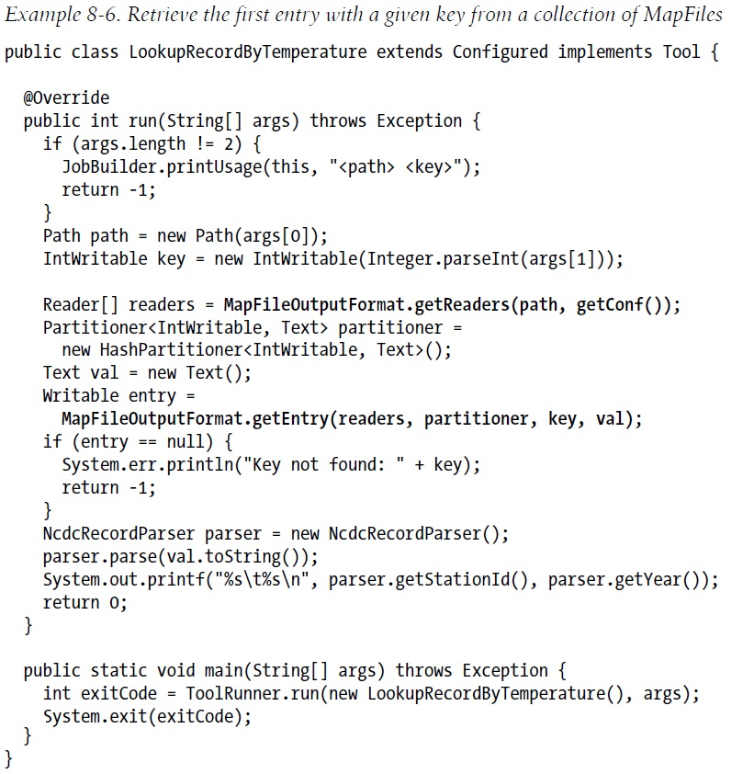
Retrieve the First Entry

Slide 13

Total Sort
  Produce a set of sorted files that, if concatenated, would form a globally sorted file.
  Use a partitioner that respects the total order of the output.
  Although this approach works, you have to choose your partition sizes carefully to ensure that they are fairly even so that job times aren’t dominated by a single reducer.

Slide 14
Sampling
  To construct more even partitions, we need to have a better understanding of the distribution for the whole dataset.
  It’s possible to get a fairly even set of partitions, by sampling the key space.
  The idea behind sampling is that you look at a small subset of the keys to approximate key distribution, which is then used to construct partitions.

Slide 15
Global Sort
  P. 276: Example 8-8

Slide 16
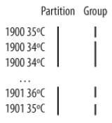
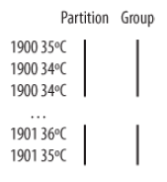

Secondary Sort – 1
  Example: calculating the maximum temperature for each year.
  It is possible to impose an order on the values by sorting and grouping the keys in a particular way.
  Make the key a composite of the natural key and the natural value.
  The key comparator should order by the composite key, that is, the natural key and natural value.
  The partitioner and grouping comparator for the composite key should consider only the natural key for partitioning and grouping.

Slide 17
Secondary Sort – 2
  P. 279: Example 8-9

Slide 18
Map-Side Join – 1
  A map-side join works by performing the join before the data reaches the map function. Requirements:
  Each input dataset must be divided into the same number of partitions.
  It must be sorted by the same key (the join key) in each source.
  Above requirements actually fit the description of the output of a MapReduce job:
  A map-side join can be used to join the outputs of several jobs that had the same number of reducers, the same keys, and output files that are not splittable.

Slide 19
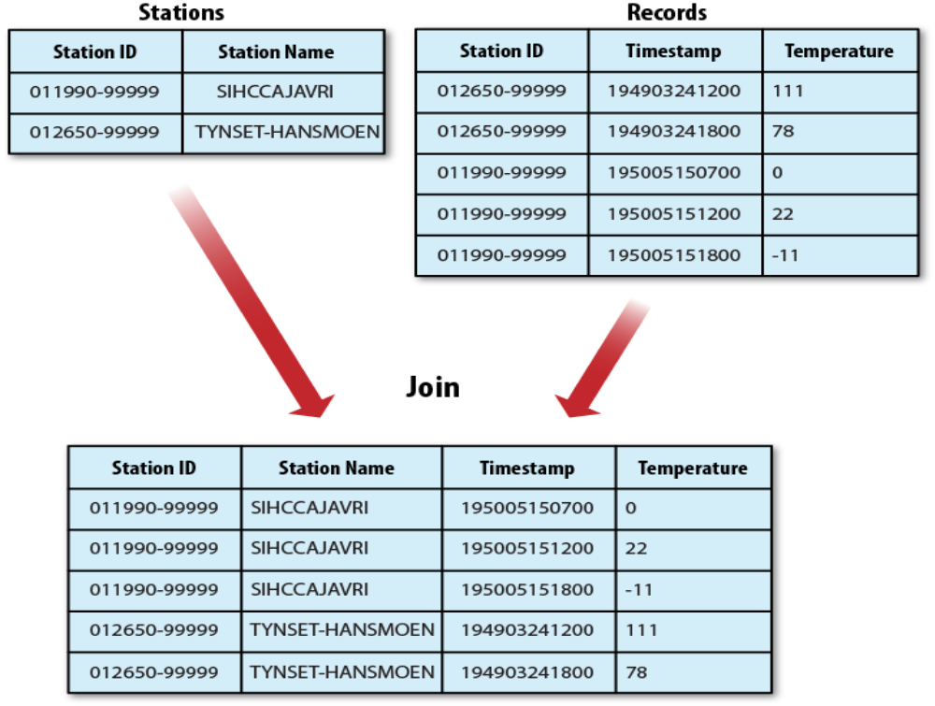
Map-Side Join – 2

Slide 20
Reduce-Side Join – 1
  Reduce-side join is more general than a map-side join:
  Input datasets don’t have to be structured in any particular way.
  Less efficient as both datasets have to go through the MapReduce shuffle.
  The mapper tags each record with its source.
  Uses the join key as the map output key so that the records with the same key are brought together in the reducer.

Slide 21
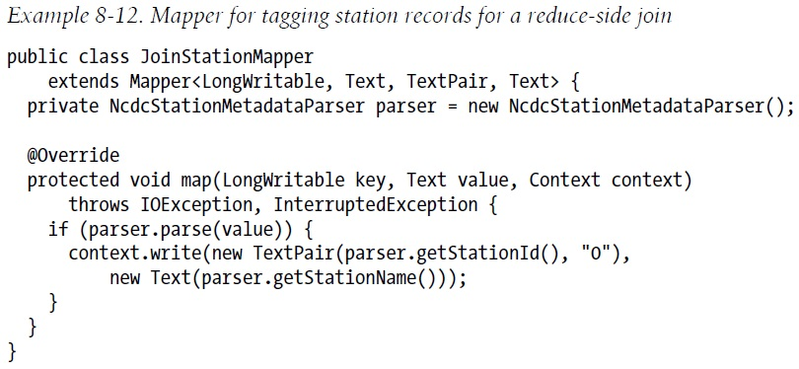
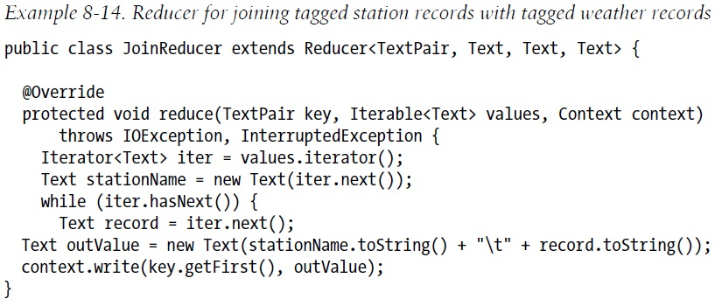
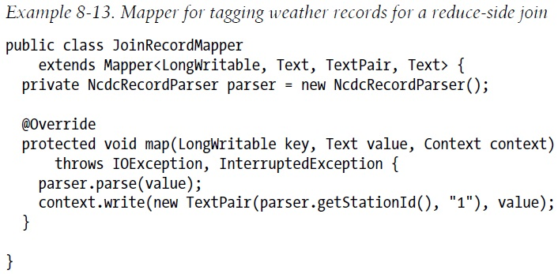
Reduce-Side Join – 2

Slide 22
Side Data Distribution
  Side data are extra read-only data needed by a job to process the main dataset.
  The challenge is to make side data available to all the map or reduce tasks (which are spread across the cluster).
  Using the Job Configuration
  Distributed Cache

Slide 23
Using the Job Configuration
  Set arbitrary key-value pairs in the job configuration using the various setter methods on Configuration.
  Useful if one needs to pass a small piece of metadata to tasks.
  Don’t use this mechanism for transferring more than a few kilobytes of data.

Slide 24
Using Distributed Cache – 1
  Distribute datasets using Hadoop’s distributed cache mechanism.
  Provides a service for copying files and archives to the task nodes in time for the tasks to use them when they run.
  GenericOptionsParser – specify the files to be distributed as a comma-separated list of URIs as the argument to the -files option.

Slide 25
Using Distributed Cache – 2
  P. 290: Example 8-16

Slide 26
Using Distributed Cache – 3
  Hadoop copies the file specified by the –file and -archives options to the jobtracker’s filesystem (normally HDFS).
  Before a task is run, the tasktracker copies the files from the jobtracker’s filesystem to a local disk—the cache—so the task can access the files.
  The tasktracker also maintains a reference count for the number of tasks using each file in the cache.
  After the task has run, the file’s reference count is decreased by one, and when it reaches zero it is eligible for deletion.
  Files are deleted to make room for a new file when the cache exceeds a certain size—10 GB by default.

