Slide 1
Play Store Analysis
Katherine Li, Karen Gao, Sarah Xi, Eva He, Zhijing Zhao

Slide 2
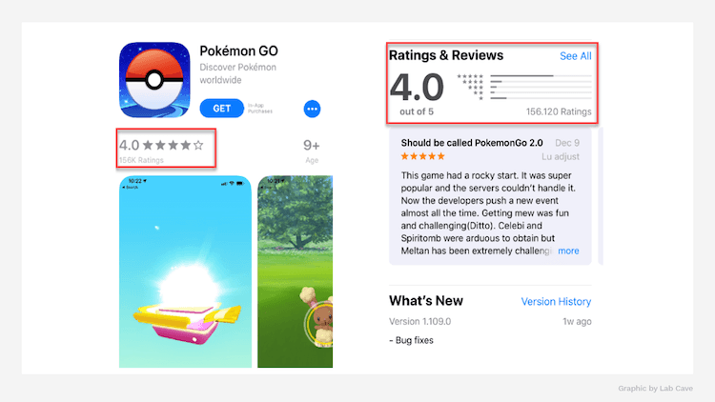
IN THE APP STORE

Slide 3
DATA CLEANING

Slide 4
DUPLICATES
play <- play %>%
arrange(desc(Reviews)) %>%
distinct(App,.keep_all = TRUE)
App | Category | Rating | Reviews | Size | Installs | Type | Price | Content.Rating | Genres | Last.Updated | Current.Ver | Android.Ver
Google Allo | COMMUNICATION | 4.3 | 346980 | Varies with device | 10,000,000+ | Free | 0 | Everyone | Communication | January 23, 2018 | Varies with device | 4.1 and up
Google Allo | COMMUNICATION | 4.3 | 346982 | Varies with device | 10,000,000+ | Free | 0 | Everyone | Communication | January 23, 2018 | Varies with device | 4.1 and up
Google Allo | COMMUNICATION | 4.3 | 347086 | Varies with device | 10,000,000+ | Free | 0 | Everyone | Communication | January 23, 2018 | Varies with device | 4.1 and up
Google Pay | FINANCE | 4.2 | 347838 | Varies with device | 100,000,000+ | Free | 0 | Everyone | Finance | July 26, 2018 | 2.70.206190089 | Varies with device
Google Pay | FINANCE | 4.2 | 347838 | Varies with device | 100,000,000+ | Free | 0 | Everyone | Finance | July 26, 2018 | 2.70.206190089 | Varies with device
Google Pay | FINANCE | 4.2 | 347874 | Varies with device | 100,000,000+ | Free | 0 | Everyone | Finance | July 26, 2018 | 2.70.206190089 | Varies with device
Google Pay | FINANCE | 4.2 | 348132 | Varies with device | 100,000,000+ | Free | 0 | Everyone | Finance | July 26, 2018 | 2.70.206190089 | Varies with device
Google Sheets | PRODUCTIVITY | 4.3 | 496397 | Varies with device | 100,000,000+ | Free | 0 | Everyone | Productivity | August 6, 2018 | Varies with device | Varies with device
Google Keep | PRODUCTIVITY | 4.4 | 691474 | Varies with device | 100,000,000+ | Free | 0 | Everyone | Productivity | August 6, 2018 | Varies with device | Varies with device
Google Keep | PRODUCTIVITY | 4.4 | 691474 | Varies with device | 100,000,000+ | Free | 0 | Everyone | Productivity | August 6, 2018 | Varies with device | Varies with device
Google Keep | PRODUCTIVITY | 4.4 | 691474 | Varies with device | 100,000,000+ | Free | 0 | Everyone | Productivity | August 6, 2018 | Varies with device | Varies with device

Slide 5
INSTALLS…
play %>%
filter(Installs != "Free") %>%
mutate(Installs = str_replace_all(Installs, ",", ""))
play$Installs <- gsub("\\+", "", play$Installs)
play$Installs = as.numeric(as.character(play$Installs))
App | Category | Rating | Reviews | Size | Installs | Type | Price | Content.Rating | Genres | Last.Updated | Current.Ver | Android.Ver
Google Allo | COMMUNICATION | 4.3 | 346980 | Varies with device | 10,000,000+ | Free | 0 | Everyone | Communication | January 23, 2018 | Varies with device | 4.1 and up
Google Allo | COMMUNICATION | 4.3 | 346982 | Varies with device | 10,000,000+ | Free | 0 | Everyone | Communication | January 23, 2018 | Varies with device | 4.1 and up
Google Allo | COMMUNICATION | 4.3 | 347086 | Varies with device | 10,000,000+ | Free | 0 | Everyone | Communication | January 23, 2018 | Varies with device | 4.1 and up
Google Pay | FINANCE | 4.2 | 347838 | Varies with device | 100,000,000+ | Free | 0 | Everyone | Finance | July 26, 2018 | 2.70.206190089 | Varies with device
Google Pay | FINANCE | 4.2 | 347838 | Varies with device | 100,000,000+ | Free | 0 | Everyone | Finance | July 26, 2018 | 2.70.206190089 | Varies with device
Google Pay | FINANCE | 4.2 | 347874 | Varies with device | 100,000,000+ | Free | 0 | Everyone | Finance | July 26, 2018 | 2.70.206190089 | Varies with device
Google Pay | FINANCE | 4.2 | 348132 | Varies with device | 100,000,000+ | Free | 0 | Everyone | Finance | July 26, 2018 | 2.70.206190089 | Varies with device
Google Sheets | PRODUCTIVITY | 4.3 | 496397 | Varies with device | 100,000,000+ | Free | 0 | Everyone | Productivity | August 6, 2018 | Varies with device | Varies with device
Google Keep | PRODUCTIVITY | 4.4 | 691474 | Varies with device | 100,000,000+ | Free | 0 | Everyone | Productivity | August 6, 2018 | Varies with device | Varies with device
Google Keep | PRODUCTIVITY | 4.4 | 691474 | Varies with device | 100,000,000+ | Free | 0 | Everyone | Productivity | August 6, 2018 | Varies with device | Varies with device
Google Keep | PRODUCTIVITY | 4.4 | 691474 | Varies with device | 100,000,000+ | Free | 0 | Everyone | Productivity | August 6, 2018 | Varies with device | Varies with device

Slide 6
gsub(pattern, replacement, x, ignore.case = FALSE, perl = FALSE, fixed = FALSE, useBytes = FALSE)
gsub vs sub
100,000,000+
$2.99
gsub("\\+", "", play$Installs)
gsub("\\$", "", play$Price)
WHY USING BACKSLASH?
Regular Expression Syntax

Slide 7
Syntax | Description
\\d | Digit, 0,1,2 ... 9
\\D | Not Digit
\\s | Space
\\S | Not Space
\\w | Word
\\W | Not Word
\\t | Tab
\\n | New line
^ | Beginning of the string
$ | End of the string
\ | Escape special characters, e.g. \\ is "\", \+ is "+"
| | Alternation match. e.g. /(e|d)n/ matches "en" and "dn"

Slide 8
play <- play %>%
filter(Size != "Varies with device" )
separate(Size, c("size_num", "size_unit"), -1)
play$size_num <- ifelse(play$size_unit == "k",
round(play$size_num/1024), play$size_num)
play <- subset(play, select = -c(6))
SIZE…
App | Category | Rating | Reviews | Size | Installs | Type | Price | Content.Rating | Genres | Last.Updated | Current.Ver | Android.Ver
Easy DIY CD Craft Ideas | ART_AND_DESIGN | NA | 7 | 5.6M | 5,000+ | Free | 0 | Everyone | Art & Design | May 30, 2018 | 1 | 2.3 and up
Skyscanner | TRAVEL_AND_LOCAL | 4.5 | 481546 | 29M | 10,000,000+ | Free | 0 | Everyone | Travel & Local | August 6, 2018 | 5.48 | 4.4 and up
KakaoTalk: Free Calls & Text | COMMUNICATION | 4.3 | 2546527 | Varies with device | 100,000,000+ | Free | 0 | Everyone | Communication | August 3, 2018 | Varies with device | Varies with device
CB Fit | HEALTH_AND_FITNESS | 5 | 1 | 7.8M | 10+ | Free | 0 | Everyone | Health & Fitness | July 9, 2018 | 4.2.2 | 4.1 and up
CP Ready | BUSINESS | 4.5 | 56 | Varies with device | 1,000+ | Free | 0 | Everyone | Business | March 5, 2018 | 6.4.16 | 4.0 and up
Pocket Lab Values | MEDICAL | 4.3 | 214 | 899k | 10,000+ | Paid | $2.99 | Everyone | Medical | November 22, 2012 | 2.5 | 2.1 and up
CL Notifier | TOOLS | 5 | 36 | 3.2M | 100+ | Free | 0 | Teen | Tools | August 2, 2017 | 1 | 4.0 and up
Cardinal Glennon ER Reference | MEDICAL | 4.2 | 19 | 20M | 1,000+ | Free | 0 | Everyone 10+ | Medical | September 21, 2017 | 1.8.3 | 4.1 and up
No. Color - Color by Number, Number Coloring | FAMILY | 4.8 | 269194 | 6.9M | 10,000,000+ | Free | 0 | Everyone | Entertainment;Brain Games | August 3, 2018 | Varies with device | Varies with device

Slide 9
CONVERT FACTOR TO NUMERIC
In any case, do not call as.numeric()
as.numeric() → the internal codes
If f is such a factor object,
you can use as.numeric(as.character(f))

Slide 10
HYPOTHESIS…

Slide 11
What Makes A Higher RATING?
App | Category | Rating | Reviews | Size | Installs | Type | Price | Content.Rating | Genres | Last.Updated | Current.Ver | Android.Ver
Easy DIY CD Craft Ideas | ART_AND_DESIGN | NA | 7 | 5.6M | 5,000+ | Free | 0 | Everyone | Art & Design | May 30, 2018 | 1 | 2.3 and up
Skyscanner | TRAVEL_AND_LOCAL | 4.5 | 481546 | 29M | 10,000,000+ | Free | 0 | Everyone | Travel & Local | August 6, 2018 | 5.48 | 4.4 and up
KakaoTalk: Free Calls & Text | COMMUNICATION | 4.3 | 2546527 | Varies with device | 100,000,000+ | Free | 0 | Everyone | Communication | August 3, 2018 | Varies with device | Varies with device
CB Fit | HEALTH_AND_FITNESS | 5 | 1 | 7.8M | 10+ | Free | 0 | Everyone | Health & Fitness | July 9, 2018 | 4.2.2 | 4.1 and up
CP Ready | BUSINESS | 4.5 | 56 | Varies with device | 1,000+ | Free | 0 | Everyone | Business | March 5, 2018 | 6.4.16 | 4.0 and up
Pocket Lab Values | MEDICAL | 4.3 | 214 | 899k | 10,000+ | Paid | $2.99 | Everyone | Medical | November 22, 2012 | 2.5 | 2.1 and up
CL Notifier | TOOLS | 5 | 36 | 3.2M | 100+ | Free | 0 | Teen | Tools | August 2, 2017 | 1 | 4.0 and up
Cardinal Glennon ER Reference | MEDICAL | 4.2 | 19 | 20M | 1,000+ | Free | 0 | Everyone 10+ | Medical | September 21, 2017 | 1.8.3 | 4.1 and up
No. Color - Color by Number, Number Coloring | FAMILY | 4.8 | 269194 | 6.9M | 10,000,000+ | Free | 0 | Everyone | Entertainment;Brain Games | August 3, 2018 | Varies with device | Varies with device

Slide 12
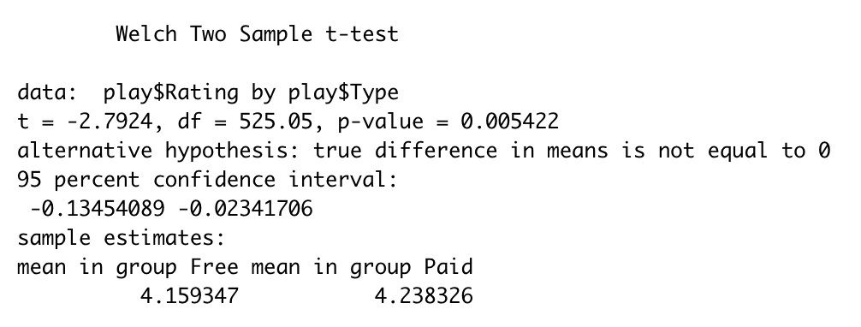
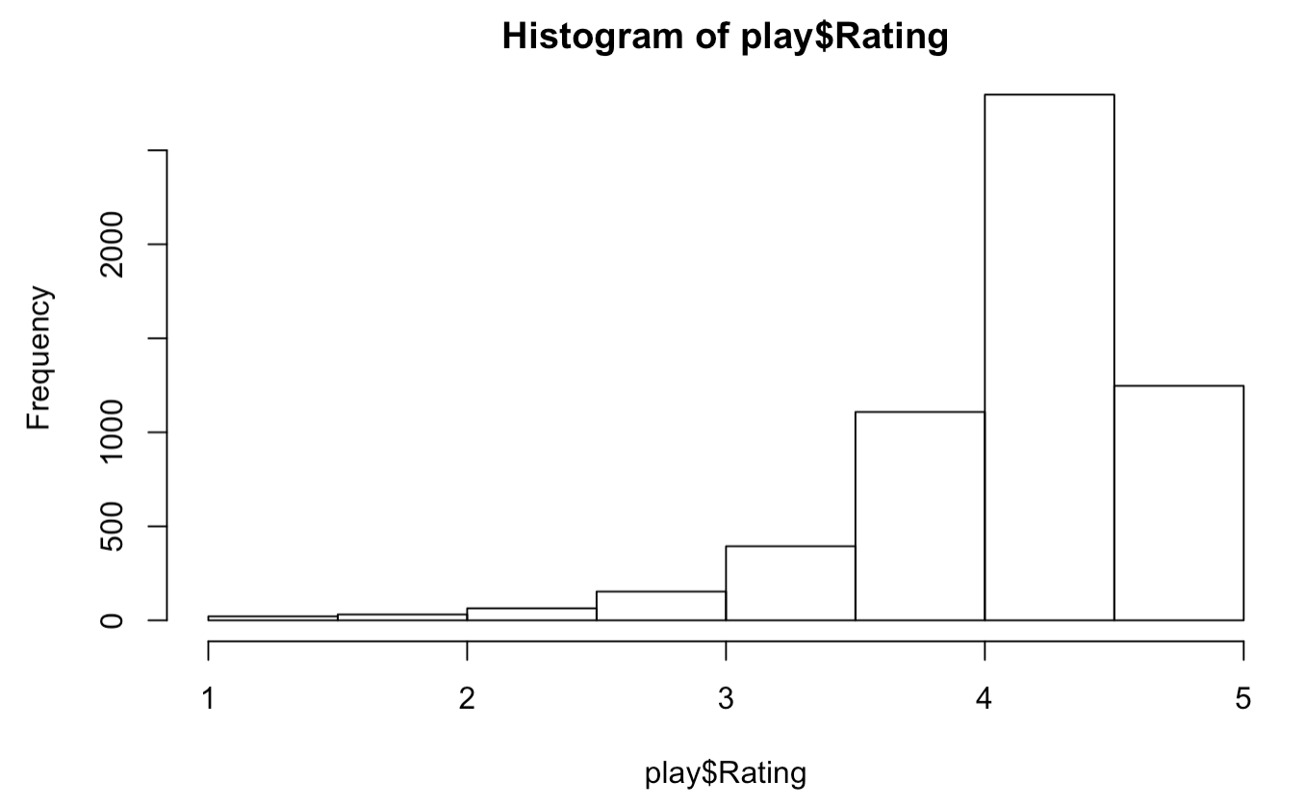
T-test

Slide 13
Interpretation:
The absolute value of the t score (-2.7924) is greater than 1.96, which is sufficiently large because only if the coefficient is much larger than its standard error then t-value would be significant. We also have a significant p-value of 0.005422 greater than 0.05. This indicates that we can reject the null hypothesis and draw a conclusion that there is a difference between the free and paid applications on rating. Also, we can see the mean difference between groups through the sample estimates section. Something needs to be noticed is that even though we reject the null hypothesis, but it is up to 50% chance of incorrectly rejecting the null for the population with p-value of 0.05 and up to 15% chance for a p-value of 0.01. Another limitation includes the dependent variable is not normally distributed based on the histogram.

Slide 14
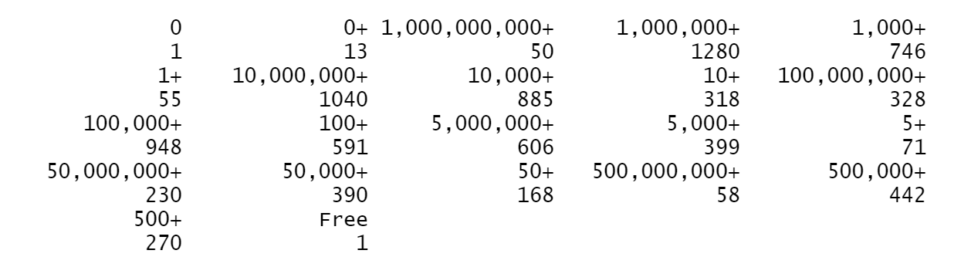
ANOVA on Ratings ~ Installs
Turning Installs into Smaller Groups of nearly equal proportions
XXS: 0; 0+; 1+; 5+; 10+; 50+; 100+; 500+ (979 data points)
XS: 1,000+; 5,000+ (1078 data points)
S: 10,000+; 50,000+ (1187 data points)
M: 100,000+; 500,000+ (1198 data points)
L: 1,000,000+ (971 data points)
XL: 5,000,000+; 10,000,000+; 50,000,000+; 100,000,000+; 500,000,000+; 1,000,000,000+ (1108 data points)

Slide 15
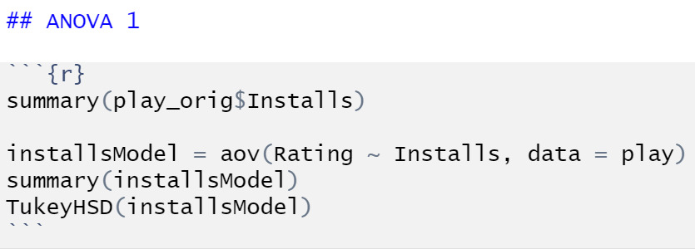
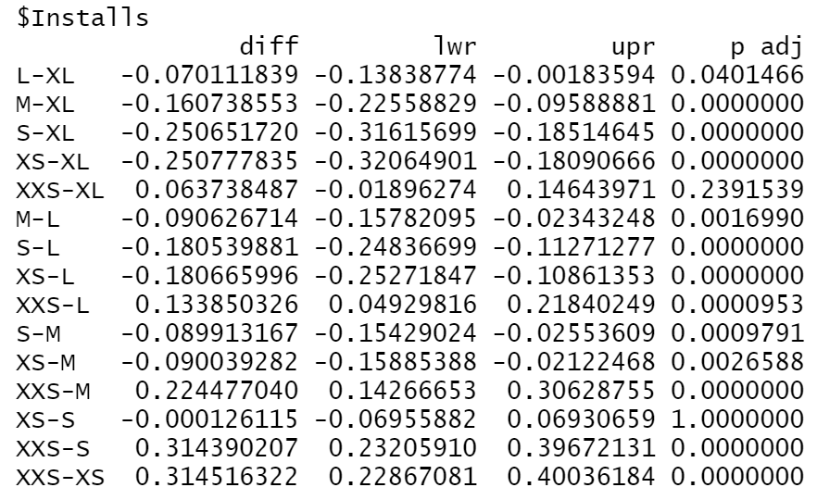
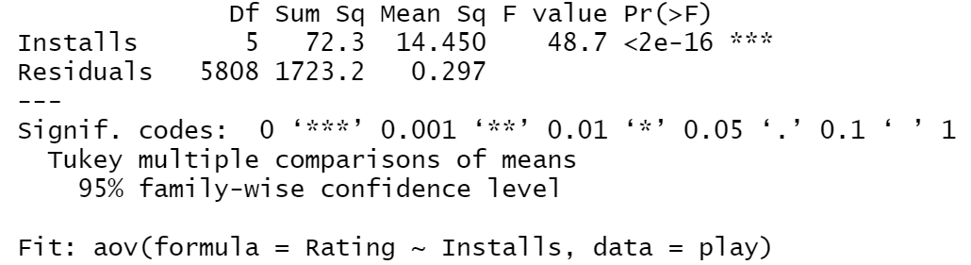
Code:
Hypothesis:
H0: There is no significant difference in ratings across the six groups with different levels of installations.
Ha: There exists some significant differences in ratings across the six groups with different levels of installations.
Tukey HSD Result:
ANOVA Result:

Slide 16
Interpretation
If set p-value cut-off point to 0.05, 13/15 comparison groups showcase significant difference; if set cut-off point to 0.01, 12/15 comparison groups showcase significant difference.
Set p-value cut-off point to 0.05, only pairs XXS-XL, and XS-S do not showcase significant difference.
XXS-XL: when apps have fewer installations, then fewer people would rate them, and thus ratings are determined only by relatively smaller pools of people. When apps have more installations, then more people would rate them, and therefore the extreme values of ratings could more easily be evened out.
XS-S
And perhaps L-XL
Limitations…
Our approach of grouping different levels of installs into smaller groups – not quite equivalently proportioned. “L” has 971 data points, while “M” has 1198 data points.
Residuals are not normally distributed. This opposes the assumption that ANOVA is based.

Slide 17
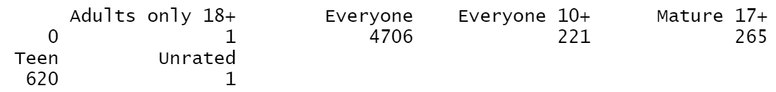
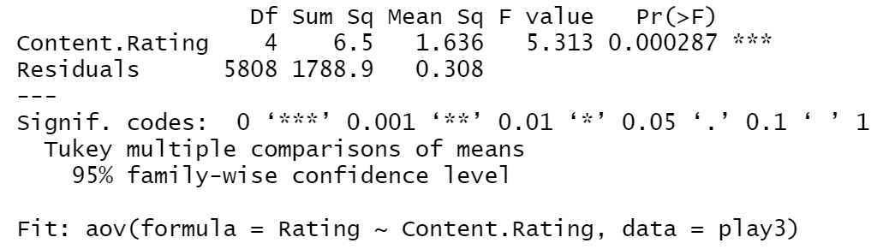
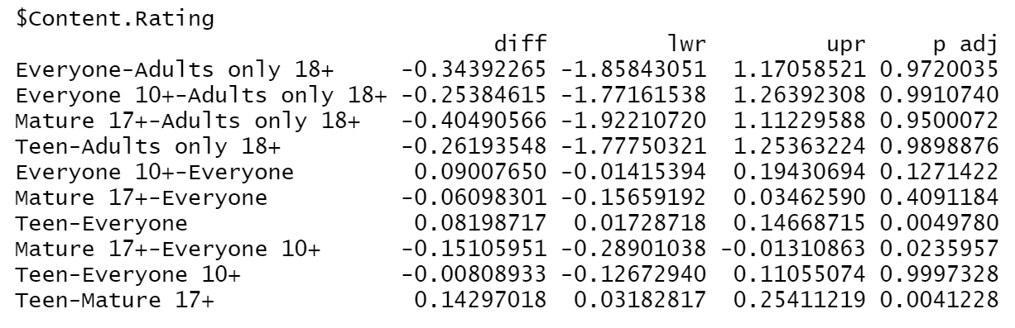
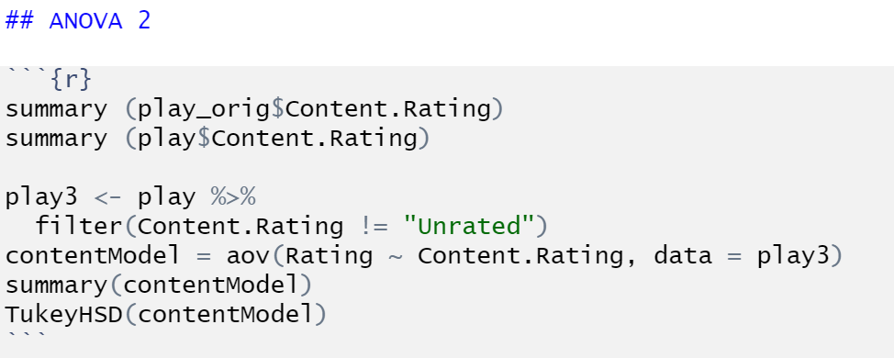
ANOVA on Ratings ~ Content Ratings
Eliminate “blank” and “Unrated”
ANOVA Result:
Hypothesis:
H0: There does not exist any significant difference in ratings among groups with different content ratings.
Ha: There are significant differences in ratings among the five groups with different content ratings.
Tukey HSD Result:
Code:

Slide 18
Interpretation
Teen-Everyone, Teen-Mature 17+ showcase significant differences in ratings.
Reasons might include: teens are not as critical as older users; teens do not have as many expectations as older users do; teens are more lenient in rating apps in general.
But why Teen-Adults only 18+, and Teen-Everyone 10+ do not showcase significant difference?
Need to take more information into account to evaluate this situation.
Limitations…
Complexity of the nature of how ratings are generated.
Limitations rooted in the original data set.
Complicated Issue

Slide 19
Hypothesis
Hypothesis 1: H0: Price does not have an impact on Ratings
H1: Price has a negative impact on Ratings
Hypothesis 2: H0: Number of installs does not have an impact on Ratings
H1: Number of installs has a positive impact on Ratings
Hypothesis 3: H0: Size does not have an impact on Ratings
H1: Size has a positive impact on Ratings
Hypothesis 4: H0: Payment type of application does not have an impact on Ratings
H1: Paid application has an impact on Ratings
Hypothesis 5: H0: Reviews does not have an impact on Ratings
H1: Reviews has a negative impact on Ratings

Slide 20
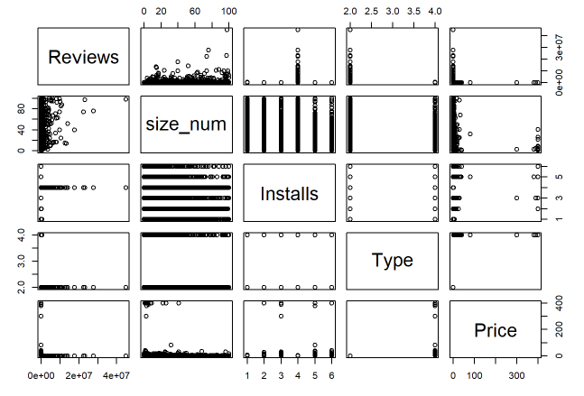
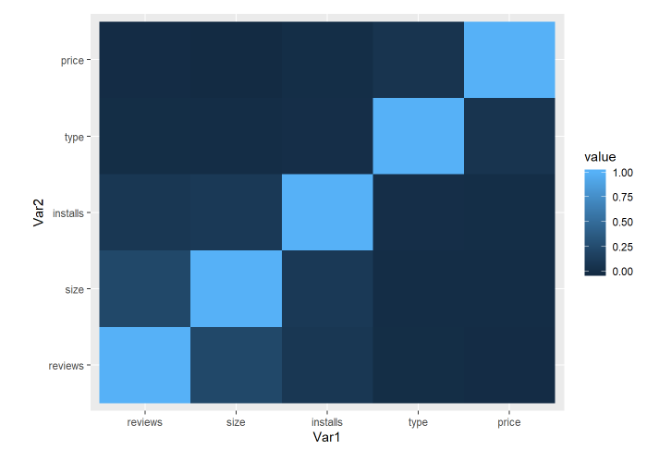
Regression Model

Slide 21
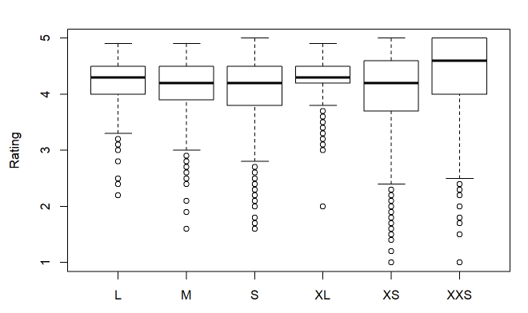
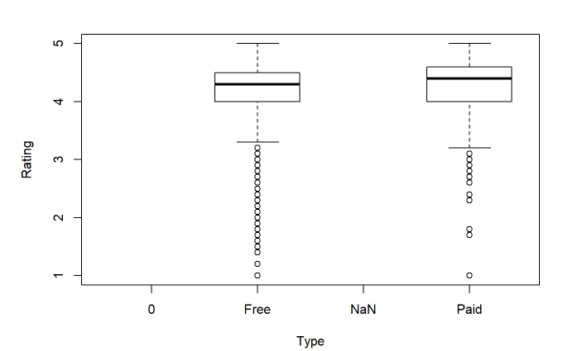

Slide 22
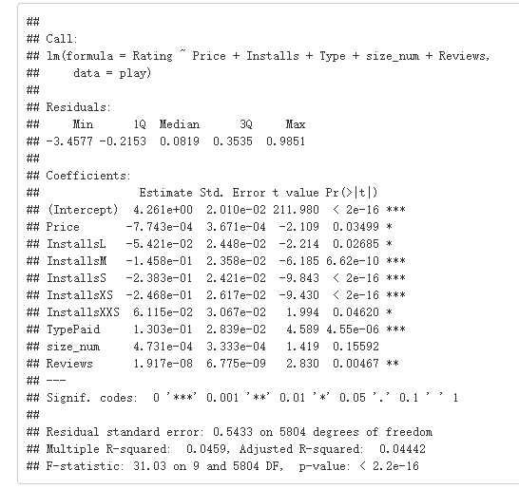

Slide 23
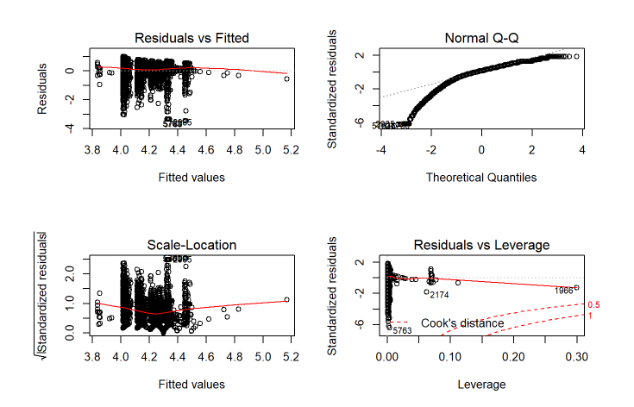
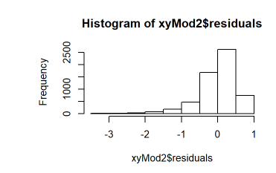

Slide 24
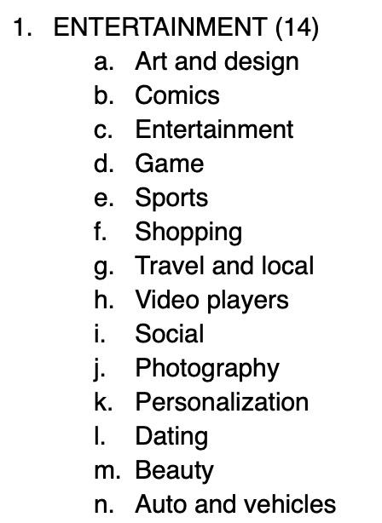
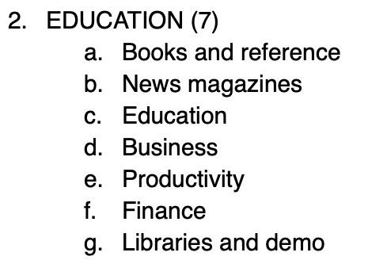
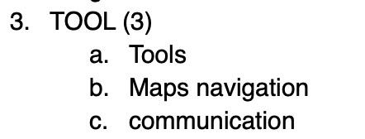
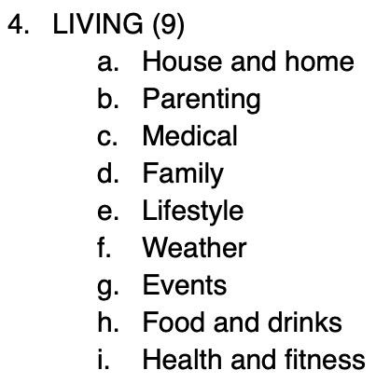
ANOVA Test for categories

Slide 25
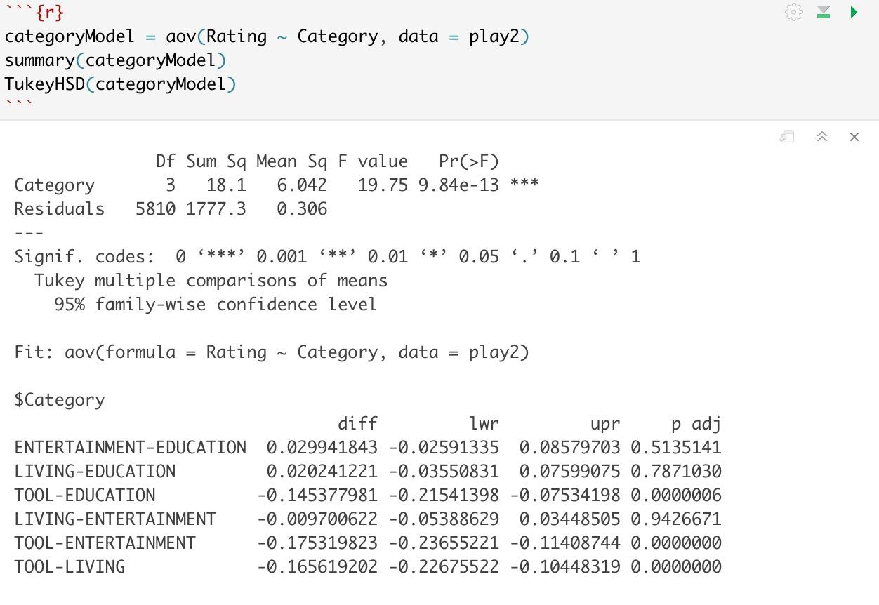
Hypothesis:
H0: Average rating is the same across all categories
Ha: Average rating is not the same across all categories

Slide 26
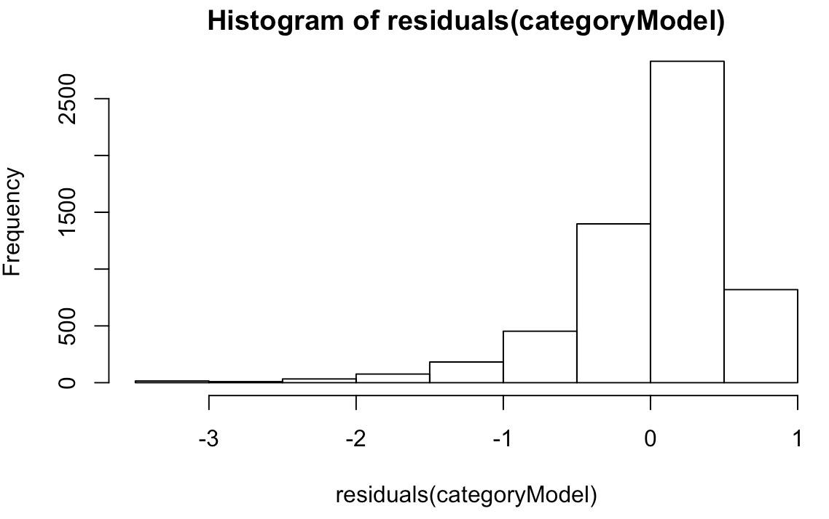
Limitation
Residuals are not normally distributed
Variances are not homogeneous
Classifications are based on personal experience

