Slide 1
PoseSwin — Smoke Test Results
Cross-video brown-bear Re-ID for the Katmai CV pipeline
Darian Ding · April 2026

Slide 2
Why we're looking at PoseSwin
A capability the Winter Quarter pipeline explicitly didn't solve
Pipeline gap
PoseSwin (Feb 2026)
• ByteTrack uses motion-only association, no appearance Re-ID
• Re-IDs reset whenever a bear leaves & re-enters the frame
• "Cross-video bear identification" was descoped from project scope
• Listed as a missing capability in the recent models report (§7)
• Pose-aware metric learning on Swin Transformer base
• 72,000 images of 109 individual Alaskan brown bears
• Katmai + McNeil River, multi-year (2017–2022)
• Open weights — exactly the gap we flagged in §7
• Pipeline: head crop → HRNet pose → Swin → 512-d embedding
• Rosenberg et al., Current Biology, Feb 2026
If integrated, recovers "how many salmon does each individual bear eat across videos" — a real population-level metric, not just per-clip counts.

Slide 3
Smoke test setup
End-to-end model load + forward pass on real Katmai footage
• Cloned amathislab/BrownBear_ReID and reviewed source
• Downloaded Public_release.zip from Zenodo (30 GB, 30 min) and extracted only checkpoints (4.2 GB)
• Built minimal single-image inference script (repo ships full training pipeline only — no demo)
• Loaded the Katmai 6-year checkpoint: net_best.pth (93.6 M params) on RTX 2080 Ti
• Extracted 4 high-confidence bear bbox crops from a Brooks Falls Low test video using our fine-tuned YOLOv8n
• Forwarded all 4 crops through PoseSwin and computed pairwise cosine similarity on the 512-d embeddings
Result: model loads cleanly, runs in ~270 ms / batch, emits structured embeddings.

Slide 4
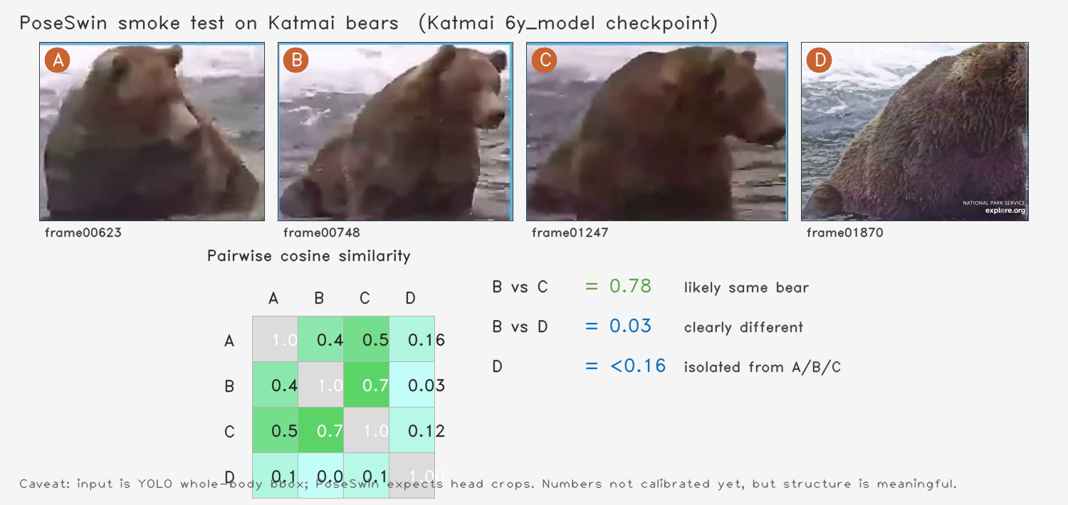
Result — 4 Katmai bear crops, cosine similarity matrix
Embeddings extracted from PoseSwin Katmai 6-year checkpoint

Slide 5
What this proves — and what it doesn't
Honest assessment after the smoke test
What the result proves
Caveats — what's still TBD
• PoseSwin loads + runs end-to-end on our hardware
• Forward pass is fast: ~270 ms for batch of 4
• Embeddings have meaningful structure on Katmai footage
• High-similarity pairs (0.78) cleanly separate from low-similarity pairs (0.03)
• Integration into our pipeline is technically feasible
• Input was YOLO whole-body bbox; PoseSwin expects head crops
• Absolute cosine values are NOT calibrated yet
• No formal accuracy measurement against ground truth IDs
• Need their face detector (Faster-RCNN, latest.pth) wired in for proper test
• Then need a held-out Katmai test set with known IDs for accuracy numbers

Slide 6
Open question — license
Need alignment before integrating deeper
Both code & dataset released under CC BY-NC 4.0 (non-commercial)
Our deliverable is meant to be open-source, so:
• Does "open-source" for our project include allowing commercial reuse?
• Or is non-commercial sufficient (Katmai NPP / conservation / education)?
If a commercial-friendly license is required, options are:
• Reach out to the EPFL Mathis Lab about licensing terms
• Make PoseSwin an opt-in plugin (users accept NC separately)
• Use only the method (Swin + pose-aware metric learning) and re-train on permissive data — much higher effort

Slide 7
Next steps
If we get a go-ahead on license
Phase 1 — proper accuracy measurement (~3 days)
• Wire up their Faster-RCNN face detector to produce head crops from YOLO bboxes
• Build a 100-frame multi-bear ground-truth set with consensus IDs
• Measure cosine-similarity accuracy: known same-bear vs known different-bear pairs
Phase 2 — integrate into pipeline (~1 week)
• Add a global-ID layer on top of ByteTrack — each ByteTrack ID gets a PoseSwin embedding
• Maintain a per-video / cross-video bear identity database
• Update behavior analysis output: "Bear 879 caught N salmon across M videos"

