Slide 1

BASF Data Challenge
Part 2 – Tableau Exploratory Analysis

Slide 2
Creating Markets
Based on basf-who we are–locations and geography
Africa
Algeria, Burundi, Congo, Congo Dem.Rep., Equator. Guinea, Ethiopia, Ghana, Guinea, Ivory Coast, Kenya, Libya, Madagascar, Malawi, Morocco, Nigeria, South Africa, Tunisia
America
Argentina, Bahamas, Bolivia, Brazil, Canada, Chile, Colombia, Costa Rica, Dominican Rep., Ecuador, El Salvador, Guadeloupe, Guatemala, Honduras, Jamaica, Mexico, Mozambique, Panama, Paraguay, Peru, Trinidad&Tobago, Urugay, USA, Venezuela
Oceania
Australia, New Zealand

Slide 3
Europe
Austria, Belgium, Bosnia and Hezeg., Bulgaria, Croatia, Cyprus, Czech Republic, Denmark, Estonia, Finland, France, Germany, Great Britain, Greece, Hungary, Iceland, Ireland, Italy, Kosovo, Latvia, Lithuania, Luxembourg, Malta, Monaco, Montenegro, Netherlands, North Macedonia, Norway, Poland, Portugal ,Reunion, Romania, Serbia, Slovakia, Slovenia, Spain, Sweden, Switzerland, Ukraine
Asia
Armenia, Azerbaijan, China, Gorgia, India, Indonesia, Japan, Kazakhstan, Pakistan, Philippines, Russian Fed., Singapore, South Korea, Taiwan, Thailand, Turkey, Uzbekistan
Middle East
Bahrain, Egypt, Iran, Israel, Jordan, Kuwait, Palestinian T., Qatar, Saudi Arabia, UAE

Slide 4
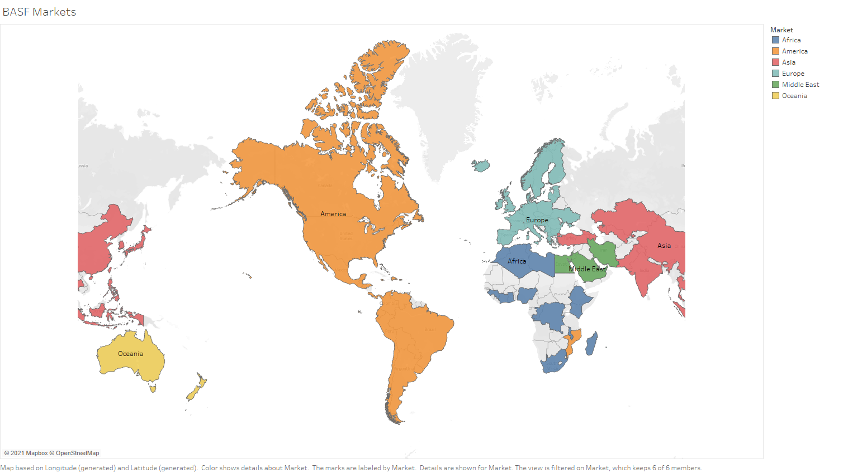

Slide 5
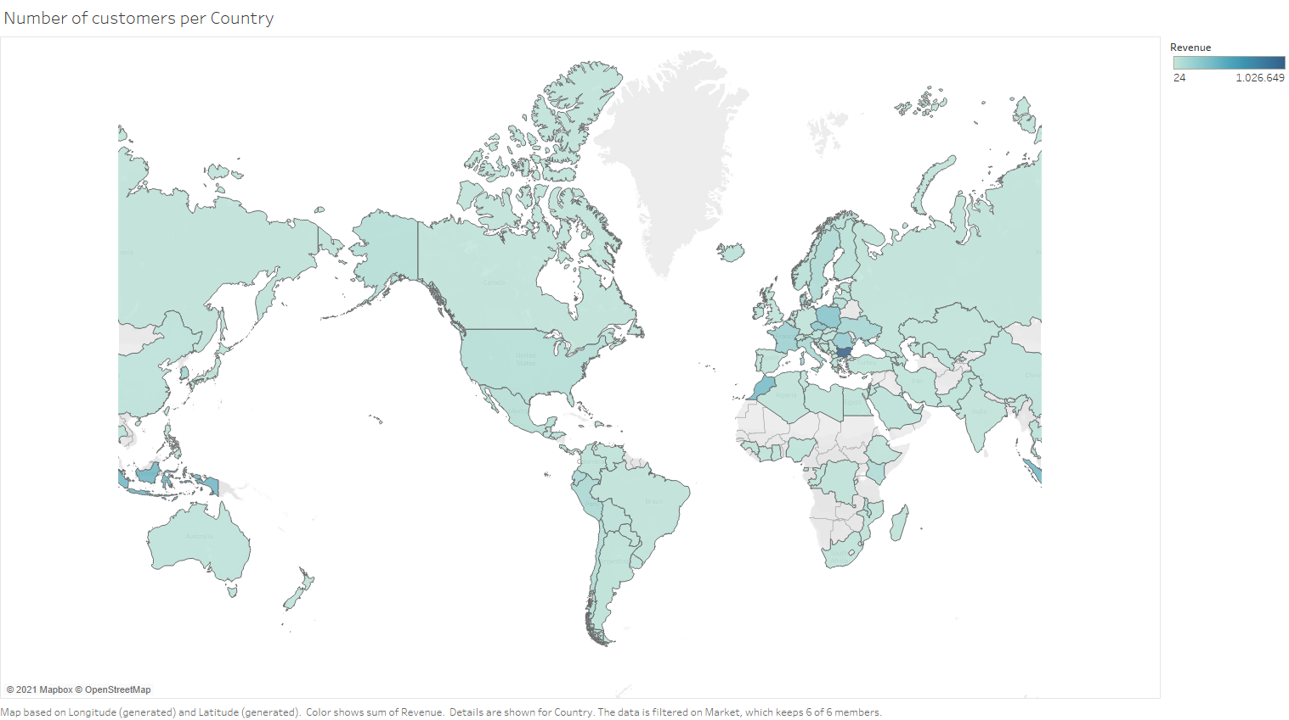

Slide 6
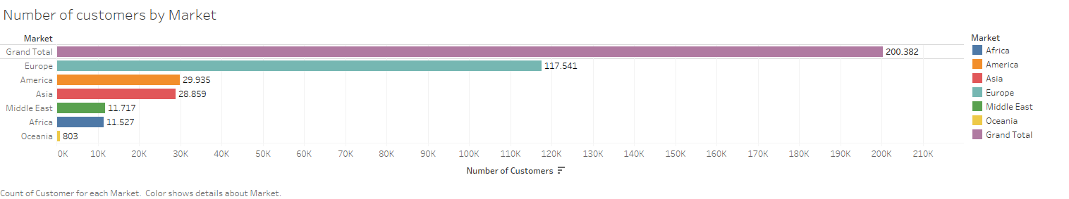
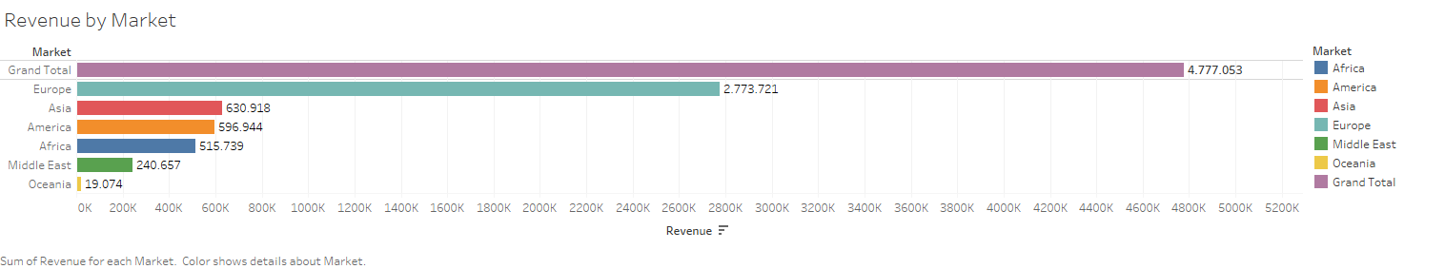
Number of Customers doesn’t exactly follow Revenue by Market - importance of wholesalers
Number of customers vs Revenue by Market

Slide 7
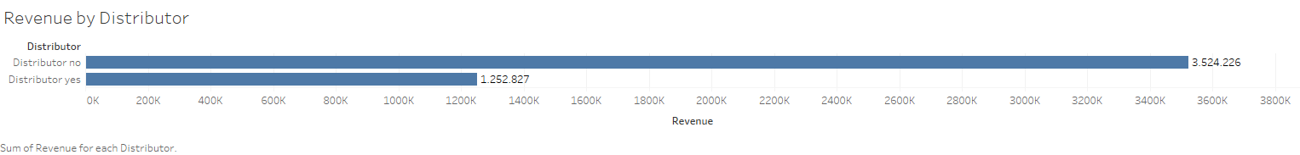
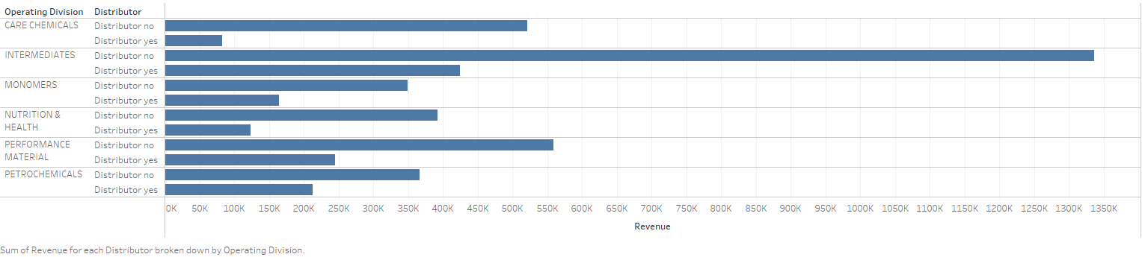
Using a distributor?
Revenue is more often generated through direct sales. Potential to expand?

Slide 8
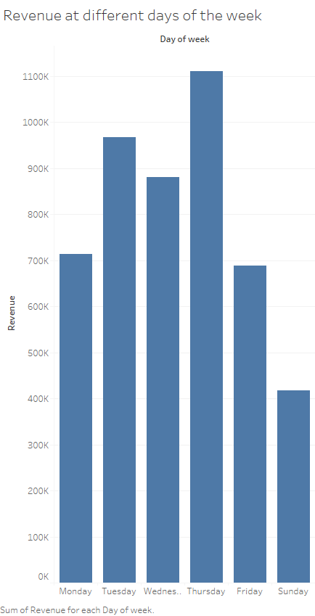
Revenue at different days of the week
Ranking sales:
Thrusday
Tuesday
Wednesday
Monday
Friday
Sunday
However, we miss Satruday data!

Slide 9
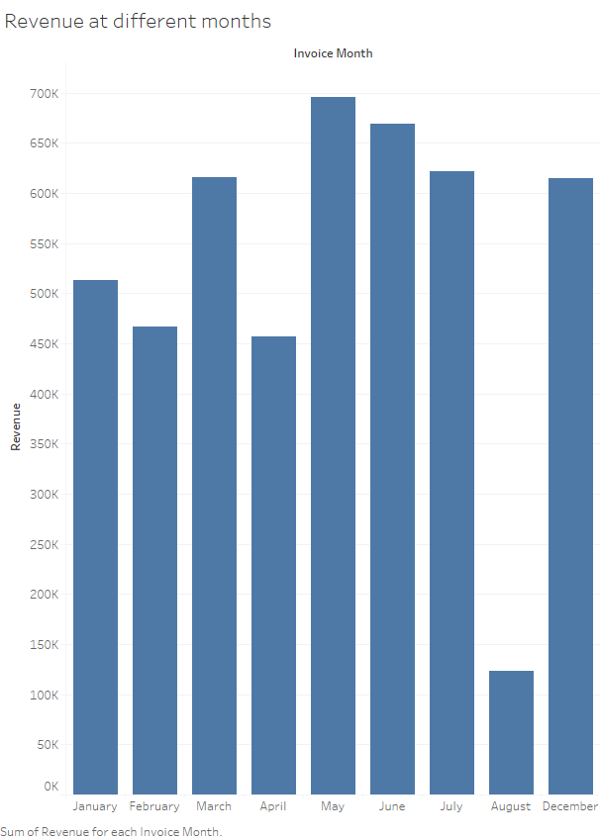
Revenue at different months
Ranking sales:
May
June – July – December – March
January
Februrary - April
We miss data range from August 15th – end of 2011

Slide 10
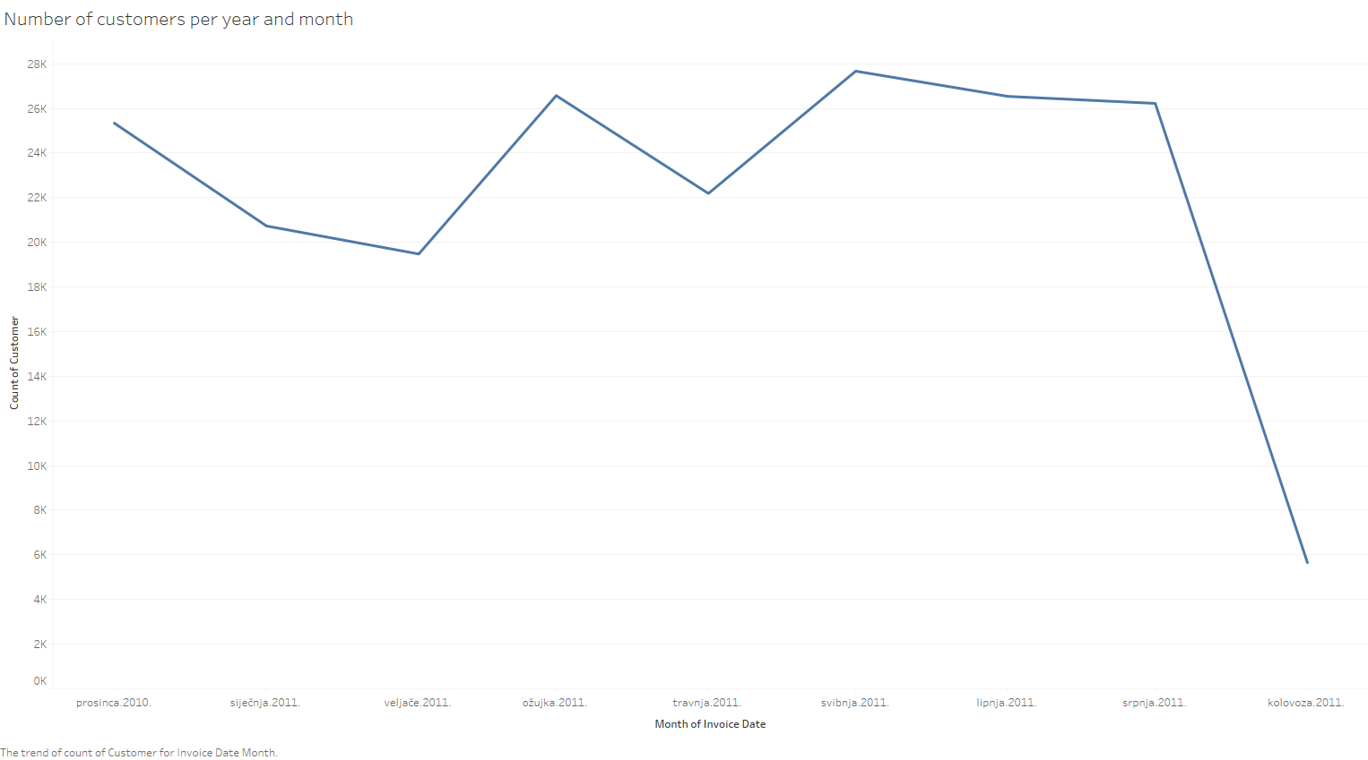
Lowering trend?
No!
We only have data for the first part of August

Slide 11
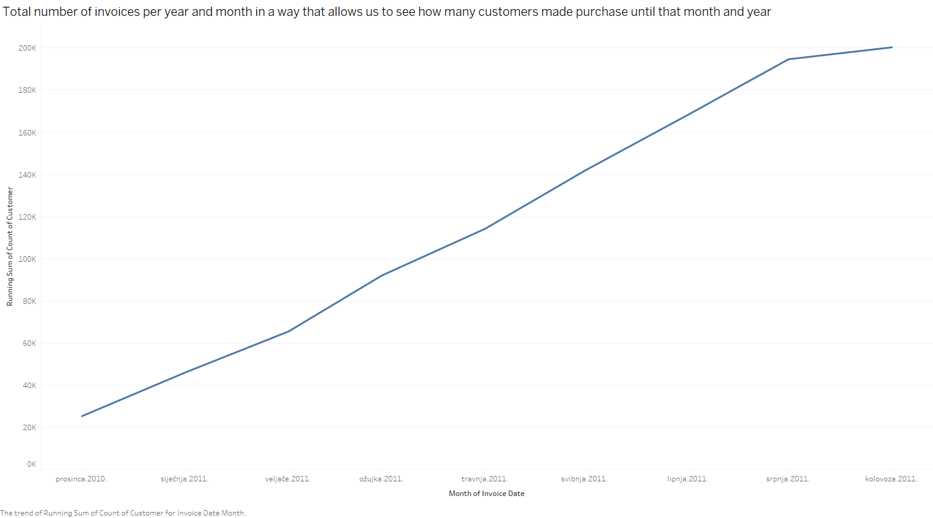
More realistic picture of a trend using cumulative sum

Slide 12
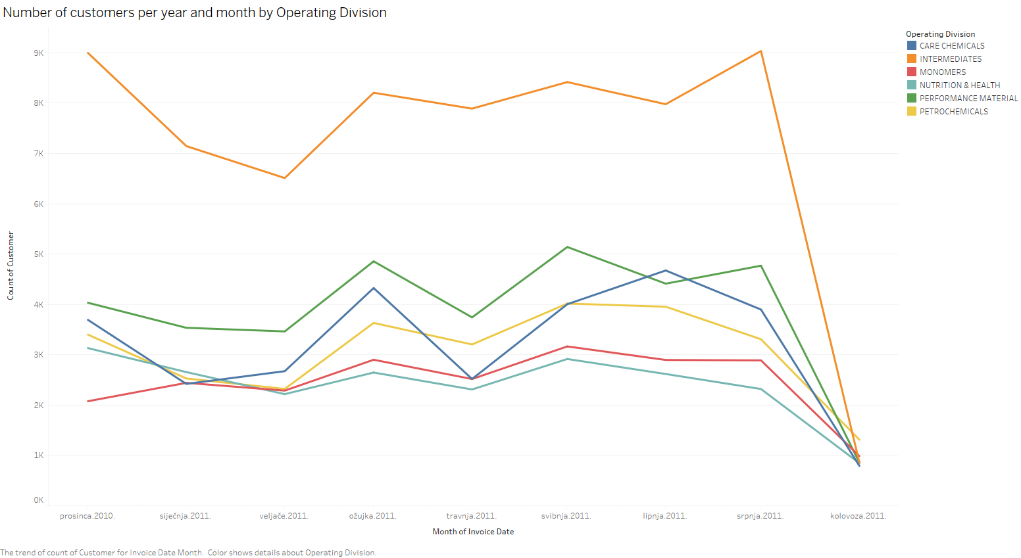
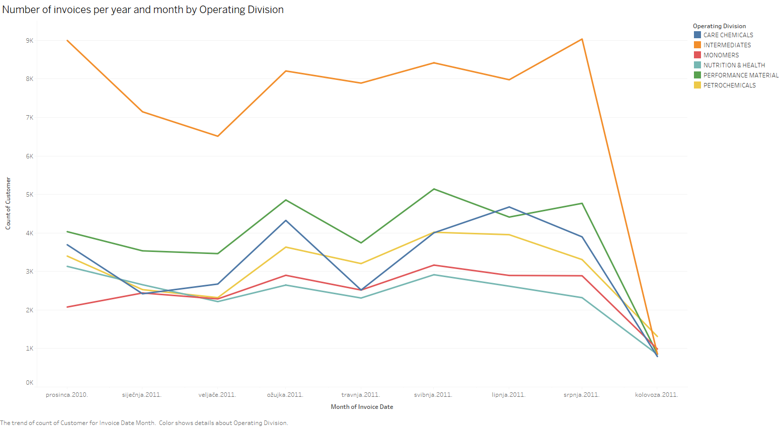

Slide 13
