Slide 1
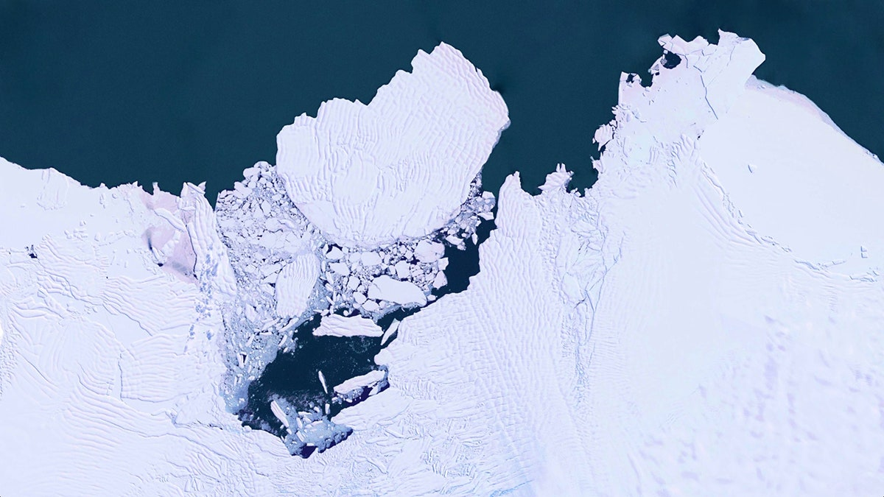
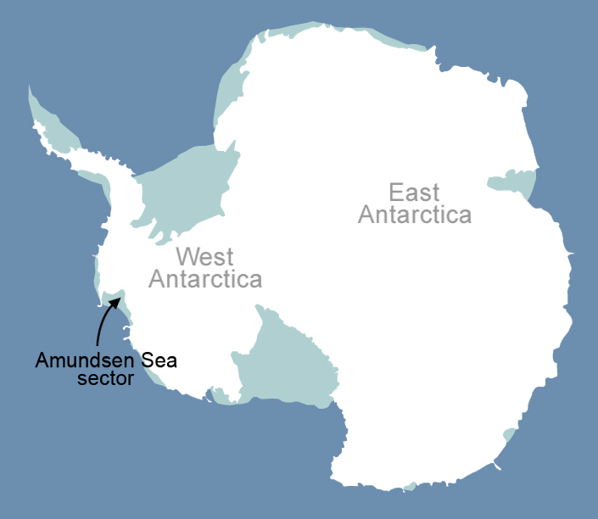
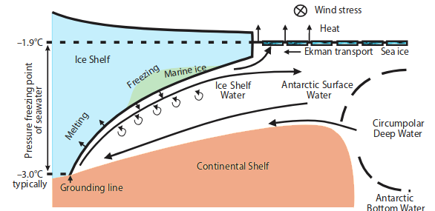


Untangling the effects of climate change on ice shelf melting in the Amundsen Sea, Antarctica
The Amundsen Sea ice shelves have the highest thinning rates in Antarctica.
[Image with basal melt]
Katherine Turner
Collapse of these ice shelves would lead to substantial sea level rise
Project Supervised By:
Kaitlin Naughten
Paul Holland
Alberto Naveira Garabato
Basal melt is thought to be driven by:
Create a model to untangle the various factors and their respective dominance for future ice sheet projections.
Changes in buoyancy (sea-ice formation)
Wind
Ocean warming
Project goal

