Slide 1
Favorite Places registration system
Cosson Raphaël
Ramires Bryan
Baldé Mamadou yero
Dibo Pierre
Dardouri Hamza
Ephreme Sebastien

Slide 2
Favorite Places registration system
The requested software is an places registration system.
Users can search locations or public events on a map as well as determine the shortest route to get there.
Identified users can add places and events in Personal Maps that can be public, private or visible only by their friends.
The system must provide a browser, tablet and smartphone interface.

Slide 3
Favorite Places registration system
Two types of users :
Guests : they have the ability to consult public data
Identified users : they can consult public datat and to add, edit and consult their data.

Slide 4
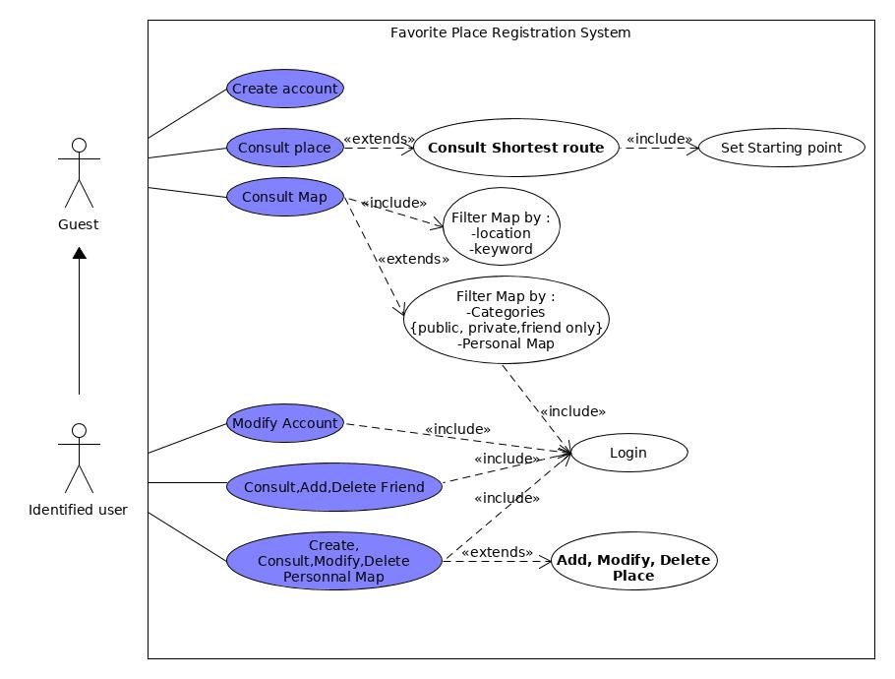
Favorite Places registration system

Slide 5
Favorite Places registration system
The Business objects are:
Users : login, password
Map : name, categories {public, private, friend_only}
Events : name, optional starting and ending date
Places : coordinates
Comments : type {image, text}, value

Slide 6
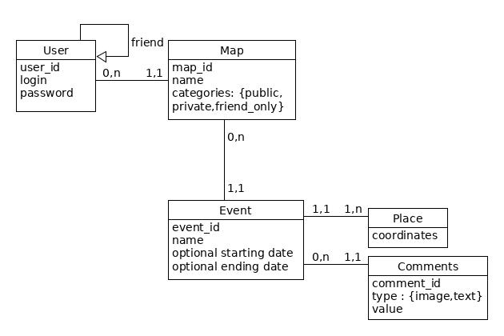
Favorite Places registration system

Slide 7
Favorite Places registration system
User (id_user, login, password)
Friend (#no_user, #no_friend)
Places (id_place, coordinates)
Event (id_event, #no_user, #place, name, start_date, end_date)
Comments (id_com, #no_user, #no_event, mess, img)
Map (id_map, #no_event, name, categories)

