Slide 1
Craft Beers and Breweries Study For Budweiser
Consultants:
Troy McSimov, Katon Pang

Slide 2
Exploratory Data Analysis (EDA)
Basic review of summary statistics
Approach to address missing values
Observations of data relationship
Organizing data and plotting for further analysis
Next steps in completing EDA

Slide 3
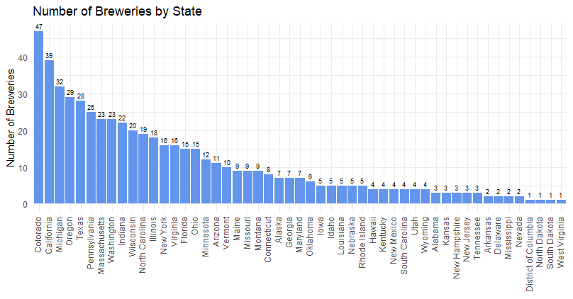
Review of Datasets
Breweries.csv (558)
- ID (Primary Key)
- Name
- City
- State
Beers.csv (2,410)
- Name
- Beer ID (Primary Key)
- ABV
- IBU
- Brewery ID (Foreign Key)
- Style
- Ounces

Slide 4
Addressing Missing Values
Original data:
ABV missing: 62 out of 2410 = 2.6%
IBU missing: 1005 out of 2410 = 42%
Style missing: 5
Address missing values with research:
ABV missing: 15 out of 2410 = 0.6%
IBU missing: 944 out of 2410 = 39%
Style missing: 3
After impute IBU missing values:
IBU missing: 11 out of 2410 = 0.46%
Impute missing IBU values with the median of IBU for that style of beer

Slide 5
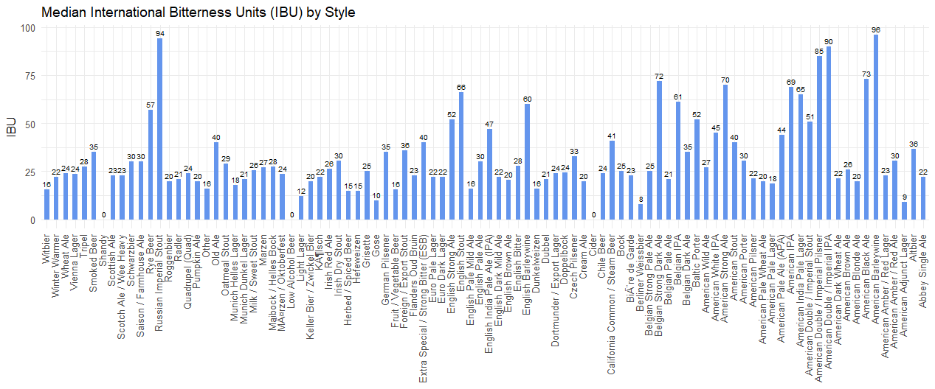
Median IBU by Style

Slide 6
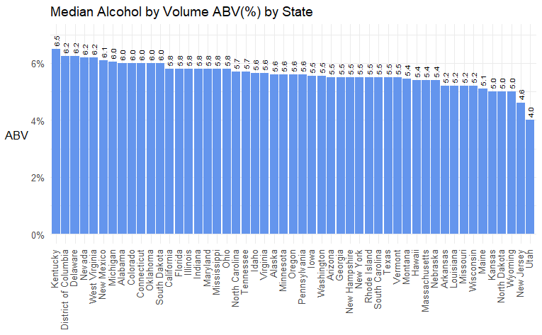
Median ABV by State
Median 5.6%
Top 5 States:
Kentucky
District of Columbia* (not a State)
Delaware
Nevada
West Virginia
Bottom 5 States:
Kansas
North Dakota
Wyoming
New Jersey
Utah
Notes:
Let’s take a look at median ABV by state. This bar graph shows median ABV in percentage for each state in a descending order.
The top 5 states that have the highest median alcohol content are:
The bottom 5 states that produce the least alcohol content are:

Slide 7
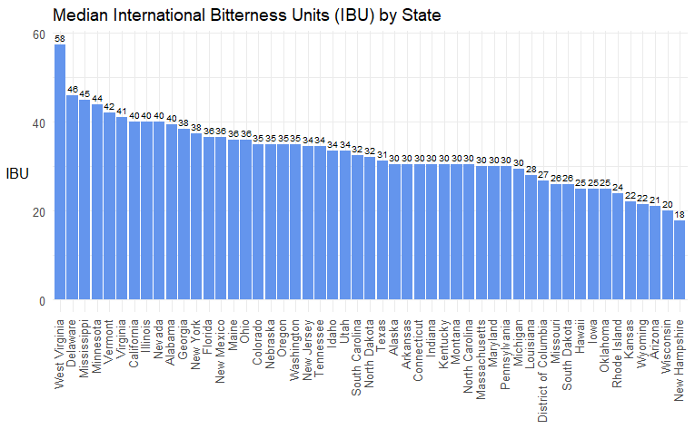
Median IBU by State
Median 30.5
Top 5 States:
West Virginia
Delaware
Mississippi
Minnesota
Vermont
Bottom 5 States:
Kansas
Wyoming
Arizonia
Wisconsin
New Hampshire
Notes:
This bar graph shows median IBU values for each state in a descending order.
The top 5 states had the highest median IBU are:
The bottom 5 states had the least median IBU are:

Slide 8
Comparing ABV and IBU by State
Kentucky led the States in highest average % alcohol, while West Virginia led the States in bitterness.
While Kentucky and DC were in the Top 5 in ABV, they scored in the lower half for IBU.
Delaware and West Virginia were in Top 5 for both ABV and IBU.
Interesting finding!
Notes:
Kentucky led the States in the highest median alcohol content, while West Virginia led in bitterness.
It is interesting to note that while Kentucky and DC were in the top 5 in median alcohol content, they are at the lower half for their median IBU’s. While hops are often used to offset the taste for beers with a higher alcohol content, this doesn’t appear to be the case for them.
On the other hand, Delaware and West Virginia were both in the top 5 for ABV and IBU, suggesting the tendency of higher alcohol content beer have higher IBU value.

Slide 9
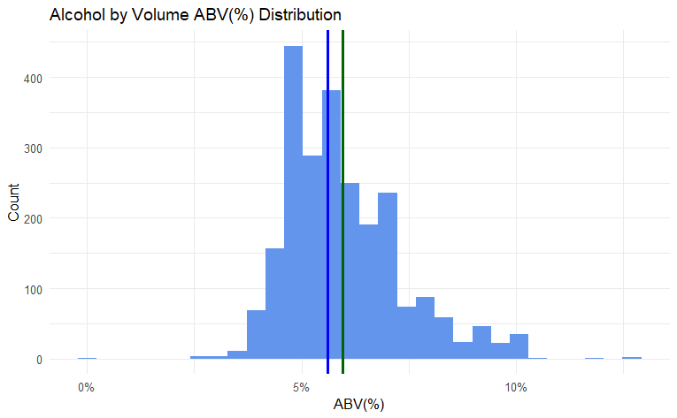
ABV Statistics
Min = 0.1%
1st Quantile (25%) = 5.0%
Median = 5.6%
Mean = 5.97%
3rd Quantile (75%) = 6.7%
Max = 12.8%
Standard Deviation = 1.35%
Budweiser: 5%
Max. Alcohol content:
Lee Hill Series Vol. 5
Boulder, CO
ABV 12.8%
Median
Mean
Notes:
This is the ABV distribution of craft beers in the data set.
The median alcohol content is at 5.6% and the mean at around 6%, while Budweiser falls in the first quantile at 5%.
CO had the most alcohol content beer in the data set, with 12.8% ABV.

Slide 10
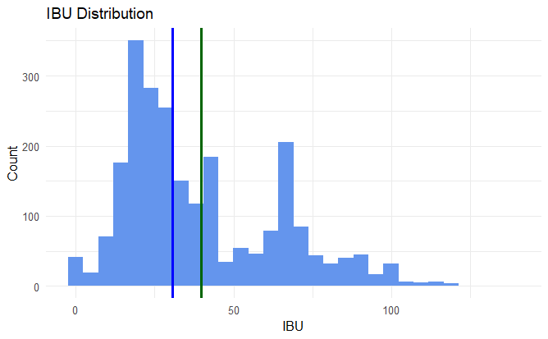
IBU Statistics
Min = 0
1st Quantile (25%) = 20
Median = 30.50
Mean = 39.77
3rd Quantile (75%) = 60.00
Max = 138.00
Standard Deviation = 24.5
Budweiser: 12
Highest IBU:
Bitter Bitch Imperial IPA
Astoria, OR
IBU 138
Median
Mean
Notes:
Here’s the IBU distribution of craft beers in the data set.
It has the median IBU at 30.5 and the mean at around 40, while Budweiser's IBU is 12.
OR had the bitterest beer in the data set, with an IBU of 138.
Let’s have Troy comes back for the rest of this presentation.

Slide 11
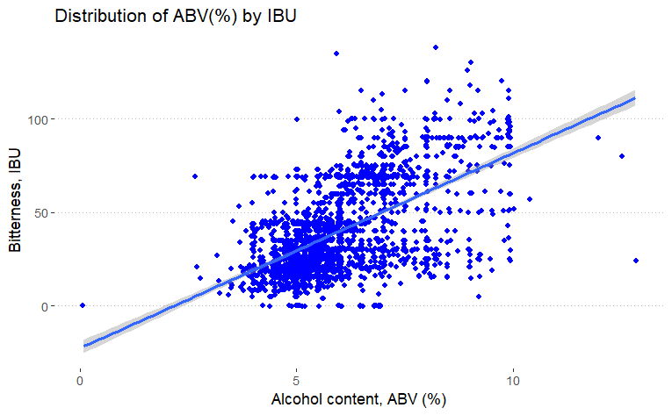
ABV vs. IBU
Notes:
Often microbrewery

Slide 12
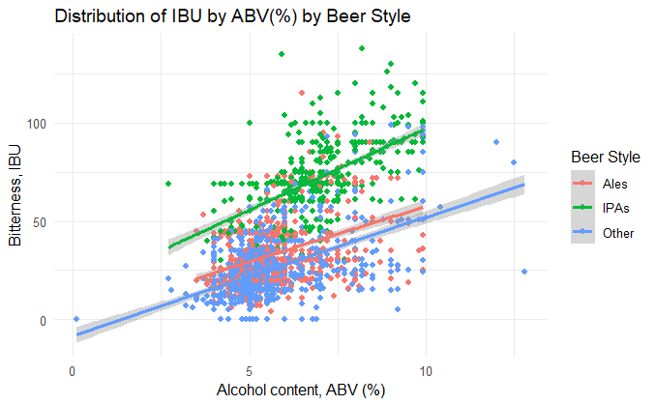
IBU vs. ABV by Beer Style
Notes:
Often microbrewery

Slide 13
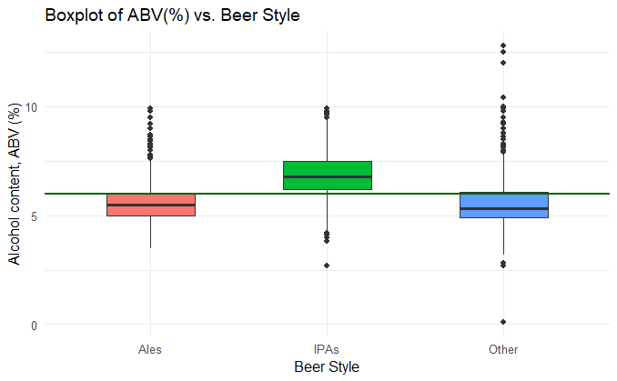
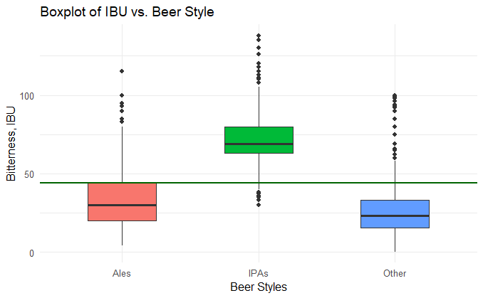
IPAs vs Ales
Notes:
Often microbrewery

Slide 14
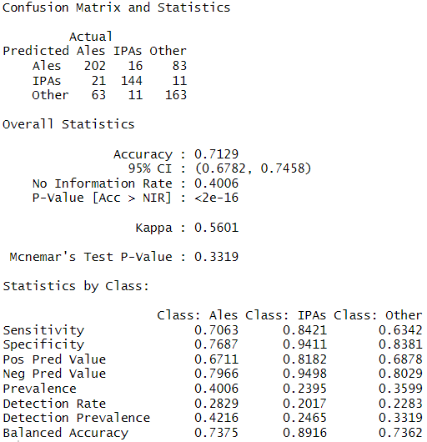
IPAs vs Ales
Notes:
Often microbrewery

Slide 15
Next Steps in EDA Process
Classification of Styles to smaller grouping (IPA, Ale’s, and Other)
Further analysis to determine any further trends, interesting findings, and data correlations

Slide 16
Thank you!

