Slide 1

Regression - Houseprices
Katherine Tolton Rodriguez

Slide 2
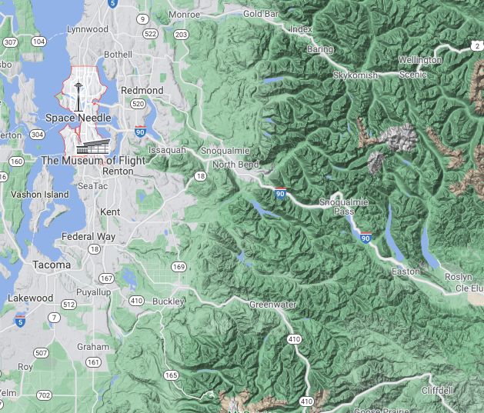
BACKGROUND
TIME FRAME: MAY 2014 – MAY 2015
Seattle Washington, surrounding area
Most popular months to buy : May, June , July, August
Notes:
Summer is the best month to move because kids are out of school

Slide 3
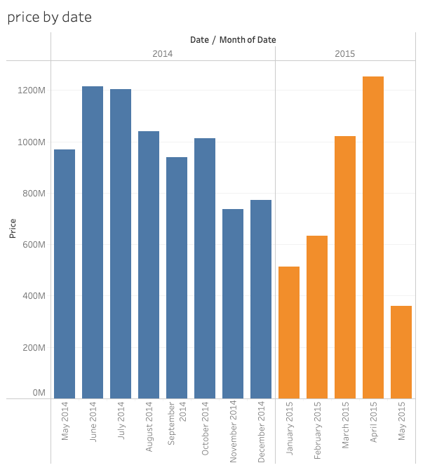
NOTE
impacts of weather (January) snowstorms
Higher mortgage rates (2015)
16% drop in construction
Notes:
Washington

Slide 4
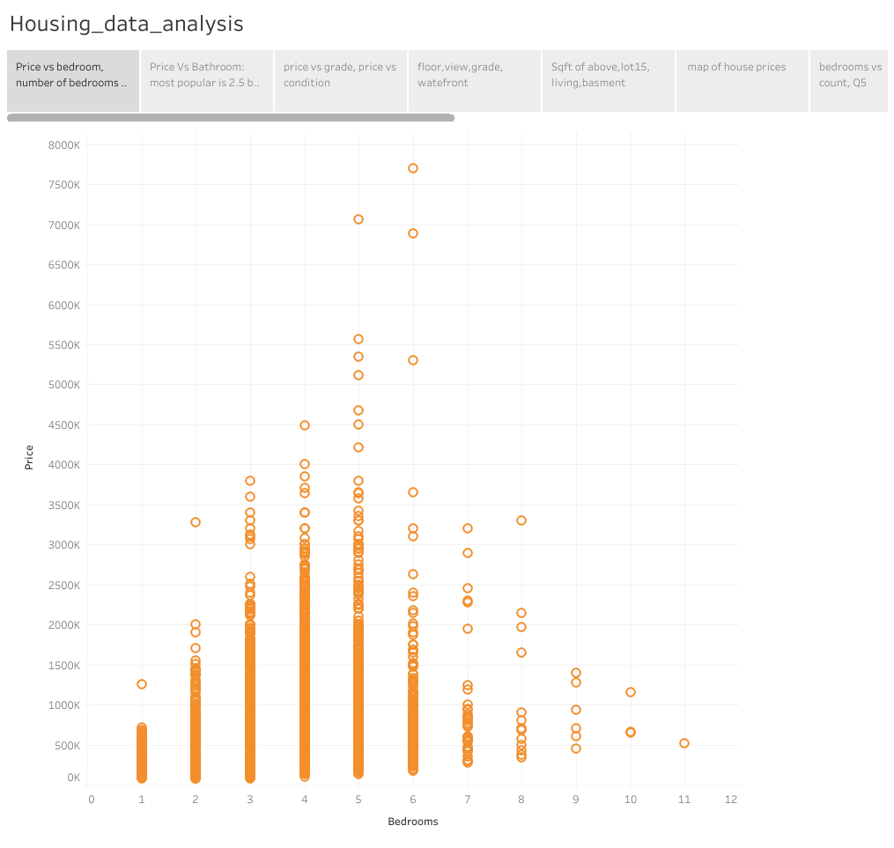
Notes:
Number of bedrooms isn’t everything, in terms of purchasing 5 and below seems to be the magic number, 3-4 being the most popular, might be best to check the size of families and how many single people there are in the housing market around this time

Slide 5
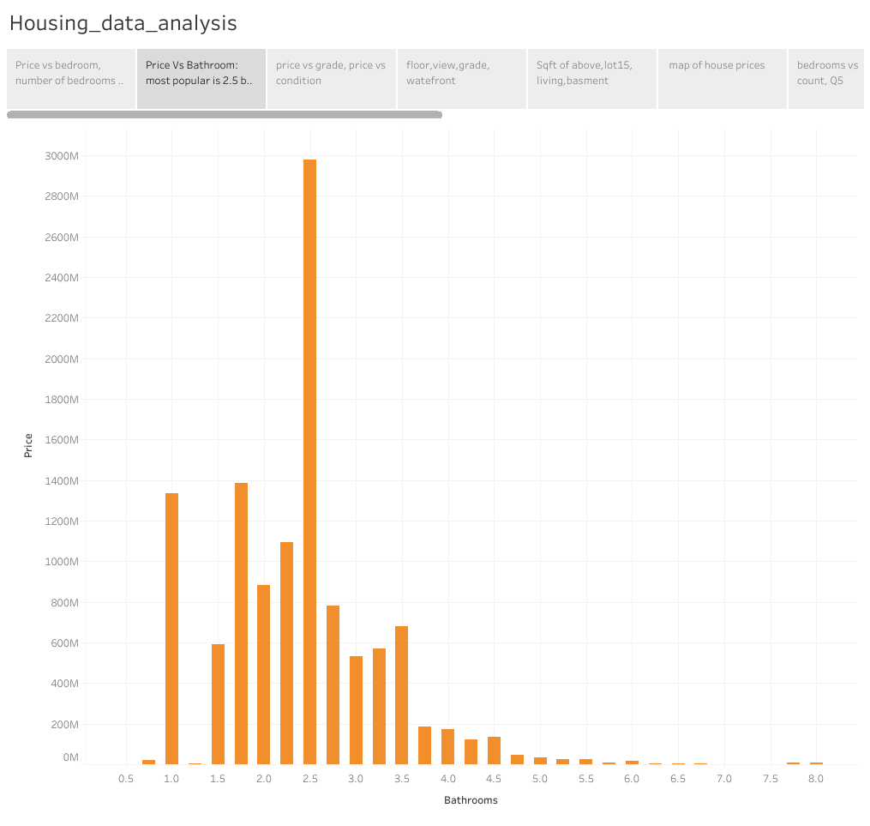
Notes:
2.5 is the most popular for bathrooms

Slide 6
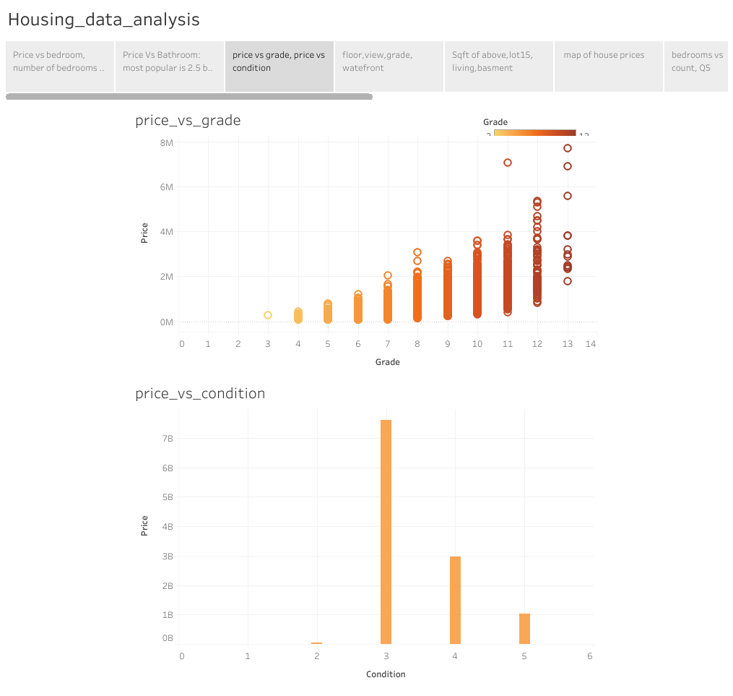
Notes:
Most popular condition is 3, then 4 then 5, nothing sold at condition 1 really , price goes up with grade

Slide 7
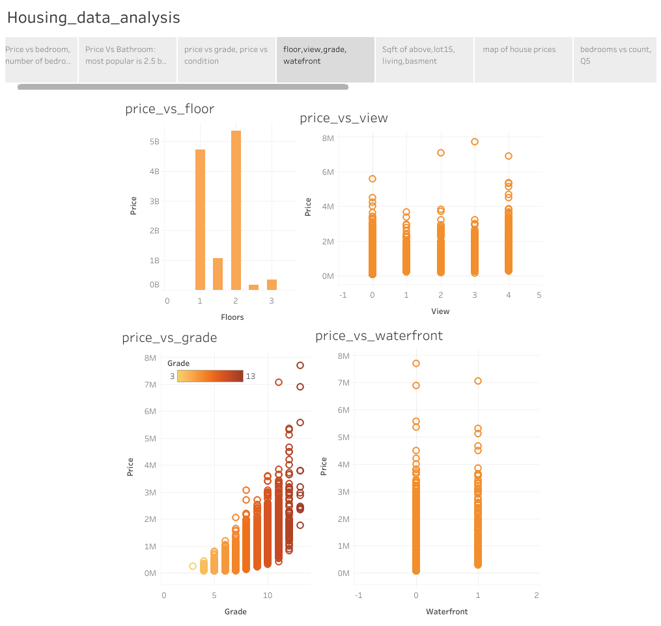

Slide 8
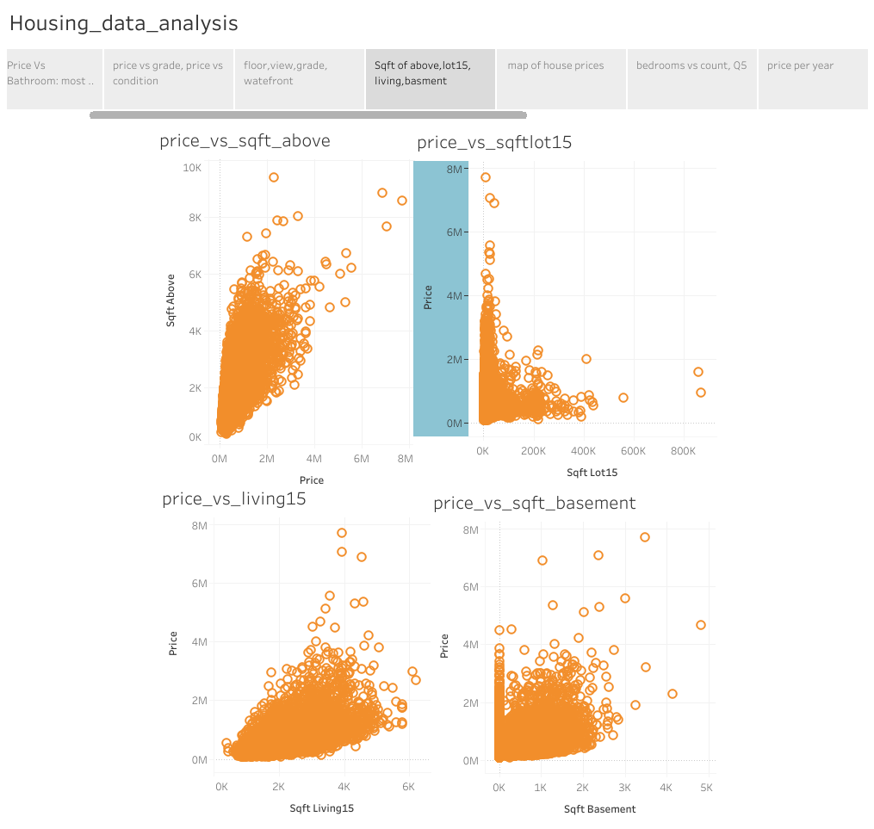

Slide 9
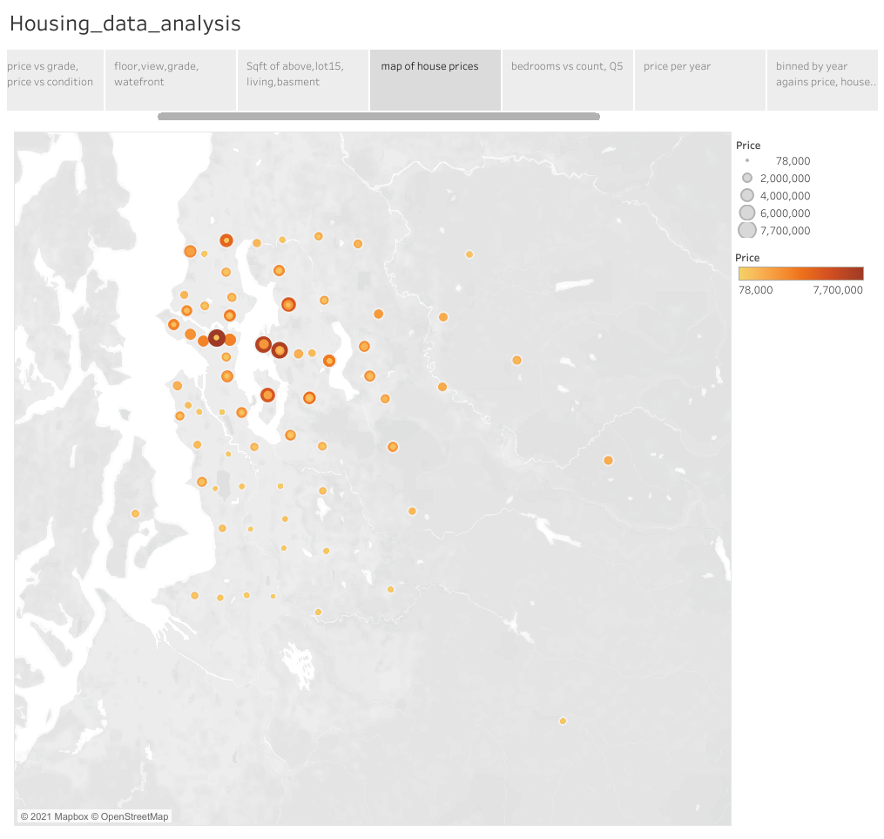

Slide 10
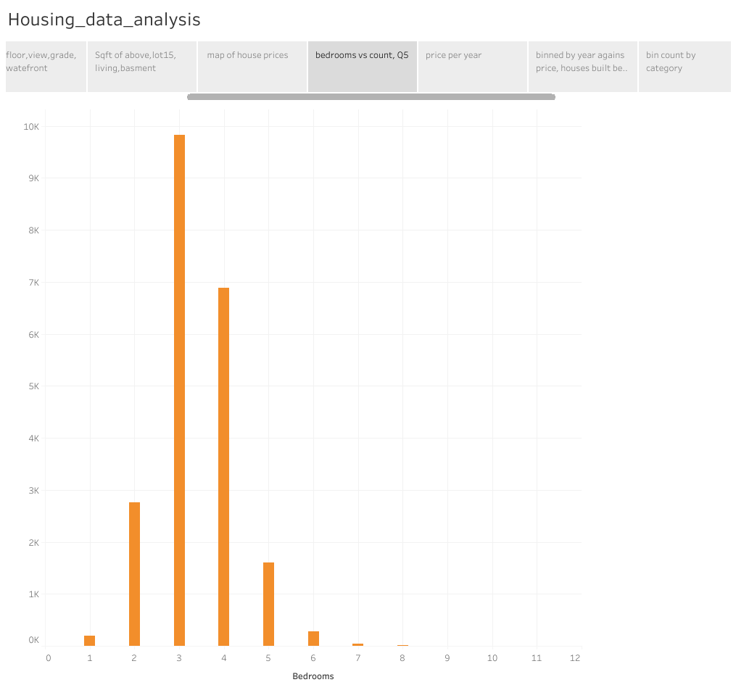

Slide 11
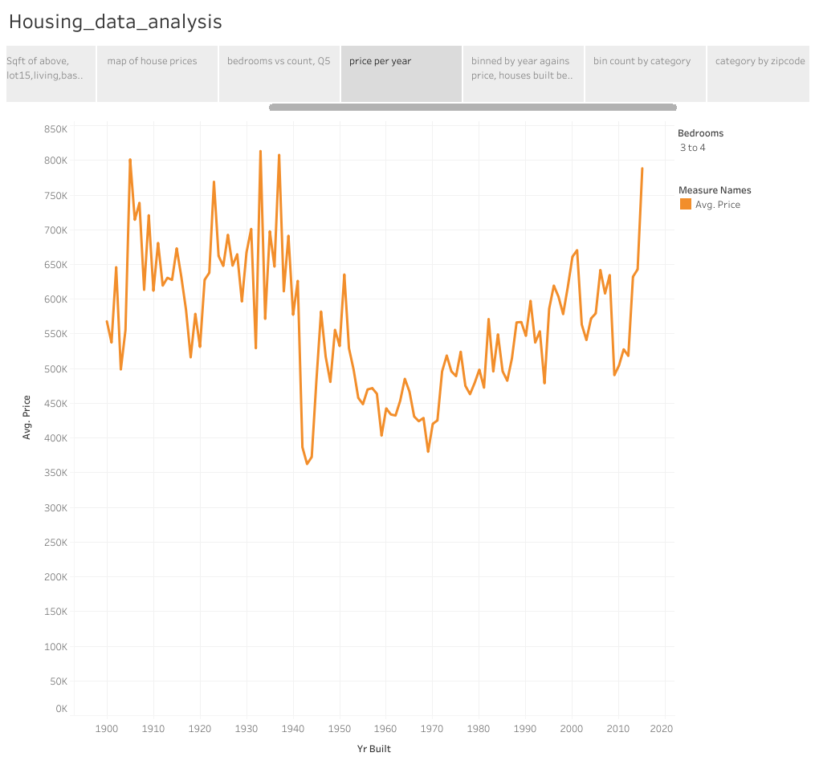
Notes:
Impressive that some of the older homes sell for some much

Slide 12
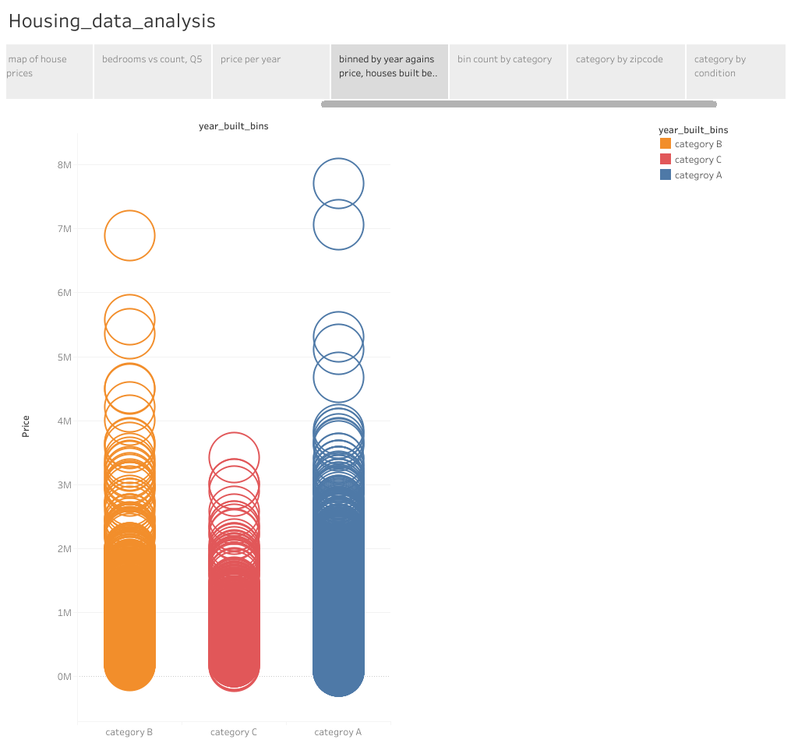

Slide 13
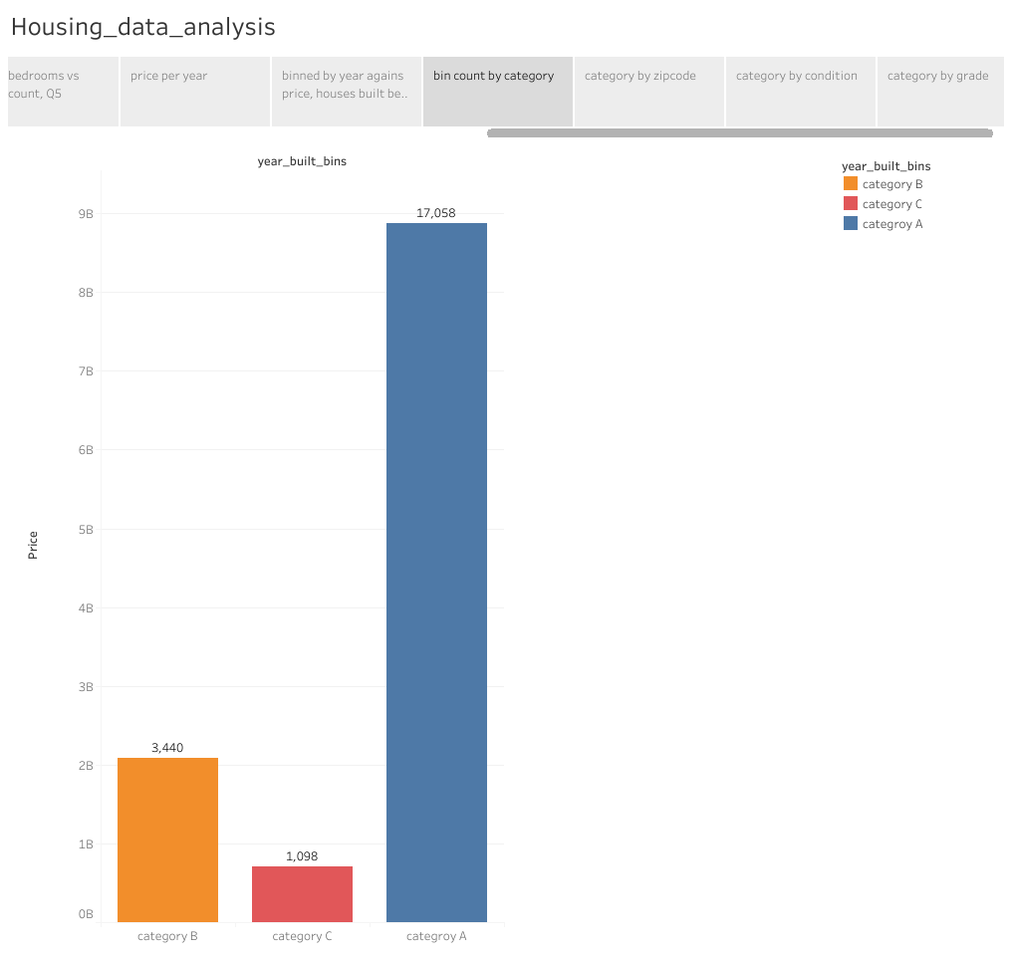

Slide 14
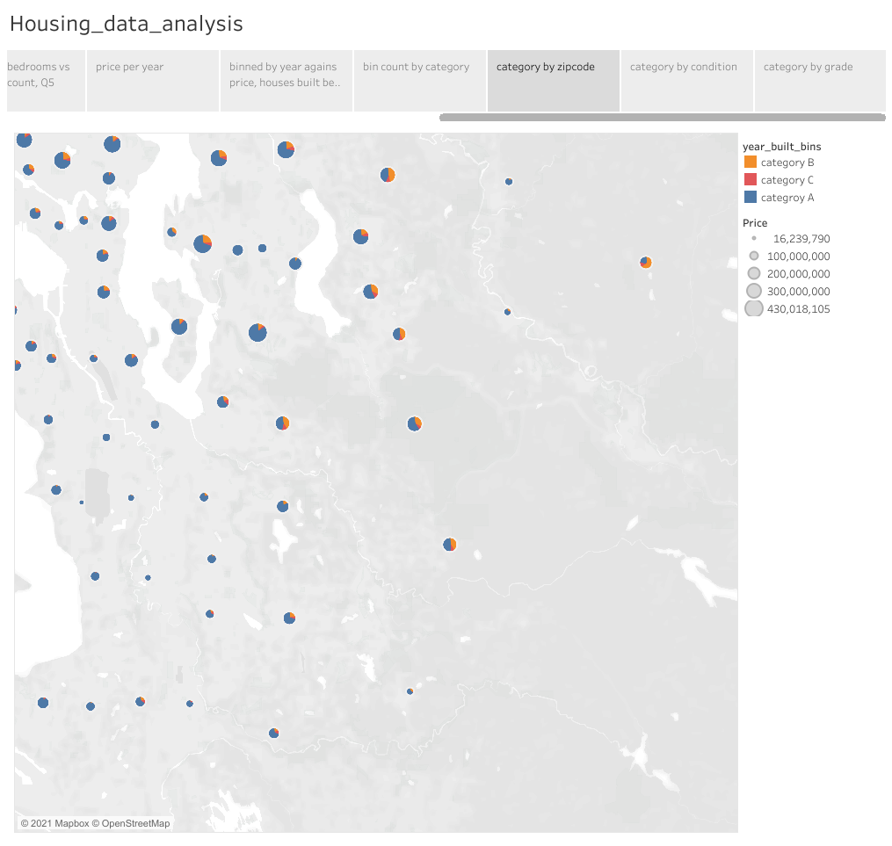

Slide 15
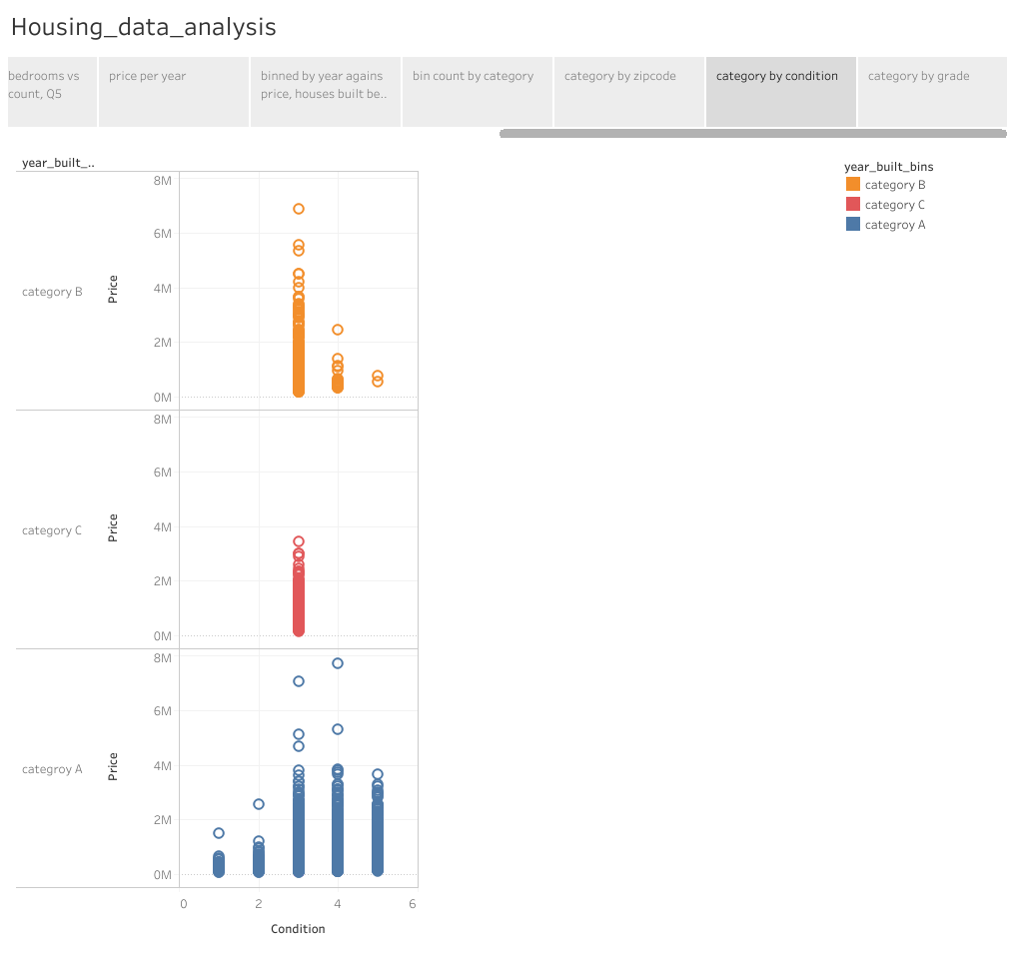

Slide 16
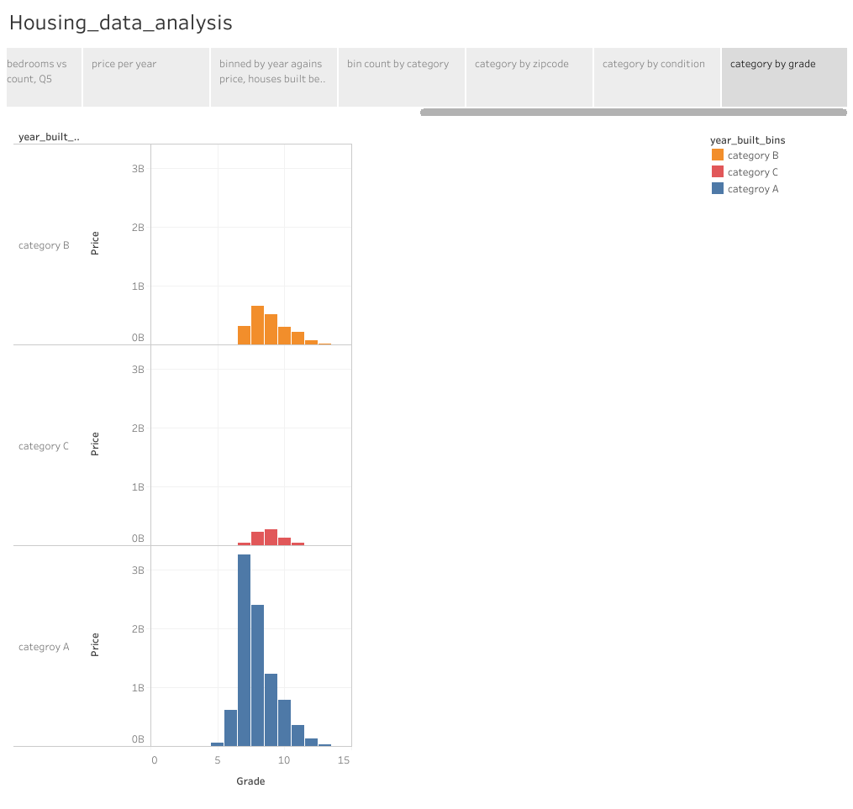

Slide 17
Improvements
filter by Zipcode using sql
Clean columns individually using the IQR]
Change the data types of certain columns
Use other methods of improving models that we have covered in class

Slide 18
Slide 3:https://komonews.com/news/business/us-home-sales-plunged-51-percent-in-january-12-18-2015

