Slide 1

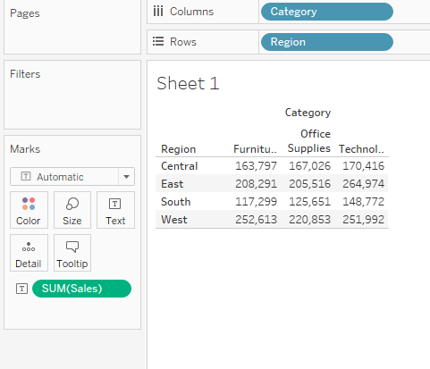
Basic Charts in Tableau
Text Tables
Text Tables- Eye for Detail/Attention to Detail
Text tables in Tableau are referred to as “Cross-Tabs”.
Text tables can be created by placing one dimension on the Rows shelf and another dimension on the Columns. The view is then completed by dragging one or more measures to Text on the Marks card.

Slide 2
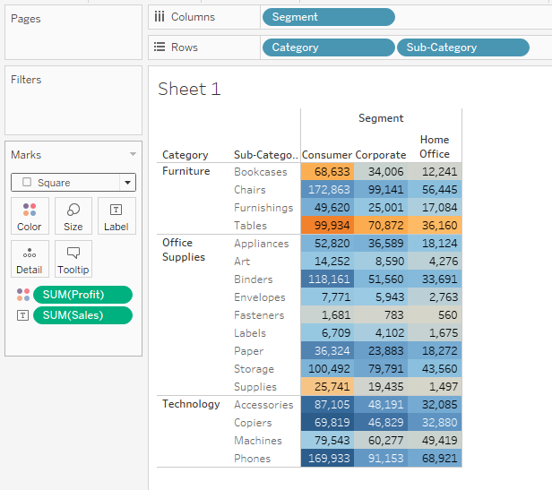
Highlight Tables:
Highlight Tables-Use highlight tables to compare categorical data using color.
Highlight tables are created by placing one or more dimensions on the Row shelf and Columns shelf. Then drag one or more measures into table Finally select ‘Square’ as mark type and place a measure of interest on the Color shelf.

Slide 3
Generated Fields in Tableau
The Tableau data pane contains few fields that do not come from your original data. They are automatically generated by tableau
Measure values appear at the bottom of the measures area. It contains all measures in the data collected into a single field with continuous values.
Measure Names appear at the bottom of the dimension area. It contains names of all measures in the data collected in the single fields with discreate values.
Latitude and Longitude: when Tableau interprets fields to be geographic fields that can be used with maps, it automatically geocodes the data and includes Latitude and Longitude fields.

Slide 4
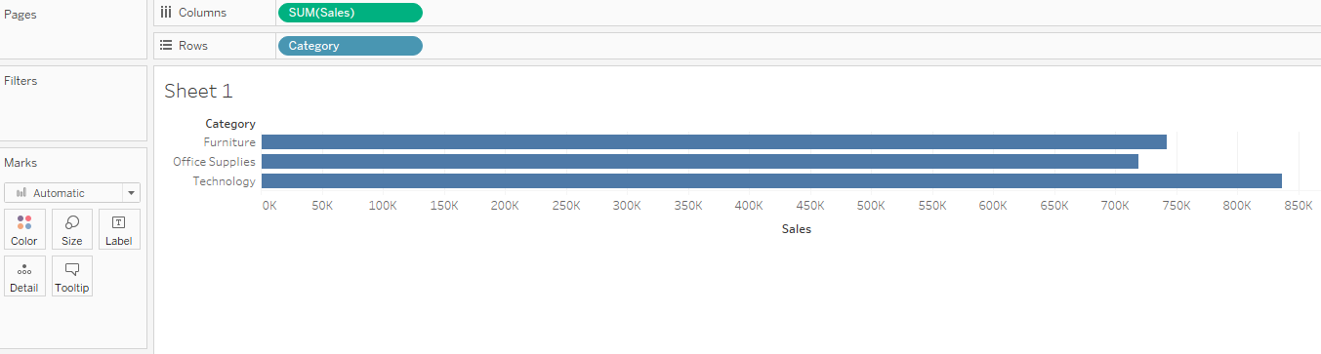
Bar Graph
Bar Graph are one of the most common ways to visualize data. It’s quick to compare information, revealing high and lows at glance.
Bar charts are especially effective when you have numerical data that splits nicely into different categories so you can quickly see trends within your data.
When to use Bar plots: Comparative Analysis.

Slide 5
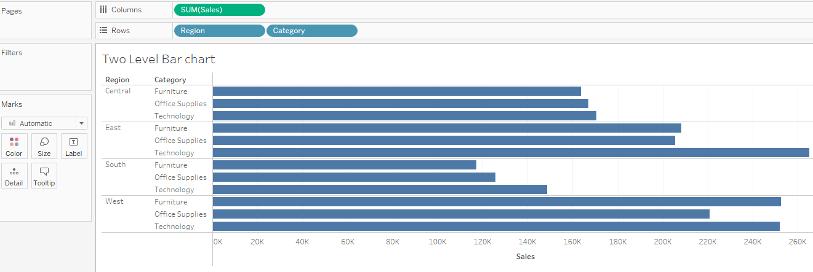
Iteration of Bar charts for deeper analysis
In previous bar graph we have seen that technology dept has more total sales.
What if you want to further understand sales amounts for departments across various regions?

Slide 6
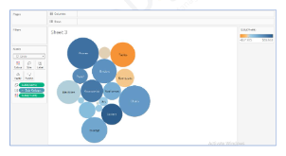
Bubble Chart
Bubble chart- A bubble chart is used to show data in bubbles or circles with varying sizes and according to a color scheme.
Dimensions define the individual bubbles, and measures define the size and color of the individual circles
When to use bubble charts: To display data in a cluster of circles.

Slide 7
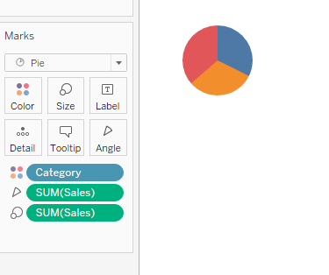
Pie Chart
Pie Chart should be used to show relative proportions-or percentage of information.
When to use pie charts: Showing proportions.

Slide 8

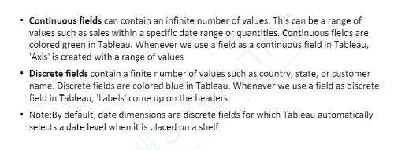
Continuous Vs Discrete

Slide 9
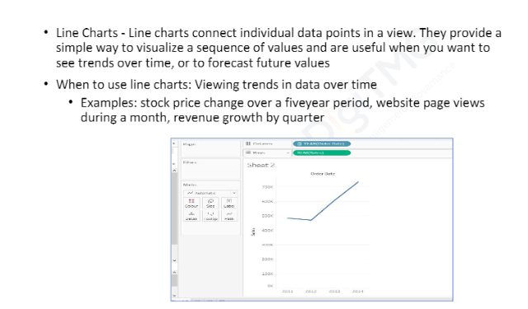
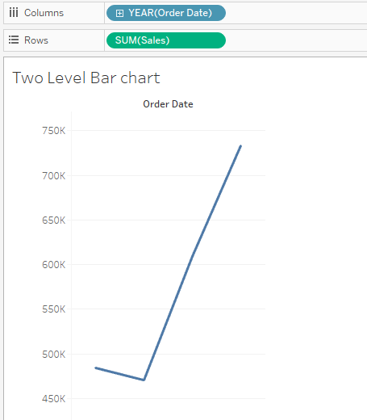
Line Chart

Slide 10
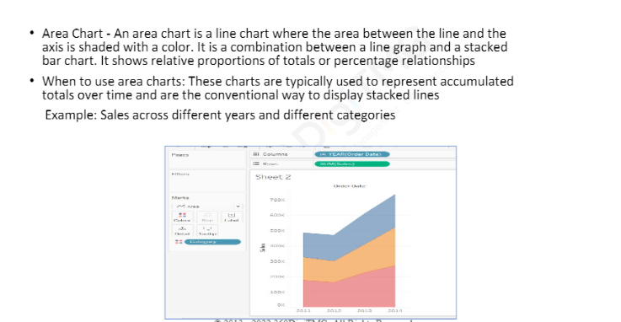
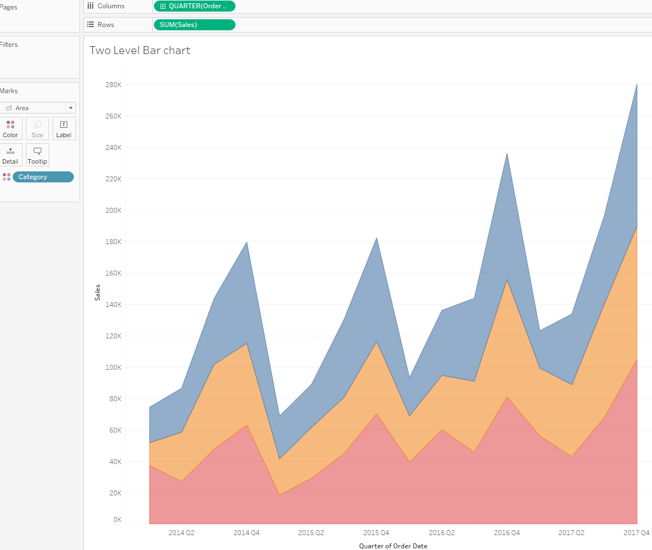
Area Chart

Slide 11
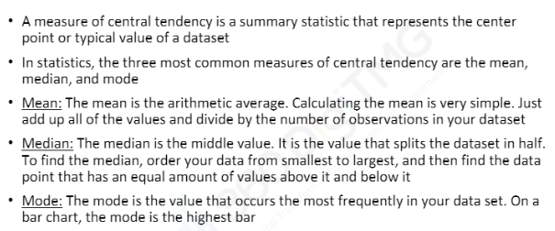
Measure of Central Tendency

