Slide 1

Filters in Tableau
Tableau has six different types of filters.
In simple terms, the filter removes the irrelevant data or extracts the essential data for our analysis.
Filters help minimize the dataset for efficiency purposes and optimize the process.
Tableau performs filter operations in a particular order, that is called Order of Operation, which is executed in the following order:
Extract Filters
Data Source Filters
Context Filters
Filters on Dimensions
Filters on Measures

Slide 2
Types of Filters
Extract Filters
Used to extracts a small subset of data from the original data source is the extract filter.
If the user extracts data from the data source, this Tableau filter is used.
It helps to lower the tableau queries to the data source
It allows adding filters to the column being extracted from the data sources
To reduce the data size, dimensions and measures filter can be applied after the extract
Data Source Filters
Applies to the data source directly
It can limit the number of records in the data set.
Used to filter data in data source section and restrict the file present in the data set

Slide 3
Types of Filters
Dimension Filter
It is a non-aggregated filter.
Applied to Dimensional (qualitative) field
Applied by both dragging them on the filter pane or right-clicking on a specific dimension
Measure Filter Applied to Measure (quantitative) fields
You can add operations like sum, mean, standard deviation, and other aggregated functions in the measure filter.
To add a measure filter, drag the measured field to the filter box
Applied after non-aggregate filters

Slide 4
Types of Filters
Filter Dates: Filter dates are the filters applied on the date fields.
Context Filters
Use to improve performance of views, filters, and queries run on data source.
It helps apply a relevant, actionable context to the entire data analysis in the tableau.
It gets applied before any other filters used in the worksheet
To add a context filter, click on Add to Context on the contextual menu of any existing categorical filter.
Table Calculation Filters
It is the last filter, applied after the view has been created
Used to look into the data without any filtering of hidden data
Table calculations are used when creating calculated fields such as LOOKUP, WINDOW_SUM etc.

Slide 5
Filtering on a Dimension : A dimension filter is used to view the data values of a smaller set of the dimension’s members.
General :This option shows the members of the selected dimension you can select for inclusion or exclusion. You can also create a custom value list.
Wildcard: This option sets up a wildcard inclusion or exclusion of dimension members matching the value entered.
Condition: This option filters values based upon specified conditions including a field, range of values or specified formula.
Top: This option filters by the top or bottom “N” where N is determined by the value of specified fields or formula.

Slide 6
Dimensions are descriptive fields having string values. There are following types of filters for dimensions in Tableau:
General Filter: It allows to select specific values from a list.
Ex: to view only central and east region sales.
Wildcard Filter: It allows to mention wildcards like cha* to filter all string values starting with cha.
Ex: To view only those sub categories sales begin with alphabet A.
Condition Filter: It applies conditions such as sum of sales.
Ex: to view the data based on product name and quantity fields
Top Filter: It chooses the records representing a range of high values
Ex: To find top 5 items based on sales

Slide 7
Filtering on a Measure: A measure filter is used to show only the values that meet your filter criteria.
When drag measure on filter shelf, it can ask to select the method of aggregation for the measure. After making your selection click on next. It offers several different options for filtering:
Range of values: It specifies the minimum and maximum values of the range to include in the view.
At Least: It includes all values that are greater than or equal to a specified value.
At Most: It includes all values that are less than or equal to a specified value.
Special: It helps you filter on Null values. It includes Null values, Non-null values, or All Values.

Slide 8
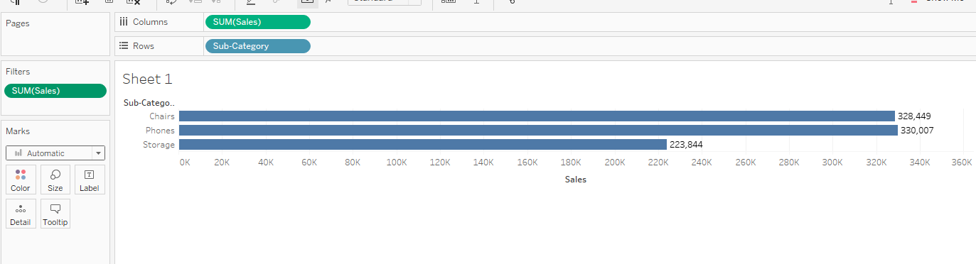

Slide 9
Date Filter
This filter is used to filter the data based on Date.
Filtering data on Dates can be done using one of the following approaches. When drag “ order Date” on filter shelf and choose Relative date and click next:
Relative Date: use this one to update data dynamically with time. The data shown in the view will be updated daily.
Ex: to view data for 6 months before/after the current date.
Range of dates-The user can specify a range of dates to filter
Start Date-Select Start date to define a fixed start date to filter on, end date is fetched from the data source.
End Date-Select End date to define a fixed end date to filter on, start date is fetched from the data source.

Slide 10
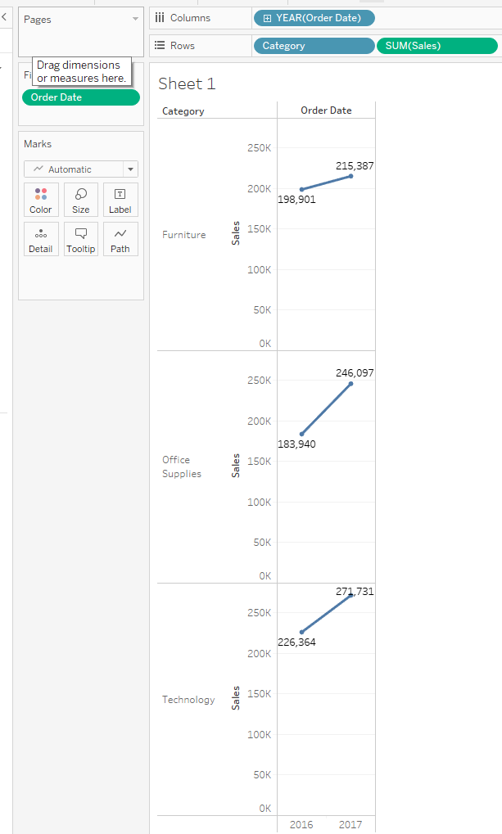
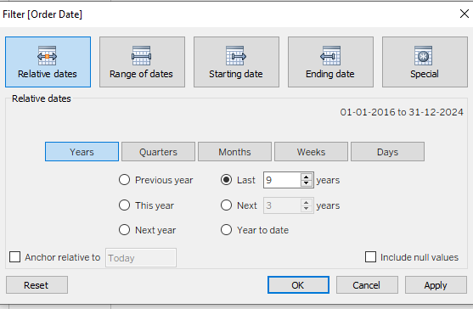
Ex1: display total sales based on category over the years.
Category and sales drag on ROWS
Order date on Columns
Now filter the data based on order date :
Order date is placed on the filter shelf
Click range of dates
Relative dates
Years

Slide 11
Context Filters
Normal filters in tableau are independent of each other.
It means each of the filter reads all rows from the data source and creates its own result.
However, there may be scenario, where you might want second filter to process only the records returned by the first filter.
In such a case, second filter is called dependent filter because they process only the data that coming from context filter.
Context filter is created because of the following reasons:
Improve Performance
Create a Dependent Numerical or Top N Filter

Slide 12
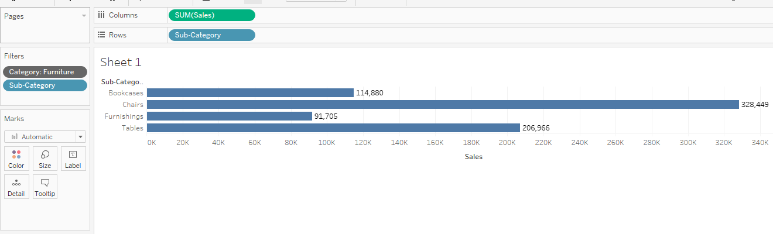
By using the Sample Super Store Find the top 5 sub category of products for category called Furniture.

Slide 13
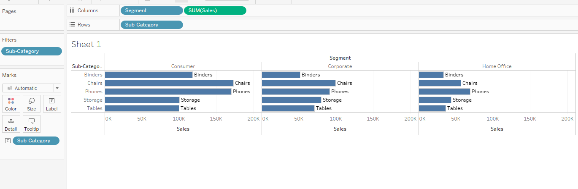
Find Sub category of products across all segments whose sales exceed one million.

