Slide 1


Introduction to Tableau

Slide 2

What is Data Visualization?
Data visualization is the graphical representation of information and data.
Data visualization tools provide an accessible way to see and understand trends, outliers and patterns in data.
It provides an excellent way to present the data.
Data visualization tools and technologies help to analyze massive amount of information and make data-driven decision.
It makes complex data more accessible and understandable.

Slide 3
Why is data visualization important?
Why Visualization
Our visual system is extremely well built for visual analysis
There is a huge of amount of data that arrives into our brain through eyes.
Our brains are extremely good at tasks such as Pattern Matching ,Edge Detection ,Shape recognition .
Data visualization provides a quick and effective way to communicate information in a universal manner using visual information .
The practice can also help business identify which factors affect customer behavior.

Slide 4
Goal of Data Visualization
The goal of Data visualization is to tell a story , without telling lies.
Influences decision
Encourage the eye to make comparisons.
Making invisible visible in Visualization.

Slide 5
Data visualization tools for business
1. MS Excel ( power BI )
spreadsheet software yet allows to create 20 types of charts
2. Google Charts
the tool can pull data – salesforce SQL database, Google sheets , HTML5 to generate charts . It offers 18 types of charts .
To share these charts Google allows to create a gallery on google’s website
3. Tableau
most popular data visualization tool in the market because of two reasons
– its relatively easy to use and incredibly powerful
It can integrate with hundreds of sources and owned by salesforce
It is widely used at enterprise level.
A free option Tableau public is also available
4. Zoho analytics 5. Data wrapper

Slide 6
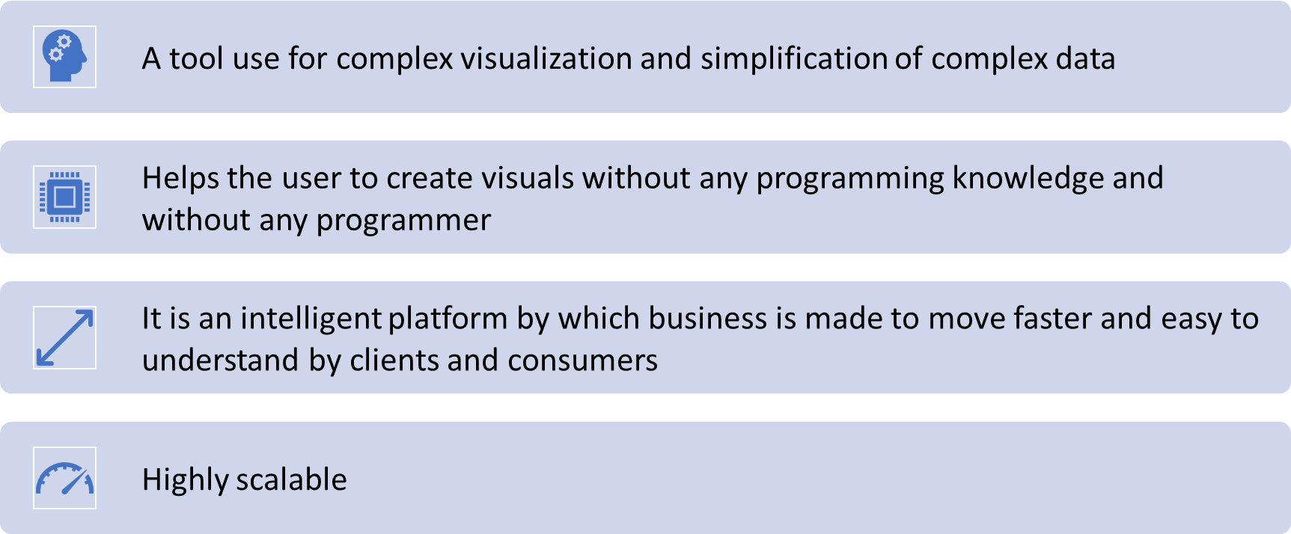
Introduction to Tableau
Tableau was founded in 2003 by Pat Hanrahan, Christian Chabot , and Chris Stolte.

Slide 7
Tableau Product Suite
Tableau Desktop: It is a data visualization tool that helps us to create Worksheets , Dashboards, and Stories
Tableau Public:
Tableau Server
Tableau Online

Slide 8
Down Load the Tableau Desktop
http://www.tableau.com/academic/students

Slide 9
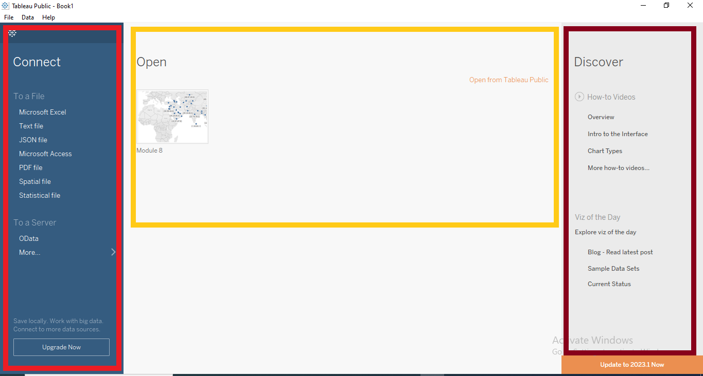
Tableau Start Page
The start page in Tableau Desktop/Tableau Public is a central location from which you can do the following:
Connect to your data
Open your most recently used workbooks, and
Discover and explore content produced by the Tableau community

Slide 10
Tableau Data Source Page
During analysis, we can make changes to the Tableau data source in data source page
We can also access the data source page by clicking the Data Source tab from any location in the workbook.
Image to keep

Slide 11
Tableau UI-Components and Terminologies
Tableau User Interface consists of menus, a toolbar, a data pane, cards and shelves, and one or more sheets.
Sheets can be worksheets, dashboards, or stories.

Slide 12
ShowMe Panel
Show Me creates a view based on the fields already used in the view and any fields you’ve selected in the Data Pane.

Slide 13
Data Types
All fields in a data sources have a data type. The data type reflects the kind of information stored in that fields.
Text Values: Alphanumeric data and strings are Text data Types
Example: “Books”, ”CA 2245465646”
Date values : Strings matching a date format are considered Dates
Date and Time values: fields that contain date as well as Time information are considered Date and Time data type.
Numeric values: Fields that Numeric data, including decimal numbers are considered Numerical data type.
Boolean values: Fields that contain T/F or 0/1 as the only sets are considered Boolean.
Geographic values: Fields that contain names of cities, states, countries or latitude and longitude information are considered Geographic.

Slide 14
Tableau Dimensions and Measures
Dimensions: Fields that contain qualitative values such as names, dates, or geographical data.
Measures: Fields that contain numeric, quantitative values such as sales, profits.

Slide 15
Save Tableau Workbook
Tableau workbook:
It contains the information about your sheets, dashboards and stories and connection details in the workbook (.twb) icon.
Tableau packaged workbook:
A packaged workbook(.twbx) contains a Tableau workbook, and the local resources used in that workbook, which could be Background Images, Custom Geocoding, Custom Shapes, Microsoft Access Files , Microsoft Excel Files, Tableau Data Extract, Text files.

Slide 16
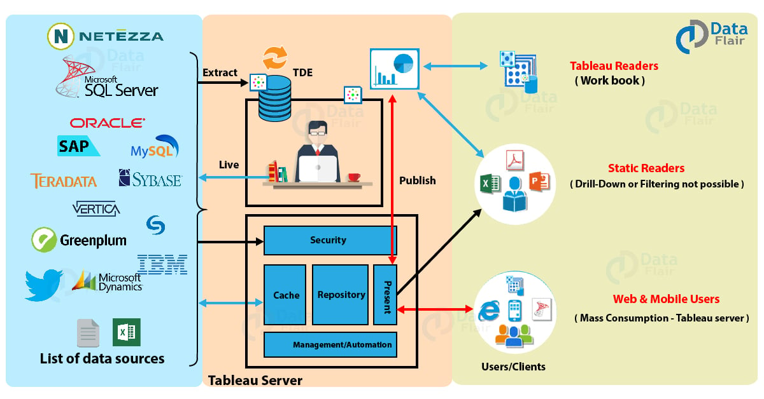
Tableau Architecture

Slide 17
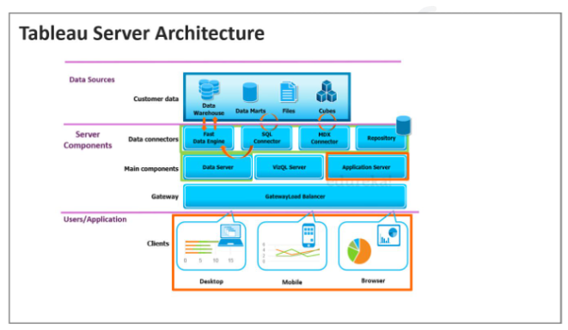
Tableau Server Architecture

Slide 18
Tableau Server Architecture
Application Server: The application server deals with login processes, domain authentication, data authorization, user or group permission management, content searches, etc.
VizQL Server: VizQL Server Sends queries directly to the data source, giving you visual feedback as you analyze.
Data Server: Data server helps in centralizing metadata management, driver deployment, and extract management in Tableau server.
Gateway: The Gateway process is the component that redirects traffic from all Tableau clients to the available server nodes in a cluster
Data server components: Tableau Data Extracts and Database connections can be managed centrally within Tableau Server and shared across workbooks.
Data sources: We can connect to data from different sources Like excel, server etc.

Slide 19
Limitations of Tableau Public
Limited Data Source connectivity options
Cannot save work locally. Can be saved only to the Tableau Gallery
No Live connection option . All the connections on Tableau Public are Extract connections
No option to export the visualizations are images.
No option to “Print to PDF”.
Custom Geo-Coding not possible
Cannot integrate Tableau public with ‘R’ and ‘Python’

