Slide 1

Cornerstone Project Based Learning – Final Review
FILE DATA ANALYZER SYSTEM
Presented by
1. Ram Charan Kancham – 25B11CS349
2. Nikhil Bantupalli - 25B11CS676
3. Pranav Aditya V - 25B11CSA00
4. Jaswanth Katragadda – 25B11CS349
II Year – 3rd Semester | Batch 11
Department of Computer Science and Engineering
1

Slide 2
INTRODUCTION
• A Python-based system designed to read, inspect, preprocess and analyze data files.
• The current prototype is implemented in Google Colab using Pandas and NumPy.
• The Superstore Sales dataset from Kaggle is used as the main demonstration dataset.
• The system extracts file structure, data types, missing values, duplicates and statistical information.
• The project is designed to grow into a reusable analyzer for multiple file formats.
2

Slide 3
PROBLEM STATEMENT
Manual inspection
Data quality
Multiple formats
Large datasets contain thousands of records and many columns, making manual inspection slow and error-prone.
Missing values, duplicates and incorrect data types can affect the reliability of later analysis.
A useful analyzer should not be restricted to one fixed dataset or one file format.
Problem to solve
Develop a simple automated system that accepts a data file, identifies its structure, performs basic preprocessing and produces useful analytical information with minimum manual effort.
3

Slide 4
OBJECTIVE
PRIMARY OBJECTIVE
KEY OPERATIONS
Provide one reusable workflow for reading different file formats and extracting useful information. The system combines file handling, analysis and reporting so the same approach can be applied to many uploaded datasets.
• Word counting
• Data filtering
• Descriptive statistics
• Missing-value and duplicate checks
• Data visualization
• Multiple-file processing using glob
• Automatic summary generation
4

Slide 5
SUPPORTED FILE FORMATS
TXT
CSV
JSON
EXCEL
Plain text files are read as text and used for direct word-count analysis.
Tabular files are processed with Pandas, including structure, filtering and statistics.
Structured data is read and recursively inspected for text and values.
XLSX and XLS spreadsheets are supported through the same analysis workflow.
FORMAT DETECTION
The system checks the file extension and routes each file to the corresponding reader. This keeps the processing flow reusable while allowing different input types to be analyzed through one menu-driven system.
5

Slide 6
DATASET & REASON FOR SELECTION
Superstore dataset
Why selected?
Role in our project
Source: Kaggle
9,994 rows
21 columns
0 missing values
0 duplicate rows
Important fields:
Sales • Quantity • Discount • Profit
Order Date • Ship Date
Category • Region • Segment
• Realistic business dataset
• Numerical + categorical data
• Date fields
• Suitable for filtering and statistics
• Large enough for file analysis
• Positive and negative profit values
Superstore is the primary CSV used to demonstrate the analyzer.
Current format:
CSV
Planned formats:
Excel • JSON • TXT
Workflow uses Pandas and NumPy.
DATASET CONSTRAINTS
Constraint | Impact / Handling
Current file format | Superstore is currently used as CSV; other formats are planned.
Fixed schema | The demonstration dataset has 21 predefined columns.
Data scope | The dataset represents U.S. business sales, so findings are limited to this scope.
No missing / duplicate rows | The dataset has 0 missing values and 0 duplicate rows; data-cleaning issues are not strongly demonstrated.
Encoding dependency | The original UTF-8 read produced an encoding error; latin1 was used for loading.
6

Slide 7
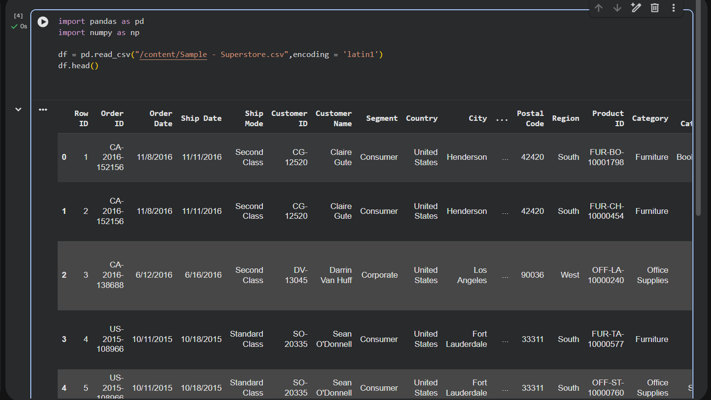
DATA PREPROCESSING
STEPS PERFORMED
• Load the Kaggle CSV using Pandas.
• Use latin1 encoding because the original UTF-8 read produced an encoding error.
• Inspect the first records and dataset structure.
• Check rows, columns and data types.
• Convert Order Date and Ship Date to datetime.
Actual Google Colab screenshot — dataset loaded with Pandas
7

Slide 8
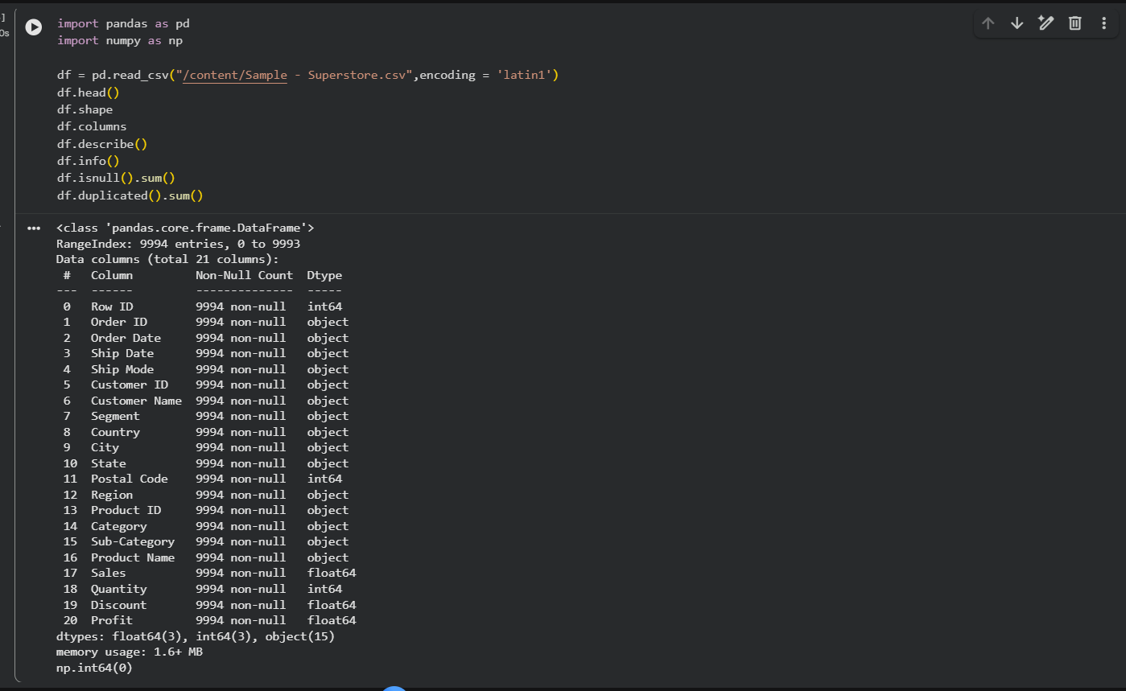
DATA PREPROCESSING RESULTS
VALIDATION RESULTS
Dataset size
9,994 records × 21 columns
Missing values
0 across all 21 columns
Duplicate rows
0 duplicate rows
Date conversion
Actual Google Colab output from df.info()
2 date columns converted to datetime
8

Slide 9
METHODOLOGY
1
2
3
4
5
6
Select File
Read File
Inspect
Preprocess
Analyze
Report
Kaggle CSV / user file
Pandas DataFrame
Shape • columns • types
Missing • duplicates • dates
NumPy + Pandas
Results & insights
Current implementation uses only Pandas and NumPy for the analysis layer.
• File handling is separated conceptually from data analysis so the system can be extended to other formats.
• The current prototype focuses on CSV + Superstore before adding the remaining file types.
• Outputs are designed to be clear enough for both technical review and project documentation.
9

Slide 10
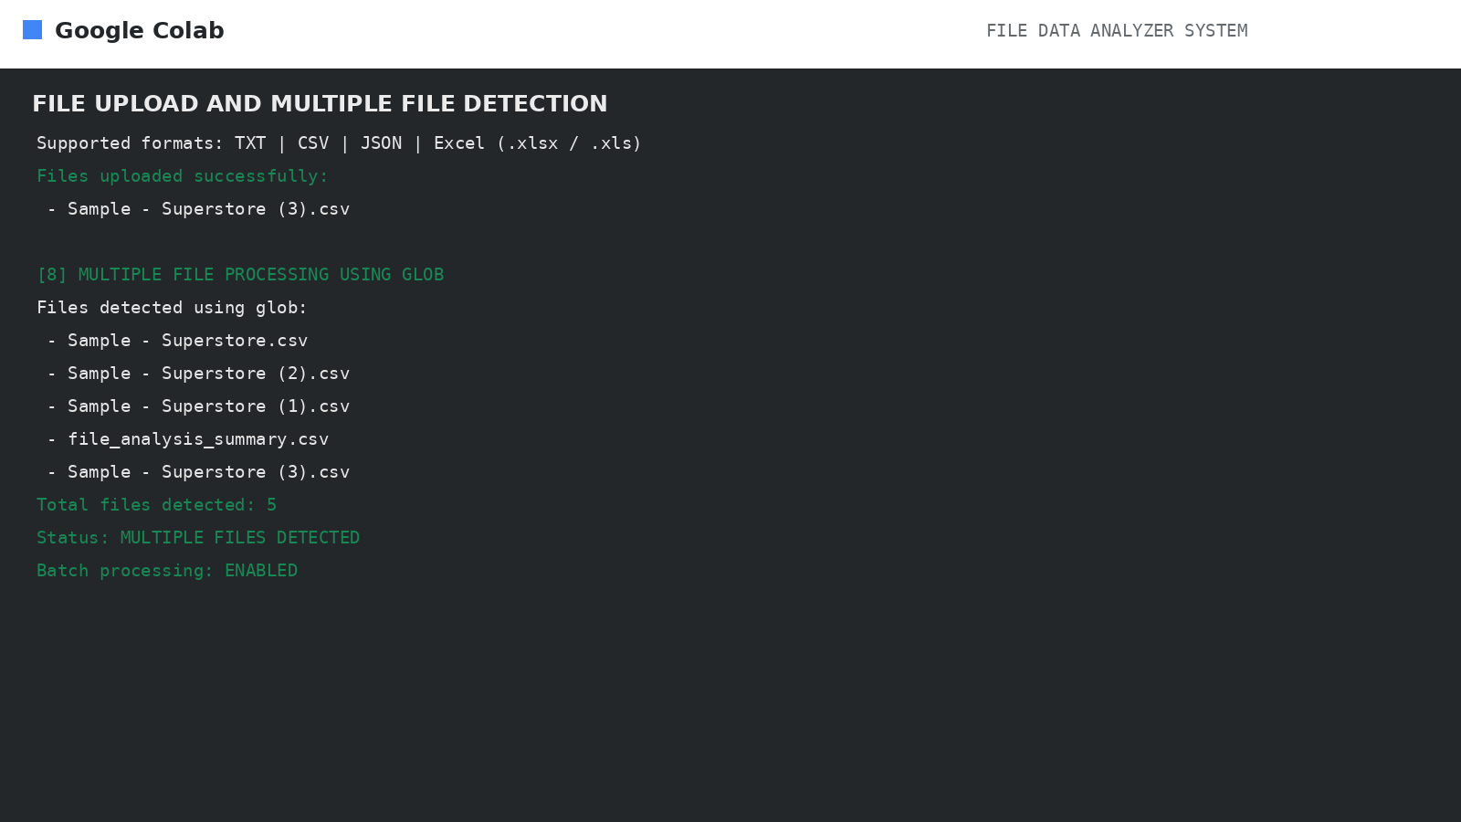
SYSTEM WORKFLOW
1
SELECT
DETECT
READ
CHECK
ANALYZE
REPORT
→
2
→
3
→
4
→
5
→
6
Upload one or more files
Identify file type
Use Pandas / JSON reader
Rows, columns, missing values
Words, statistics, filtering
Charts + CSV summary
BATCH PROCESSING
Files are collected with glob patterns, processed according to extension and summarized into a single report. The same workflow can therefore be repeated across multiple uploaded files.
10

Slide 11
SYSTEM ARCHITECTURE
INPUT LAYER
Kaggle dataset / user-uploaded file
FILE HANDLING
Detect extension and read the file
PREPROCESSING
Validate structure, missing values, duplicates and data types
ANALYSIS
Pandas + NumPy for filtering, statistics and aggregation
OUTPUT
Dataset summary, filtered results and analytical findings
Planned file readers: CSV • Excel • JSON • TXT
11

Slide 12
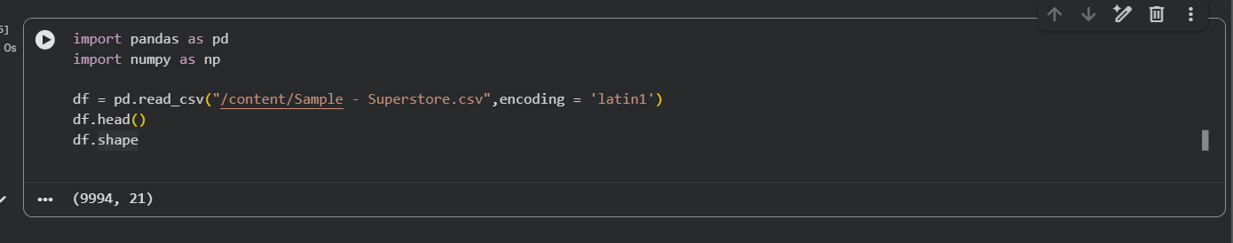
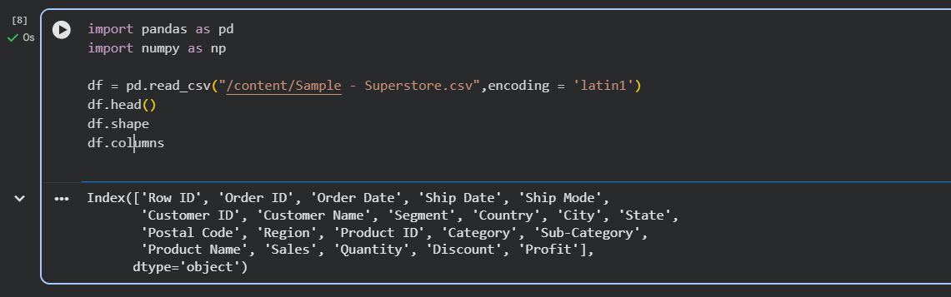
CURRENT IMPLEMENTATION & CODE EVIDENCE
df.shape → (9994, 21)
df.columns → 21 dataset attributes
Implemented
Libraries
Next module
CSV loading, file inspection, missing-value check, duplicate check and date conversion.
Pandas for file/data operations and NumPy for numerical analysis.
Automatic upload + format detection, followed by filtering and statistical analysis.
12

Slide 13
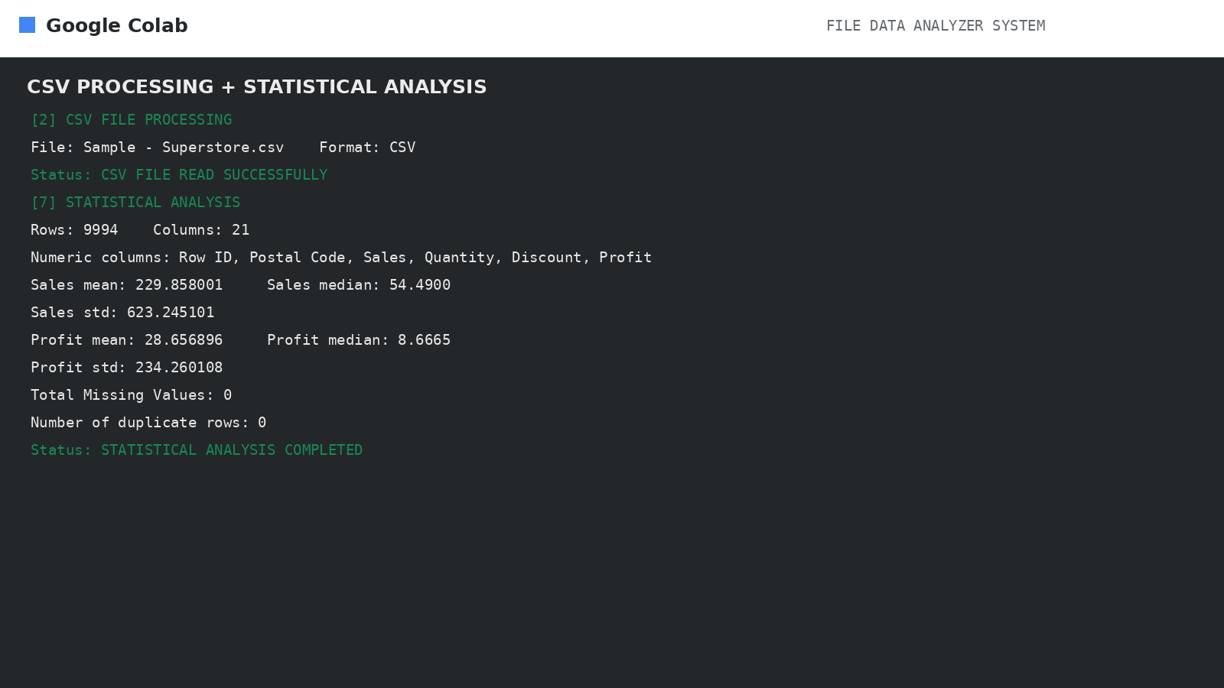
STATISTICAL ANALYSIS
SUPERSTORE RESULTS
Mean Sales: 229.858
Median Sales: 54.49
Mean Profit: 28.657
Median Profit: 8.667
Sales standard deviation: 623.245
Profit standard deviation: 234.260
The system identifies numeric columns and calculates descriptive statistics while also reporting dataset dimensions and validation results.
13

Slide 14
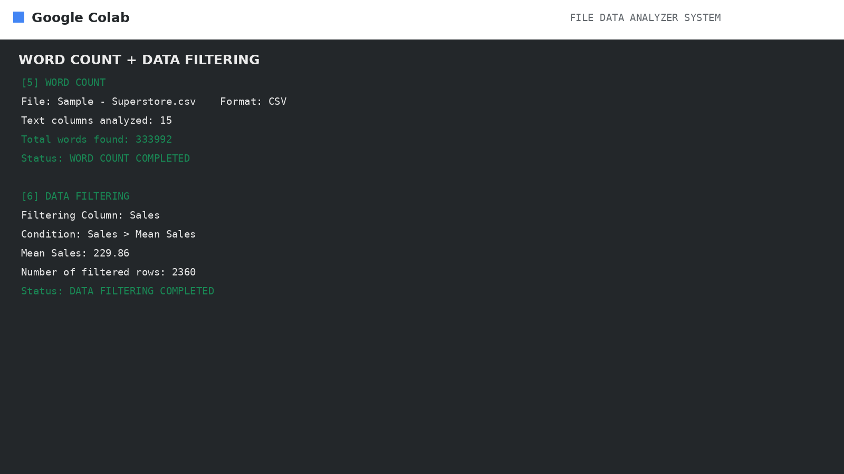
WORD COUNT & DATA FILTERING
WORD COUNT
The CSV text columns produce a total of 333,992 words. This demonstrates that word analysis can be performed on tabular data, not only on standalone text files.
DATA FILTERING
Filter condition: Sales > mean Sales (229.86). The execution returns 2,360 rows for inspection, demonstrating how a numeric condition can reduce a large dataset.
14

Slide 15
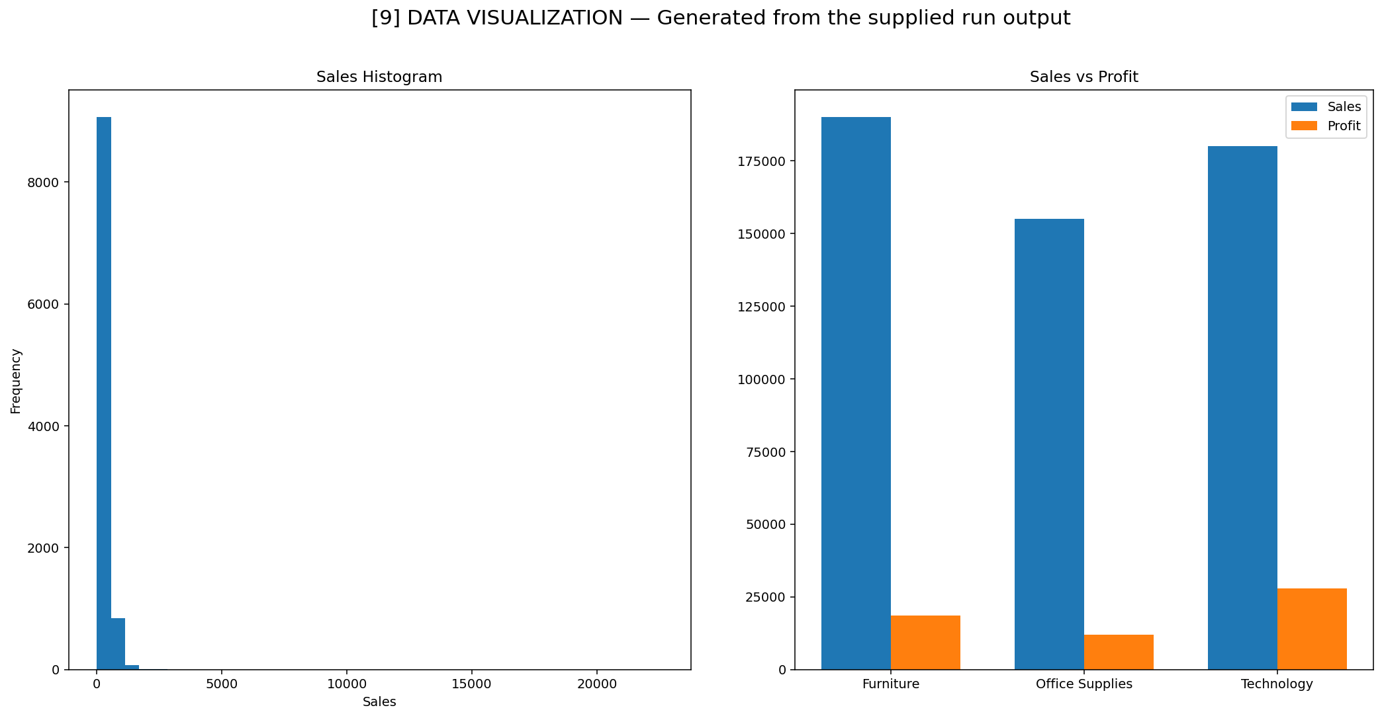
DATA VISUALIZATION
GENERATED CHARTS
• Sales histogram for distribution
• Sales vs Profit comparison
The charts provide visual views of numeric behavior and relationships, and are generated as part of the automated analysis workflow.
15

Slide 16
MULTIPLE FILES USING GLOB
BATCH EXECUTION
The supplied run detected five files and processed them in one workflow. Several Superstore CSV copies were analyzed successfully, demonstrating that the same operations can be repeated without manually rewriting the analysis for each file.
RUN NOTE
The generated file_analysis_summary.csv was also present in the folder and was picked up by the glob pattern during this run.
16

Slide 17
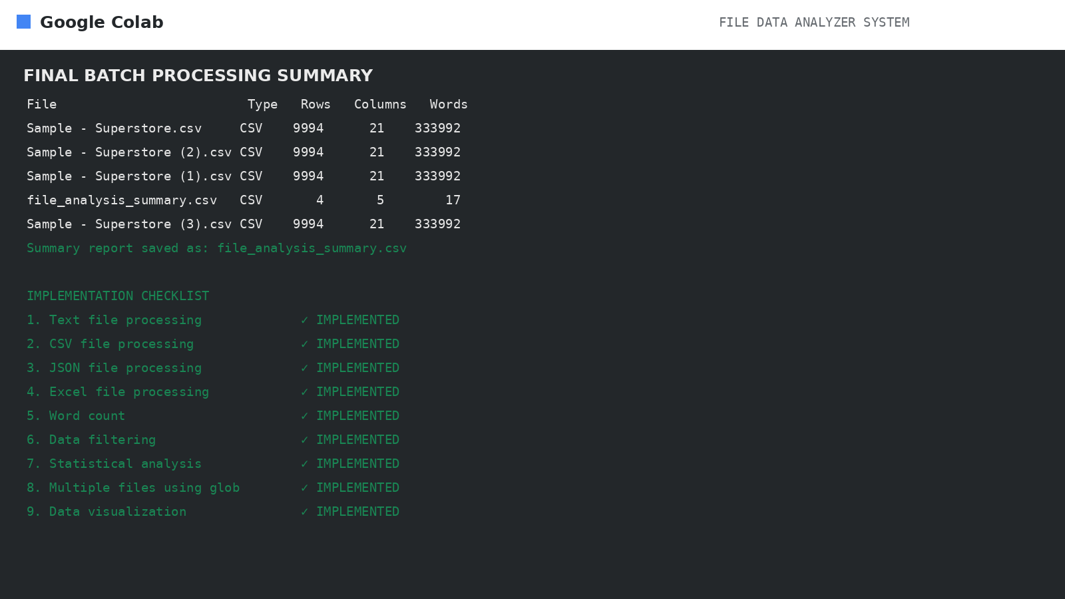
EXECUTION RESULTS
IMPLEMENTATION CHECKLIST
✓ Text file processing
✓ CSV file processing
✓ JSON file processing
✓ Excel file processing
✓ Word count
✓ Data filtering
✓ Statistical analysis
✓ Multiple files using glob
✓ Data visualization
17

Slide 18
ENHANCEMENTS
PLANNED ENHANCEMENTS
• Support Excel, JSON and TXT files in addition to CSV.
• Add batch processing for multiple files.
• Automate file summaries and analytical reports.
• Add flexible filtering and aggregation options.
• Add visualization after the core Pandas/NumPy workflow is complete.
Thank You
18

Slide 19
CONCLUSION
KEY OUTCOMES
• The Review 1 prototype successfully loads and inspects the Kaggle Superstore dataset.
• The dataset contains 9,994 rows and 21 columns with no missing or duplicate rows.
• Date fields have been converted into usable datetime values.
• The project now has a foundation for a reusable multi-format File Data Analyzer System.
Thank You
19

