Slide 1

Cornerstone Project Based Learning – Review 1
FILE DATA ANALYZER SYSTEM
Presented by
1. Ram Charan Kancham – 25B11CS349
2. Nikhil Bantupalli - 25B11CS676
3. Pranav Aditya V - 25B11CSA00
4. Jaswanth Katragadda – 25B11CS349
II Year – 3rd Semester | Batch 11
Department of Computer Science and Engineering
1

Slide 2
INTRODUCTION
• A Python-based system designed to read, inspect, preprocess and analyze data files.
• The current prototype is implemented in Google Colab using Pandas and NumPy.
• The Superstore Sales dataset from Kaggle is used as the main demonstration dataset.
• The system extracts file structure, data types, missing values, duplicates and statistical information.
• The project is designed to grow into a reusable analyzer for multiple file formats.
2

Slide 3
PROBLEM STATEMENT
Manual inspection
Data quality
Multiple formats
Large datasets contain thousands of records and many columns, making manual inspection slow and error-prone.
Missing values, duplicates and incorrect data types can affect the reliability of later analysis.
A useful analyzer should not be restricted to one fixed dataset or one file format.
Problem to solve
Develop a simple automated system that accepts a data file, identifies its structure, performs basic preprocessing and produces useful analytical information with minimum manual effort.
3

Slide 4
DATASET & REASON FOR SELECTION
Superstore dataset
Why selected?
Role in our project
Source: Kaggle
9,994 rows
21 columns
0 missing values
0 duplicate rows
Important fields:
Sales • Quantity • Discount • Profit
Order Date • Ship Date
Category • Region • Segment
• Realistic business dataset
• Numerical + categorical data
• Date fields
• Suitable for filtering and statistics
• Large enough for file analysis
• Positive and negative profit values
Superstore is the primary CSV used to demonstrate the analyzer.
Current format:
CSV
Planned formats:
Excel • JSON • TXT
Workflow uses Pandas and NumPy.
DATASET CONSTRAINTS
Constraint | Impact / Handling
Current file format | Superstore is currently used as CSV; other formats are planned.
Fixed schema | The demonstration dataset has 21 predefined columns.
Data scope | The dataset represents U.S. business sales, so findings are limited to this scope.
No missing / duplicate rows | The dataset has 0 missing values and 0 duplicate rows; data-cleaning issues are not strongly demonstrated.
Encoding dependency | The original UTF-8 read produced an encoding error; latin1 was used for loading.
4

Slide 5
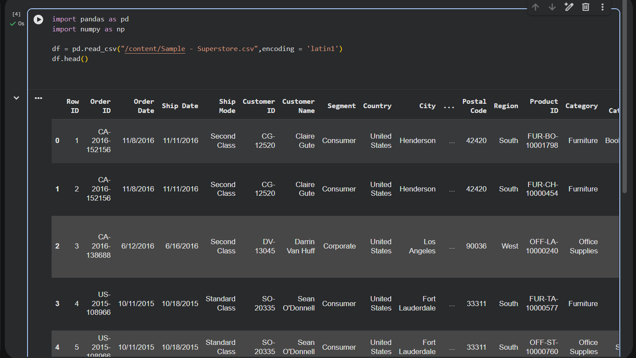
DATA PREPROCESSING
STEPS PERFORMED
• Load the Kaggle CSV using Pandas.
• Use latin1 encoding because the original UTF-8 read produced an encoding error.
• Inspect the first records and dataset structure.
• Check rows, columns and data types.
• Convert Order Date and Ship Date to datetime.
Actual Google Colab screenshot — dataset loaded with Pandas
5

Slide 6
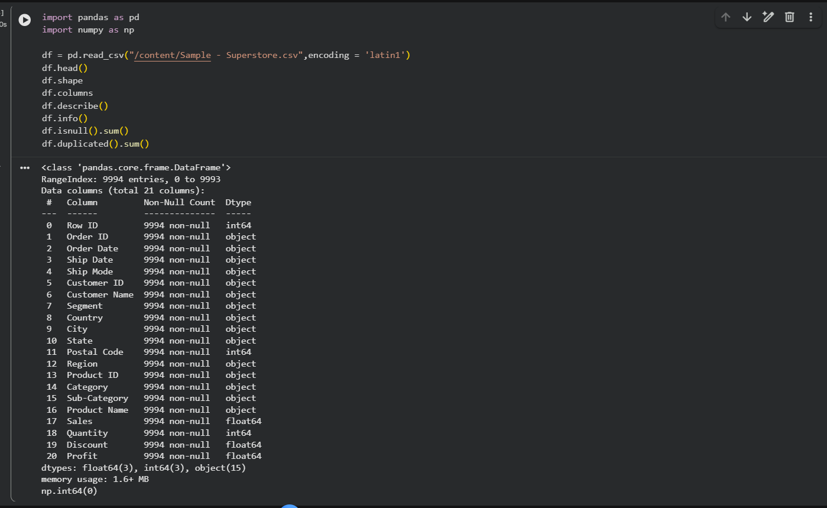
DATA PREPROCESSING RESULTS
VALIDATION RESULTS
Dataset size
9,994 records × 21 columns
Missing values
0 across all 21 columns
Duplicate rows
0 duplicate rows
Date conversion
Actual Google Colab output from df.info()
2 date columns converted to datetime
6

Slide 7
METHODOLOGY
1
2
3
4
5
6
Select File
Read File
Inspect
Preprocess
Analyze
Report
Kaggle CSV / user file
Pandas DataFrame
Shape • columns • types
Missing • duplicates • dates
NumPy + Pandas
Results & insights
Current implementation uses only Pandas and NumPy for the analysis layer.
• File handling is separated conceptually from data analysis so the system can be extended to other formats.
• The current prototype focuses on CSV + Superstore before adding the remaining file types.
• Outputs are designed to be clear enough for both technical review and project documentation.
7

Slide 8
SYSTEM ARCHITECTURE
INPUT LAYER
Kaggle dataset / user-uploaded file
FILE HANDLING
Detect extension and read the file
PREPROCESSING
Validate structure, missing values, duplicates and data types
ANALYSIS
Pandas + NumPy for filtering, statistics and aggregation
OUTPUT
Dataset summary, filtered results and analytical findings
Planned file readers: CSV • Excel • JSON • TXT
8

Slide 9
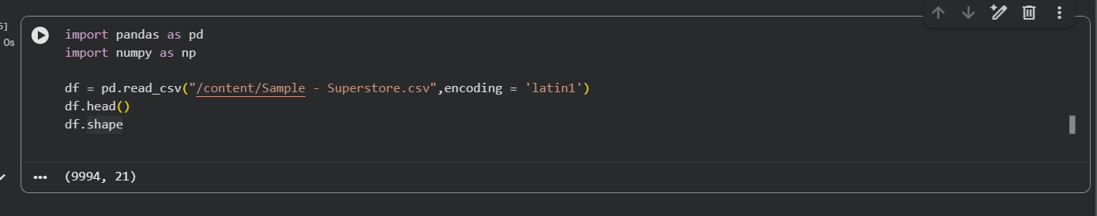
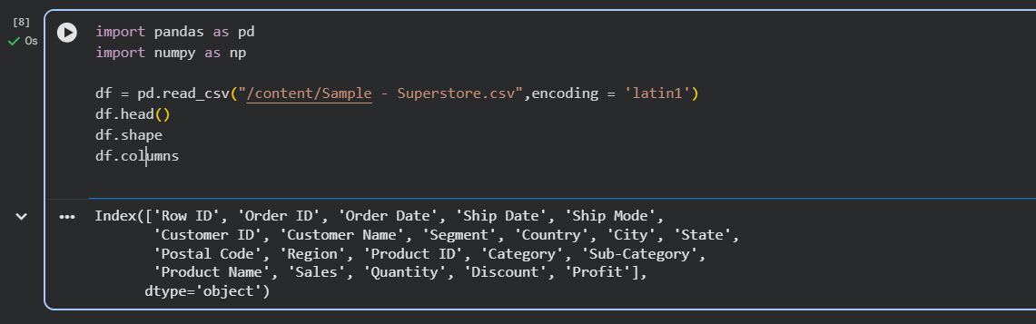
CURRENT IMPLEMENTATION & CODE EVIDENCE
df.shape → (9994, 21)
df.columns → 21 dataset attributes
Implemented
Libraries
Next module
CSV loading, file inspection, missing-value check, duplicate check and date conversion.
Pandas for file/data operations and NumPy for numerical analysis.
Automatic upload + format detection, followed by filtering and statistical analysis.
9

Slide 10
ENHANCEMENTS
PLANNED ENHANCEMENTS
• Support Excel, JSON and TXT files in addition to CSV.
• Add batch processing for multiple files.
• Automate file summaries and analytical reports.
• Add flexible filtering and aggregation options.
• Add visualization after the core Pandas/NumPy workflow is complete.
Thank You
10

Slide 11
CONCLUSION
KEY OUTCOMES
• The Review 1 prototype successfully loads and inspects the Kaggle Superstore dataset.
• The dataset contains 9,994 rows and 21 columns with no missing or duplicate rows.
• Date fields have been converted into usable datetime values.
• The project now has a foundation for a reusable multi-format File Data Analyzer System.
Thank You
11

