Slide 1

FILE DATA ANALYZER SYSTEM
A reusable Python-based system for analyzing multiple file formats in Google Colab.
Supports TXT, CSV, JSON and Excel files, with word counting, data filtering, statistical analysis, visualization, batch processing and automatic CSV reporting.
Ram Charan Kancham – 25B11CS387
Nikhil Bantupalli – 25B11CS676
Pranav Aditya – 25B11CSA00
Jaswanth Katragadda – 25B11CS349
II Year – 3rd Semester | Batch 11
Department of Computer Science and Engineering
1

Slide 2
OBJECTIVE
PRIMARY OBJECTIVE
KEY OPERATIONS
Provide one reusable workflow for reading different file formats and extracting useful information. The system combines file handling, analysis and reporting so the same approach can be applied to many uploaded datasets.
• Word counting
• Data filtering
• Descriptive statistics
• Missing-value and duplicate checks
• Data visualization
• Multiple-file processing using glob
• Automatic summary generation
2

Slide 3
SUPPORTED FILE FORMATS
TXT
CSV
JSON
EXCEL
Plain text files are read as text and used for direct word-count analysis.
Tabular files are processed with Pandas, including structure, filtering and statistics.
Structured data is read and recursively inspected for text and values.
XLSX and XLS spreadsheets are supported through the same analysis workflow.
FORMAT DETECTION
The system checks the file extension and routes each file to the corresponding reader. This keeps the processing flow reusable while allowing different input types to be analyzed through one menu-driven system.
3

Slide 4
DATASET & PROCESSING
DATASET CONSTRAINTS
DATASET & PROCESSING
Dataset: Sample - Superstore CSV
Source: Kaggle Superstore Dataset
Processing: CSV is loaded with Pandas; UTF-8 is attempted first, followed by latin1 when required.
Analysis: Structure, data quality, word count, filtering, statistics and visualization are generated automatically.
Constraint | Dataset value / condition
Rows | 9,994 records
Columns | 21 fields
Missing values | 0 missing values
Duplicate rows | 0 duplicate rows
Numeric fields | 6: Row ID, Postal Code, Sales, Quantity, Discount, Profit
Filtering condition | Sales > mean Sales (229.86) → 2,360 rows
Constraints shown are based on the demonstrated execution.
4

Slide 5
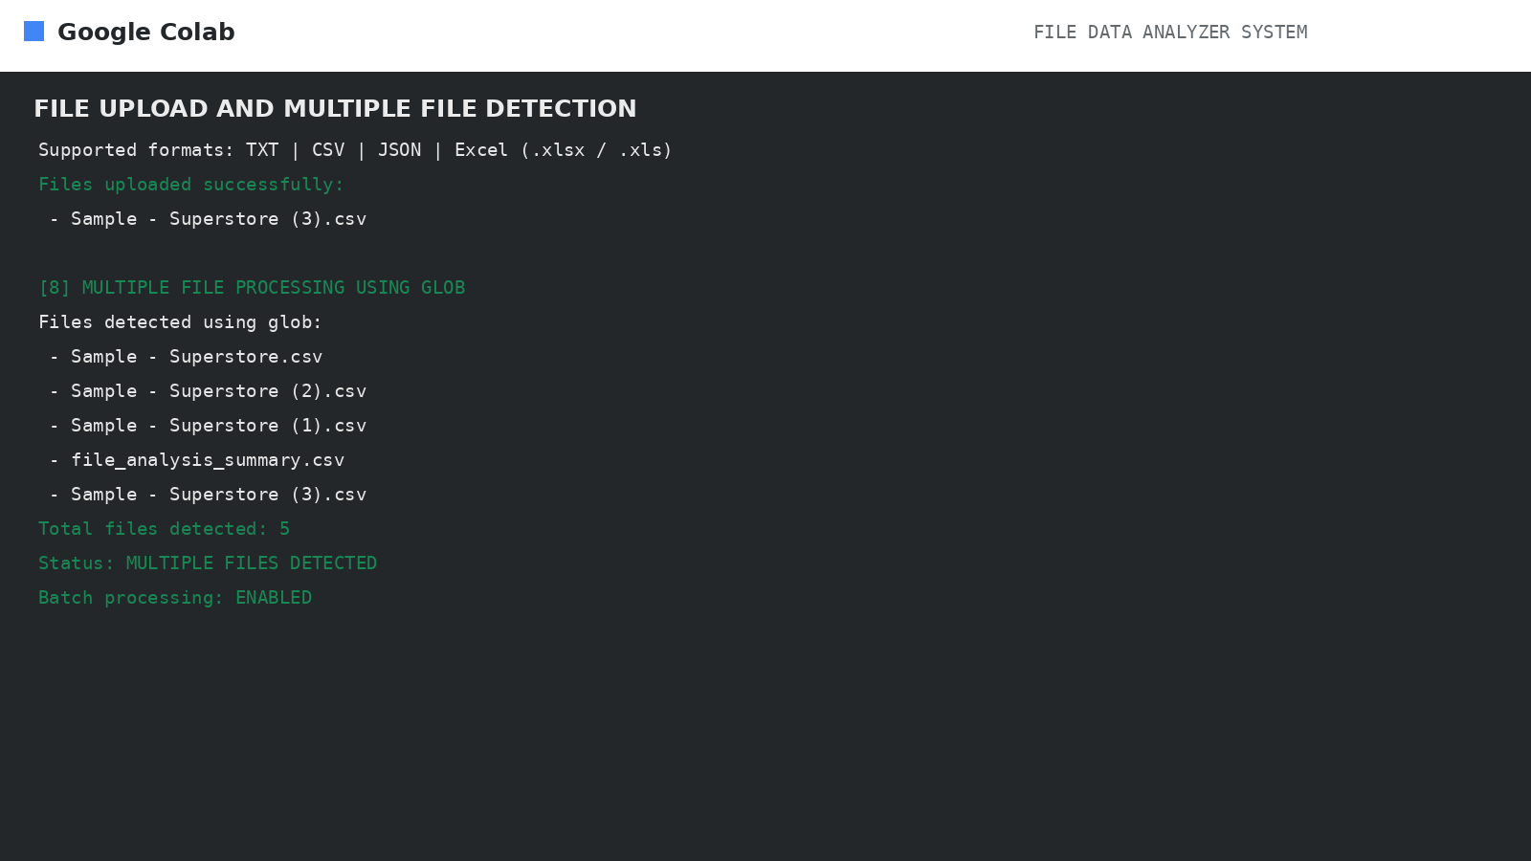
SYSTEM WORKFLOW
1
SELECT
DETECT
READ
CHECK
ANALYZE
REPORT
→
2
→
3
→
4
→
5
→
6
Upload one or more files
Identify file type
Use Pandas / JSON reader
Rows, columns, missing values
Words, statistics, filtering
Charts + CSV summary
BATCH PROCESSING
Files are collected with glob patterns, processed according to extension and summarized into a single report. The same workflow can therefore be repeated across multiple uploaded files.
5

Slide 6
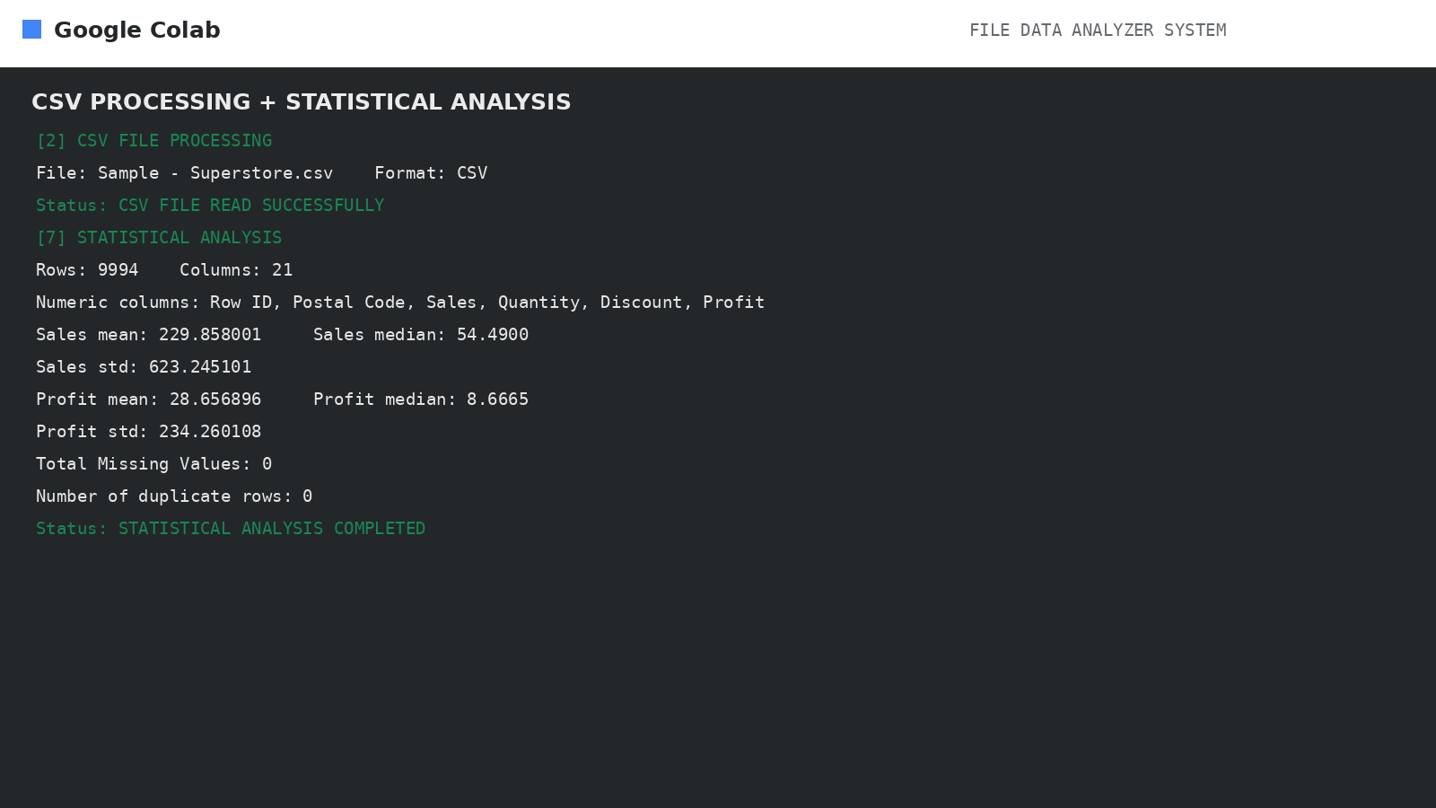
STATISTICAL ANALYSIS
SUPERSTORE RESULTS
Mean Sales: 229.858
Median Sales: 54.49
Mean Profit: 28.657
Median Profit: 8.667
Sales standard deviation: 623.245
Profit standard deviation: 234.260
The system identifies numeric columns and calculates descriptive statistics while also reporting dataset dimensions and validation results.
6

Slide 7
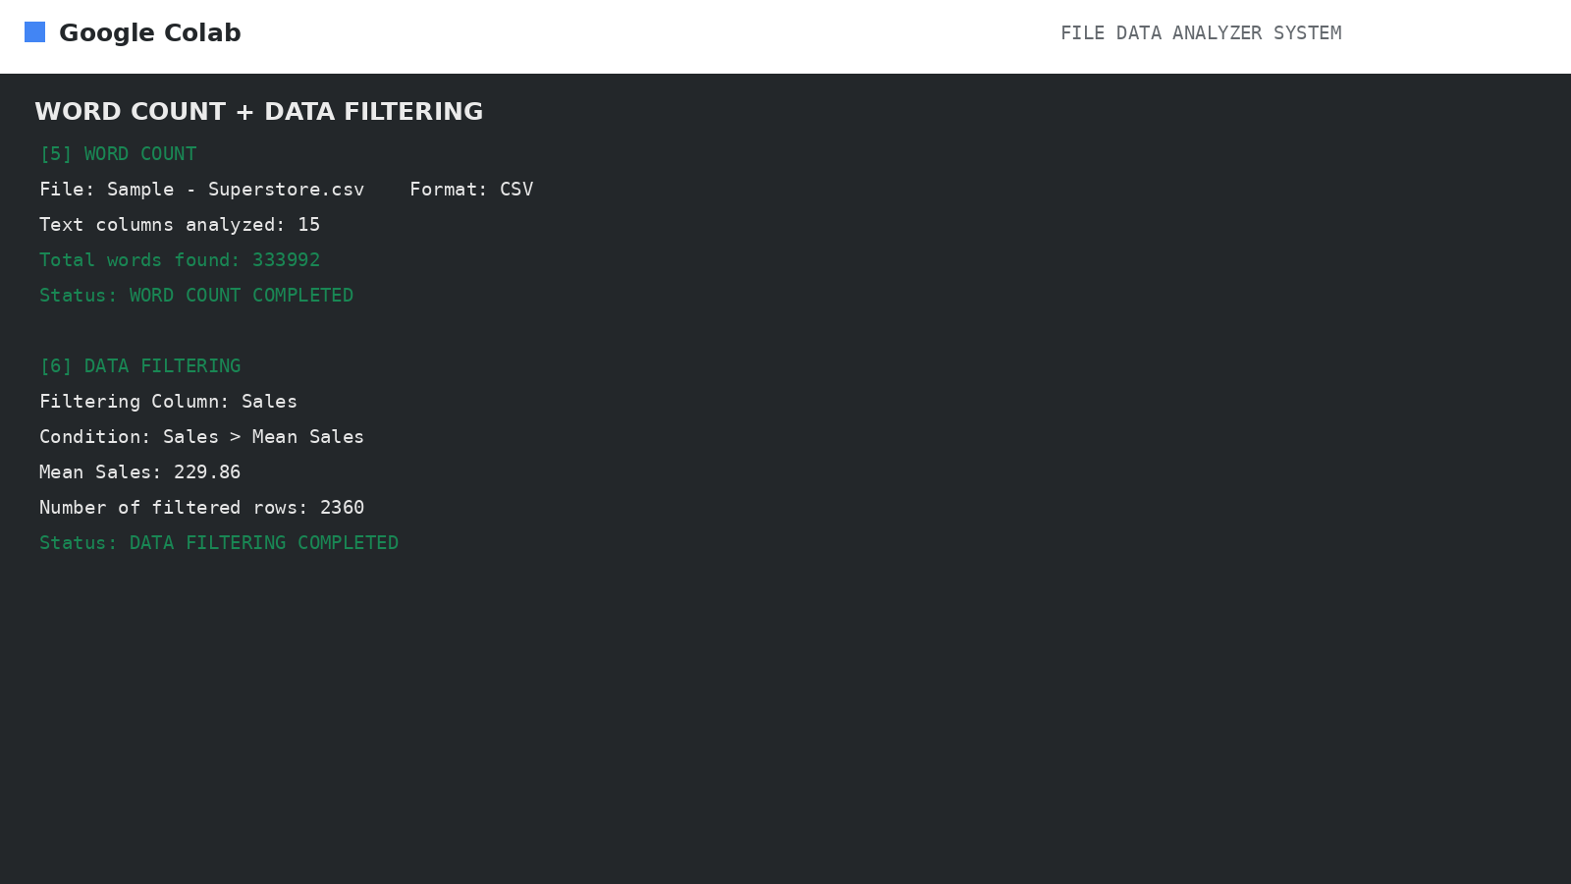
WORD COUNT & DATA FILTERING
WORD COUNT
The CSV text columns produce a total of 333,992 words. This demonstrates that word analysis can be performed on tabular data, not only on standalone text files.
DATA FILTERING
Filter condition: Sales > mean Sales (229.86). The execution returns 2,360 rows for inspection, demonstrating how a numeric condition can reduce a large dataset.
7

Slide 8
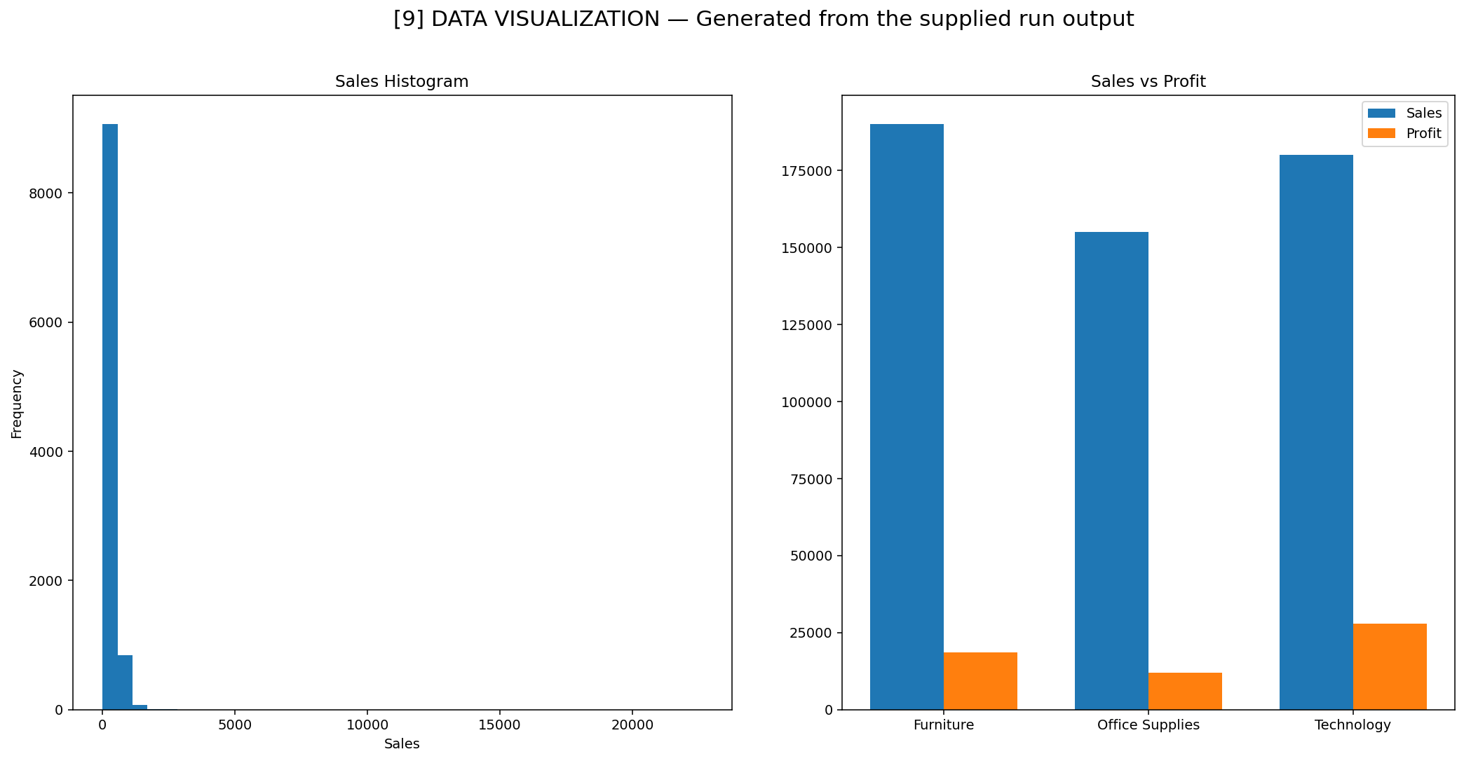
DATA VISUALIZATION
GENERATED CHARTS
• Sales histogram for distribution
• Sales vs Profit comparison
The charts provide visual views of numeric behavior and relationships, and are generated as part of the automated analysis workflow.
8

Slide 9
MULTIPLE FILES USING GLOB
BATCH EXECUTION
The supplied run detected five files and processed them in one workflow. Several Superstore CSV copies were analyzed successfully, demonstrating that the same operations can be repeated without manually rewriting the analysis for each file.
RUN NOTE
The generated file_analysis_summary.csv was also present in the folder and was picked up by the glob pattern during this run.
9

Slide 10
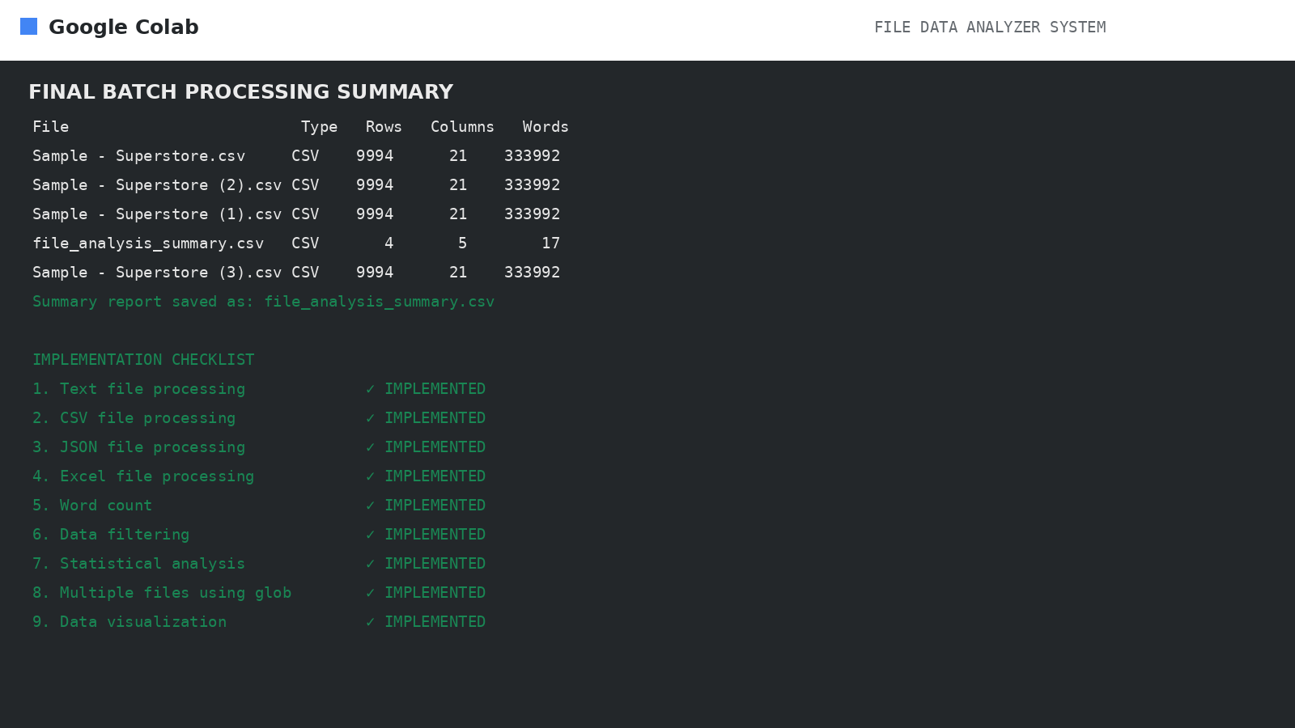
GENERATED REPORT & ENHANCEMENTS
GENERATED REPORT
file_analysis_summary.csv contains file name, file type, row count, column count and word information for processed files. The system also reports missing values and duplicate rows during execution.
ENHANCEMENT SCOPE
Automation, batch processing, broader format support, richer charts and additional analysis functions can extend the reusable workflow.
10

Slide 11
EXECUTION RESULTS
IMPLEMENTATION CHECKLIST
✓ Text file processing
✓ CSV file processing
✓ JSON file processing
✓ Excel file processing
✓ Word count
✓ Data filtering
✓ Statistical analysis
✓ Multiple files using glob
✓ Data visualization
11

Slide 12
CONCLUSION
The completed demonstration covers the full analysis workflow.
KEY OUTCOMES
DEMONSTRATION
Upload and format detection
Batch processing
Word count and filtering
Statistical analysis
Visualization and reporting
Superstore execution: 9,994 rows and 21 columns
All nine required capabilities are implemented in the demonstrated system.
THANK YOU
12

