Slide 1


Department of Electronics and Communication Engineering
“SMART ATTENDENCE SYSTEM USING CNN”
Under the guidance of
Prof. Dattaprasad Torse
SI NO | NAME | USN
1 | Abhinandan Malaji | 02FE21BEC001
2 | Brunda Gulagannavar | 02FE21BEC023
3 | Chandrashekhar Katral | 02FE21BEC025
4 | Parvati Halse | 02FE21BEC057

Slide 2

Problem Statement
Develop a real-time facial recognition attendance system using a CNN model and face_recognition library. The system marks attendance in a CSV file, displays recognized faces with accuracy, and adapts to diverse lighting and expressions.

Slide 3
Objectives
Automated Attendance Tracking
Real-time Face Recognition
Attendance Record Keeping
Efficient Resource Management

Slide 4

Facial Recognition System:
Implementing a real-time facial recognition attendance system.
Utilizes Convolutional Neural Network (CNN) through the face_recognition library for accurate face recognition.
Automated Attendance Marking:
Marks attendance automatically when a known face is detected in the webcam feed.
Recorded data includes names, timestamps, and accuracy metrics in a CSV file (Attendance.csv).
Robust and Adaptable:
Robust to varying lighting conditions and facial expressions.
Enhances user experience by displaying recognized faces with accuracy on the video feed.

Slide 5
What is CNN?
A Convolutional Neural Network (CNN) is a type of deep learning algorithm that is particularly well-suited for image recognition and processing tasks. It is made up of multiple layers, including convolutional layers, pooling layers, and fully connected layers.
Convolutional Neural Networks has been playing a significant role in many applications including surveillance, object detection, object tracking, etc.
Extensive research is recorded for face recognition using CNNs, which is a key aspect of surveillance applications. In most recent times, the Face Recognition technique is widely used in University automation systems, Smart Entry management systems, etc.

Slide 6
Methodology
Project Definition
Research and Requirement Analysis
Data Collection and Preparation
Library and Tool Selection
Code Development
Testing and Debugging
Resource Management and Optimization

Slide 7
Literature Survey
Study 1 | Study 2 | Study 3 | Study 4
Objective: | Objective: | Objective: | Objective:
Propose a CNN for face recognition, develop SAMS. | Develop attendance system with face recognition. | System using ML for attendance, compares recognition methods. | Develop face recognition-based student attendance system.
Method: | Method: | Method: | Method:
Collect face data, train 20-layer CNN, develop SAMS... | Use camera for face capture, employ face detection... | Compare SVM, MLP, CNN methods, use PCA, LDA for features… | Four stages: data entry, train dataset, face recognition...
 |  |  | Capture faces, compare with pre-trained dataset, record...
Results: | Results: | Results : | Results:
99.86% accuracy, SAMS feasibility demonstrated... | Up to 98% accuracy using CNN-PCA, outperforming PCA... | CNN achieves 98% testing, 89% real-time accuracy, discusses... | 92% average recognition accuracy, real-time detection of faces
 | Reliable and robust for real-time identification... | Factors affecting accuracy discussed: camera quality, illumination | Total attendance calculated during a specific time span
Conclusion: | Conclusion: | Conclusion : | Conclusion:
Easy to deploy and maintain, secure and reliable... | Effective face attendance machine, real-time capable... | CNN identified as most robust and efficient, proposes upgrades | Reduces manual effort, provides accurate and efficient...

Slide 8
Block diagram
Data Preparation
Real-time Face Recognition
Attendance Management
Resource Management
Visualization and Interaction
Accuracy Calculation and Reporting

Slide 9
Flow Diagram
Import Libraries
Load Images & Class Names
Encode Known Faces
Open Webcam
Main Recognition Loop
Detect and Encode Faces in Current Frame
Face Recognition Loop
Display webcam Feed
Exit the Loop
Releases Resources and Print Final Results in .CSV file
Initialize Counters

Slide 10
Future Scope
Graphical User Interface (GUI) Implementation
Cloud Deployment for Scalability
Integration of Additional Features
Machine Learning Optimization
Mobile Application Integration

Slide 11
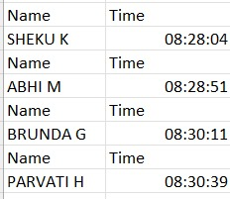
Results

Slide 12
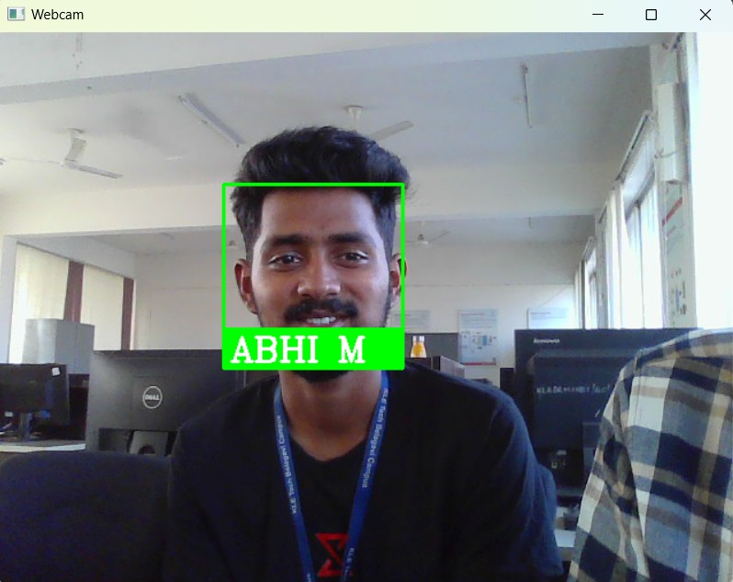
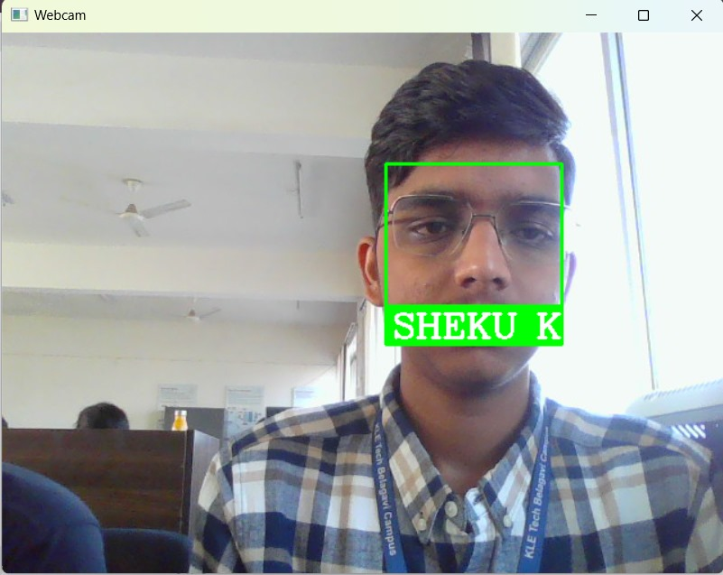
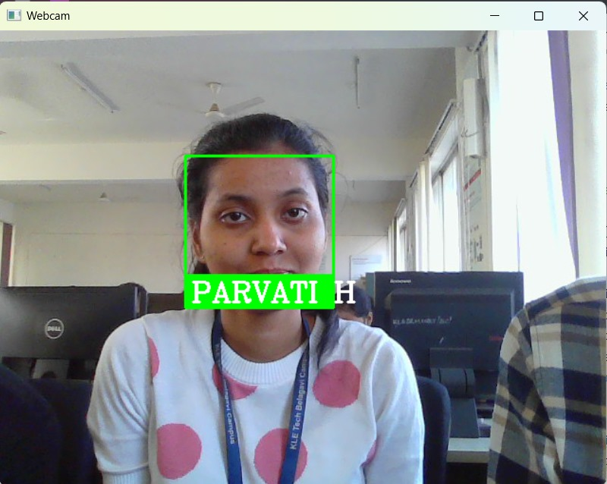
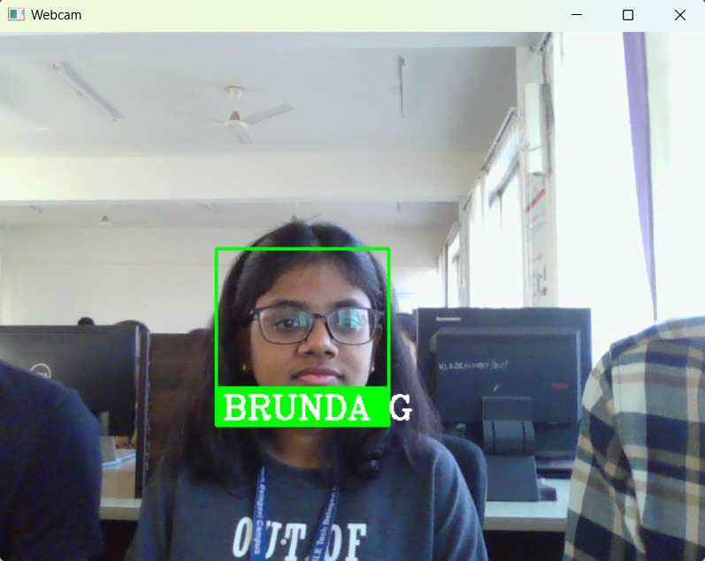
Output

Slide 13
Reference
S. Chowdhury, S. Nath, A. Dey, A. Das, “Development of an Automatic Class Attendance System using CNN-based Face Recognition.”
R.C. Damale, Prof. B. V. Pathak, “Face Recognition Based Attendance System Using Machine Learning Algorithms.”
S. Kakarla, P. Gangula, M. S. Rahul, C. S. C. Singh, T. H. Sarma, “Smart Attendance Management System Based on Face Recognition Using CNN.”
K. S. Selvi, P. Chitrakala, A. A. Jenitha, “Face Recognition Based Attendance Marking System.”
Smitha, P. S. Hegde, Afshin, “Face Recognition based Attendance Management System.”

Slide 14
Github Link
https://github.com/katral-99/Machine_Learning

Slide 15
Thank You

