Slide 1
Representations of Depth Maps: Spherical Harmonics and Wavelets
Katrina Ashton: u5586882
Supervisor: Jochen Trumpf
Australian National University

Slide 2
Make points disappear at same time as arrow appears
Notes:
(2 next few slides)
Talk about representing depth in general ~ applications.
Talk about negatives of point clouds
Talk about depth maps ~ radial directions (emp.)

Slide 3
Notes:
Difficulty of updating polygonal meshes

Slide 4
Basis Functions
Benefits:
Integrate previous knowledge
Store coefficients, can interpolate
->Efficient
Well-studied update formulae
Bases looked at:
Spherical harmonics
Spherical Haar wavelets
Notes:
(0.5 -> 2.5)
Refer to Fourier transforms

Slide 5
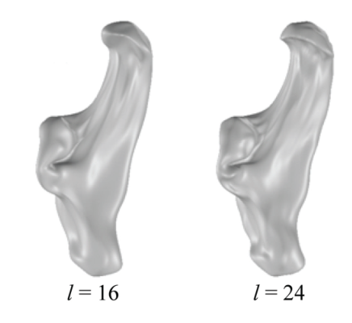
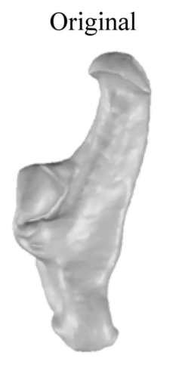
Spherical Harmonics
R. Green. Spherical Harmonic Lighting: The Gritty Details.
Archives of the Game Developers Conference, Vol. 56, 2003.
L. Shen, H. Farid, M. McPeek. Modelling three-dimensional morphological structures using spherical harmonics. Evolution, 63(4), 2010.
Notes:
(1.5 -> 4)
What are spherical harmonics? ~ (“for the maths people”) can give name of equation and/or form Hilbert basis of square integrable functions on sphere
Benefits (simple to understand and implement, smooth)
Drawbacks (not localised, sensitive to symmetry ~ think about add figure to show this)

Slide 6
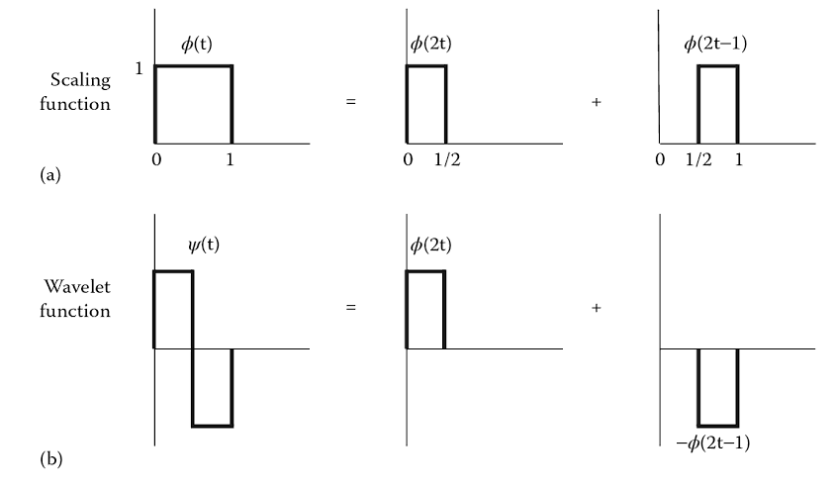
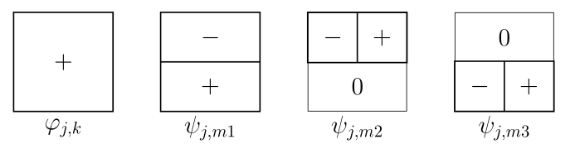
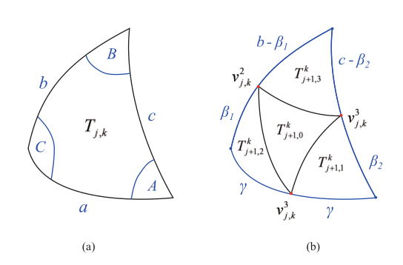
Spherical Haar Wavelets
P. Addison. The Illustrated Wavelet Transform Handbook. IOP Publishing, 2002. p 74.
W. Sweldens. The lifting scheme: A construction of second generation wavelets.
SLAM journal on mathematical analysis, 29(2):511-546, 1998.
C. Lessig and E. Fiume. SOHO: orthogonal and symmetric Haar wavelets on the sphere.
ACM Transactions on Graphics (TOG), 27(1):4, 2008
Notes:
(2.5 -> 6.5)
Could do just scaling or just wavelet, but get better properties by combining -> only works because in infinite dimensional space
Brief overview of wavelets in general (translates dilates, relate to Fourier transform)
Introduce necessary terminology
Benefits (wavelets in general, specific?)
Negatives (specific: rigid sampling scheme)

Slide 7
Updating Models
Unaligned measurements
1. Transformed model
2. Transformed measurements
Notes:
(0.5 -> 7)
Define pose (1 sentence)
Make explicit statement about equivalence between taking measurements in body fixed frame and unaligned measurements in space fixed frame
Moving measurement vs moving model ~ corresponds to doing calculation in different frame
Unfortunately cannot translate models
Brief explanation of two different ways to move measurements

Slide 8
Transforming measurements
Notes:
(2 -> 9)
Issue:

Slide 9
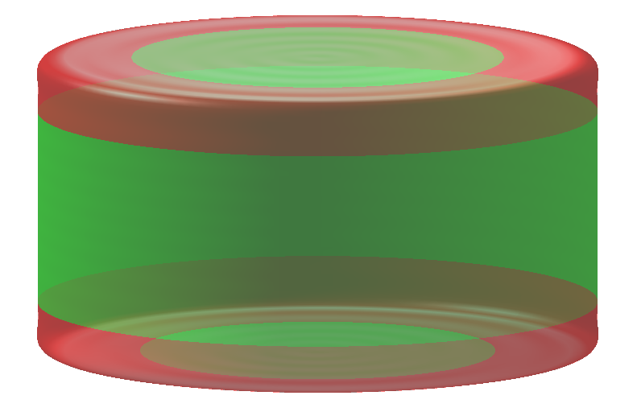
Results
 | Spherical Harmonics |  | Spherical Haar Wavelets
Moved Model Method | Need to choose good step size Negligible difference in noise floor, robustness and convergence | No translation | Choice of data structure is important Need to choose good step sizes Only have preliminary results | No translation
Moved Measurements Method |  | Translation Fast |  | Translation
l = 40
nc = 1,681
j = 6
nc =
nc0 =
Notes:
(1.5 -> 9.5)
Key benefits/negatives of each method
Where I’m up to
*sparse

Slide 10
Results
Notes:
(1 -> 10.5)
SSE for SH (can skip)
Differences between methods. Best method for various situations (considering aspects talked about in previous slide as well)

Slide 11
Conclusion and Future Work
Notes:
(1 -> 11.5)
-Main results ~ major things I’ve done
-Obvious next steps
-Long-term goal
(put dot-points on slide)

Slide 12
Questions

Slide 13
Notes:
What are obvious questions? Should I have figures or formulas?
Figures showing models with set number of coefficients for SHs and wavelets

