Slide 1
Representations of Depth Maps: Spherical Harmonics and Spherical Haar Wavelets
Katrina Ashton: u5586882
Supervisor: Jochen Trumpf
Australian National University

Slide 2
Notes:
(2 next few slides)
Talk about representing depth in general ~ applications.
Talk about negatives of point clouds
Talk about depth maps ~ radial directions (emp.)

Slide 3
Notes:
(2 next few slides)
Talk about representing depth in general ~ applications.
Talk about negatives of point clouds
Talk about depth maps ~ radial directions (emp.)

Slide 4
Notes:
(2 next few slides)
Talk about representing depth in general ~ applications.
Talk about negatives of point clouds
Talk about depth maps ~ radial directions (emp.)

Slide 5
Notes:
Difficulty of updating polygonal meshes

Slide 6
Notes:
Difficulty of updating polygonal meshes

Slide 7
Notes:
Difficulty of updating polygonal meshes

Slide 8
Basis Functions
Benefits:
Integrate previous knowledge
Store coefficients, can interpolate
->Efficient
Well-studied update formulae
Bases looked at:
Spherical Harmonics
Spherical Haar Wavelets
Notes:
(0.5 -> 2.5)
Refer to Fourier transforms

Slide 9
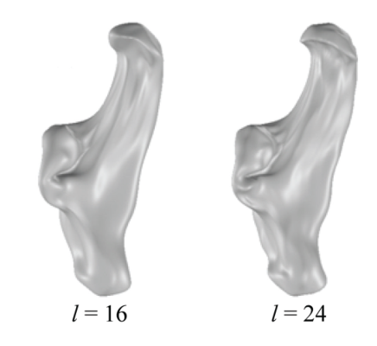
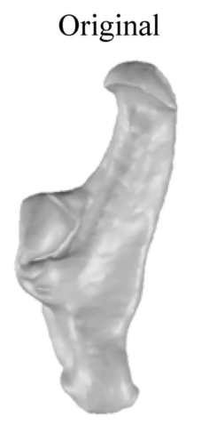
Spherical Harmonics
R. Green. Spherical Harmonic Lighting: The Gritty Details.
Archives of the Game Developers Conference, Vol. 56, 2003.
L. Shen, H. Farid, M. McPeek. Modelling three-dimensional morphological structures using spherical harmonics. Evolution, 63(4), 2010.
Notes:
(1.5 -> 4)
What are spherical harmonics? ~ (“for the maths people”) can give name of equation and/or form Hilbert basis of square integrable functions on sphere
Benefits (simple to understand and implement, smooth)
Drawbacks (not localised, sensitive to symmetry ~ think about add figure to show this)

Slide 10
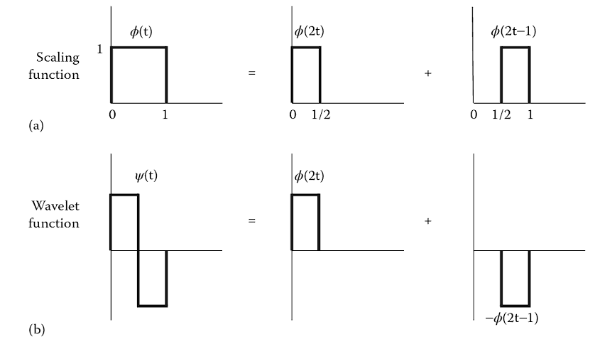
Spherical Haar Wavelets
P. Addison. The Illustrated Wavelet Transform Handbook. IOP Publishing, 2002. p 74.
Notes:
(2.5 -> 6.5)
Could do just scaling or just wavelet, but get better properties by combining -> only works because in infinite dimensional space
Brief overview of wavelets in general (translates dilates, relate to Fourier transform)
Introduce necessary terminology
Benefits (wavelets in general, specific?)
Negatives (specific: rigid sampling scheme)

Slide 11
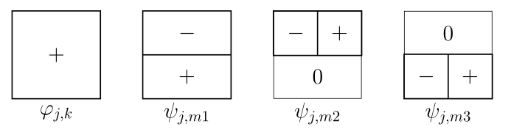
Spherical Haar Wavelets
P. Addison. The Illustrated Wavelet Transform Handbook. IOP Publishing, 2002. p 74.
W. Sweldens. The lifting scheme: A construction of second generation wavelets.
SLAM journal on mathematical analysis, 29(2):511-546, 1998.
Notes:
(2.5 -> 6.5)
Could do just scaling or just wavelet, but get better properties by combining -> only works because in infinite dimensional space
Brief overview of wavelets in general (translates dilates, relate to Fourier transform)
Introduce necessary terminology
Benefits (wavelets in general, specific?)
Negatives (specific: rigid sampling scheme)

Slide 12
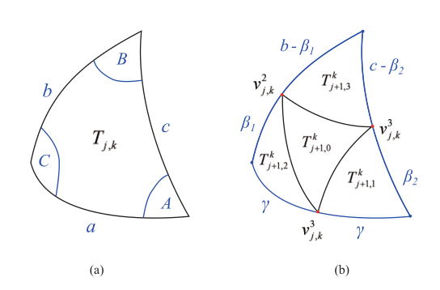
Spherical Haar Wavelets
P. Addison. The Illustrated Wavelet Transform Handbook. IOP Publishing, 2002. p 74.
W. Sweldens. The lifting scheme: A construction of second generation wavelets.
SLAM journal on mathematical analysis, 29(2):511-546, 1998.
C. Lessig and E. Fiume. SOHO: orthogonal and symmetric Haar wavelets on the sphere.
ACM Transactions on Graphics (TOG), 27(1):4, 2008
Notes:
(2.5 -> 6.5)
Could do just scaling or just wavelet, but get better properties by combining -> only works because in infinite dimensional space
Brief overview of wavelets in general (translates dilates, relate to Fourier transform)
Introduce necessary terminology
Benefits (wavelets in general, specific?)
Negatives (specific: rigid sampling scheme)

Slide 13
Updating Models
Unaligned measurements
1. Transformed model
2. Transformed measurements
Notes:
(0.5 -> 7)
Define pose (1 sentence)
Make explicit statement about equivalence between taking measurements in body fixed frame and unaligned measurements in space fixed frame
Moving measurement vs moving model ~ corresponds to doing calculation in different frame
Unfortunately cannot translate models
Brief explanation of two different ways to move measurements

Slide 14
Transforming measurements
Notes:
(2 -> 9)
Issue

Slide 15
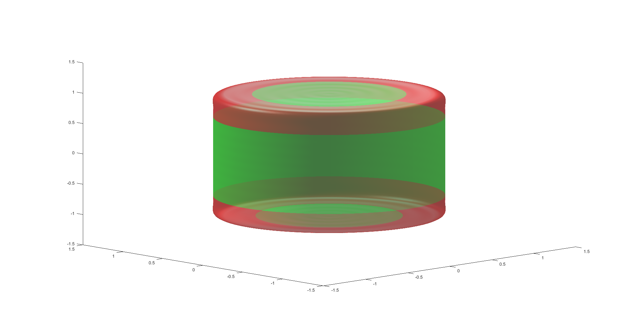
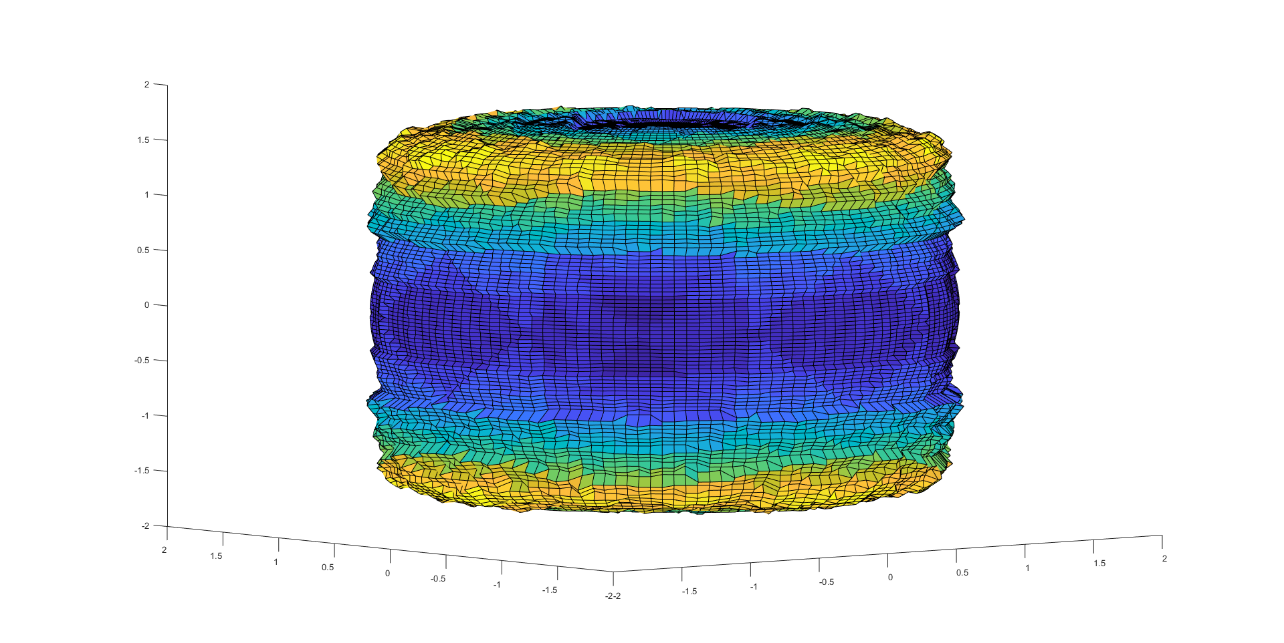
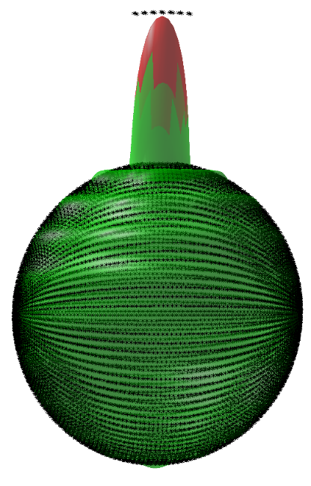
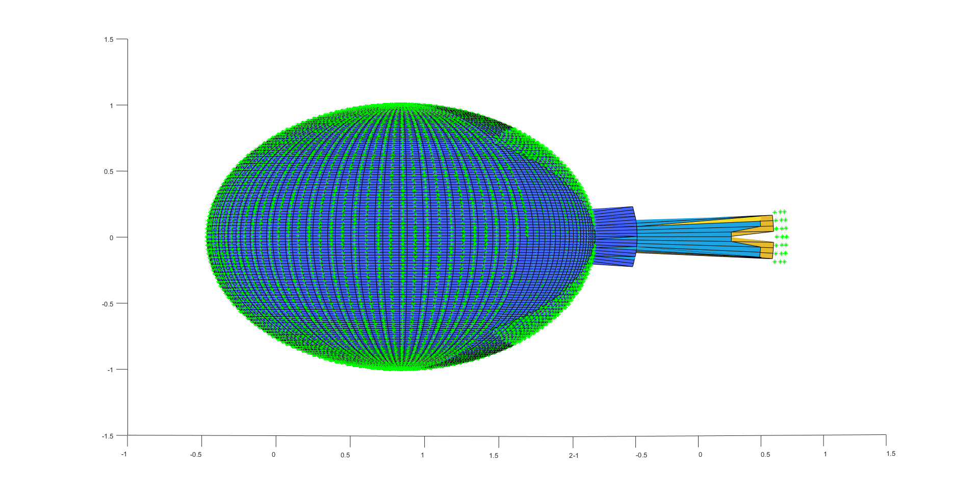
Results
 | Spherical Harmonics |  | Spherical Haar Wavelets
Moved Model Method | Need to choose good step size Negligible difference in noise floor, robustness and convergence | No translation | Choice of data structure is important Need to choose good step sizes Only have preliminary results | No translation
Moved Measurements Method |  | Translation Fast |  | Translation
l = 20
nc = 441
j = 5
nc = 20
nc0 =8,192
l = 40
nc = 1,681
j = 5
nc = 1,681
nc0 =8,192
Notes:
(1.5 -> 10.5)
Key benefits/negatives of each method
Where I’m up to
*sparse

Slide 16
Results
Notes:
(~11)
SSE for SH (can skip)
Differences between methods. Best method for various situations (considering aspects talked about in previous slide as well)

Slide 17
Conclusion and Future Work
Main outcomes
Spherical Harmonic Basis Functions
Implementation of creating a base model
Implementation of update method
Spherical Haar Wavelet Basis Functions
Implementation of creating a base model
Implementation of update method
Future work
Modelling different shapes
Investigate which way to implement the moved measurements method
Investigate different data structures
Investigate different spherical wavelet bases
Notes:
(1 -> 12)
-Main results ~ major things I’ve done
-Obvious next steps
-Long-term goal
(put dot-points on slide)

Slide 18
Questions?
Notes:
What are obvious questions? Should I have figures or formulas?
Figures showing models with set number of coefficients for SHs and wavelets

Slide 20
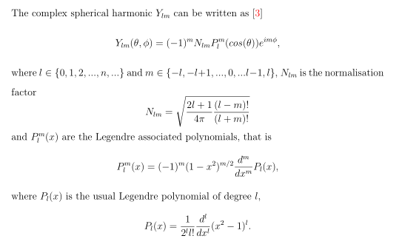
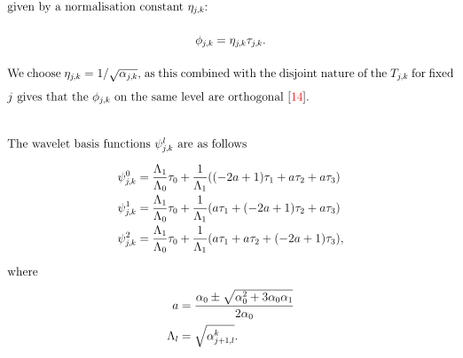
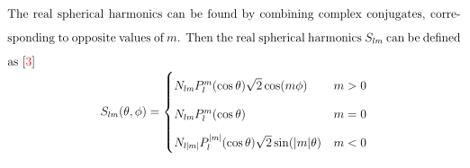
Formulae
Spherical Harmonics
Spherical Haar Wavelets

