Slide 1
How Product Teams Are Using Cursor to Build with AI
Executive CPO Brief | Discovery Learnings and PLC Implications | Mar 2026

Slide 2
Executive Summary: What Matters Most
Cursor adoption is real and broad, but maturity is uneven across teams and PLC stages.
Teams are strongest in drafting/synthesis tasks; weakest in governance, traceability, and stage discipline.
The winning model is not 'AI as a parallel process'—it is AI embedded in the existing PLC with guardrails.
Biggest value unlock: shift PM behavior from document production to decision velocity and evidence quality.
Immediate priority: codify standards (prompts, checklists, automation, metrics) before scaling adoption.

Slide 3
Discovery Scope and Evidence Base
Evidence reviewed
Confluence discovery pages reviewed across Product Ops + AI playbook + Cursor blueprint (Mar 2026 exports).
Evidence sources include PLC phase playbooks, maturity framework, operating model docs, and AI-MV artefacts.
Signal quality: strong process evidence, early adoption patterns, and clear risk/guardrail guidance.
Gap: limited quantified productivity baselines in current pack (requires instrumentation in next phase).

Slide 4
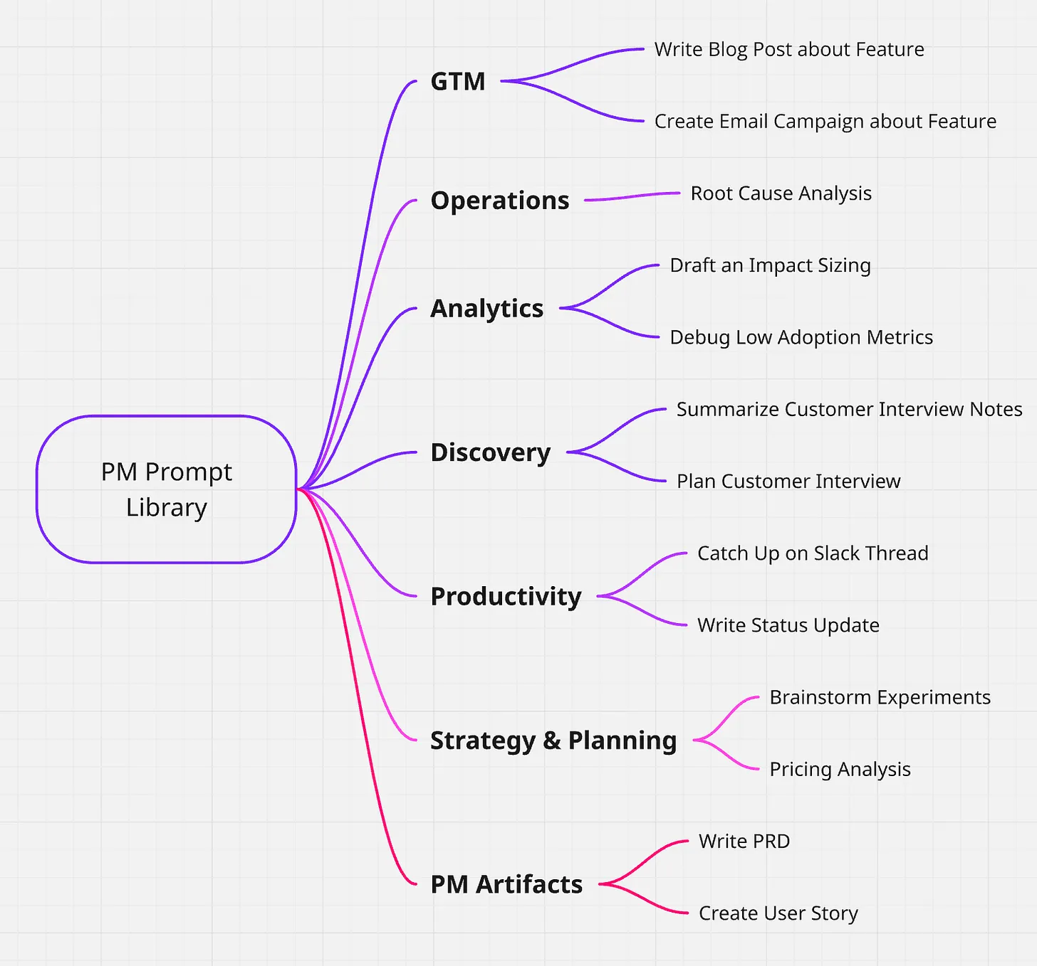
Current Usage Pattern: Where Teams Already Use Cursor
Prompt-library pattern observed across Discovery, PM artefacts, strategy/planning, analytics, operations, and GTM.

Slide 5
Top-Line Themes: What Stayed the Same vs What Changed
What Stayed the Same | What Changed with Cursor + AI
Outcome-led product management remains the standard. | AI embedded into every PLC phase (Discovery → Launch) as a workflow accelerator.
Continuous discovery and real customer contact remain non-negotiable. | Teams use AI for synthesis, structure, alternatives, and consistency checks.
Human judgment owns prioritisation and final decisions. | Product Ops now must codify prompts, quality bars, and automation rules.
Evidence-based decisions remain the quality bar. | Shift from “what doc should I write?” to “what decision am I driving?”

Slide 6
Key Outtakes: Current Challenges
Inconsistent PLC discipline: stage-skipping and 'teleporting to build' still occurs in lower-maturity teams.
Artefact quality and linkage are uneven; context is still rebuilt due to scattered or stale documentation.
RACI and decision rights are variably enforced, creating approval latency and rework loops.
Tooling/data hygiene friction (tags, fields, cross-linking) limits AI reliability and downstream reporting.
Adoption blockers are less about access and more about trust, prompt skill, and governance confidence.

Slide 7
Opportunity Areas (Next Value Pools)
Standardize PM prompt libraries by PLC phase and critical artefact type.
Add AI touchpoints directly into templates (discovery snapshot, OST, brief/spec, experiment plan, GTM).
Deploy readiness checklists + guardrails for quality, privacy, and evidence traceability.
Automate Jira/Confluence workflow hooks (stage tagging, artefact linkage, review triggers).
Build one central artefact repository with naming/versioning standards and searchable history.
Launch AI literacy program for PMs/trios/leads focused on intent-input-context-output practice.

Slide 8
What We Learned from Discovery
Adoption lessons
• AI works best as a co-thinker, not a decision-maker.
• Teams gain speed first in synthesis and drafting tasks.
• Without standards, local prompt practices fragment quickly.
• Human validation checkpoints are the difference between speed and risk.
Operating-model lessons
• Product Ops is the scaling layer for AI-enabled PLC execution.
• Maturity progression is visible: Ad-hoc → Emerging → Defined → Embedded.
• Governance must be lightweight and built into everyday flow.
• Success requires measurement of both adoption and decision quality.

Slide 9
How This Changes the PLC Workflow (Future-State Design)
PLC Stage | New AI-Enabled Practice | Human Gate / Accountability
Discover | AI clusters interview evidence into snapshots/themes | PM validates evidence; trio agrees problem framing
Evaluate | AI compares opportunities and surfaces assumption gaps | Trio prioritises; leadership confirms trade-offs
Design | AI generates concept variants and edge-case prompts | Customers + trio test concepts and choose direction
Build | AI drafts specs/stories/acceptance criteria | Eng + PM agree scope, feasibility, and DoD
Pilot | AI summarizes pilot results and alternative interpretations | Trio decides scale / iterate / stop
Launch/Grow | AI drafts comms and clusters adoption friction signals | Cross-functional leaders own launch/no-launch + improvement backlog

Slide 10
90-Day Adoption Plan
Pragmatic scale sequence
Days 0–30: Baseline maturity + select 2 pilot product teams + define guardrails and success metrics.
Days 31–60: Roll out phase-based prompt packs, template touchpoints, and workflow automations in pilots.
Days 61–90: Measure cycle-time + quality deltas, codify playbook v1, and prepare scaled rollout by team maturity.
Governance cadence: biweekly pilot review, monthly CPO checkpoint, quarterly PLC standards refresh.

Slide 11
How We Will Measure Success
Metric Type | Core KPI | Target Direction
Adoption | % initiatives using standardized AI touchpoints by PLC stage | Up
Speed | Cycle time from discovery synthesis to decision-ready artefact | Down
Quality | Artefact readiness pass rate at stage-gates | Up
Decision health | % decisions with explicit evidence + assumptions + trade-off log | Up
Rework | Late-stage requirement churn / reopen rate | Down
Enablement | PM/trio AI literacy completion + confidence score | Up

Slide 12
Decisions Requested from CPO
Approve Product Ops ownership of the Cursor Playbook for PMs (standards + governance).
Approve 90-day pilot with 2 product teams and explicit success gates.
Mandate PLC-stage traceability (artefact links + decision logs) as rollout prerequisite.
Sponsor cross-functional enablement (PM, Eng, PMM, Data) and monthly executive review cadence.

Slide 13
Appendix: Source Pages Used
Product Operations × Cursor (5687279682)
AI Product Playbook + phase pages: Discovery, Opportunity, Solution, Delivery, Experimentation, Launch
AI Enablement in Our Product Operating System (5688131588)
Maturity Level Framework (5665325076)
(PLC) Standard Product Life Cycle (5657952336)
Discovery & Research + Reusable Scoring Table (5664374841, 5663817753)

