Slide 1

SONCUYA, Katrina Faye A.
BSChE-2B
Name It,
Draw It
Two-way IUPAC Nomenclature of Alkanes, Cycloalkanes and Haloalkanes

Slide 2

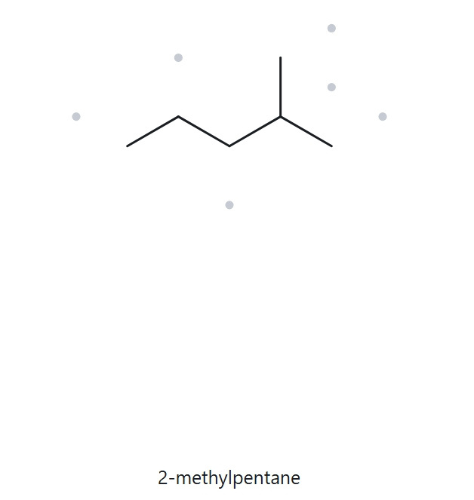
CARD A01 - STRUCTURE - NAME
Foundation · Molecular formula (counted): C6H14
1 · NUMBERED PARENT
2 · NAMING TRAIL
Parent: longest chain = 5 C → pentane.
Numbering: right → left gives 2; left → right gives 4. 2 < 4, so number from the right.
Substituents: methyl on C2 → 2-methyl.
4
2
5
3
1
3 · MY NAME (WRITTEN FIRST)
4 · THE ALKANE CHECK
2-methylpentane
Returned name: 2-methylpropane
✓ Match
✓ longest chain confirmed ✓ lowest locants ✓ alphabetical order ✓ punctuation ✓ formula counted

Slide 3
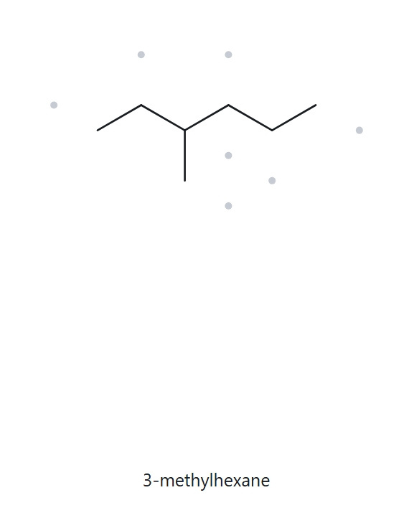
CARD A02 - STRUCTURE - NAME
Foundation · Molecular formula (counted): C7H16
1 · NUMBERED PARENT
2 · NAMING TRAIL
Parent: longest chain = 6 C, running through the ethyl arm (not the horizontal 5 C) → hexane.
Numbering: branch at C3 from one end, C4 from the other. 3 < 4, so number from the end that gives 3.
Substituents: methyl on C3 → 3-methyl.
2
4
6
3
1
5
3 · MY NAME (WRITTEN FIRST)
4 · THE ALKANE CHECK
3-methylhexane
Returned name: 3-methylhexane
✓ Match
✓ longest chain confirmed ✓ lowest locants ✓ alphabetical order ✓ punctuation ✓ formula counted

Slide 4
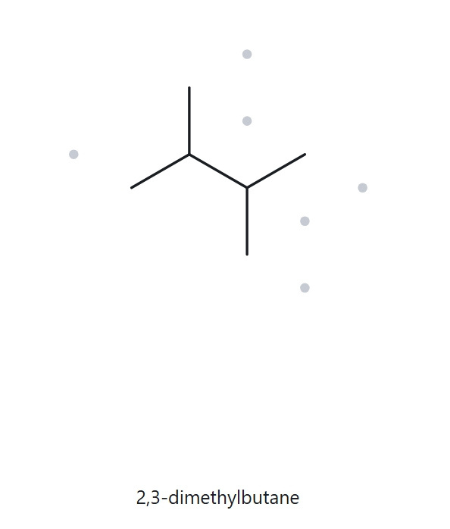
CARD A03 - STRUCTURE - NAME
Foundation · Molecular formula (counted): C6H14
1 · NUMBERED PARENT
2 · NAMING TRAIL
Parent: longest chain = 4 C → butane.
Numbering: both directions give {2,3}: a tie, so either direction works.
Substituents: methyl on C2 and C3 → 2,3-dimethyl.
4
3
2
1
3 · MY NAME (WRITTEN FIRST)
4 · THE ALKANE CHECK
2,3-dimethylbutane
Returned name: 2,3-dimenthylbutane
✓ Match
✓ longest chain confirmed ✓ lowest locants ✓ alphabetical order ✓ punctuation ✓ formula counted

Slide 5
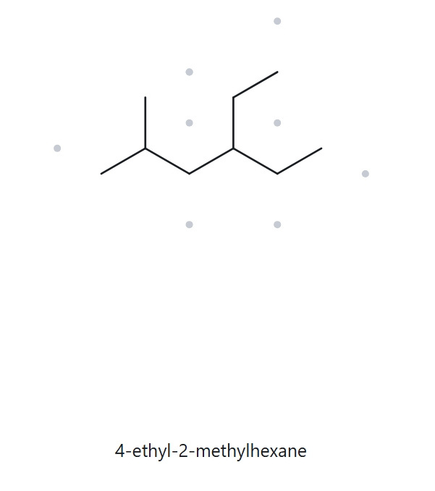
CARD A04 - STRUCTURE - NAME
Developing · Molecular formula (counted): C9H20
1 · NUMBERED PARENT
2 · NAMING TRAIL
Parent: longest chain = 6 C → hexane.
Numbering: left → right gives {2,4}; right → left gives {3,5}. 2 < 3, so number from the left.
Substituents: ethyl on C4, methyl on C2. Ethyl is cited first (e before m).
6
2
4
1
3
5
3 · MY NAME (WRITTEN FIRST)
4 · THE ALKANE CHECK
4-ethyl-2-methylhexane
Returned name: 4-ethyl-2-methylhexane
✓ Match
✓ longest chain confirmed ✓ lowest locants ✓ alphabetical order ✓ punctuation ✓ formula counted

Slide 6
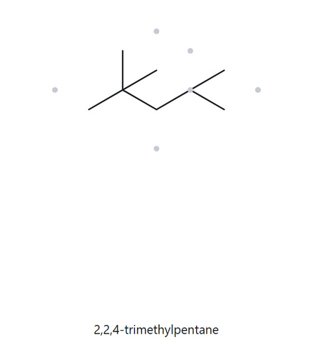
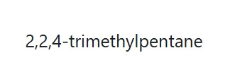
CARD A05 - STRUCTURE - NAME
Developing · Molecular formula (counted): C8H18
1 · NUMBERED PARENT
2 · NAMING TRAIL
Parent: longest chain = 5 C → pentane.
Numbering: right → left gives 2,2,4; left → right gives 2,4,4. First point of difference: 2 < 4, so number from the right.
Substituents: methyl on C2, C2 and C4 → 2,2,4-trimethyl.
4
2
5
3
1
3 · MY NAME (WRITTEN FIRST)
4 · THE ALKANE CHECK
2,2,4-trimethylpentane
Returned name: 2,2,4-trimethylpentane
✓ Match
✓ longest chain confirmed ✓ lowest locants ✓ alphabetical order ✓ punctuation ✓ formula counted

Slide 7
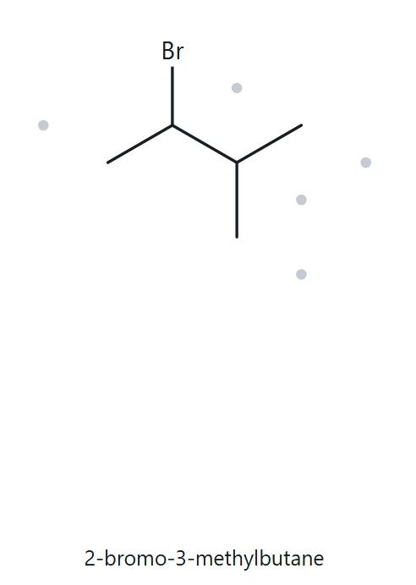
CARD A06 - STRUCTURE - NAME
Developing · Molecular formula (counted): C5H11Br
1 · NUMBERED PARENT
2 · NAMING TRAIL
Parent: longest chain = 4 C → butane.
Numbering: both directions give {2,3}: a tie. Bromo precedes methyl alphabetically, so bromo gets C2.
Substituents: bromo on C2, methyl on C3 → 2-bromo-3-methyl.
Br
4
3
2
1
3 · MY NAME (WRITTEN FIRST)
4 · THE ALKANE CHECK
2-bromo-3-methylbutane
Returned name: 2-bromo-3-methylbutane
✓ Match
✓ longest chain confirmed ✓ lowest locants ✓ alphabetical order ✓ punctuation ✓ formula counted

Slide 8
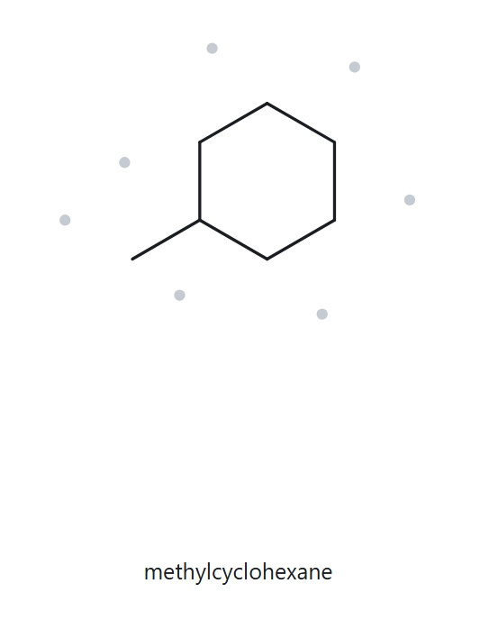
CARD A07 - STRUCTURE - NAME
Developing · Molecular formula (counted): C7H14
1 · NUMBERED PARENT
2 · NAMING TRAIL
Parent: ring of 6 C is the parent → cyclohexane.
Numbering: one substituent only, so no locant is needed.
Substituents: methyl → methyl (no locant).
6
1
2
5
3
4
3 · MY NAME (WRITTEN FIRST)
4 · THE ALKANE CHECK
methylcyclohexane
Returned name: methylcyclohexane
✓ Match
✓ longest chain confirmed ✓ lowest locants ✓ alphabetical order ✓ punctuation ✓ formula counted

Slide 9
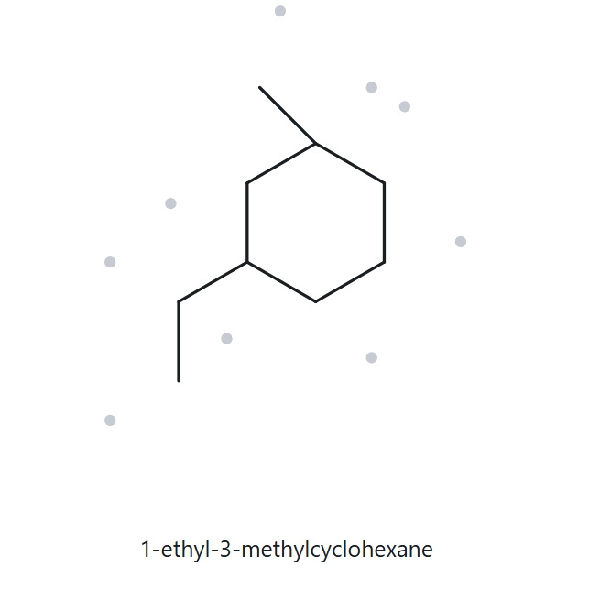
CARD A08 - STRUCTURE - NAME
Challenge · Molecular formula (counted): C9H18
1 · NUMBERED PARENT
2 · NAMING TRAIL
Parent: ring of 6 C is the parent → cyclohexane.
Numbering: locants are {1,3} either way round the ring: a tie. Ethyl precedes methyl alphabetically, so ethyl gets C1.
Substituents: ethyl on C1, methyl on C3 → 1-ethyl-3-methyl.
6
1
2
3
5
4
3 · MY NAME (WRITTEN FIRST)
4 · THE ALKANE CHECK
1-ethyl-3-methylcyclohexane
Returned name: 1-ethyl-3-methylcyclohexane
✓ Match
✓ longest chain confirmed ✓ lowest locants ✓ alphabetical order ✓ punctuation ✓ formula counted

Slide 10
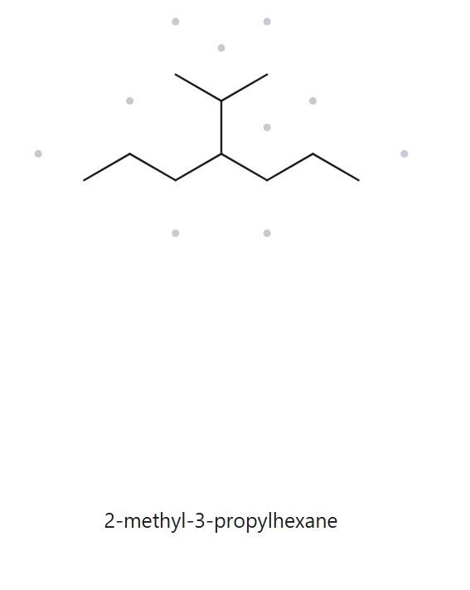
CARD A09 - STRUCTURE - NAME
Challenge · Molecular formula (counted): C10H22
1 · NUMBERED PARENT
2 · NAMING TRAIL
Parent: longest chain = 7 C → heptane. The path through the branch is only 6 C.
Numbering: the branch is at C4 from either end.
Substituents: isopropyl on C4 (also written (1-methylethyl) or propan-2-yl).
2
6
4
1
3
5
7
3 · MY NAME (WRITTEN FIRST)
4 · THE ALKANE CHECK
4-isopropylheptane
Returned name: 2-methyl-3-propylhexane
✗ Mismatch (state the correct name and the rule)
✓ longest chain confirmed ✓ lowest locants ✓ alphabetical order ✓ punctuation ✓ formula counted

Slide 11
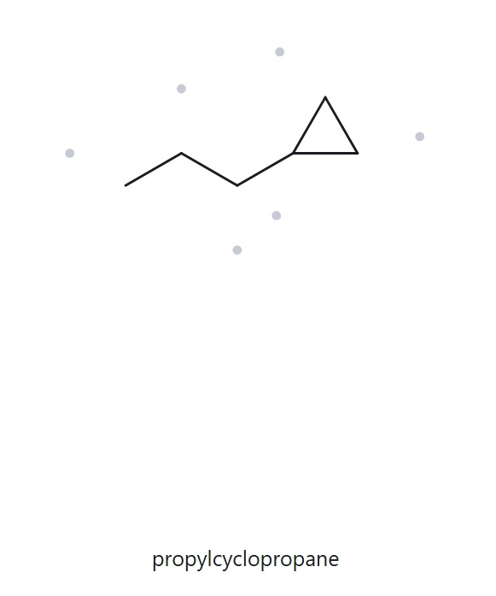
CARD A10 - STRUCTURE - NAME
Challenge · Molecular formula (counted): C6H12
1 · NUMBERED PARENT
2 · NAMING TRAIL
Parent: ring of 3 C is the parent → cyclopropane (this activity prefers the ring).
Numbering: one substituent only, so no locant is needed.
Substituents: propyl → propyl (no locant).
1
3
2
3 · MY NAME (WRITTEN FIRST)
4 · THE ALKANE CHECK
propylcyclopropane
Returned name: propylcyclopropane
✓ Match
✓ longest chain confirmed ✓ lowest locants ✓ alphabetical order ✓ punctuation ✓ formula counted

Slide 12
CARD B01-NAME-STRUCTURE
Foundation · Given name: 2-methylpropane
1 · NAME DECODED
2 · BOND-LINE STRUCTURE (THE ALKANE)
Parent: propane → a 3-carbon chain.
Substituents: methyl on C2.
Expected formula: 3 + 1 = 4 C; open chain → C4H10
3 · FORMULA CHECK
4 · BACK-CHECK
Counted from the drawing: C4H10
CnH2n+2 = C4H10 ✓
Returned by The Alkane: 2-methylpropane
✓ Same as the given name
✓ parent length matches ✓ substituent positions match ✓ formula agrees ✓ back-check recorded

Slide 13
CARD B02-NAME-STRUCTURE
Foundation · Given name: 3-ethylpentane
1 · NAME DECODED
2 · BOND-LINE STRUCTURE (THE ALKANE)
Parent: pentane → a 5-carbon chain.
Substituents: ethyl on C3.
Expected formula: 5 + 2 = 7 C; open chain → C7H16
3 · FORMULA CHECK
4 · BACK-CHECK
Counted from the drawing: C7H16
CnH2n+2 = C7H16 ✓
Returned by The Alkane: 3-ethylpentane
✓ Same as the given name
✓ parent length matches ✓ substituent positions match ✓ formula agrees ✓ back-check recorded

Slide 14
CARD B03-NAME-STRUCTURE
Foundation · Given name: 2,2-dimethylbutane
1 · NAME DECODED
2 · BOND-LINE STRUCTURE (THE ALKANE)
Parent: butane → a 4-carbon chain.
Substituents: two methyls, both on C2.
Expected formula: 4 + 2 = 6 C; open chain → C6H14
3 · FORMULA CHECK
4 · BACK-CHECK
Counted from the drawing: C6H14
CnH2n+2 = C6H14 ✓
Returned by The Alkane: 2,2-dimethylbutane
✓ Same as the given name
✓ parent length matches ✓ substituent positions match ✓ formula agrees ✓ back-check recorded

Slide 15
CARD B04-NAME-STRUCTURE
Developing · Given name: 3-ethyl-2-methylpentane
1 · NAME DECODED
2 · BOND-LINE STRUCTURE (THE ALKANE)
Parent: pentane → a 5-carbon chain.
Substituents: methyl on C2; ethyl on C3.
Expected formula: 5 + 1 + 2 = 8 C; open chain → C8H18
3 · FORMULA CHECK
4 · BACK-CHECK
Counted from the drawing: C8H18
CnH2n+2 = C8H18 ✓
Returned by The Alkane: 3-ethyl-2-methylpentane
✓ Same as the given name
✓ parent length matches ✓ substituent positions match ✓ formula agrees ✓ back-check recorded

Slide 16
CARD B05-NAME-STRUCTURE
Developing · Given name: 1-chloro-2-methylpropane
1 · NAME DECODED
2 · BOND-LINE STRUCTURE (THE ALKANE)
Parent: propane → a 3-carbon chain.
Substituents: chloro on C1; methyl on C2.
Expected formula: 3 + 1 = 4 C; C4H10, Cl replaces one H → C4H9Cl
Cl
3 · FORMULA CHECK
4 · BACK-CHECK
Counted from the drawing: C4H9Cl
C4H10 minus one H for Cl = C4H9Cl ✓
Returned by The Alkane: 1-chloro-2-methylpropane
✓ Same as the given name
✓ parent length matches ✓ substituent positions match ✓ formula agrees ✓ back-check recorded

Slide 17
CARD B06-NAME-STRUCTURE
Developing · Given name: 1,2-dimethylcyclopentane
1 · NAME DECODED
2 · BOND-LINE STRUCTURE (THE ALKANE)
Parent: cyclopentane → a 5-carbon ring.
Substituents: methyls on C1 and C2.
Expected formula: 5 + 2 = 7 C; one ring → C7H14
3 · FORMULA CHECK
4 · BACK-CHECK
Counted from the drawing: C7H14
One ring: CnH2n = C7H14 ✓
Returned by The Alkane: 1,2-dimethylcyclopentane
✓ Same as the given name
✓ parent length matches ✓ substituent positions match ✓ formula agrees ✓ back-check recorded

Slide 18
CARD B07-NAME-STRUCTURE
Developing · Given name: 4-ethyl-3,3-dimethylheptane
1 · NAME DECODED
2 · BOND-LINE STRUCTURE (THE ALKANE)
Parent: heptane → a 7-carbon chain.
Substituents: two methyls on C3; ethyl on C4.
Expected formula: 7 + 2 + 2 = 11 C; open chain → C11H24
3 · FORMULA CHECK
4 · BACK-CHECK
Counted from the drawing: C11H24
CnH2n+2 = C11H24 ✓
Returned by The Alkane: 4-ethyl-3,3-dimethylheptane
✓ Same as the given name
✓ parent length matches ✓ substituent positions match ✓ formula agrees ✓ back-check recorded

Slide 19
CARD B08-NAME-STRUCTURE
Challenge · Given name: tert-butylcyclohexane
1 · NAME DECODED
2 · BOND-LINE STRUCTURE (THE ALKANE)
Parent: cyclohexane → a 6-carbon ring.
Substituents: tert-butyl, C(CH3)3, on C1.
Expected formula: 6 + 4 = 10 C; one ring → C10H20
3 · FORMULA CHECK
4 · BACK-CHECK
Counted from the drawing: C10H20
One ring: CnH2n = C10H20 ✓
Returned by The Alkane: (1,1-dimethylethyl)cyclohexane (expected). Same compound: tert-butyl and (1,1-dimethylethyl) are equivalent forms.
✓ Same compound as given
✓ parent length matches ✓ substituent positions match ✓ formula agrees ✓ back-check recorded

Slide 20
CARD B09-NAME-STRUCTURE
Challenge · Given name: 3-ethyl-1,1-dimethylcyclohexane
1 · NAME DECODED
2 · BOND-LINE STRUCTURE (THE ALKANE)
Parent: cyclohexane → a 6-carbon ring.
Substituents: two methyls on C1; ethyl on C3.
Expected formula: 6 + 2 + 2 = 10 C; one ring → C10H20
3 · FORMULA CHECK
4 · BACK-CHECK
Counted from the drawing: C10H20
One ring: CnH2n = C10H20 ✓
Returned by The Alkane: 3-ethyl-1,1-dimethylcyclohexane
✓ Same as the given name
✓ parent length matches ✓ substituent positions match ✓ formula agrees ✓ back-check recorded

Slide 21
CARD B10-NAME-STRUCTURE
Challenge · Given name: 2-ethylbutane (deliberately incorrect)
1 · NAME DECODED
2 · BOND-LINE STRUCTURE (THE ALKANE)
Parent: butane → a 4-carbon chain, drawn exactly as written.
Substituents: ethyl on C2.
Expected formula: 4 + 2 = 6 C; open chain → C6H14
3 · FORMULA CHECK
4 · BACK-CHECK
Counted from the drawing: C6H14
CnH2n+2 = C6H14 ✓
Returned by The Alkane: 3-methylpentane (expected). The ethyl branch extends the chain to 5 C, so the parent is pentane with methyl on C3. Rule broken: the longest chain was not chosen as the parent.
✗ Differs from the given name
✓ parent length matches ✓ substituent positions match ✓ formula agrees ✓ back-check recorded

Slide 22
SONCUYA, Katrina Faye A.
BSChE-2B
Thank You

