Slide 1

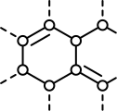
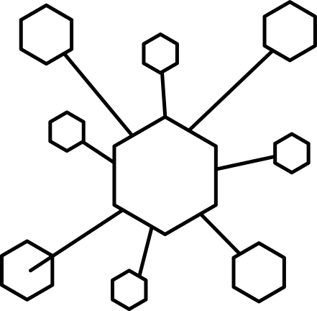
ONE MOLECULE, FOUR REPRESENTATIONS:
From Molecular Formula to Bond-Line Structure
CHEM 13 - Organic Chemistry (Lecture) | BS Chemical Engineering
Katrina Faye A. Soncuya
2B-BSChE

Slide 2
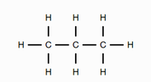
Propane
Molecular Formula: C₃H₈
C₃H₈
Molecular Formula:
Lewis Structure:
CH₃CH₂CH₃
Condensed Structural Formula:
Bond-Line Formula:

Slide 3
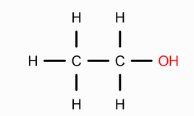

Ethanol
Molecular Formula: C₂H₆O
C₂H₆O
Molecular Formula:
Lewis Structure:
CH₃CH₂OH
Condensed Structural Formula:
Bond-Line Formula:

Slide 4
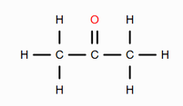

Acetone (Propan-2-one)
Molecular Formula: C₃H₆O
C₃H₆O
Molecular Formula:
Lewis Structure:
CH₃C(=O)CH₃
Condensed Structural Formula:
Bond-Line Formula:

Slide 5
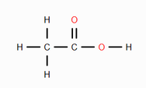

Acetic acid (ethanoic acid)
Molecular Formula: C₂H₄O₂
C₂H₄O₂
Molecular Formula:
Lewis Structure:
CH₃COOH
Condensed Structural Formula:
Bond-Line Formula:

Slide 6
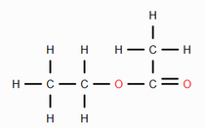

Ethyl Acetate (ethyl ethanoate)
Molecular Formula: C₄H₈O₂
C₄H₈O₂
Molecular Formula:
Lewis Structure:
CH₃COOH₂CH₃
Condensed Structural Formula:
Bond-Line Formula:

Slide 7
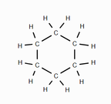

Cyclohexane
Molecular Formula: C₆H₁₂
C₆H₁₂
Molecular Formula:
Lewis Structure:
CH₂CH₂CH₂CH₂CH₂CH₂
Condensed Structural Formula:
Bond-Line Formula:

Slide 8
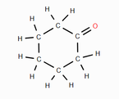

Cyclohexanone
Molecular Formula: C₆H₁₀O
C₆H₁₀O
Molecular Formula:
Lewis Structure:
(CH₂)₅CO
Condensed Structural Formula:
Bond-Line Formula:

Slide 9
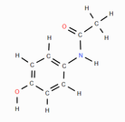

Acetaminophen (paracetamol)
Molecular Formula: C₈H₉NO₂
C₈H₉NO₂
Molecular Formula:
Lewis Structure:
HOC₆H₄NHCOCH₃
Condensed Structural Formula:
Bond-Line Formula:

Slide 10
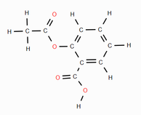
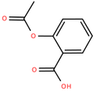
Aspirin (acetylsalicylic acid)
Molecular Formula: C₉H₈O₄
C₉H₈O₄
Molecular Formula:
Lewis Structure:
CH₃COOC₆H₄COOH
Condensed Structural Formula:
Bond-Line Formula:

Slide 11
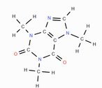
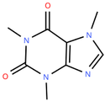
Caffeine
Molecular Formula: C₈H₁₀N₄O₂
C₈H₁₀N₄O₂
Molecular Formula:
Lewis Structure:
CH₃N₄C₅O₂(CH₃)₂
Condensed Structural Formula:
Bond-Line Formula:

