Slide 1

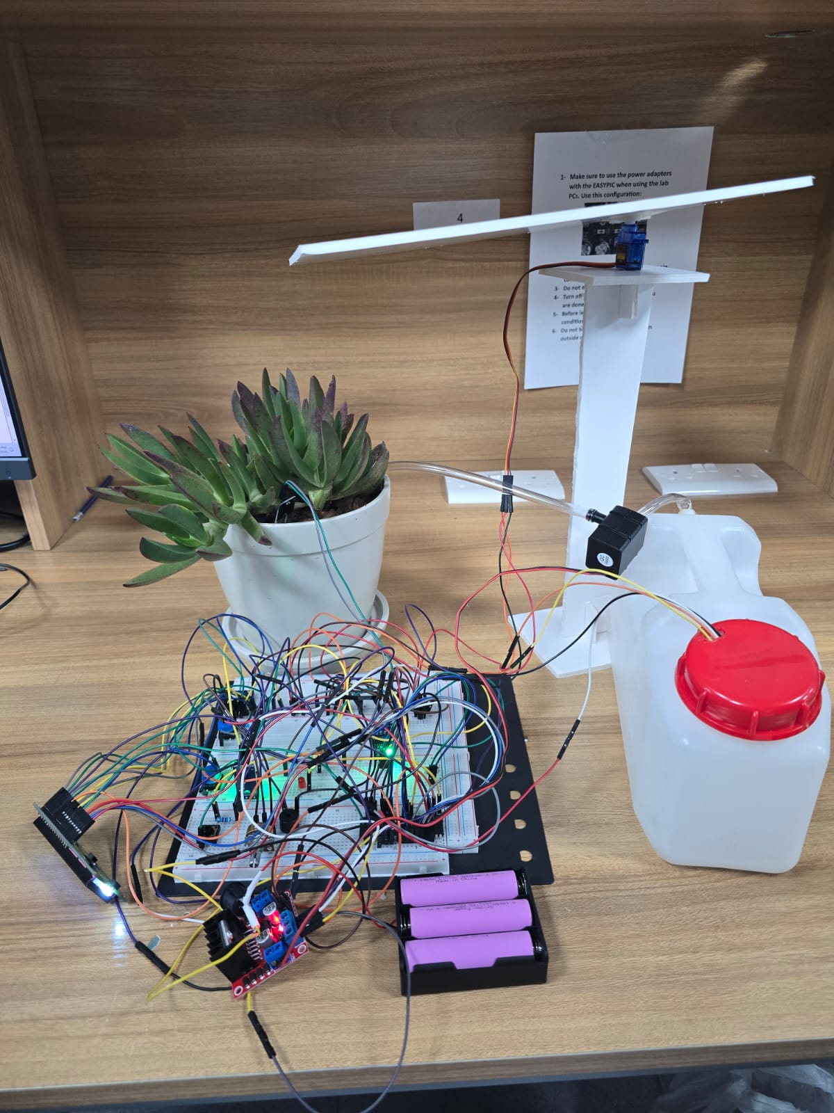
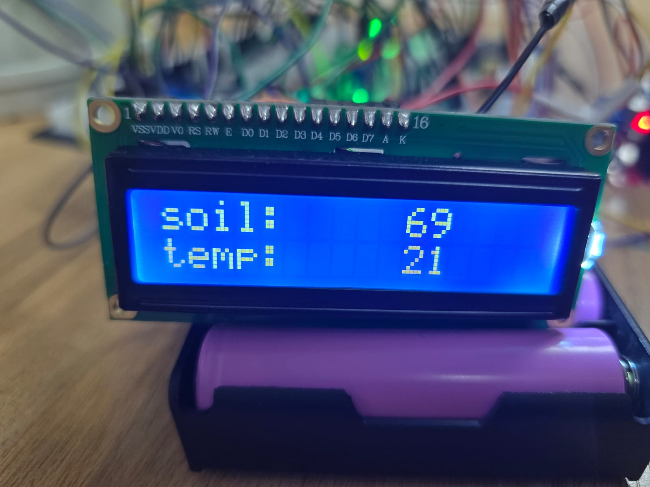
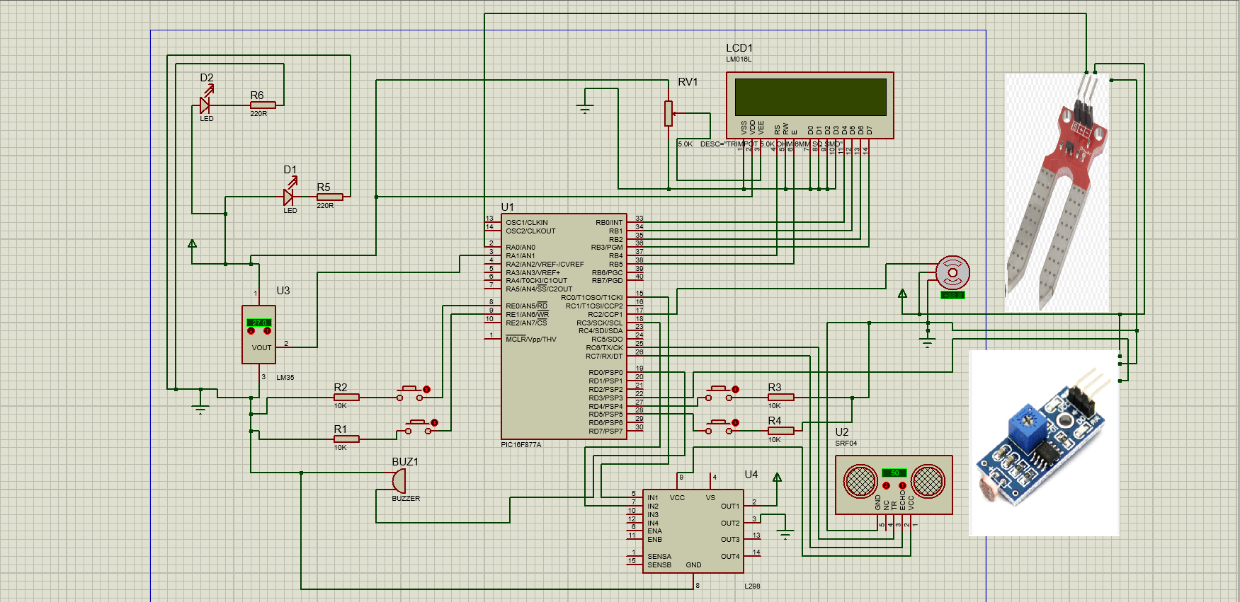
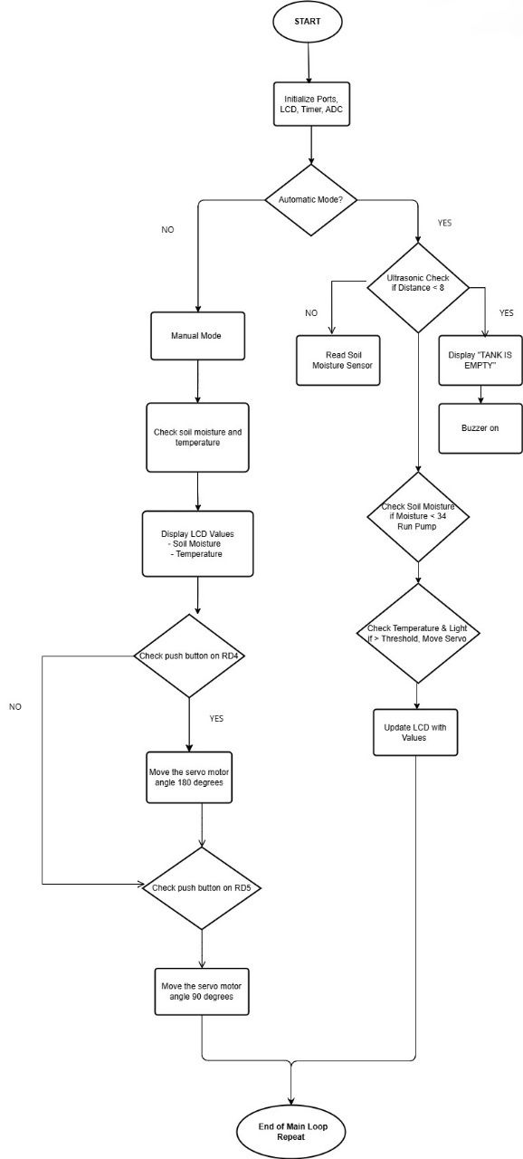
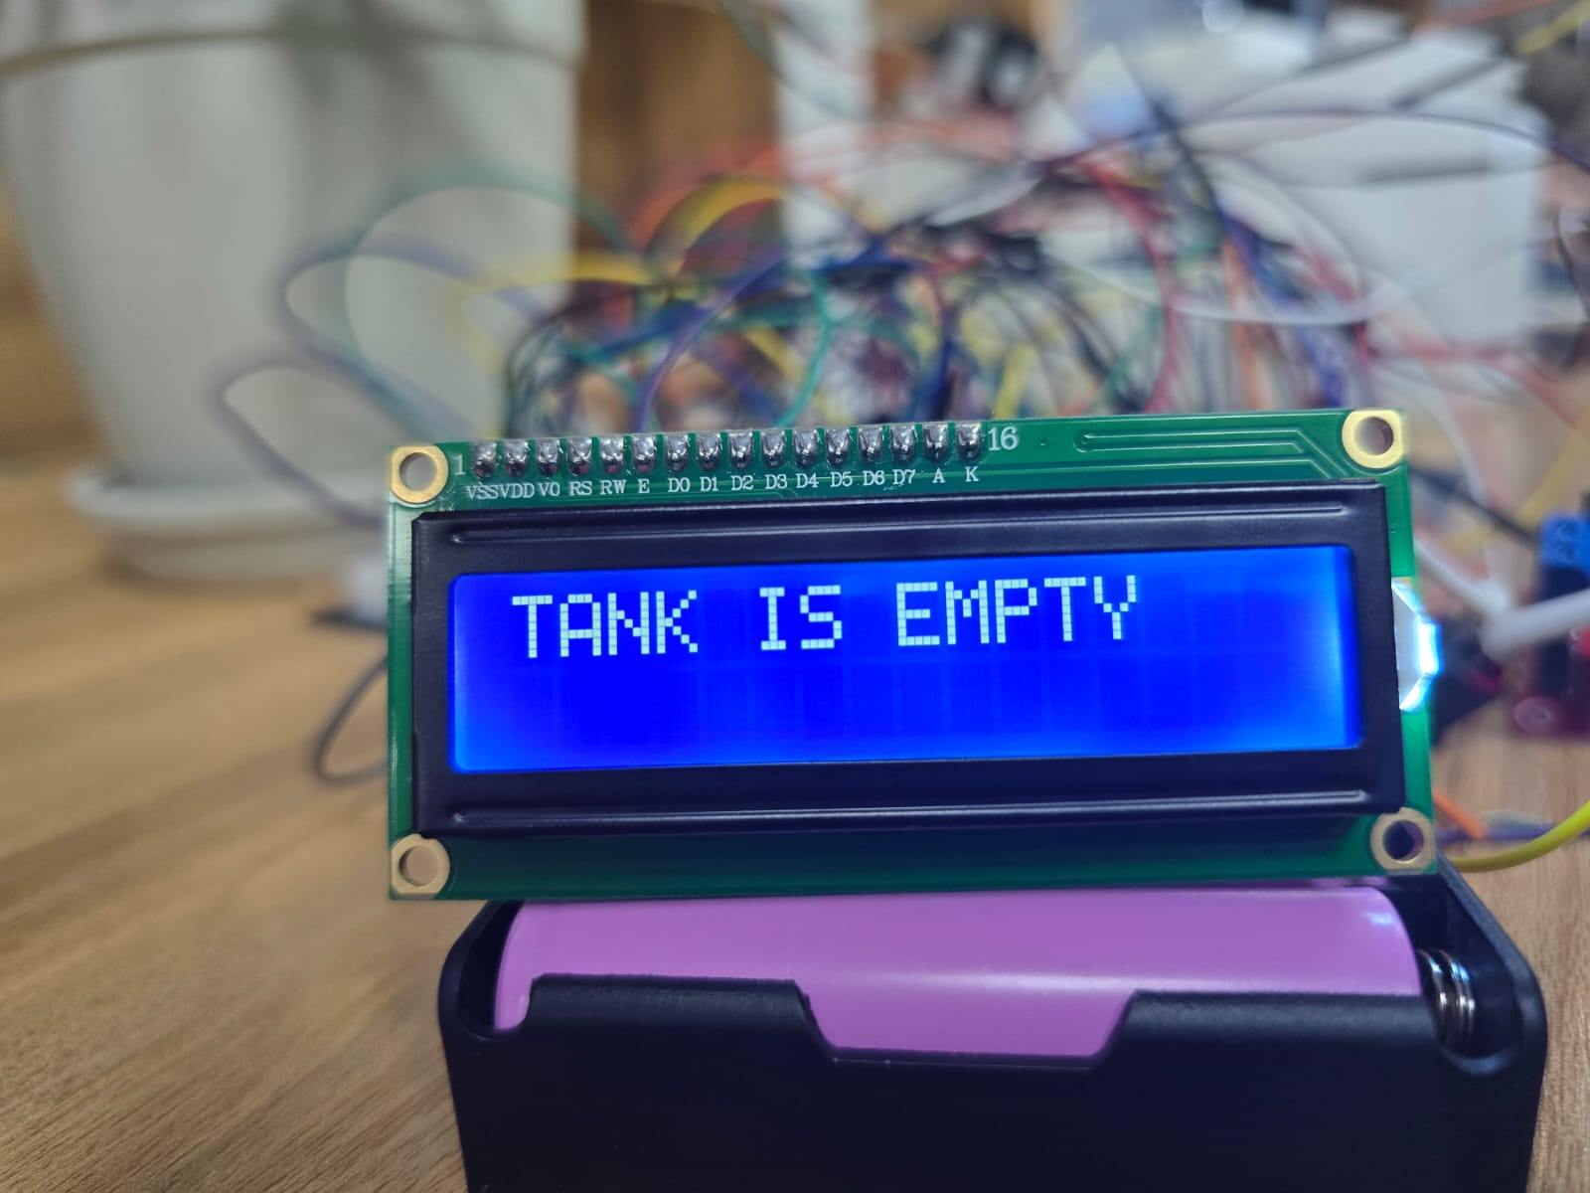
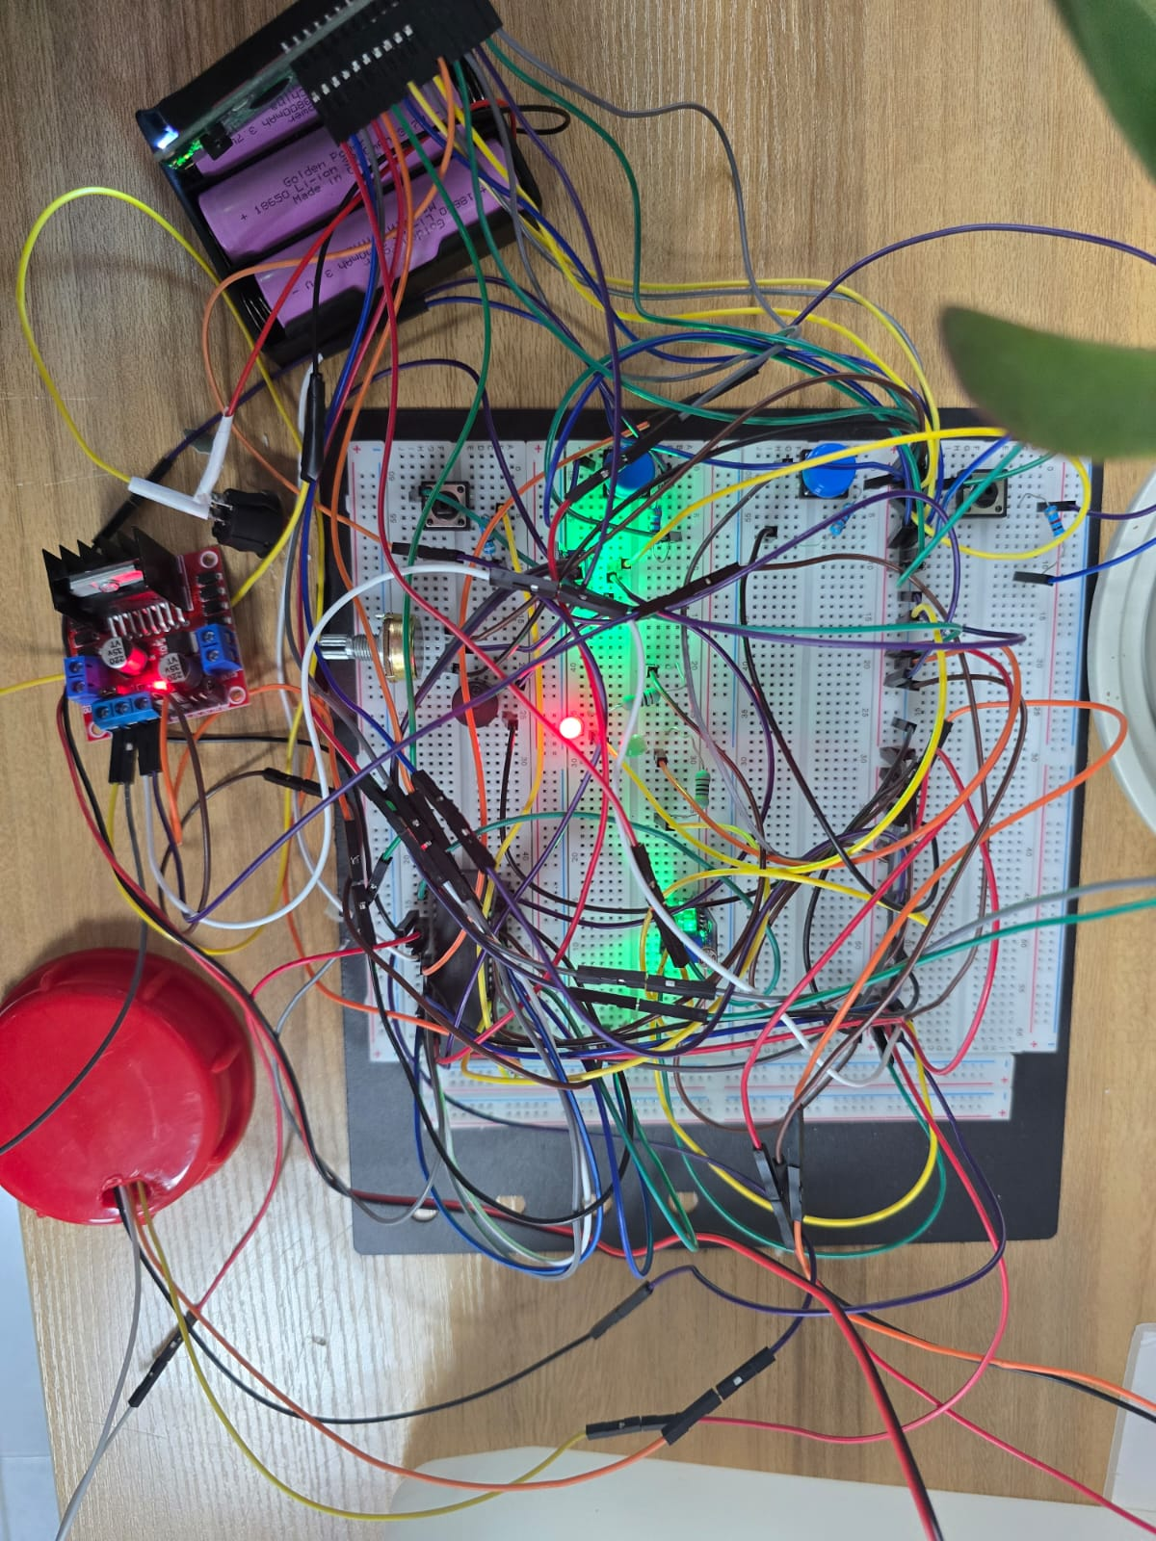
Automated Plant Care System (APCS)
L. Amro, R. Bishawi, and K. Alzagha
Supervisor: Dr. Bilal Sababha
Embedded Systems Final Design Project, Fall 2024
King Abdullah II School of Engineering
Princess Sumaya University for Technology
Introduction
The project presents the design and development of the automated plant care system , APCS specifically designed for taking care of a plant using PIC16F877A microcontroller. The system measure the moisture value in soil and irrigates the system depending on a threshold value. Also the LDR sensor measures the amount of light so the servo will do an action depending on the value of it , with other advantages like temperature and humidity to ensure effective caring of a plant. This poster details the electrical, and software components that automate the APCS and discusses the design process.
Results
Once the system is on the soil moisture will start to sense the amount of water in the soil and display the result on LCD , and if the soil moisture is under a threshold value the dc water pump will irrigate the plant with ultrasonic sensor detect the if the tank is empty or not , if it is empty the buzzer will make a sound and the dc water pump will stop irrigating.
Figure 3: APCS.
Figure 4: soil moisture and temp value
Figure 5: indication that tank is empty
Figure 6: Manual mode on
Design
APCS was designed using PIC16F877A interfaced with 16x2 LCD, soil moisture sensor, LDR module sensor, temperature sensor, Buzzer, 4 pushbutton, servo motor, ultrasonic sensor, DC water pump, H-bridge, two led and switch. It was programmed using C language using MicroC software. The electrical design illustrates the connections , while the software design outlines the project’s operational logic.
Figure 1: Circuits design
Figure 2 Software design
Conclusion
In today’s world , every person need to care about his plants , but we are not always free to take care of it so to combat the challenges of a busy schedule and ensure we care about our plants we inspired the creation of automated plant care system , a device designed to help people watering their plants based on some measurements to increase the growth of our plant without making a lot of effort , through this project we encourage people to take the first step of taking care about plants in a way that is easy for them.

