Slide 1


RISK DOMINATION GAME BUILD 3 SOEN 6441 (Advance Programming Practices) Submitted to: Joey Paquet
40271170 - ANKUSH DESAI 40292874 – KRUPALI DOBARIYA
40270119 - ARCHILKUMAR KATRODIYA 40280054 - HONGWU LI
40272399 - MIHIR GEDIYA

Slide 2
Table of Contents
Introduction
Architectural design of the Project.
Goal of MVC Architecture
Folder Structure
Phases of the game
Class Diagram
Coding Conventions
Tools used.
Test Cases

Slide 3
Introduction
Warzone is a strategy game where each player tries to conquer all countries on a map based upon specific turns.
In this project, we are developing Warzone. The Warzone is developed using Extreme Programming approach by following its features such as collective ownership, pair programming, continuous integration, and testing.
Here, we are specifically following incremental development model and releasing build with small number of features in each iteration.
Furthermore, this game is developed using MVC (Model, View, Controller) architecture with State Pattern, Command Pattern and Observer Pattern.

Slide 4
Architectural design
USER
CONTROLLER
CONTROLLR
UPDATE
MODEL
ACTION
VIEW
MODEL
VIEW
FEEDBACK
FEEDBACK
MODEL – VIEW – CONTROLLER ARCHITECTURE

Slide 5
Goals of MVC Architecture
Clear Separation: MVC enforces a strong separation between data logic (Model), presentation (View), and interaction handling (Controller).
Data Focus: Data-driven development emphasizes the significance of data structures even more. Together, these strategies provide modular code that is problem specific.
Easier Modification: Views and controllers are less affected by changes to your data storage strategy, and vice versa. This greatly improves the smoothness of updating or adding new feature.
Parallel Development: Data-driven design combined with MVC makes it easier for teams to work on several project areas at once.
Collaboration: Having distinct roles and duties promotes better team communication and understanding.

Slide 6
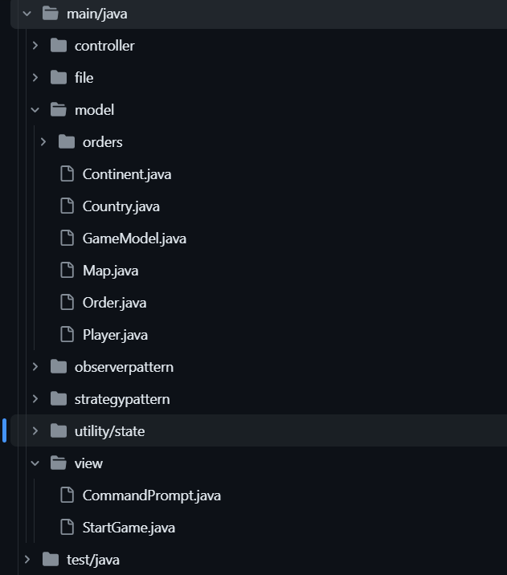
Folder Structure

Slide 7
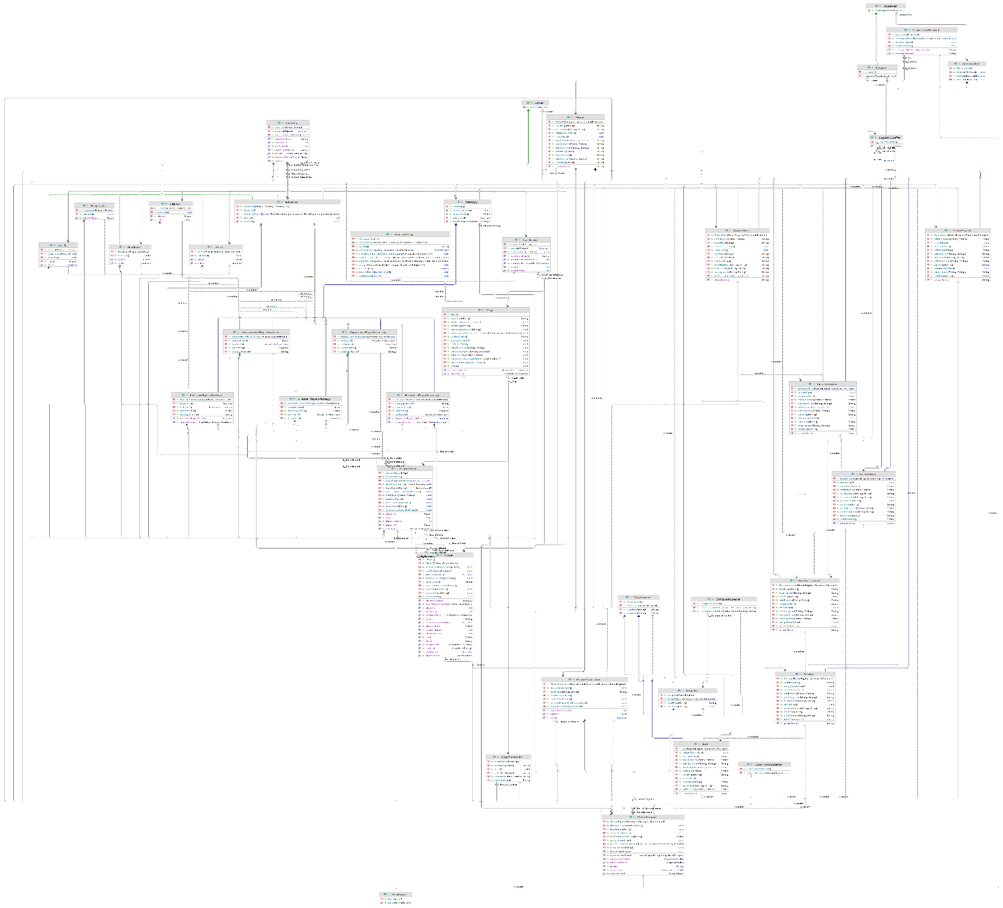
Class Diagram

Slide 8
Model
Continent.java | This Class is for all the Continents of the Map
Country.java | This is a class for all the countries/territories.
GameModel.java | Represents the GameModel class which manages the game data and logic.
Map.java | This class consists of all the data members and behavior associated with Map.
Order.java | Parent interface which is implemented by different Orders in the game.
Player.java | The Player class represents a player in the game.
Advance.java | The Advance class is a type of an Order issued by a Player. This Order provides the ability for a player to attack a territory belonging to some other player with some number of armies.

Slide 9
Model
Airlift.java | Airlift class implements the Order interface and overrides the execute method.
Blockade.java | The Blockade class represents a blockade order in the game.
Deploy.java | Represents a Deploy order, where a player deploys armies to a specific country.
Bomb.java | The Bomb class represents a bomb order in the game.
Negotiate.java | Represents a Negotiate order, where a player initiates diplomacy with another player.

Slide 10
View
CommandPrompt.java | The window interacts with the user and show feedback.
StartGame.java | It is a driver class of the game.

Slide 11
Controller
GameEngine.java | This class serves as the main controller in the MVC model.
MapContoller.java | This class update the MapModel. Also receives the acknowledgement for the update and pass it back to the parent GameEngine.
PlayerController.java | The Player Controller class controls the activities of all the players at once.
ValidateMap.java | This class checks the validity of the map by converting into a graph object.

Slide 12
Observer pattern
LogEntryBuffer.java | To log any changes in file, we use the object of this class.
Logger.java | This is a concrete class which implements observer interface.
Observable.java | Observable class which has methods to connect/disconnect with observers and notifies if there is any update.
Observer.java | Interface observer which has one update method which is called when observable notifies it.

Slide 13
State Pattern
Edit.java | Represents the Edit Phase, which extends the Phase class and implements methods specific to this phase.
ExecuteOrder.java | The ExecuteOrder phase extends the Phase class and implements methods specific to this phase. It handles executing orders during gameplay.
GameOver.java | It handles the end of the game and provides relevant acknowledgements.
IssueOrder.java | It handles issuing orders during gameplay.
Phase.java | Represents an abstract class for game phases, each phase extending this class represents different game states.
Reinforcement.java | It handles reinforcing armies during gameplay.
StartUp.java | It returns invalid command for others which are not compatible with this Phase.

Slide 14
File
ConquestLoader .java | This is the ConquestLoader class which has roadmap and save map functions for the conquest map type. ConquestLoader’s functionality is similar to the target, but it is used for another type of map file.
Adapter.java | Adapter class works as a bridge between the target and adaptee. We can use the adapter to call the method of adaptee by calling the methods used in target.
MapLoader.java | This is the target class for the adapter pattern. This class is used to call the existing implementation of loadmap and savemap functionality of domination map type.

Slide 15
Strategy Pattern
AggresivePlayerStrategy.java | This is a class which creates orders from the AggresivePlayer according to his strategy. This class extends the parent Strategy class which has createOrder method to be implemented here.
BenevolentPlayerStrategy.java | This class implements the Strategy for the benevolent type of player. This type of player always deloys on its weak country and never attacks.
CheaterPlayerStrategy .java | This Strategy class belongs to the Cheater Player. It encapsulates the behavior of a Cheater Player. This strategic player only issues deploy and advance orders to attacks on neighboring countries and increases the number of armies on its countries that have enemy neighbors.
HumanPlayerStrategy .java | This Strategy class belongs to the Human Player. It encapsulates the behavior of a Human Player.

Slide 16
Strategy Pattern
RandomPlayerStrategy.java | This Strategy class belongs to the Random Player. It encapsulates the behavior of a Random Player.
Strategy.java | This is a parent class for the strategy pattern. Each player has their different strategy and they extends this class and implements the methods accordingly.

Slide 17
Phases of the game
Map Loader Phase
Startup Phase
Reinforcement Phase
Issue Order Phase
Execute Order Phase
Map Editor Phase

Slide 18
CODING CONVENTIONS
Class names in CamelCase that starts with a capital letter.
Data members start with d_ .
Method parameters start with p_ .
Local variables start with l_ .
Static members start with a capital letter, non-static members start with a lowercase letter.

Slide 19
Tools Used
For version control we have used VSCode and Github.
For documentation we have used Javadoc and PlantUML.
For unit testing we have used JUnit.
For Continuous Integration we have used Github Actions.

Slide 20
Testing
Here we are using JUnit version 4 for our testing purpose.
We have tested few models such as country, continent, game map, player.
We have also done test for the Card, GameCommands and for the Player.
On top of that, we have also tested controller such as IssueOrderController, MapEditorController, MapLoaderController, ReinforcementController, StartGameController.
In this build we have implemented test cases for various orders such as AdvanceOrder, AirliftOrder, BlockadeOrder, BombOrder, DeployOrder, NegotiateOrder.
We have also validated map with help of map validator test.

Slide 21
Thank you

